Slide 1
MPAI – what it is, what it does, what it would like to do
Leonardo Chiariglione
MPAI President
2021/09/09

Slide 2
Data and intelligence
Humans learn the world by subjecting their brains to experience
We make guesses about how human experience is represented and stored in their brains
We teach machines by transferring experience to them in the form of artificially created models
Current models are suitable for implementation with data processing technologies
It is more efficient to subject machine to experience than to transfer models of knowledge

Slide 3
It is an epochal transition
30 years ago a transition of comparable importance was in the making – media made digital
The trend was: let countries and industries choose their own way to go digital
MPEG heralded a new age of purely technology-driven and generic media standards
Industry and consumers do not regret the old age of policy and market share driven standards
Artificial Intelligence (AI): the next revolution after the digital revolution

Slide 4
The right standards for artificial intelligence
Artificial Intelligence is often used as a catch-all word
Here we are interested in data coding, like it is done by humans
What is data coding?
Data compression
Feature extraction
…
The right AI-centred data coding standards positively affect industry and consumers
We need an organisation
Delivering AI-based data coding standards
Looking at the full spectrum of applications

Slide 5
MPAI
The MPAI activities are based on 5 pillars
# | Pillar
1 | A rigorous process to develop MPAI standards
2 | MPAI standardises the I/O data of basic units called AI modules (AIM)
3 | Aggregated AIMs are executed in a standard AI Framework (AIF)
4 | A Framework Licence is defined before a Call for Technologies is issued
5 | Implementations can be tested for technical (conformance) and assessed for non-technical (performance) adherence to an MPAI standard
Moving Picture, Audio and Data Coding by Artificial intelligence
An international, unaffiliated, not-for-profit organisation developing AI-centred data coding standards
Data coding is the transformation of a format into another more suitable to an application

Slide 6
Pillar #1: New process improving old shortcomings
Use Case
Interest
Collection
Functional
Requirem.
Commercial
Requirem.
Call for
Technolog.
Standard
Developm.
MPAI
Standard
Stage 0
Stage 1
Stage 2
Stage 3
Stage 4
Stage 5
Stage 6
Principal
Members
All
Members
Principal
Members
All
Why only members of a standards committee can define the technical requirements of a standard?
Why goods and services but NOT standards are delivered according to technical and commercial requirements?

Slide 7
Pillar #2: Sound technology
AI modules (AIM)
AI Framework (AIF)
User Agent
AI Workflow (AIW)
User Agent
AI Module (AIM)
AI Module AIM
Video analysis
Emotion
Inputs
Outputs
Meaning
Internal
Storage
AI Module AIM
AI Module AIM
Access
Controller
Communication
Global Storage
Access
MPAI Store

Slide 8
Pillar #3 – Framework Licences
Stage | Actions
Before | Anybody can propose and contribute to the development of functional requirements of a Use Case
 | Active Members develop & adopt the Framework Licence, the IPR holders’ business model used to monetise their IP in a standard without values: $, %, dates etc.
 | The text of the FWL will, at least, state that the total cost of the licenses issued by IPR holders will be in line with the total cost of the licenses for similar data coding technologies and will take into account the value on the market of the specific standardised technology.
During | Any Member making a contribution declares they will make available their licences according to the FWL not after commercial implementations of the standard become available on the market
After | Active Members express their preference on the patent pool administrator (2/3 qualified majority).
 | All Members declare they will get a licence for other members’ IPRs, if used, within 1 year after publication of IPR holders’ licensing terms.
 | Non Members using the standard shall get a licence from IPR holders
Active Member: a Principal Member who intends to contribute to the standard
MPAI plays no role in the definition of the licence

Slide 9
Pillar #4 – Being sure of how data are handled
MPAI is aware of the impact AI will have on humans and their society
MPAI’s AIM-AIF approach enhances explainab-ility of MPAI standards’ implementations
MPAI defines 4 attributes of Performance: Reliability, Robustness, Fairness, Replicability
MPAI will appoint Performance Testers to test the Performance of implementations
Users will be able to use implementations whose Performance has been tested and execute workflows on their devices

Slide 10
Benefits of MPAI standards
Component providers can offer conforming AIMs to an open competitive market
Application developers can find the AIMs they need on the open competitive market
Consumers have a wider choice of better AI applications from competing application developers
Innovation is fuelled by the demand for novel/more performing AIMs
Society can lift the veil of opacity from large, monolithic AI-based applications.

Slide 11
Context-based Audio Enhancement (MPAI-CAE)
Adding a desired emotion to an emotion-less speech (Sep 2021)
Management and Control
Model utterance
Speech
feature
analyser1
Emotion
descriptors
Emotion
inserter
Speech
w/ emotion
Speech w/o
emotion
Emotion
descriptors
Speech
feature
analyser2
Emotion
descriptors
Emotion ID
Storage
Emotion KB
Communication

Slide 12
MPAI Multimodal Conversation (MPAI-MMC)
Audio-visual conversation with a machine (Sep 2021)
User Agent
Input
Selection
Dialog Proce-ssing
Input
Text
Language Under-standing
Meaning (Text)
Output
Text
Text (Speech)
Speech Recog-nition
Emotion (Text)
Emotion Fusion
Input
Speech
Speech
Synthesis (Emotion)
Output
Speech
Recognised Text
Emotion (Speech)
Final
Emotion
Text With
Emotion
Speech
Segment
Lips Anim-ation
Output
Video
Video Analysis
Emotion (Video)
Input
Video
Final
Emotion
Meaning (Video)
Controller
Communication
Global Storage
MPAI Store
Video Of
Faces KB

Slide 13
Multimodal Conversation (MPAI-MMC)
Request for information about a displayed object (Sep 2021)
Input
Selection
Ques-tion Ans-wering
User Agent
Input
Text
Lan-guage Under-stan-ding
Speech
Synthesis (Text)
Video
Video Analysis
Object identifier
Meaning
Reply
Text
Output
Speech
Recognised
Text
Meaning
Question
Analysis
Intention
Output
Text
Speech
Speech recog-nition
Recognised Text
Management and Control
Communication
Storage
MPAI Store

Slide 14
Multimodal Conversation (MPAI-MMC)
Translation of a sentence preserving the speaker’s speech features in the synthetic voice (Sep 2021)
User Agent
Input
Selection
Translation
Output Text
Requested
Languages
Input Text
Translated Text
Speech
Synthesis
(Features)
Speech Recognition
Recognised Text
Output
Speech
Input
Speech
Speech
Feature
Extraction
Speech Features
Controller
Communication
Global Storage
MPAI Store

Slide 15
Compression and Understanding of Industrial Data (MPAI-CUI)
Prediction of company performance (Sep 2021)
User Agent
Prediction
horizon
Prediction
Adequacy index of organ. model
Governance
Governance Assessment
Governance features
Default probability
Financial statement
Financial Assessment
Financial features
Default probability
Perturbation
Business continuity probability
Risk
assessment
Risk Matrix Generation
Risk matrix
Controller
Communication
Global Storage
MPAI Store

Slide 16
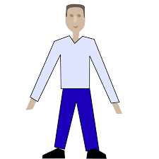
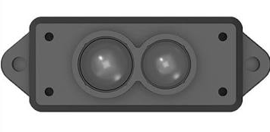
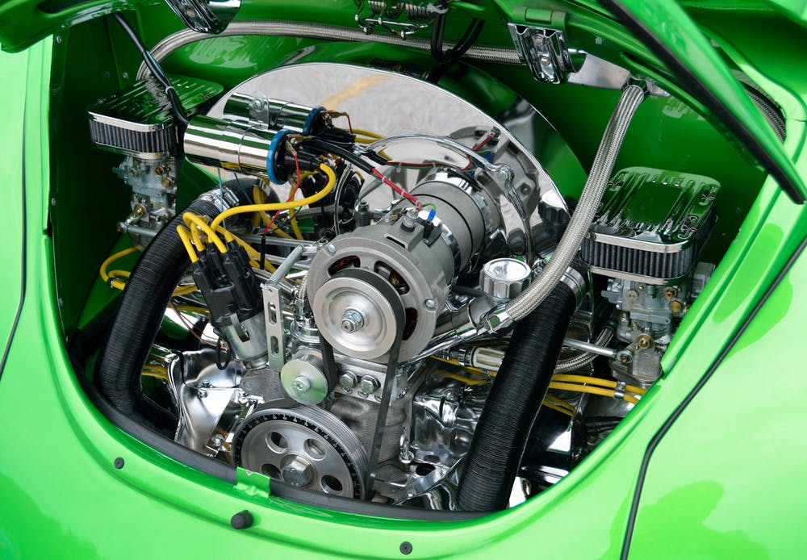
Connected Automotive Vehicles (MPAI-CAV)
Human-CAV Interaction
(HCI)
Autonomous Motion Subsystem (AMS)
CAV to Everything
(V2X)
Environment Sensing Subsystem
(EDS)
Motion Actuation Subsystem
(MAS)

Slide 17
Viewer Command
S
Full World
Representation
Viewer
FWRV Audio
Autonom.
Motion SS
Full World Representation
FWRV Video
Input Text
Question & Dialog Processing
Speech Separ-ation
Separ.
Speech
Speaker Recognit.
Speaker ID
Input Audio
Emotion-S
Emotion Fusion
Command/Request
Separ.
Speech
Speech Secognit.
Autonom.
Motion SS
Feedback/Response
Input Text
Fused
Emotion
Object & Gesture Analysis
Emotion-G
Emotion-F
Concept
(Speech)
Speech
Synthesis
Output Speech
Text-S
Language Under-standing
Text-S
Output Text
Object
ID
Meaning-T
Question
Analysis
Fused
Meaning
Meaning-G
Concept (Face)
Face animation
Output Video
Input Video
Inten-
tion
Face Analysis
Meaning-F
User Agent
Face Identific.
Face ID
Controller
Communication
Storage
MPAI Store

Slide 18
Mixed-reality
Collaborative Spaces
(MPAI-MCS)
S
Speech Separ-ation
Separated
Speech
Speaker Recognit.
Speaker ID
Input
Audio
Separated
Speech
Speech Encoding
Encoded Speech
Avatar-based videoconference
Separated
Speech
Speech Analysis
Emotion
Final Emotion
Emotion Fusion
Emotion
Meaning
User Agent
Face Analysis
Meaning
Question
analysis
Final Meaning
Input
Video
Head Analysis
Head Motion
Face Analysis
Face ID
Avatar Model
Avatar Model
3D AV Object
3D AV Object
Commands
Commands
Controller
Communication
Storage
MPAI Store

Slide 19
Server-based Predictive Multiplayer Gaming
Prediction of missing data and anticheating
User Agent
MPAI-SPG
Online Game Server
Game State Engine
-AI
GS
CD
Game State Engine
GM
CD
Virtual Client 1
CD
Thin
Client 1
Physics Engine
GM*
Physics
Engine-AI
GMp
Game State Engine
GM’
GS
Video
GM*
GMp
GM
CD
Virtual Client 2
CD
Thin
Client 2
Rules
Engine-AI
Behaviour Engine
GM’
GS
Video
GSp
GM*
Behaviour Engine-AI
GMp
GM
CD
Virtual Client 3
CD
Thin
Client 3
Rules Engine
GM’
GS
Video
Management and Control
CD
Virtual Client N
CD
Thin
Client N
Other Engines
GM
Communication
Storage
MPAI Store
GM’
GS
Video

Slide 20
MPAI Work plan
Visual Object and Scene Description
Mixed Reality Collaborative Spaces
Integrative Genomics/ Sensor Analysis
AI-Enhanced
Video Coding
Server-based Predictive Multiplayer Gaming
Compression and Under-standing of
Industrial Data
Connected Autonomous Vehicles
Context-based Audio Enhancement
AI Framework
Multi-Modal Conversation
MPAI-OSD
MPAI-MCS
MPAI-CAV
MPAI-GSA
MPAI-EVC
MPAI-SPG
MPAI-CUI
MPAI-MMC
MPAI-CAE
MPAI-AIF
Use Case
Functional Requirements
Standard Development

Slide 21
Timeline
V | Std | UseCas | FunReq | ComReq | CfT | StdDv | TechS | RefSw | ConfT | PerfA | Demo
1 | CUI |  | 11/18 | 02/17 | 03/17 | 05/12 | 09/30 | 09/30 | 09/30 | 09/30 | 09/30
1 | MMC |  | 10/21 | 12/16 | 02/17 | 04/14 | 09/30 |  | 10/27 | 11/24
1 | CAE |  | 10/21 | 12/16 | 02/17 | 04/14 | 10/27 |  | 11/24 | 12/22
1 | AIF |  | 10/21 | 11/18 | 12/16 | 02/17 | 10/27 |  | 11/24 | 12/22
 | SPG |  | 10/21
 | CAV | 06/09 | 07/19
 | MCS | 07/19 | 08/25
 | EVC |  | 10/21
 | GSA |  | 10/21
 | OSD
Legend: 2020 and 2021

Slide 22
Governance of the MPAI Ecosystem
MPAI
(Governance,
Standard Development)
Implem-enter
End User
$
Legend:
TS: Technical Specification
RS: Reference Software
CT: Conformance Testing
PA: Performance Assessment
OK: Passed
Standard
(TS-RS-CT-PA)
Implem-
entation
Licence
Licence
MPAI Store
- ConfTest
- Security
$
Implem
entation
Establishes, controls &
confers CT authority
Implem-
entations
$
OK
OK
Performance Assessors
Appoints for PA

Slide 23
Conclusion
MPAI has been established 11 month ago
Members sign a statute when joining
MPAI has developed a rigorous standard development process
MPAI has a workplan for 10 “container” standards
Each standard includes several use cases
2 standards to be approved in September and 2 in October
As its standards take shape, MPAI wishes to establish liaison with other bodies
We are keen to establish a working relationship with ISO/IEC JTC 1/SC 35

Slide 24
If you wish to join MPAI, you should…
Be
A legal entity or an individual representing a technical departments of a university
Supporting the MPAI mission and
Able to contribute to the development of MPAI standards
Choose
One of the two classes of membership:
Principal Members, with the right to vote (2400 € p.a.)
Associate Members, can participate in standard development (480 € p.a.)
Send
Secretariat@mpai.community a copy of
The template for MPAI Membership applications (signed)
The MPAI Statutes. Each page should be signed and initialled
The bank transfer
See
mpai.community/how-to-join/join/

Slide 25
Join the fun, build the future
www.mpai.community

