Slide 2
Basic Applications, Technologies and Benefits for Video Coding by means of Artificial Intelligence
Mike Tsinberg, Ajay Luthra,
Roberto Iacoviello and Marina Bosi

Slide 3
Compression standard thirty years ago: a historical watershed
The media industry was at a crossroad
  HDTV digital development opened a door for uniform digital compression standard - MPEG2
  A few HDTV variations were developed
  However, all HDTV and later DVD all used generic media compression standards
As a result: 30 years of uninterrupted expansion
New technology and hardware capability opened a door for the next step in compression
Artificial Intelligence – AI
  Plays an important role in industrial and consumer applications
  Improves coding efficiency of video (and of other data types)
AI standards can
  Have the same positive effects on the industry
  Mitigate today’s AI problems, e.g., opacity and application redeployment

Slide 4
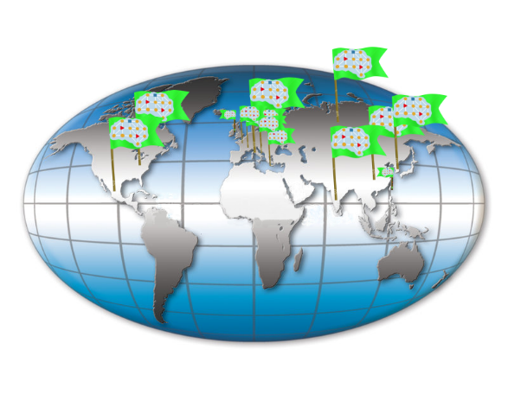
MPAI – Moving Picture, Audio and Data Coding by Artificial Intelligence
MPAI, established 30 September 2020 , is as an international non-profit organisation based on two pillars:
  Artificial Intelligence (AI) as core technology for its standards
  Framework Licence, to facilitate eventual development of licences

Slide 5
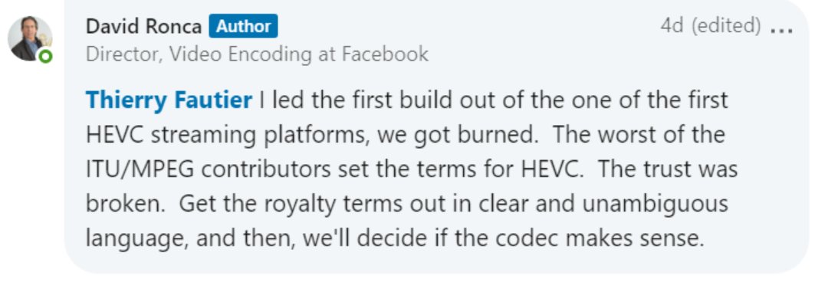
Framework License
The wrong license can kill the standard!

Slide 6
The MPAI solution: Framework Licences
Framework Licence (FWL) is the Intellectual Property (IPR) holders’ business model to monetise their IP in a standard without values: $, %, dates etc.
  Before Standard established: Active members adopt the FWL
  During Standardization: When they make a contribution, Active members declare they will make available the terms of their license according to the FWL after standard approval
  After: All members declare they will get a license for other Members’ IPRs, if used, within 1 year after publication of IPR holders’ licensing terms
To use an MPAI standard, non MPAI entity shall get a license from Standard Essential Patent (SEP) party
There are rights and duties for all parties…

Slide 7
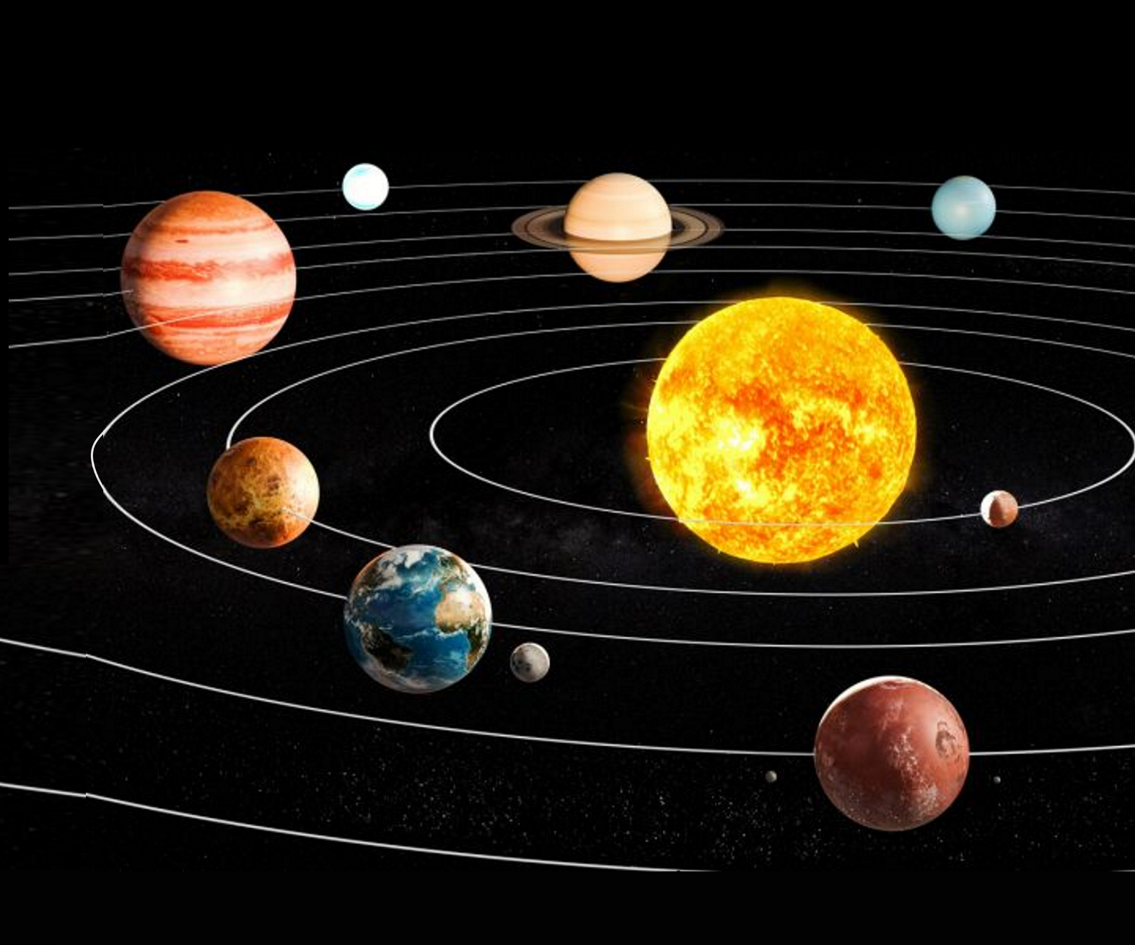
MPAI Solar System
MPAI-GSA
Analysis of mixed genomics&sensor data
MPAI-AIF
Creation&execution
of AI-ML-DP workflows
MPAI-SPG
Prediction of missing data in on- line gaming
MPAI
MPAI-CUI
Probability estimate
of company
risks from
its data
MPAI
MPAI-EVC
Extending
video codec
capability with AI
MPAI-MMC
Conversation with machines, naturally
as with humans
MPAI-CAE
Audio at home, in the office, on the go, in the studio
MPAI-OSD
Visual Object
and Scene Analysis
using AI

Slide 8
Use Cases and
Functional Requirements for
AI-Enhanced Video Coding
(MPAI-EVC)

Slide 9
MPAI-EVC Use Cases Under Considerations
Entertainment TV Content Distribution
Video Games, including eSports and Cloud Gaming
Videoconferencing
Social Media
Drones Based/Wearable Cameras
Medical video
Telemedicine
Security/Surveillance
Digital Cinema
Professional Content Creation and Production in Studios
Autonomous Vehicles
…
Note: The list above provides some of the use cases initially considered to develop the Requirements.
The list of MPAI-EVC Use Cases is expected to continue to grow with time

Slide 10
MPAI-EVC Requirements
Coding Efficiency
  Must be able to provide up to 50% bitrate reduction for the same resolution (efficiency improvement) over state-of-the-art existing video coding standard EVC
Content Types
  Natural video (Video camera captured content), Moving Film (Film cameras captured content) Computer generated graphics, Hybrid, Video gaming content

Slide 11
MPAI-EVC Requirements (Continued)
Content Attributes
  Up to 8k resolution – currently…
  Rectangular video with wide range of aspect ratios, including video banners and vertical video
  SDR, HDR standards
  Standard and Wide Color Gamut
  4:2:0, 4:2:2 and 4:4:4 Color formats (initial focus is on YUV based coding)
  Frame Rates: up to 120 Hz
  Bit depth: Initial focus is up to 10 followed to 12 bits video
This list provides only the main focus, not the limitations, of the initial EVC standard development effort

Slide 12
MPAI-EVC Requirements (Continued)
Compression Types
  Initial focus is on Lossy compression and visually Lossless compression
  Currently, mathematically lossless coding is not considered
Compression Modes
  Real Time and Off-Line Coding
Viewing Environment
  2D, including Head Mounted Display (HMD)
  3D (Stereoscopic) and Immersive – Not in Phase 1
Distribution Networks
  Guaranteed channel bandwidth and capacity
  Best effort channel capacity

Slide 13
MPAI-EVC Requirements (Continued)
Protocols
  Friendly for distribution of compressed video using different transport protocols
    IP based (including HTTP Live Streaming)
    MPEG-2 Transport Stream (TS)
    MPEG Media Transport (MMT)
    Others
Rate Control
  CBR, VBR, Capped VBR
End-to-end delay
  High (> 100 msec to off-line encoding)
  Low (30 msec < Delay <100 msec)
  Very Low (< 30 msec; less than one picture frame)
Accessibility
  Picture level/resolution (Editing, Splicing etc.)
  Greater than one picture lag/resolution (channel change, commercial insertion etc.)

Slide 14
MPAI-EVC Requirements (Continued)
Implementation
  Friendly for multiple hardware architectures
    CPU, CPU+GPU/FPGA, CPU+GPU+NPU and ASICs
  System
    Stand alone
    Cloud based
Complexity
  Should be implementable in a cost-effective way with technology available in near future
Special Effects and Editability
  Pause, Fast Forward, Rewind
  Concatenation of two streams in compressed domain

Slide 15
MPAI-EVC Requirements (Continued)
Backward Compatibility/Scalability
  Extensible to support Temporal, Spatial, SNR and Codec scalabilities
Desirable Features
  Codec agnostic AI based improvements
  Friendly to AI based pre and post processing technologies
    Noise reduction
    Film grain removal and insertion
    Deep fake detection, feature detection
Error Resilience
  Not in the current phase

Slide 16
Join MPAI if you want to make MPAI-EVC Requirements or technology under consideration more friendly to your business!

Slide 17
What is
AI-Enhanced Video Coding
(MPAI-EVC)

Slide 18





Video Predictive Loop coding for the last 30 years
Input Frame
+
$r$_{t}
Residual Coding
Entropy Coding
Output
Bitstream
$$x_{t}$$
-
Intra Coding
Pred. Frame
Residual Decoding
$${\overline{x}}_{t}$$
Inter Coding
Ref Frame
$${\hat{x}}_{t−1}$$
+
Reference Frame Buffer
Rec. Frame
+
$${\hat{x}}_{t}$$

Slide 19
Case for farther improvement by the mean of AI
According to Cisco, Video transmission is expected to dominate 79% of current global internet traffic with an annual growth rate of 31% by 2020.
Classic block-based hybrid coding frameworks have not changed significantly for decades.
The MPAI Enhanced Video Coding mission is to exploit advances in Artificial Intelligence to develop video coding standards that improve the coding efficiency.
The rationale is to use AI tools that are able to distil aspects of the data semantics relevant to Video compression.

Slide 20


There are good video codecs
36% bit rate reduction
Coding Efficiency
EVC
Baseline
HEVC
EVC Main
HEVC
>20 years old tools
Simplified IP
structure

Slide 21
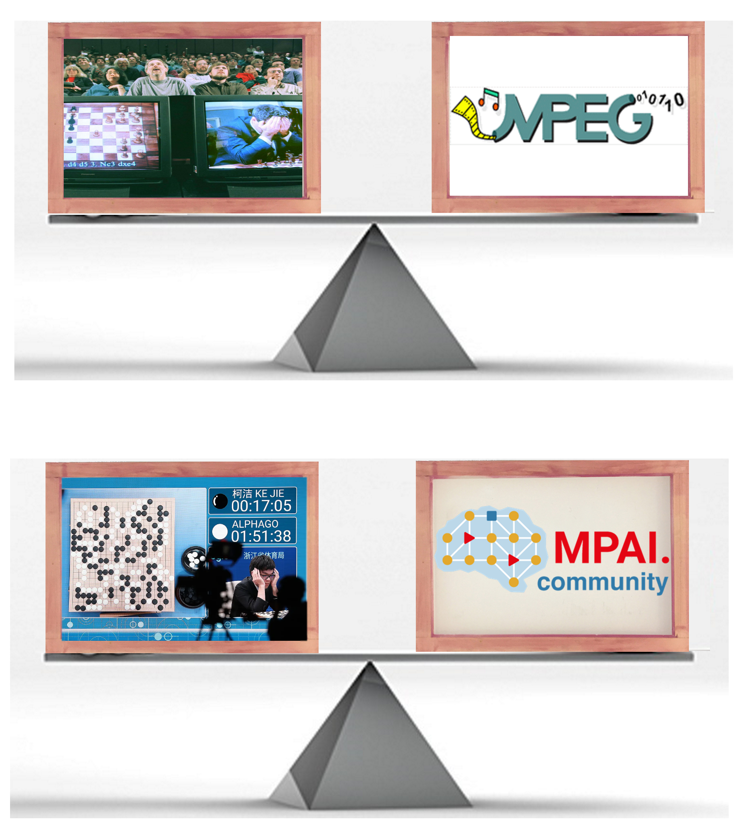
Different technologies for different ages
Brute Force
1988 MPEG
1997 IBM Deep Blue
1988 MPEG
AI
2016 AlphaGo
2020 MPAI

Slide 22
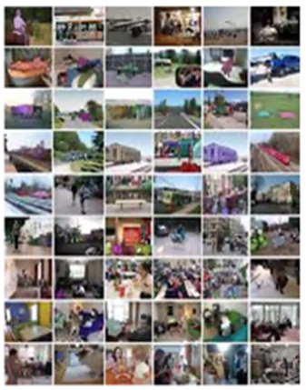
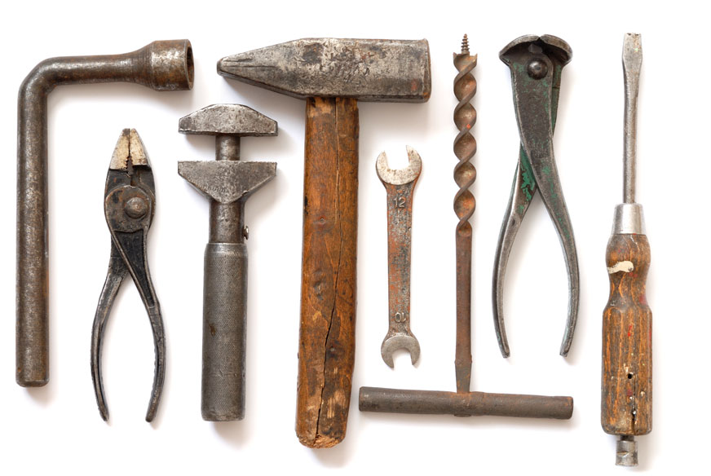
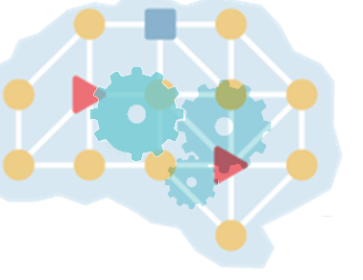
Old and new data coding
Old coding tools
(hardwired a priori statistical knowledge)
Data
AI coding tools
(knowledge acquired
by learning the statistics)

Slide 23
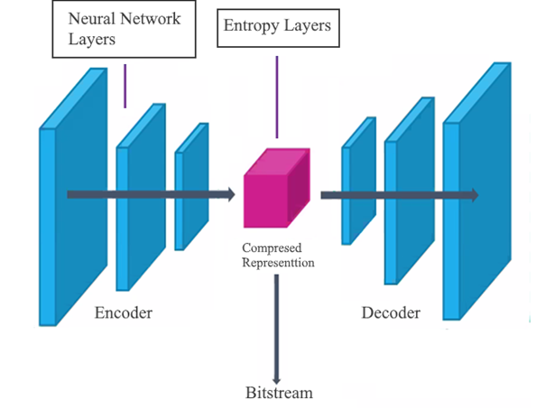
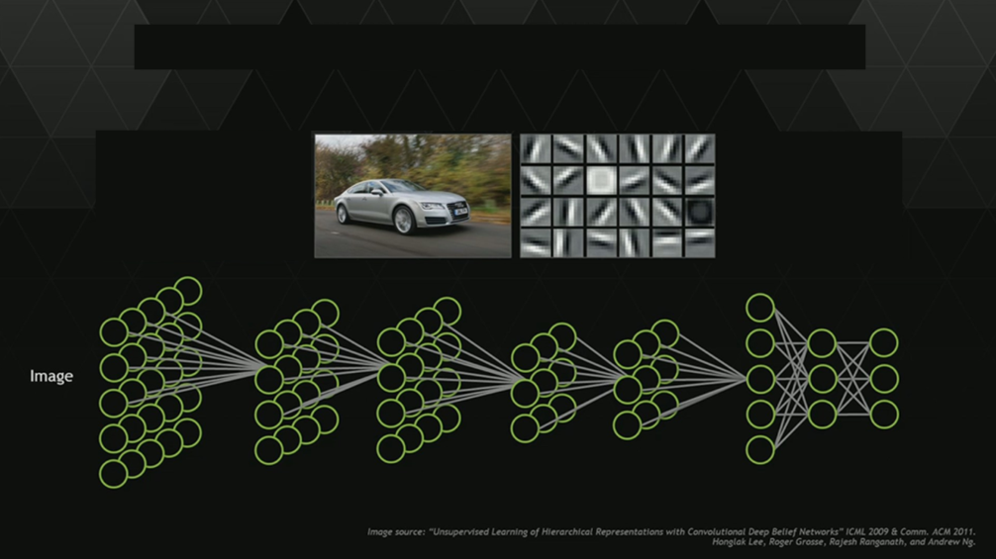
How neural networks work
Learning
Inference
Notes:
There are two phases in the Neural Network lifecycle: the learning phase and the Inference phase.
In supervised learning the network is provided with the input picture and the desired target. In a kind of nonlinear mapping the network learns how to match input and the target. Layer after layer, it processes the input picture by multiplying it with coefficients, called weights, that, at the end of the process, will store what the network has learnt. If the target is not achieved the process start over and over again, adjusting the weights, until the target is finally reached.
Layer after layer, thanks to this process, the neural network extracts useful image features, like the ones in the red square. If you notice this features are very similar, for example, to the directional modes of the intra prediction and at the last layer, after many iterations, the network learns what is the best intra mode prediction.
In the inference phase the weights are frozen and, giving the input picture, the network will provide the output.

Slide 24
MPAI-EVC Evidence Project
Develop a video coding standard with improved coding efficiency
  +25% (Evidence project) PSNR
  +35% (Final standard) PSNR
  +~50% subjective
We enhance/replace legacy tools with AI tools
Each AI tool learns the statistics of the specific input data

Slide 25
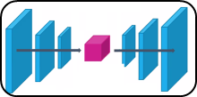
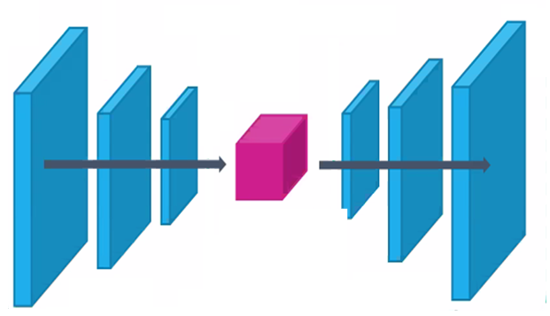




MPAI-EVC Evidence Project
AI Residual Coding
AI Entropy Coding
Input Frame
+
$r$_{t}
Output
Bitstream
$$x_{t}$$
AI Intra Coding
-
AI Residual Decoding
Pred. Frame
AI Inter Coding
$${\overline{x}}_{t}$$
Ref Frame
$${\hat{x}}_{t−1}$$
AI In-Loop Filtering
+
Reference Frame Buffer
+

Slide 26
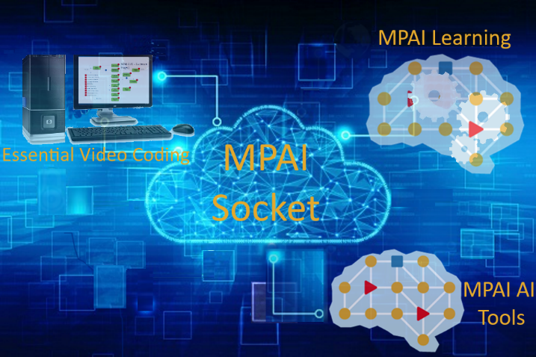
How can MPAI manage this project?
Problem
MPAI members come from 15 countries
Holding strictly online meetings
Wishing to develop AI coding standards collaboratively
Solution:
Create a collaborative environment

Slide 27

www.mpai.community
To join MPAI send email to secretariat@mpai.community

