Slide 1
Avatar interoperability
J. Yoon and A. Bottino, 2023 March 31 T08:00 & 18:40 UTC

Slide 2
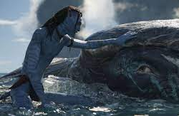
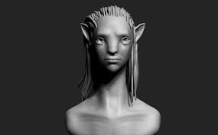
1) Importance of Avatar

Slide 3
2. Types of Avatar
avatars are used to express myself in virtual spaces such as the metaverse.
besides me, it is also used to express the existence of someone outside, such as a virtual assistant.

Slide 4
3. Avatar concept in MPAI

Slide 5
4. What is Avatar Representation and Animation?
Objective1: To enable a user to reproduce a virtual environment.
Objective2: to enable a user to reproduce an avatar of a third party and its animation as intended by the sender.
Objective3: to estimate the personal status of a human or avatar.
Objective4: to display an avatar with a selected personal status.
Definition: Personal Status is the ensemble of information internal to a person, including Emotion, Cognitive State, and Attitude.

Slide 6
5. Examples of avatars implementation in MPAI

Slide 7
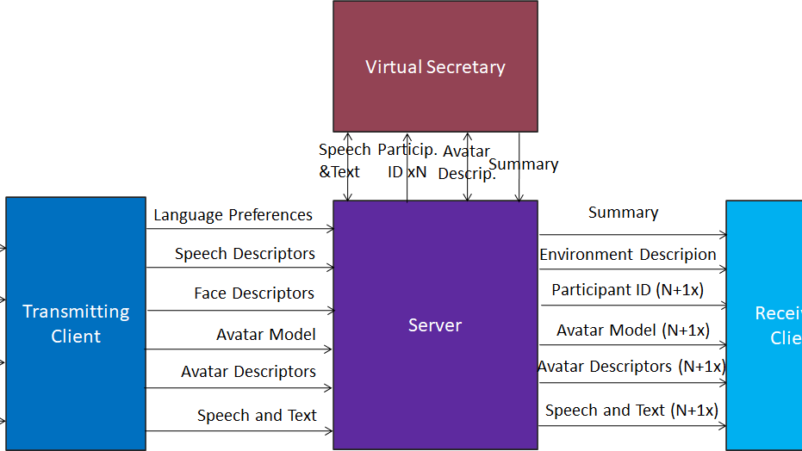
Target use case: avatar-based video-conference (ABV)

Slide 8
Target use case: avatar-based video-conference (ABV)
Virtual Secretary
Speech
&Text
Particip. ID xN
Avatar
Descrip.
Summary
Point of View
Transmitting Client
Language Preferences
Server
Summary
Receiving Client
Language
Preferences
Speech Descriptors
Environment Description
Visual
Face Descriptors
Participant ID (N+1x)
Output
Audio & Text
Avatar Model
Avatar Model (N+1x)
Speech
and Text
Output
Visual
Avatar Descriptors
Avatar Descriptors (N+1x)
Avatar
Model
Summary
Speech and Text
Speech and Text (N+1x)

Slide 9
ABV walkthrough/1
A user selects:
The virtual space (Environment) where the avatars operate.
The avatar model to be animated.
The position occupied by an avatar in the Virtual Environment.
The user’s Point of View when watching and hearing the 3D Audio-Visual Scene in the Virtual Environment.
A machine
Perceives the Audio-Visual components of the Real Environment and creates:
An Audio Scene Description composed of independent audio objects and their locations.
A Visual Scene Description composed of independent visual objects and their locations.
A complete Audio-Visual Scene Description

Slide 10
ABV walkthrough/2
Identifies a human belonging to a group composed of a limited number of humans (closed set identification) using
Speech Descriptors.
Face Descriptors.
Decodes a human’s Personal Status by:
Extracting the Descriptors of the Manifestations of a human’s Personal Status (Text, Speech, Face, and Gesture).
Extracting a human’s Personal Status from Text, Speech, Face, and Gesture Descriptors.
Fusing the different Personal Status in Text, Speech, Face, and Gesture into Personal Status.

Slide 11
AABV walkthrough/3
Animates a speaking avatar by:
Synthesising speech using Text, Speech, and Personal Status of Text (PS-Text) and Personal Status of Speech (PS-Speech).
Animating the Face using Text, Synthesised Speech, Personal Status of Face (PS-Face).
Animating the Gesture of an avatar using Text and Personal Status of Gesture (PS-Gesture).
Converses with another party (human or avatar) by:
Decoding the other party’s Personal Status (Personal Status).
Animating an avatar representing it (see 5.).
Summarises and refines the speech of other parties by analysing and interpreting their Text, Speech, and Personal Status Manifestations.

Slide 12
MPAI approach to standardisation
User Agent
AI Workflow (AIW)
AI Module (AIM)
AI Module (AIM)
Open market of
components with
standardises
functions and
Interfaces,
competing in
performance.
Inputs
Outputs
AIM
Storage
AI Module (AIM)
AI Module (AIM)
Controller
Communication
Global Storage
Access
MPAI Store
MPAI-AIF enables independently sourced AI Modules having standardised interfaces to be executed in an environment with standardised APIs.

Slide 13
ABV Client: transmitting side
User Agent
Language Preference
Language Preference
Avatar Model
Avatar Model
Text
Text
Audio Scene Description
Audio Scene Parsing
Speech
Input Audio
Audio Scene
Descriptors
Recognised Text
Language
Understanding
Avatar Description
Speech
Speech Recognition
Recognised
Text
Personal Status Extraction
Meaning
Speech
Personal Status
Text
Face Descriptors
Compressed Avatar Descriptors
Face & Body Description
Personal Status
Body Descrptors
Input Video
Face Descriptors
Body Descriptors
Controller
Communication
Global Storage
MPAI Store

Slide 14
ABV Server
User Agent
Summary
S
Summary
Environment Model
Environment Model
Avatar Models (xN+1)
Avatar Models (xN+1)
Spatial Attitudes (xN+1)
Spatial Attitudes (xN+1)
Avatar Descriptors (xN+1)
Avatar Descriptors (xN+1)
Participant Identities (xN)
Participant Authentication
Speech Descriptors (A) (xN)
Participant ID (xN)
Face Descriptors (A) (xN)
Languages Preferences (xN)
Text and Speech
Translation
Speech (xN+1)
Speech (xN+1)
Text (xN+1)
Text (xN+1)
Controller
Communication
Global Storage
MPAI Store

Slide 15
Special ABV Server: Virtual Secretary
User Agent
Text (xN)
S
Dialogue Processing
Speech Recognition
Recognised Text
Language Understanding
Lang-Und Text
Speech (xN)
Summary
Recognised Text
Personal Status Extraction
Meaning
Personal Status Display
Text (xN)
Avatar Model
Speech (xN)
Descriptor Decompression
Personal Status
Meaning
Summarisation
VS Personal Status
VS Text
Edited
Summary
Body Descriptors
VS Speech
Text (Lang-Und)
Compressed Avatar Descriptors (xN)
Summary
Face Decriptors
VS Text
VS Compressed Avatar Descriptors
Personal Status
Personal Status
Controller
Communication
Global Storage
MPAI Store

Slide 16
ABV Client: Receiving Side
User Agent
Environment Model
S
Visual Scene Creation
AV Scene Viewer
Avatar Model (xN+1
Spatial Attitudes (xN+1)
Visual Scene
Point of View
Participant ID (xN)
Compressed Avatar Descriptors (xN+1)
Output
Audio
Spatial Attitudes (xN+1)
Audio Scene Creation
Participant ID (Nx)
Audio Scene
Output
Visual
Speech (xN+1)
Controller
Communication
Global Storage
MPAI Store

Slide 17
Personal Status Extraction
Selection
S
Text
PS-Text Description
PS-Text Descriptors
PS-Text Interpretation
PS-Text
Personal Status Fusion
Speech
PS-Speech Description
PS-Speech Descriptors
PS-Speech Interpretation
PS-Speech
PS-Face Description
PS-Face Interpretation
Personal Status
Face Object
PS-Face Descriptors
PS-Face
Face Descriptors
Body Object
PS-Gesture Description
PS-Gesture Descriptors
PS-Gesture Interpretation
PS-Gesture
Body Descriptors

Slide 18
Personal Status Display
Selection
Test
Test
Speech
Speech Synthesis
PS-Speech
Machine
Speech
Face Description
Avatar
Description
Descriptor
Compression
Face
Descriptors
Avatar
Descriptors
Compressed
Descriptors
PS-
Face
Test
Avatar
Model
Body Description
Avatar Synthesis
Body
Descriptors
Avatar
Descriptors
Avatar
PS-
Gesture
Avatar
Model

Slide 19
Implementation…
glTF is a specification providing information of model geometry and material.
To animate an avatar we use skeletal animation.
H-Anim is a standard providing a body model.
To capture a real body movement, devices must be used, e.g., Kinect that uses its own skeleton model, slightly different from H-Anim.
To animate 3D models we need a real-time environment, e.g., Unity is an engine providing a complete management of virtual environments (rendering, physics, spatialised audio, avatar animation)
Unity uses its own skeleton model, slightly different from H-Anim.
The expression of the face of an avatar model are represented by blend shapes according to FACS. For body we use the evolution in time of joint positions and angles between joints.
MPAI intends to specify an Avatar Representation and Animation format that is genetared (e.g., captured) and transmitted to a receiving end to reproduce the avatar as intended by the transmitting end

Slide 20
We look forward to your
participation in this
exciting project!
Join MPAI
Share the fun
Build the future!
https://mpai.community/

