Slide 1
Connected Autonomous Vehicles
David Schultens,
2023 March 31 T07:20 & 21:20 UTC
David@OpenVideoSystem.com

Slide 2
Connected Autonomous Vehicles (CAV)
Collaboratively and constantly refined AI Models
Comparison of results in Simulation of Use Cases.
Partitioning of AIM component revisions
Improved interfaces and Licensed Framework Reference from MPAI
Users/regulators: make sure that a CAV is safe, reliable, and explainable.
Facilitated by CAV’s componentization for Edge compute.
Standard-based components accelerate a CAV mass market.
CAV standards as milestones in a process for intercommunication,
moving from research to standardization to deployment.

Slide 3
MPAI approach to standardisation
User Agent
AI Workflow (AIW)
AI Module (AIM)
AI Module (AIM)
Open market of
components with
standardises
functions and
Interfaces,
competing in
performance.
Inputs
Outputs
AIM
Storage
AI Module (AIM)
AI Module (AIM)
Controller
Communication
Global Storage
Access
MPAI Store
MPAI-AIF enables independently sourced AI Modules having standardised interfaces to be executed in an environment with standardised APIs.

Slide 4
Connected Autonomous Vehicles (CAV)
Collaboratively and constantly refined AI Models
Comparison of results in Simulation of Use Cases.
Partitioning of AIM component revisions
Improved interfaces and Licensed Framework Reference from MPAI
Users/regulators: make sure that a CAV is safe, reliable, and explainable.
Facilitated by CAV’s componentization for Edge compute.
Standard-based components accelerate a CAV mass market.
CAV standards as milestones in a process for intercommunication,
moving from research to standardization to deployment.

Slide 5
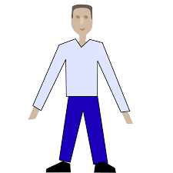
Elements of a CAV Use Case Simulation
Passenger
Human
Roadside Unit
Traffic light
Other vehicles
CAV-enabled vehicles

Slide 6
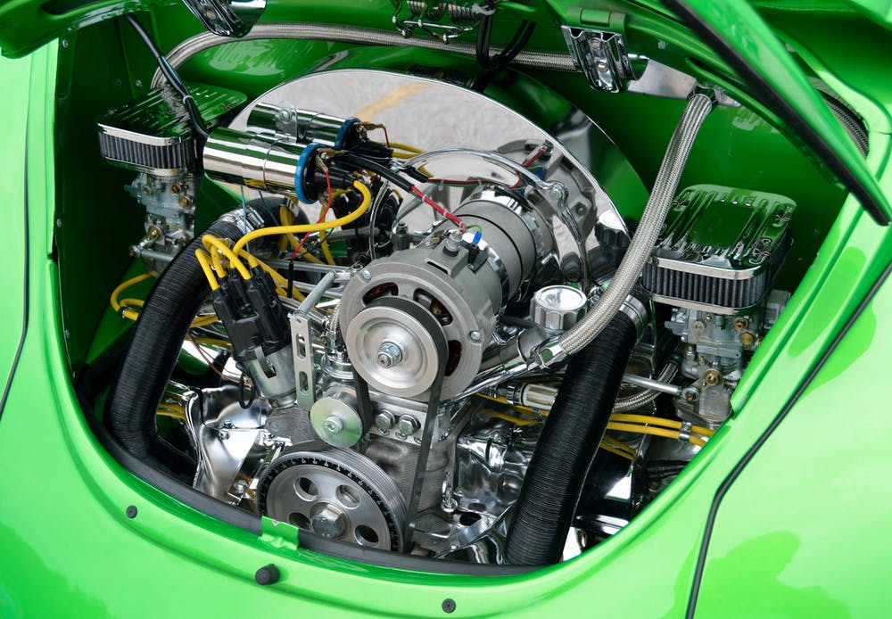
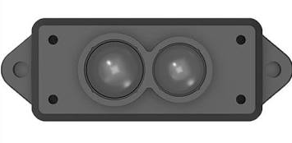
CAV Subsystems containing AIM (modules)
Environment Sensing Subsystem
(ESS)
Motion Actuation Subsystem
(MAS)
Autonomous Motion Subsystem (AMS)
Human-CAV Interaction
(HCI)
3-Apr-23
6

Slide 7
Functions of CAV subsystems
Human-CAV interaction (HCI) responds to hum­ans’ commands and queries, sensing activ­ities during travel, activates other sub­systems required by:
Humans as deemed nec­essary.
Environment by identified conditions.
Environment Sensing Subsystem (ESS) acquires in­formation from the environment
Synthesis of sensor data creates and shares
Basic Environment Representation (BER).
Autonomous Motion Subsystem (AMS) builds a Full Environment Representation (FER) using internal and external edge compute (BERs from other CAVs and RSU) information to automatically route plan safely avoiding collision and efficiently flocking together.
Motion Actuation Subsystem (MAS) senses information from and
Actuates motion instructions in the physical environment and sends feedback.

Slide 8
HCI Human CAV Interaction
Autonomous Motion
Subsystem
S
FWR Audio
FER Commands
Full Envron..
Representation
Viewer
Full Environment Representation
FWR Video
Text
Autonomous Motion Subsystem
Dialogue Processing
Audio Scene Description
Speech
Speaker Recognition
Command
Audio
(Indoor)
Speaker ID
Environment Sensing Subsystem
Speech
Speech Recognition
Recognised
Text
Language Understanding
Response
Audio
(Outdoor)
Recognised Text
Personal Status Extraction
Meaning
Speech
Text
Personal Status
Face Object
Personal Status
Visual Scene Description
Video
(Outdoor)
Human Object
Personal Status Display
Machine
Face
Physical Object Identification
Output
Personal Status
Human Object
Physical Object ID
Text (Lang-Und)
User Agent
Machine
Gesture
Physical Object
Video
(Outdoor)
Face Recognition
Face ID
Machine
Text
Face Object
Output Text
Machine
Speech
Controller
Communication
Global Storage
MPAI Store

Slide 9
User Agent
Radar Data
Radar Scene D.
R. Scene Description
ESS Data Fusion
Autonomous Motion Subsystem
BER
Lidar Data
Radar Scene D.
L. Scene Description
BER
Camera Data
Road Topology
Traff.Sig. Recognition
BER
Camera Data
Camera Scene D.
C. Scene Description
BER
Ultrasound Data
Ultrasound Scene
U. Scene Description
BER
Map Scene D.
Basic
Environ. Represent.
Offline Map Data
M. Scene Description
BER
Audio Data
Audio Scene D.
Microphone
Array Geom.
A. Scene Description
BER
GNSS Data
Spatial Attitude Generator
Spatial Attitude
Spatial
Attitude
Motion Actuation Subsystem
Spatial Attitude
Other Environment Data
Controller
MPAI Store

Slide 10
Basic Environment
Representation
Environment Sensing Subsystem
Full Environment Representation (FER) Fusion
Basic Environment
Representation
Other V2X Data
Full Environment
Representation
Human-CAV Interaction
Full Environment
Representation
Environment Sensing Subsystem
FER
FER
FER
FER
Env.
Info.
Feed
back
Alert
Route Planner
Route
Path Planner
Path
Motion Planner
Trajec--tory
Obstacle Avoider
Destination
Trajec--tory
Command Issuer
Command
R. State
R. State
R. State
Motion Actuation Subsystem
R. State
Feedback
User Agent
Route
Path
Trajectory
Trajectory
FeedBack
Decision Recorder
Controller
Communication
Global Storage
Offline Map
MPAI Store

Slide 11
User Agent
Motion
Accelerometer
Spatial Attitude Generation
Environment Sensing Subsystem (ESS)
Speedometer
Spatial
Attitude
Odometer
Other Environment Data
Road wheel motor
Command Interpreter
Commands
Autonomous Motion Subsystem
(AMS)
Road wheel direction
Feedback
Brakes
Controller
Communication
Global Storage
MPAI Store

Slide 12
Plans/1
MPAI is developing Technical Report – Architecture of Connected Autonomous Vehicles (MPAI-CAV) defining 4 interconnected subsystems that:
Understands human utterances (HCI).
Plans a Route to reach a destination.
Senses and builds a representation of the external Environment (BER).
Exchanges BER with other CAVs and CAV-aware entities.
Makes decisions about how to execute the Route (AMS).
Actuates the motion (MAS).

Slide 13
Plans/2
For each Subsystem, the Technical Report provides:
The Function of the Subsystem.
The Functional Requirements of some I/O data.
The Topology of the Components (AI Modules).
For each Subsystem Component (AI Module) the Technical Report provides :
The Function of the AIM
The Functional Requirements of some I/O data.
The Formats of some I/O data.

Slide 14
We look forward to your
participation in this
exciting project!
Join MPAI
Share the fun
Build the future!
https://mpai.community/

