Slide 1
Call for Technologies: Connected Autonomous Vehicle (MPAI-CAV) – Architecture
Leonardo Chiariglione
Presentation of MPAI-MMM – Architecture Call for Technologies
2023/07/26 T08 & 15 UTC
.

Slide 2
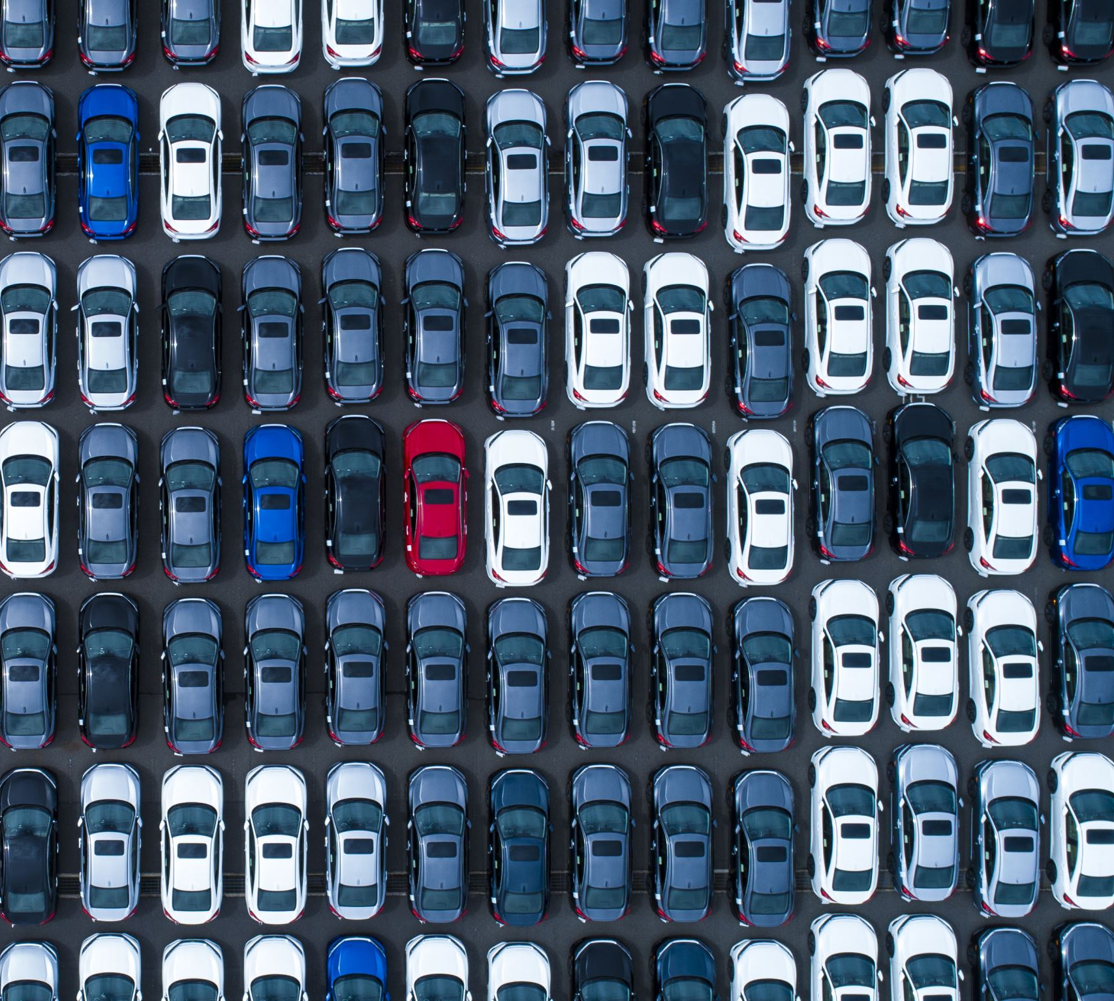
Connected autonomous vehicles (CAV)
Many benefits from CAVs:
Replace human error with a machine errors rate orders of magnitude lower.
Optimise use of vehicles and infrastructure.
Give human brains more time for rewarding activities.
Optimise traffic management.
Reduce congestion and pollution.
Help elderly and disabled people have a better life, and more.Long history of reducing human effort driving vehicles.
Should we just wait for
Industry to produce cars with higher SAE Levels and
Research to advance our understanding?

Slide 3
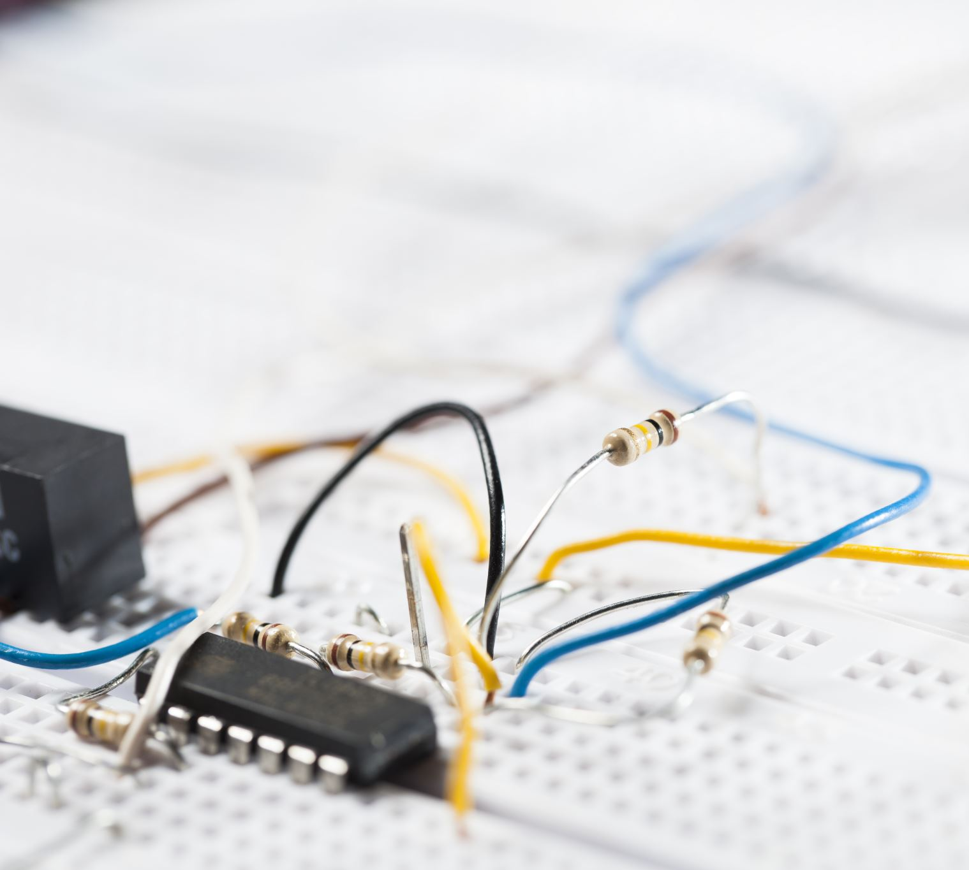
MPAI thinks we can do more
Specify:
A CAV Reference Model broken down into Subsystems.
The Functions of each Subsystem.
The Data exchanged between Subsystems.
Break down each Subsystem in Components.
For each Components specify:
The Functions of the Components.
The Data exchanged between Components.
The Topology of Components and Connections.
The Functional Requirements of the Data exchanged.

Slide 4
Benefits to standardisation
Research can
Concentrate on a Component.
Optimise the Component keeping the interfaces’ Functional Requirements.
Industry can promote the definition of Data Formats when:
Research results are mature.
A Component is needed.
The Reference Model can be explained.

Slide 5
Benefits to the market
Component manufacturers can:
Develop optimised solutions based on publicly available specifications.
Put their standard components to the market.
Car manufacturers can:
Access an open global market of components.
With standard functions and interfaces.
That can be tested for conformance using standard procedures.
Regulators have tools to oversee the development of the market.

Slide 6
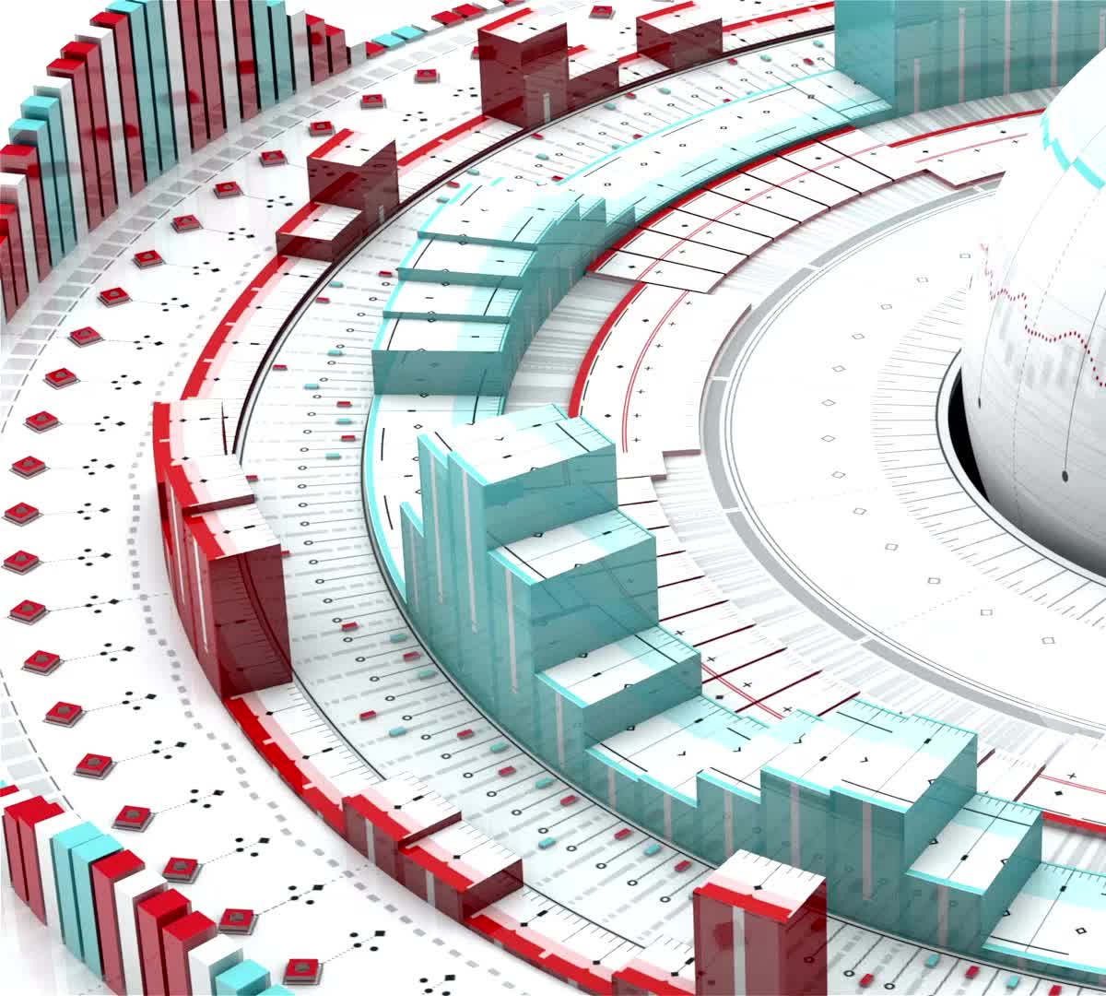
Benefits of standards
Standards can accelerate the creation of a high-tech market (see the MPEG story).
Standards can:
Enhance competition (higher quality at lower prices).
Explain system operation (depending on the standard “atomicity”).
Assuage consumer concerns (when the technology may be “feared”).
Provide tools for regulation
Standard include Conformance Testing.
Here we need Performance Assessment

Slide 7
About MPAI

Slide 8
Moving Picture, Audio, and Data Coding by Artificial Intelligence.
International, unaffiliated, non-profit SDO.
Developing AI-based data coding standards.
With clear Intellectual Property Rights licensing frameworks.

Slide 9
The MPAI standard development process
Develop Use Cases and Functional Requirements.
Develop Commercial Requirements (Framework Licence).
Issue Call for Technologies satisfying:
Functional Requirements.
Commercial Requirements.
Develop standard (only by MPAI members).
SEP holders select patent pool administrator.
Stage 0
Stage 1
Stage 2
Stage 3
Use Cases
Interest
Collection
Functional
Requirements
Commercial
Requirements
Technical
Specification
Reference
Software
Community
Comments
Standard
Development
Call for
Technologies
Conformance
Testing
Reference
Software
Performance
Assessment
Stage 7
Stage 6
Stage 5
Stage 4
Principal Members
All
All Members

Slide 10
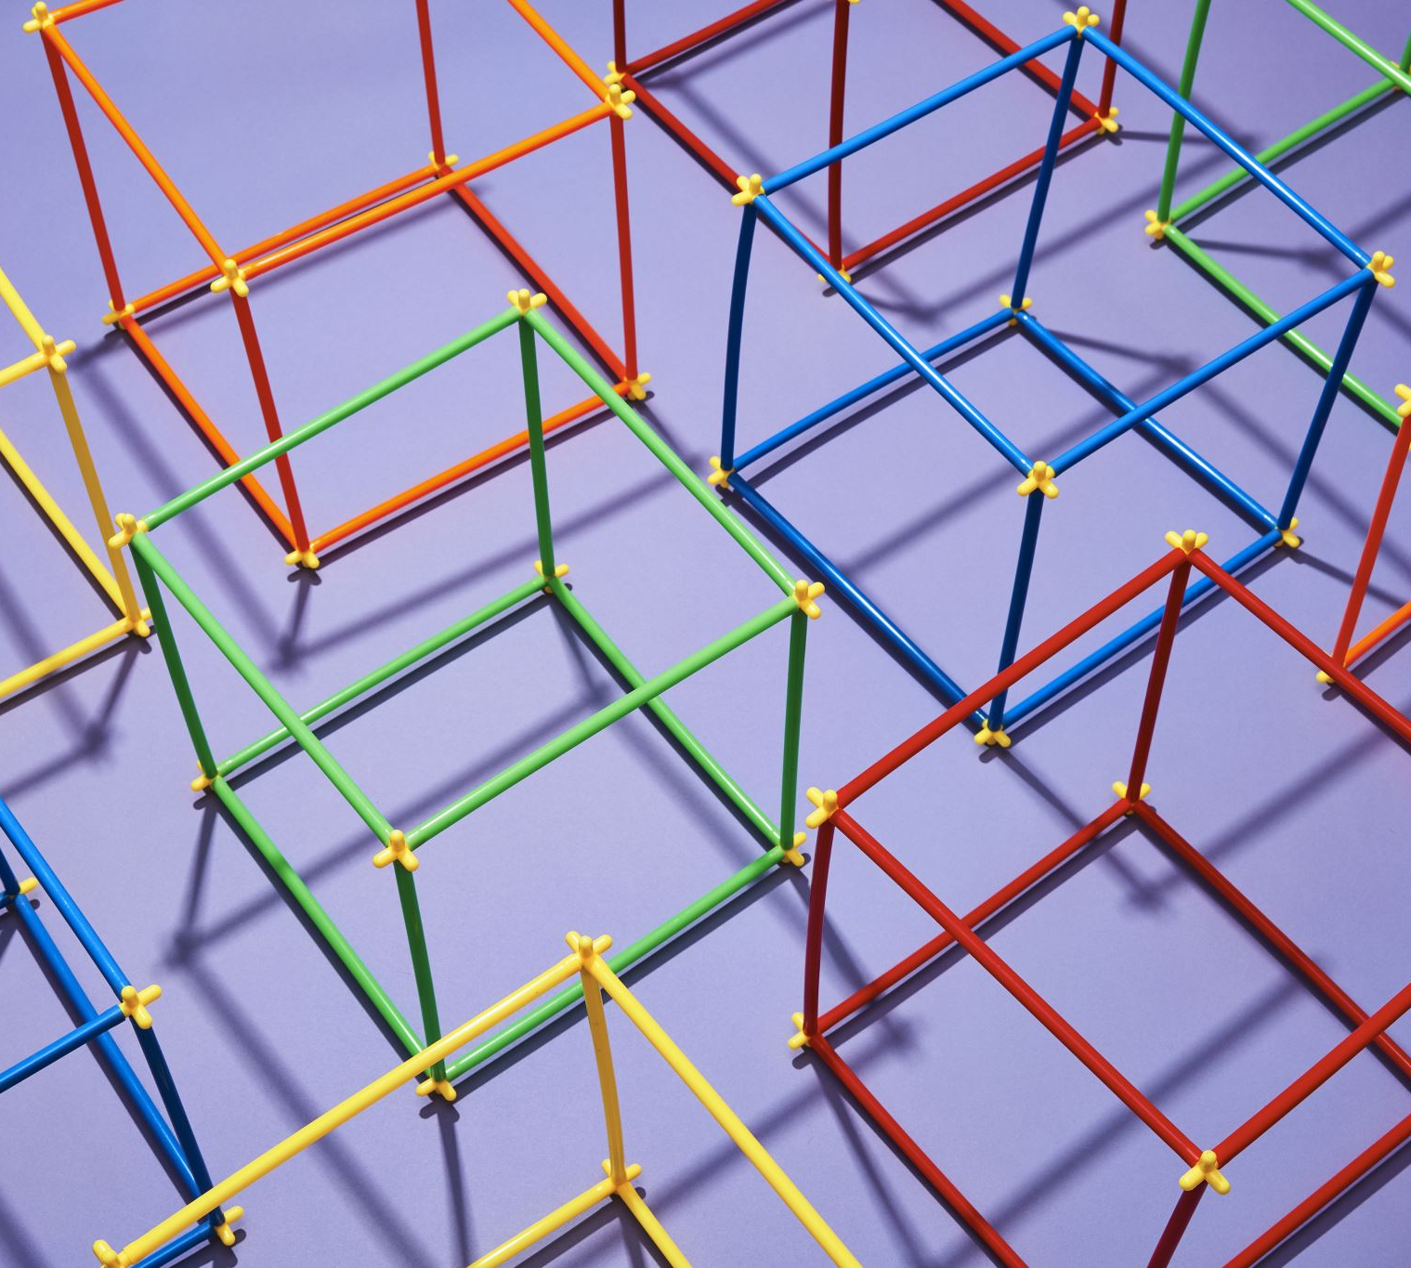
Why is MPAI engaged in “Connected Autonomous Vehicles”?
CAVs need a lot of AI to process disparate data types.
Coding data with AI is MPAI’s mission.
CAVs components must be securely operated.
MPAI’s Secure AI Framework underpins MPAI standards.
CAVs and metaverse are connected.
MPAI is developing the Metaverse Model – Architecture standard.

Slide 11
Secure execution of AI applications
User Agent
AI Module (AIM)
AI Module (AIM)
Inputs
Outputs
AIM/AIW Storage
(non-secure)
AI Module (AIM)
AIM/AIW Storage
(secure)
AI Module (AIM)
Controller (Non-secure/Secure)
SAL
Communi-cation
Global Storage
Access
MPAI Store
Trusted Services
Communica-tion Service
Encryption Service
Attestation Service
AIM Security Engine
AIM Storage Service
AIM Model Service

Slide 12
MPAI standards
MPAI’s AI standardisation is “component-based”.
An AI application:
- Subdivided in smaller components: AI modules (AIM).
- Aggregated in one or more AI workflows (AIW).
- Executed in a standard environment (AIF).
1 foundational Techical Specification
AI Framework (MPAI-AIF)
1 system Technical Specification:
Governance of the MPAI Ecosystem (MPAI-GME).
12

Slide 13
The MPAI ecosystem
Implementer
MPAI Store
End User
Implementation
Develops Implem-entations
Verifies security
Tests Conformance
Checks Performance
Down-loads Implem-entation
Performance Assessor
Implementation
OK
Assesses Perfor-mance
OK
Implementation
Experience
Score
Standards
Appoints
Establishes and controls
MPAI
Issues standards: Technical Specification-Reference Software-Conformance Testing-Performance Assessment
Appoints Performance Assessors assessing Reliability, Robustness, Replicability and Fairness of implementations
Establishes MPAI Store, not-for-profit commercial entity distributing implementations
13

Slide 14
More published MPAI standards
4 Technical Specifications
- Context-based Audio Enhancement (MPAI-CAE)
- Compression and Understanding of Financial Data (MPAI-CUI)
- Multimodal Conversation (MPAI-MMC)
- Neural Network Watermarking (MPAI-NNW)
2 Technical Reports
- MPAI Metaverse Model (MPAI-MMM) – Functionalities
- MPAI Metaverse Model (MPAI-MMM) – Functionality Profiles

Slide 15
Five more standards to be published soon
Developing extensions (delivery in September)
- AI Framework V2 MPAI-AIF)
- Multimodal Conversation V2 (MPAI-MMC)
Developing new standards (delivery in September)
- Avatar Representation and Animation V1 (MPAI-ARA)
- Connected Autonomous Vehicles V1 (MPAI-CAV)
- MPAI Metaverse Model V1 (MPAI-MMM) – Architecture

Slide 16
Brewing in the pot
Soon to be standard activities (Call for Technologies in August)
1 – Artificial Intelligence for Health (MPAI-AIH)
2 – Extended Reality Venues (MPAI-XRV)
Exploring
3 - AI-based End-to-End Video Coding
4 - AI-Enhanced Video Coding
5 - Server-based Predictive Multiplayer Gaming (MPAI-SPG)

Slide 17
MPAI and IEEE
MPAI Technical Specifications adopted as IEEE standards
MPAI-AIF – 3301-2022
MPAI-CAE – 3302-2022
MPAI-MMC – 3300-2022
MPAI-CUI – 3303-2023
MPAI-NNW (on its way)
All this achieved in less than 3 years!

Slide 18
MPAI’s Connected Autonomous Vehicles (MPAI-CAV)

Slide 19
Define a CAV
A system that :
Understands the mission utterances (e.g., take me home) by interacting with human.
Plans a Route (e.g., from here to home).
Senses and represents the external Environment (i.e., the space around the CAV).
Exchanges representations with other CAVs and CAV-aware entities.
Decides how to execute the steps of the Route.
Implements decisions though commands to the motion actuation subsystem.

Slide 20
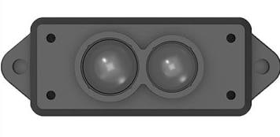
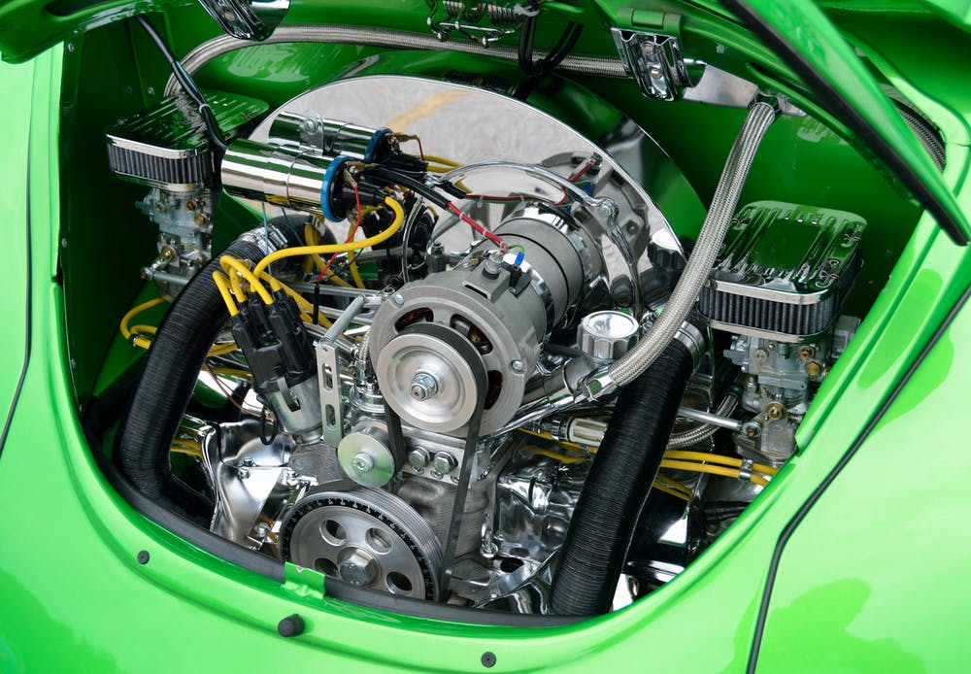
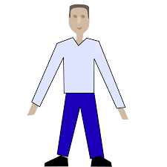
Reference model of Connected Autonomous Vehicle
Environment Sensing Subsystem
(ESS)
Motion Actuation Subsystem
(MAS)
Autonomous Motion Subsystem (AMS)
Human-CAV Interaction
(HCI)
The CAV Architecture Call for Technologies requests comments on this CAV system partitioning.

Slide 21
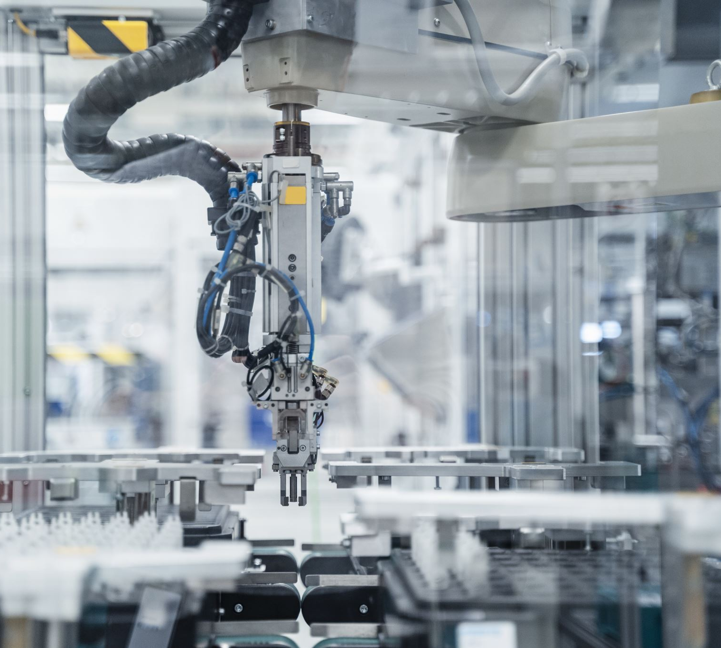
Disclaimer
MPAI
At this stage, does not intend to include the CAV’s mechanical parts in the planned Connected Autonomous Vehicle – Architecture standard.
Only intends to reference the interfaces of the Motion Actuation Subsystem interacting with such mechanical parts.

Slide 22
Terms and definitions
Use Cases and Functional Requirements collects > 100 terms and definitions.
Here we will use a few Acronyms:
HCI
ESS
AMS
MAS
EST
BER
FER
Human-CAV Interaction (Subsystem)
Environment Sensing Subsystem
Autonomous Motion Subsystem
Motion Actuation Subsystem
Environment Sensing Technology
Basic Environment Representation
Full Environment Representation

Slide 23
1. Functions of Human-CAV Interaction
Authenticates humans, e.g., to let them into the CAV.
Converses Interpreting utterances based on humans’ Personal Statuses, e.g., to go to a destination, or during a conversation.
Converses with the Autonomous Motion Subsystem to execute commands.
Lets passengers navigate the Full Environment Representation.
Appears as a speaking avatar showing a Personal Status dependent on:
The content of the conversation.
The information it is aware of.
The Personal Status of the human it converses with.
MPAI welcomes comments and proposals on the HCI functions.

Slide 24
2. Reference Architecture of Human-CAV Interaction
Autonomous Motion Subsystem
Full Environment Representation Commands
Full Environment
Representation
Viewer
FER Audio
Full Environment Representation
FER Visual
Audio Scene Description
Speech
Speaker Recognition
Speaker ID
Dialogue Processing
Remote HCIs
Audio
(Indoor)
Inter HCI
Information
Speech
Meaning
Personal Status Extraction
Meaning
Autonomous Motion Subsystem
Environment Sensing Subsystem
Speech Recognition
Language Understanding
HCI-AMS Command
Audio
(Outdoor)
Speech
Recognised Text
Refined Text
Refined Text
AMS-HCI Response
Video
(Outdoor)
Visual Scene Description
Body Descriptors
Physical Object Identification
Physical Object ID
Machine
Text
Physical Object
Personal Status
Personal Status Display
Video
(Indoor)
Face Descriptors
Machine
Personal Status
Machine
Avatar
Body Descriptors
Face Recognition
Face ID
Machine Text
Machine
Speech
Face Object

Slide 25
3. I/O Data of Human-CAV Interaction
Input data | From | Comment
Full Environment Representation | Autonomous Motion Subsystem | Rendered by Full Environment Representation Viewers
Full Environment Representation Commands | Cabin Passengers | To control rendering of Full Environment Representation
Audio (ESS) | Environment Sensing Subsystem | User authentication, User command, User conversation
Audio | Cabin Passengers | User’s social life, Commands/interaction with HCI
Video (ESS) | Environment Sensing Subsystem | Commands/interaction with HCI
Video | Cabin Passengers | User’s social life, Commands/interaction with HCI
AMS-HCI Response | Autonomous Motion Subsystem | Response to HCI-AMS Command
Output data | To | Comments
FER Audio | Passenger Cabin | For passengers to hear external Environment
FER Video | Passenger Cabin | For passengers to view external Environment
Inter HCI Information | Remote HCI | HCI-to-HCI information
HCI-AMS Command | Autonomous Motion Subsystem | HCI-to-AMS information
Machine Text | Cabin Passengers | HCI’s response to passengers
Machine Avatar | Cabin Passengers | HCI’s avatar when conversing
Machine Speech | Humans in Environment, Cabin Passengers | HCI’s response to humans, HCI’s response to passengers
MPAI welcomes comments and proposals.

Slide 26
4. Functions of Human-CAV Interaction’s AI Modules
AIM | Function
Audio Scene Description | Produces the Audio Scene Descriptors using the Audio captured by the appropriate (indoor or outdoor) Microphone Array.
Visual Scene Description | Produces the Visual Scene Descriptors using the visual information captured by the appropriate (indoor or outdoor) visual sensors.
Speech Recognition | Converts speech into Text.
Physical Object Identification | Provides the ID of the class of objects of which the Physical Object is an Instance.
Full Environment Representation Viewer | Converts the FER produced by the Autonomous Motion Subsystem into Audio-Visual Scene Descriptors that can be perceptibly rendered.
Language Understanding | Improves Text from Speech Recognition by using context information (e.g., Instance ID of object).
Speaker Recognition | Provides Speaker ID from Speech.
Personal Status Extraction | Provides the Personal Status of human.
Face Recognition | Provides Face ID from Face Object.
Dialogue Processing | Provides HCI’s: Text containing response to human. Personal Status coherent with the Text produced by HCI.
Personal Status Display | Produce Machine’s Speech, Face, and Body.
MPAI welcomes comments and proposals.

Slide 27
5. Input/Output Data of Human-CAV Interaction’s AIMs
AIM | Input | Output
Audio Scene Description | Environment Audio (outdoor/indoor | Speech Objects
Visual Scene Description | Environment Video (outdoor/ indoor) | Face Descriptors, Body Descriptors , Physical Objects
Speech Recognition | Speech Object | Recognised Text
Physical Object Identification | Physical Object, Body Descriptors | Physical Object ID
Full Environment Representation Viewer | FER Commands | FER Audio, FER Visual
Language Understanding | Recognised Text, Personal Status, Physical Object ID | Meaning, Personal Status, Refined Text
Speaker Recognition | Speech Descriptors | Speaker ID
Personal Status Extraction | Recognised Text, Speech Object, Face Object, Human Object | Personal Status
Face Recognition | Face Object | Face ID
Dialogue Processing | Speaker ID, Meaning, Refined Text, Personal Status, Face ID, AMS-HCI Response | AMS-HCI Commands , Machine Text, Machine Personal Status
Personal Status Display | Machine Text, Machine Personal Status | Machine Text, Machine Avatar, Machine Speech
MPAI welcomes comments and proposals.

Slide 28
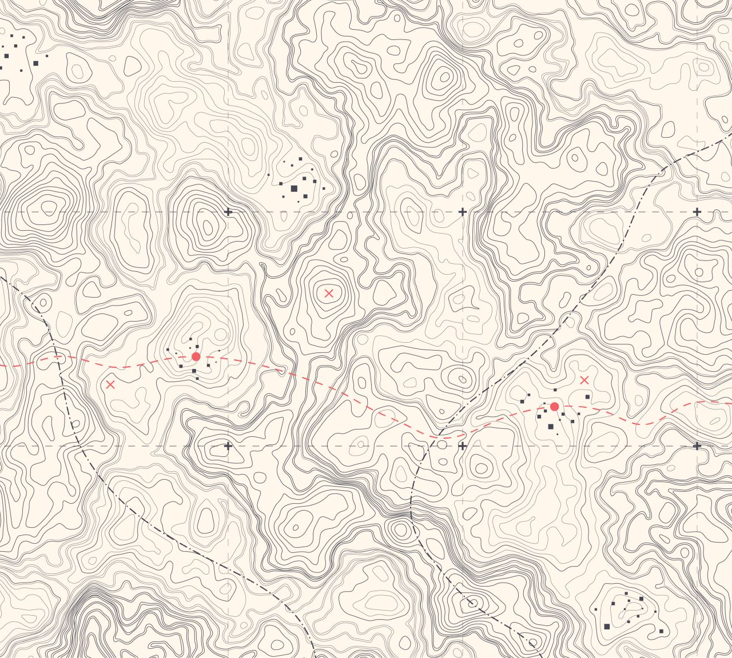
1. Functions of Environment Sensing Subsystem
Acquires Environment information using Subsystem’s RADAR, LiDAR, Cameras, Ultrasound, Offline Map, Audio, GNSS,…
Receives Ego CAV’s Spatial Attitude and Environment Data (temperature, humidity, etc.) from Motion Actuation Subsystem.
Produces Environment Sensing Technology Scene Descriptors in a common format
Integrates Scene Descriptors in a Basic Environment Representations during the travel.
Passes the BERs, including Alerts, to the Autonomous Motion Subsystem.
MPAI welcomes comments and proposals.

Slide 29
2. Reference Architecture of Environment Sensing Subsystem
Radar Data
RADAR Scene D.
ESS Data Fusion
Autonomous Motion Subsystem
R. Scene Description
BER
Lidar Data
LiDAR Scene D.
L. Scene Description
BER
Camera Data
Road Topology
Traff.Sig. Recognition
BER
Camera Data
Camera Scene D.
C. Scene Description
BER
Ultrasound Data
Ultrasound Scene
U. Scene Description
BER
Map Scene D.
Basic
Environ. Represent.
Offline Map Data
M. Scene Description
BER
Audio Data
Audio Scene D.
Microphone
Array Geom.
A. Scene Description
BER
GNSS Data
Spatial Attitude Generation
Spatial Attitude
Spatial
Attitude
Motion Actuation Subsystem
Spatial Attitude
Environment Data

Slide 30
3. I/O Data of Environment Sensing Subsystem
Input data | From | Comment
Radar Data | ~25 & 75 GHz Radio | Capture Environment with Radar
Lidar Data | ~200 THz infrared | Capture Environment with Lidar
Camera Data (2/D and 3D) | Video (400-800 THz) | Capture Environment with Cameras
Ultrasound Data | Audio (>20 kHz) | Capture Environment with Ultrasound
Offline Mapa Data | Local storage | cm-level data at time of capture
Audio Data | Audio (16 Hz-16 kHz) | Capture Environment or cabin with Microphone Array
Microphone Array Geometry | Microphone Array | Microphone Array disposition
Global Navigation Satellite System (GNSS) Data | ~1 & 1.5 GHz Radio | Get Pose from GNSS
Spatial Attitude | Motion Actuation Subsystem | To be fused with GNSS data
Other Environment Data | Motion Actuation Subsystem | Temperature etc. added to BER
Output data | To | Comment
Alert | Autonomous Motion Subsystem | Critical Environment Descriptor from EST (in BER)
Basic Environment Representation | Autonomous Motion Subsystem | ESS-derived representation of external Environment
MPAI welcomes comments and proposals.

Slide 31
4. Functions of Environment Sensing Subsystem’s AIMs
AIM | Function
RADAR Scene Description | Produces RADAR Scene Descriptors from RADAR Data
LiDAR Scene Description | Produces LiDAR Scene Descriptors from LiDAR Data
Traffic Signalisation Recognition | Produces Road Topology of the Environment from Camera and LiDAR Data.
Camera Scene Description | Produces Camera Scene Descriptors from Camera Data
Ultrasound Scene Description | Produces Ultrasound Scene Descriptors from Ultrasound Data.
Online Map Scene Description | Produces Online Map Data Scene Descriptors from Online Map Data.
Audio Scene Description | Produces Audio Scene Descriptors from Audio Data.
Spatial Attitude Generation | Computes the CAV Spatial Attitude using information received from GNSS and Motion Actuation Subsystem with respect to a predetermined point in the CAV defined as the origin (0,0,0) of a set of (x,y,z) Cartesian coordinates with respect to the local coordinates.
Environment Sensing Subsystem Data Fusion | Selects critical Environment Representation as Alert; produces CAV’s Basic Environment Representation by fusing the Scene Descriptors of the different ESTs, The Basic Environment Representation (BER) includes all available information from ESS and MAS that enables the CAV to define a Path in the Decision Horizon Time. The BER results from the integration of: The different Scene Descriptors generated by the different EST-specific Scene Description AIMs. Environmental data. The Spatial Attitude of the Ego CAV as estimated by the Motion Actuation Subsystem.
MPAI welcomes comments and proposals.

Slide 32
5. I/O Data of Environment Sensing Subsystem’s AIMs
AIM | Input | Output
Radar Scene Description | Radar Data, Basic Environment Representation | Radar Scene Descriptors
Lidar Scene Description | Lidar Data, Basic Environment Representation | Lidar Scene Descriptors
Traffic Signalisation Recognition | Camera Data, Basic Environment Representation | Road Topology
Camera Scene Description | Camera Data, Basic Environment Representation | Lidar Scene Descriptors
Ultrasound Scene Description | Ultrasound Data, Basic Environment Representation | Ultrasound Scene Descriptors
Map Scene Description | Offline Map Data, Basic Environment Representation | Map Scene Descriptors
Audio Scene Description | Audio Data, Basic Environment Representation | Audio Scene Descriptors
Spatial Attitude Generation | GNSS Data, Spatial Attitude form MAS | Spatial Attitude
Environment Sensing Subsystem Data Fusion | RADAR Scene Descriptors, LiDAR Scene Descriptors, Road Topology, Lidar Scene Descriptors, Ultrasound Scene Descriptors, Map Scene Descriptors, Audio Scene Descriptors, Spatial Attitude, Other Environment Data | Basic Environment Representation Alert
MPAI welcomes comments and proposals.

Slide 33
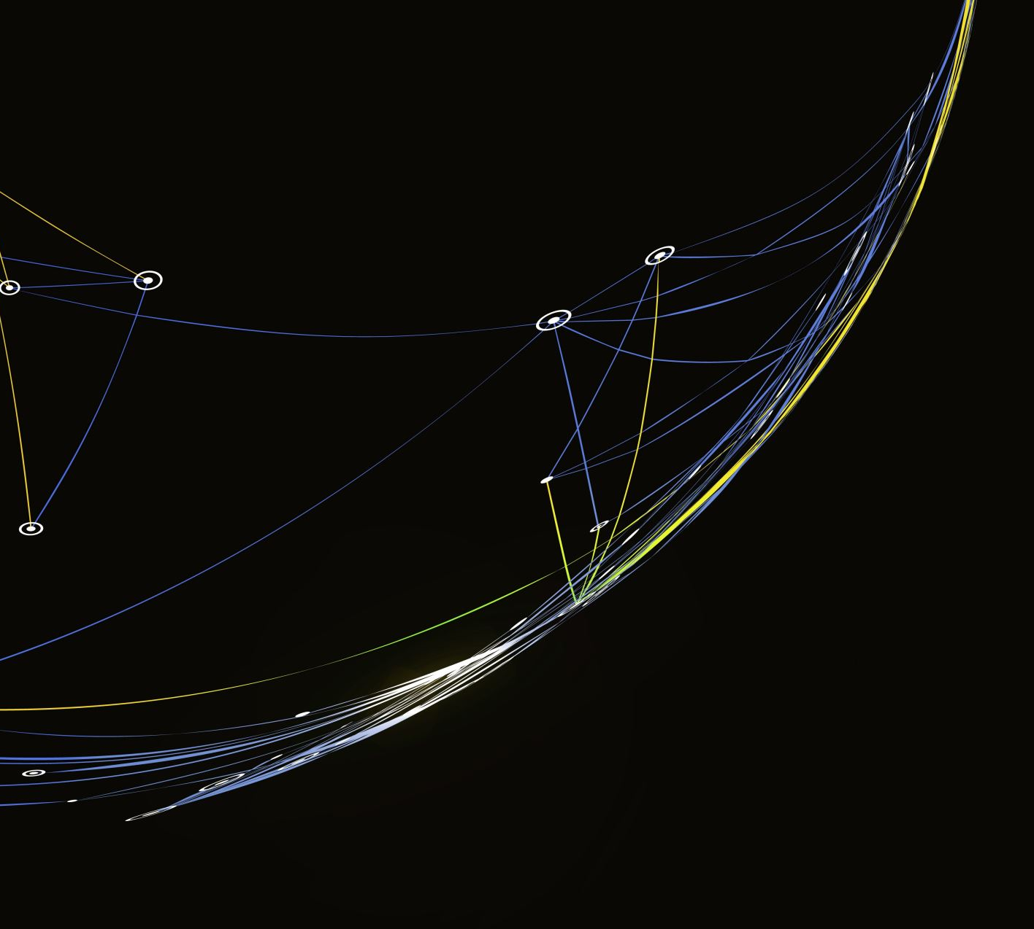
1. Functions of Autonomous Motion Subsystem
Computes human-requested Route.
Receives current BER from Environment Sensing Subsystem.
Communicates with other CAVs’ AMSs (e.g., exchanges subsets of BER and other data).
Produces Full Environment Representation by fusing its own BER with info from other CAVs in range.
Sends Commands to Motion Actuation Subsystem to take the CAV to the next Pose.
Receives and analyses responses from MAS.
MPAI welcomes comments and proposals.

Slide 34
2. Reference Architecture of Autonomous Motion Subsystem
Environment Sensing Subsystem
Environment Representation Fusion
Environment
Representation
Remote AMSs
Basic
Environment
Representation
Environment Sensing Subsystem
FER
FER
FER
FER
Response
Human-CAV Interaction
Route Planner
Path Planner
Motion Planner
Obstacle Avoider
Alert
HCI-AMS
Command
Route
Path
Trajectory
Trajectory
Command Issuer
Command
AMV-HCI
Response
Motion Actuation Subsystem
Road
State
Road
State
Road
State
Road
State
Response
Route
Path
Trajectory
Trajectory
Response
Decision Recorder

Slide 35
3. I/O Data of Autonomous Motion Subsystem
Input data | From | Comment
Command from HCI | Human-CAV Interaction | Human commands, e.g., “take me home”
Basic Environment Representation | Environment Sensing Subsystem | CAV’s Environment representation.
Other V2X Data | Other CAVs | Other CAVs and vehicles, and roadside units.
Feedback from MAS | Motion Actuation Subsystem | CAV’s response to Command.
Output data | To | Comment
Response to HCI | Human-CAV Interaction | MAS’s response to AMS Command
Command to MAS | Motion Actuation Subsystem | Macro-instructions, e.g., “in 5s assume this State”.
Full Environment Representation | Other CAVs | For information to other CAVs
MPAI welcomes comments and proposals.

Slide 36
4. Functions of Autonomous Motion Subsystem’s AIMs
AIM | Function
Full Environment Representation Fusion | Creates an internal representation of the Environment by fusing infor­mation from itself, CAVs in range and other transmitting units.
Route Planner | Computes a Route, through a road network, from the current to the target destination.
Path Planner | Generates a set of Paths, considering: The Route. Spatial Attitude. Full Environment Representation. Traffic Rules.
Motion Planner | Defines a Goal and a Trajectory to reach the Goal using the Spatial Attitude satisfying the CAV’s kinematic and dynamic constraints and considering passengers’ comfort.
Obstacle Avoider | Checks that the Trajectory is compatible with any Alert information. If it is, it passes the Trajectory to the Command Issuer. If it is not, it requests a new Trajectory. If Command Issuer informs Obstacle Avoider that there is an anomalous situation, Obstacle Avoider may issue a “discontinue previous Command” and forward to the next appropriate upstream AIM, possibly including the Route Planner. This may decide to communicate the Road State to the Human-CAV Interaction Subsystem.
Command Issuer | Instructs the MAS to execute the Trajectory considering the Environment conditions and receives MAS-AMS Responses about the execution.
MPAI welcomes comments and proposals.

Slide 37
5. I/O Data of Autonomous Motion Subsystem’s AIMs
CAV/AIM | Input | Output
Environment Representation Fusion | Alert Basic Environment Representations Environment Representations from other CAVs Other data from other CAVs | Full Environment Representation
Route Planner | Full Environment Representation Offline maps | Route Estimated time
Path Planner | Route Full Environment Representation Offline maps | Set of Paths
Motion planner | Path Full Environment Representation | Trajectory
Obstacle Avoider | Trajectory Full Environment Representation | Trajectory Route State
Command to AMS | Trajectory Environment Data Feedback | Command
MPAI welcomes comments and proposals.

Slide 38
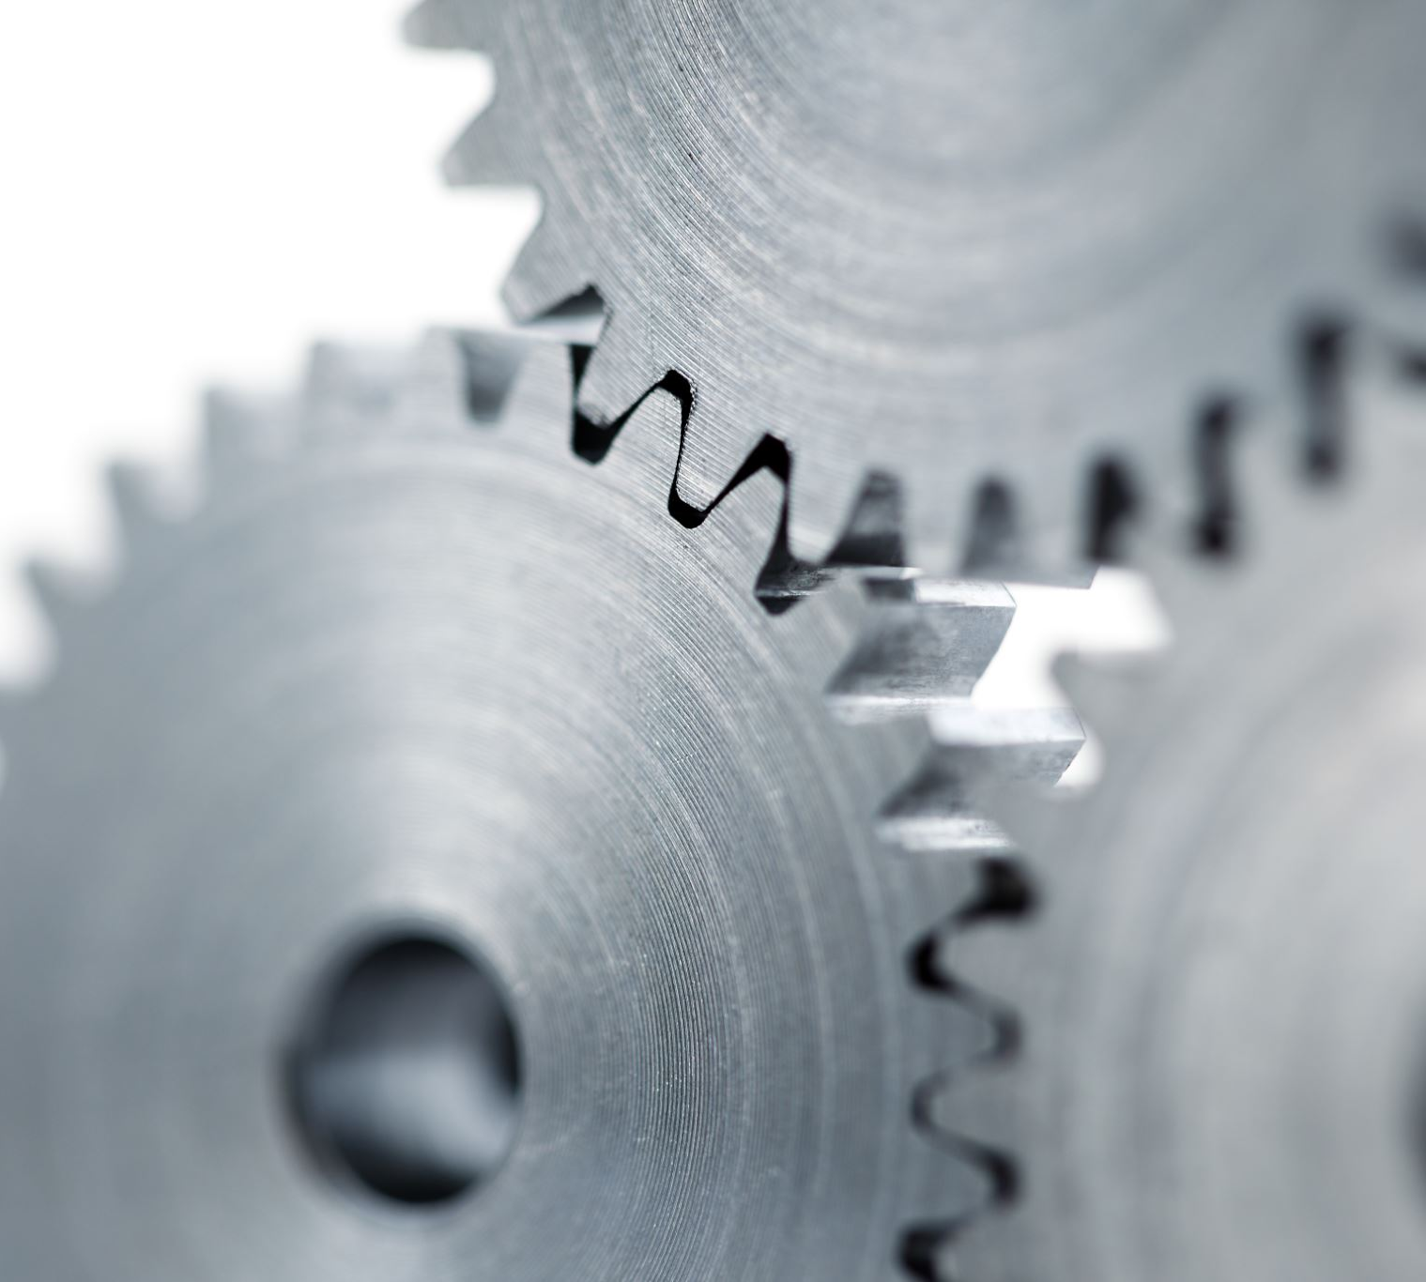
1. Functions of Motion Actuation Subsystem
Transmits spatial/environmental information from sensors/mechanical subsystems to Environment Sensing Subsystem.
Receives Autonomous Motion Subsystem Commands.
Translates Commands into specific Commands to its own mechanical subsystems, e.g., brakes, wheel directions, and wheel motors.
Receives Responses from its mechanical subsystems.
Sends Responses to Autonomous Motion Subsystem about execution of commands.
MPAI welcomes comments and proposals.

Slide 39
2. Reference Architecture of Motion Actuation Subsystem
Odometer Data
MAS Spatial Attitude Generation
Environment Sensing Subsystem (ESS)
Speedometer Data
Spatial
Attitude
Accelerometer Data
Other Environment Data
Wheel motor command
Autonomous Motion Subsystem
(AMS)
AMS Command Interpreter
AMS-MAS Command
Wheel direction command
Brake command
Wheel motor response
MAS Response Analyser
MAS-AMS Response
Wheel direction response
Brake response

Slide 40
3. I/O Data of Motion Actuation Subsystem
Input | Comments
Odometer | Provides distance data.
Speedometer | Provides instantaneous velocity.
Accelerometer | Provides instantaneous acceleration.
Other Environment data | Other environment data, e.g., humidity, pressure, temperat­ure.
AMS-MAS Command | High-level motion command.
Wheel Motor Response | Forces wheels rotation, gives feedback.
Wheel Direction Response | Moves wheels by an angle, gives feedback.
Brake Response | Acts on brakes, gives feedback.
Output | Comments
MAS-AMS Response | Feedback from Response Analyser during and after Command ex­ecution.
Spatial Attitude | Position-Orientation and their velocities and accelerations.
Other Environment data | Other environment data, e.g., humidity, pressure, temperat­ure.
Wheel Motor Command | Forces wheels rotation, gives feedback.
Wheel Direction Command | Moves wheels by an angle, gives feedback.
Brakes Command | Acts on brakes, gives feedback.

Slide 41
4. Functions of Motion Actuation Subsystem’s AIMs
AIM | Function
Spatial Attitude Generation | Computes Ego CAV’s Spatial Attitude using GNSS, odometer, speedometer, and accelerometer data.
AMS Command Interpreter | Receives, analyses, and actuates AMS-MAS Commands into commands to Brakes, Wheel directions, and Wheel motors.
MAS Response Analyser | Receives and analyses responses from Brakes, Wheel direction, and Wheel motor. Forwards MAS-AMS Response to AMS.
MPAI welcomes comments and proposals.

Slide 42
5. Input/Output Data of Subsystem’s AIM
CAV/AIM | Input | Output
AMS Command Interpreter | AMS-MAS Command | Brake Command Wheel Motor Command Wheel Direction Command
MAS Response Analyser | Brake Response Wheel Direction Response Wheel Motor Response | MAS-AMS Response
MAS Spatial Attitude Generation | Odometer Speedometer Accelerometer | Spatial Attitude
MPAI welcomes comments and proposals.

Slide 43
MPAI and the metaverse (M-Instance)
A set of Processes providing some/all of functions:
Senses data from U-Locations.
Processes the sensed data.
Produces one or more M-Environments populated by Objects.
Processes Objects from the M-Instance or potentially from other M-Instances.
Affects U- and/or M-Locations in ways that are:
Consistent with the goals set for the M-Instance.
Effected within the capabilities of the M-Instance.
Complying with the Rules set for the M-Instance.

Slide 44
M-Instance: A set of Processes that
Perform Actions on Items if they hold the Rights to do that (Item is M-Instance data with known format).
Request other Processes to perform Actions by sending a standard Request-Action Item.
Respond to a Request-Action Item with a Response-Action Item.
Communicate with Processes in other M-Instances through a Resolution Service.

Slide 45
A CAV-oriented metaverse use case/1
HCI_{A} (represent human in CAV_{A}‘s M-Instance)
Authenticates humans (e.g., recognises their voice).
Interprets the message (“I want go home”).
Sends corresponding command to AMS_{A} (represents human in CAV_{A}‘s M-Instance)
AMS_{A}
Gets a representation of the real world from ESS_{A} (understands where it is).
Asks Route Planner for Routes.
Sends selection of Routes to HCI_{A}.
HCI_{A}
Communicates Route choices to human (e.g., speech for AMS_{A}‘s response).
Interprets human’s final choice (e.g., recognises their voice).
Sends command to AMS_{A} (e.g., execute Route).
HCI
AMS

Slide 46
A CAV-oriented metaverse use case/2
AMS_{A}
AMS_{B}
AMS_{A}
Mutually authenticates AMS_{B} (nearby CAV).
Improves its real-world perception by watching AMS_{B}’s real world view.
Activates AMS_{A}’s Processes leading to sending a command to MAS_{A}.
AMS_{B}
Improves its real-world perception by watching AMS_{A}’s real world view.
Activates AMS_{B}’s Processes leading to sending a command to MAS_{B}.
HCI_{A}
Mutually authenticates HCI_{B}.
Watches CAV_{B}’s Full Environment Representation.
HCI_{A}
HCI_{B}

Slide 47
Framework Licence: MPAI-CAV Architecture

Slide 48
Preliminaries
Coverage
This Framework Licence applies to the MPAI Connected Autonomous Vehicle (MPAI-MMM) Architecture Technical Specification as it will be defined in document Nwxyz of Moving Picture, Audio and Data Coding by Artificial Intelligence (MPAI). All contributors to MPAI-CAV – Architecture shall confirm in writing their intention to make available a Licence for their Essential IPR based on the Conditions of use of the Licence in Section 3.
Definitions
Conforming Implementation, Data, Development Rights, Enterprise, Essential IPR, Framework Licence, General Availability, Implementation, Implementation Rights, Licence, Profile, Standard Essential IPR, Technical Specification, Trial

Slide 49
Conditions of use of the Licence/1
The Licence will be in compliance with generally accepted principles of competition law and the MPAI Statutes
The Licence will grant access to Essential IPRs of the MPAI-CAV – Architecture Technical Specification in a non-discriminatory fashion.
The Licence will cover:
All claims to Essential IPR and copyright of a Licensor that are practised by a Licensee of the MPAI-CAV – Architecture Technical Specification.
Development Rights and Implementation Rights.
The scope of the Licence may be subject to legal, bias, ethical and moral limitations.

Slide 50
Conditions of use of the Licence/2
Royalties will apply:
To a baseline CAV – Architecture profile and to other profiles containing additional technologies.
To any Implementation that is based on the MPAI-CAV Technical Specification, with the exclusion of the types of implementations specified in clause 7.1.
On a worldwide basis.
An MPAI-CAV – Architecture Implementation may use other IPR to extend the MPAI-CAV – Architecture Implementation or to provide additional functionalities.

Slide 51
Conditions of use of the Licence/3
Exemptions:
The Licence for Development and Implementation Rights, to the extent it is developed and implemented only for the purpose of evaluation or demo solutions or technical trials, will be free of charge.
The Licence may be granted free of charge for particular usages if licensors so decide.
A Licence free of charge for a limited time and a limited amount of forfeited royalties will be granted on request.
A preference will be expressed on the entity that should administer the patent pool of holders of Patents Essential to the MPAI-CAV – Architecture Technical Specification.

Slide 52
Conditions of use of the Licence/4
The Licence will be issued before commercial implementations of the MPAI-CAV – Architecture Technical Specification become available on the market. Commercial implementation implies General Availability to any users and does not include trials.
The total cost of the Licences issued by IPR holders will be in line with the total cost of the Licences for similar technologies standardised in the context of Standard Development Organisations.
The total cost of the Licences will take into account the value on the market of the Standard Essential IPR.

Slide 53
Next steps
MPAI publishes MPAI-CAV – Architecture CfP 12 July
MPAI presents MPAI-CAV – Architecture CfP 26 July
Respondents preregister (recommended) 31 July
Respondents submit responses 15 August
MPAI publishes MPAI-CAV – Architecture requesting comments 23 August
MPAI approves and publishes MPAI-CAV – Architecture 29 September

Slide 54
Conclusions
MPAI is requesting Technologies to develop a Technical Specification that:
Partitions CAV into subsystems.
Partitions SS into components.
Specifies SS function, I/F & topology.
Specifies component functions & I/F.
The MPAI-CAV specification benefits from key MPAI technologies such as:
Secure execution of AI workflows.
Metaverse Model.
The MPAI-CAV Architecture is the starting point for the next steps of the MPAI-CAV roadmap.
Next step: functional requirements of data exchanged.

Slide 55
Thank you for participating.
We look forward to working with you on this exciting MPAI project!
Join MPAI
Share the fun
Build the future
55
55
55
55

