Slide 1
Neural Network Watermarking
.
2023/12/12 T15:00UTC
http://nnw.mpai.community

Slide 2
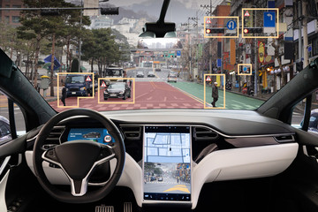
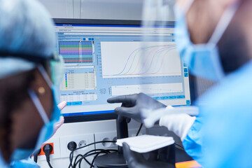
Neural Networks today
Deployed in an increasing variety of domains
Continuously renewed (industry & academia)
At the heart of various autonomous systems:
Autonomous robots
Unmanned vehicles
Deployed in more and more critical domains:
Medical decisions
Autonomous vehicles with passengers

Slide 3
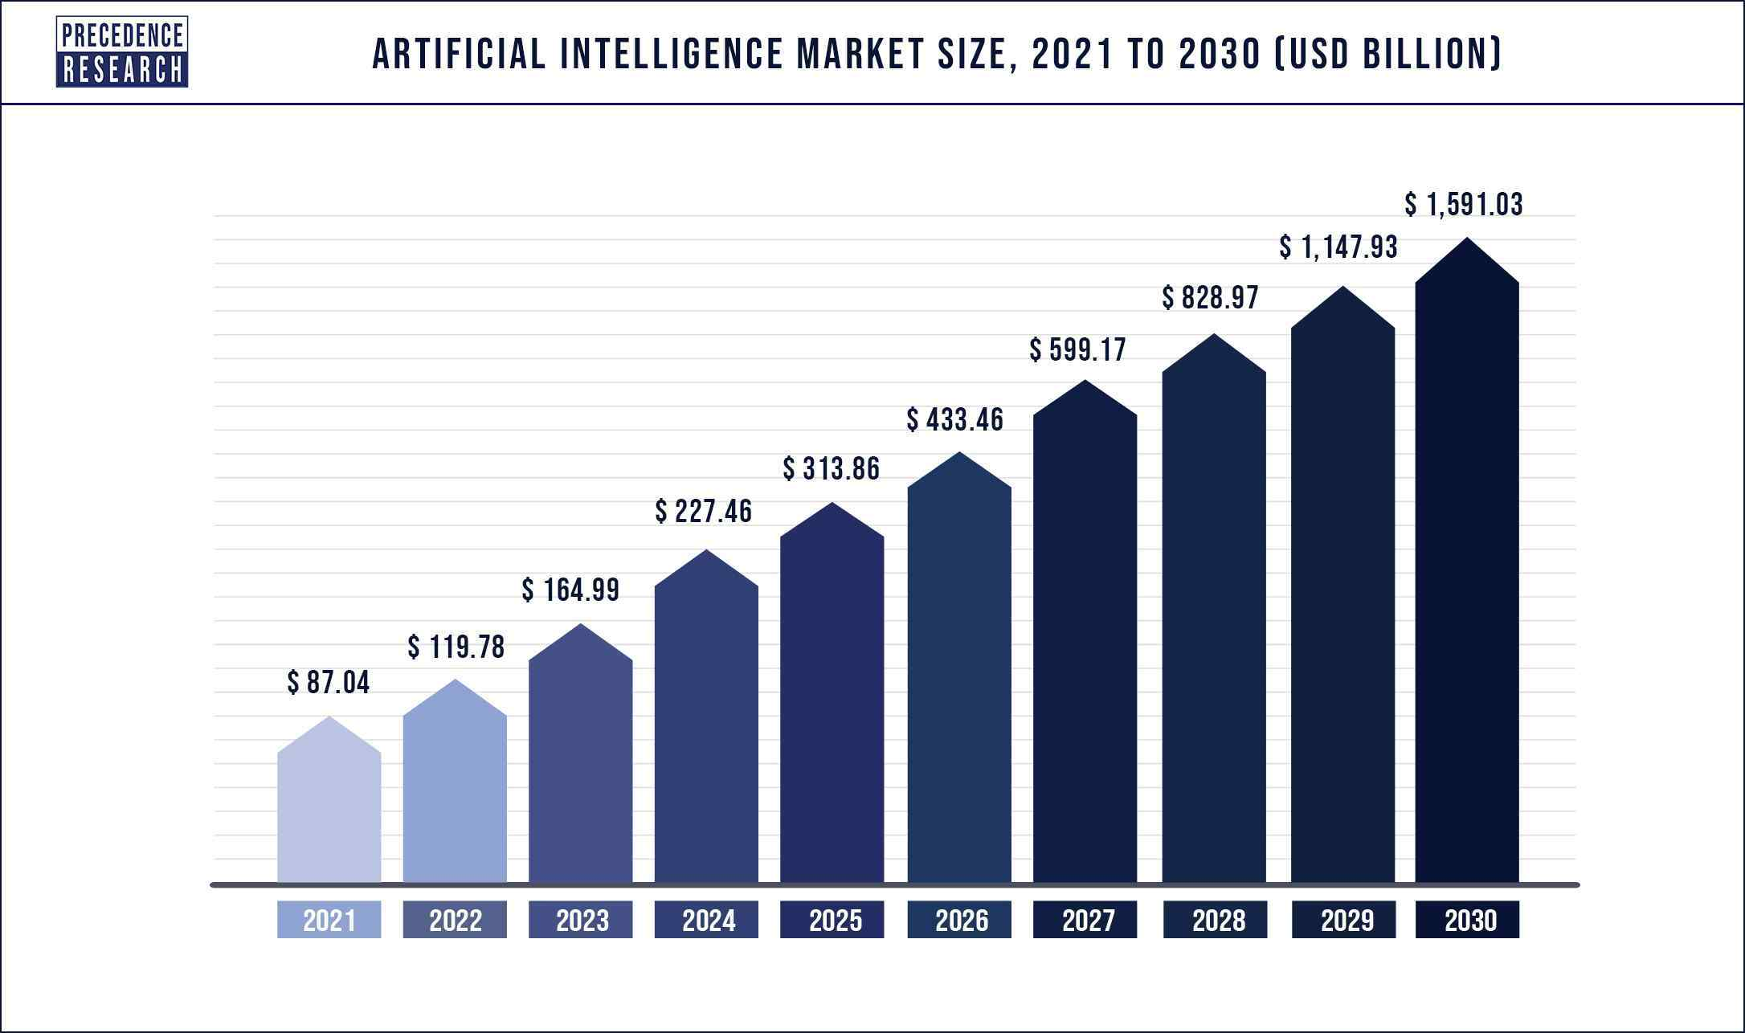
Why watermarking is useful for Neural Networks
Machine learning is a costly field:
Buying AI solution ranges from $ 6000 to $300.000
Renting a pre-built module costs around $ 40.000/year
An AI solution could:
use multiple alternative Neural Networks to provide an inference -> identifying the one that actually produced the inference is important
be shared among multiple users -> keeping track of this process is useful
be altered or maliciously attacked -> identifying such modifications avoid faulty functioning
Ensuring traceability and integrity of Neural Networks becomes mandatory

Slide 4
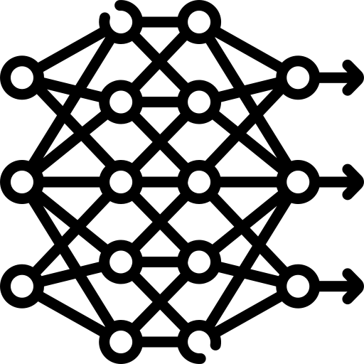
Neural Network Watermarking synopsis
Watermarking provides tools allowing to imperceptibly and persistently insert some data into original content
Watermarking Neural Network is a new challenge:
Watermark insertion is not static (as it was for media) but dynamic, as the watermark can also be:
inserted during training
detected from inference
Evaluation of watermark impact on inference is much more complex than on multimedia quality
Imperceptibility
Watermarking
Robustness
Data payload

Slide 5
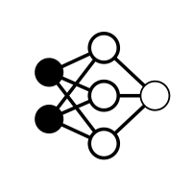
Neural Network Watermarking use cases
Identify an NN
The retrieved data conveys information about the NN itself.
Identify the actors of an NN
The retrieved data conveys information about some or all the actors.
Verify the integrity of an NN
The retrieved data conveys information about NN integrity.
NN - 007
input
output
Detector
MPAI
property
modification
Integrity
checker

Slide 6
Scope of the MPAI-NNW Standard
MPAI-NNW specifies methodologies to evaluate the following aspects of a neural network watermarking technology:
The impact on the performance of a watermarked neural network and/or on its inference.
How well a neural network watermarking detector/decoder can detect/decode a payload when the watermarked neural network has been modified.
The computational cost of injecting, detecting or decoding a payload in the watermarked neural network.
s
NNW - Evaluate performances of watermarking NN
Modification of performance induced by the watermarking process
0 1 0 0 0 1 1
injector
Processing cost of the insertion
injector
Trained NN
Watermarked NN
detector
detector
decoder
Yes
Performance criteria for the detector/decoder
decoder
MPAI Tester
detector
Watermark provider
No
decoder
0 1 0 0 0 1 1
Processing cost of the detection/decoding phase

Slide 7
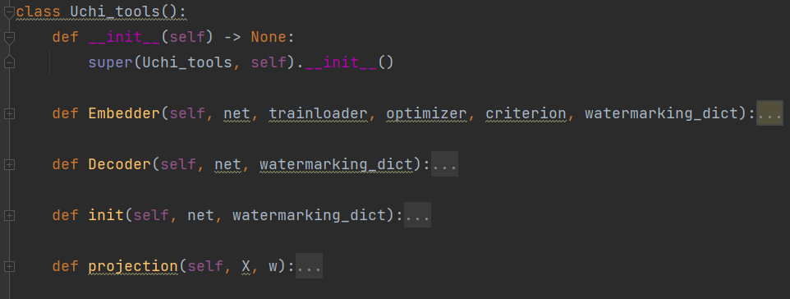
MPAI-NNW Reference software
The purposes of MPAI-NNW Reference software is
to provide an instance of MPAI-NNW Software for the image classification task
to upgrade conventional AI-based processing workflows with traceability and integrity checking functions
Two key software components
injector
decoder
Inputs
start
Property Evaluation
end
MPAI User

Slide 8
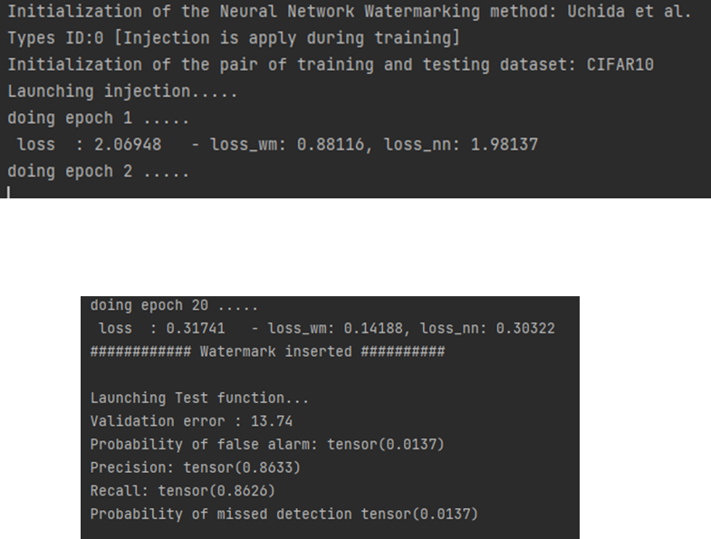
MPAI-NNW Reference software: Imperceptibility evaluation
0 1 0 0 0 1 1 1
injector
Trained NN
Watermarked NN
start
Injector “Uchida et al.” method
“0” type
“CIFAR 10” training dataset
Training dataset
Embedder
Testing dataset
Imperceptibility Evaluation
end
“CIFAR 10” testing dataset

Slide 9
MPAI-NNW Reference software: Robustness evaluation
Yes
detector
No
decoder
0 1 0 0 0 1 1 1
start
Decoder “Uchida et al.” method
“4” type
Quantizing
$B=[16,8,4]$
Modification ID
Parameters
Modifications
Test dataset
Detector/
Decoder
Robustness Evaluation
end

Slide 10
MPAI-NNW Reference software: Computational cost evaluation
Processing cost of the insertion
Processing cost of the detection/decoding phase
start
Memory_footprint
Time_module
end

Slide 11
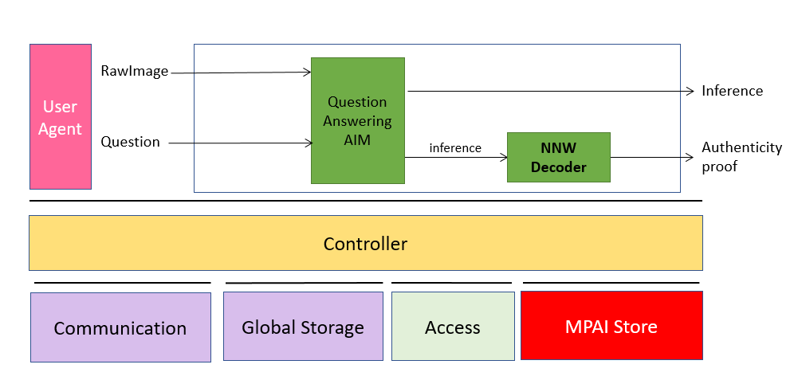
MPAI-NNW Reference software: Upgrading convention MPAI workflows with watermarking functionalities
What city is this?
Example: End-user use-case “Question Answering AIM”
Buy a “Question Answering” solution
Make sure about the authenticity of the inference produced by that AIM:
IPR protection
No counter fighting
No malicious (adversial) tempering
Watermarked NN
End-user
Certification of the AI solution

Slide 12
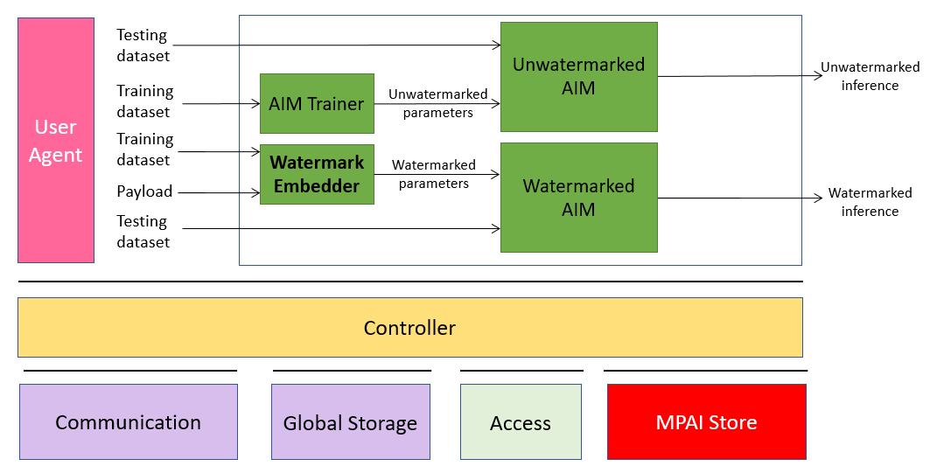
MPAI-NNW Reference software: Upgrading convention MPAI workflows with watermarking functionalities
Main novelty of MPAI-NNW RS v1.1
Python-based MPAI AIF implementation
AIMs represented as Python classes with attributes being the ports and a “run” function
Controller and User Agent built as server/client program
JSON AIM/AIW metadata parsed in fully automatized manner for standard topologies (written from top to bottom and left to right)
Hooks for C code are provided
Controller.py
Input.py
APIs.py
JSON & AIMs

Slide 13
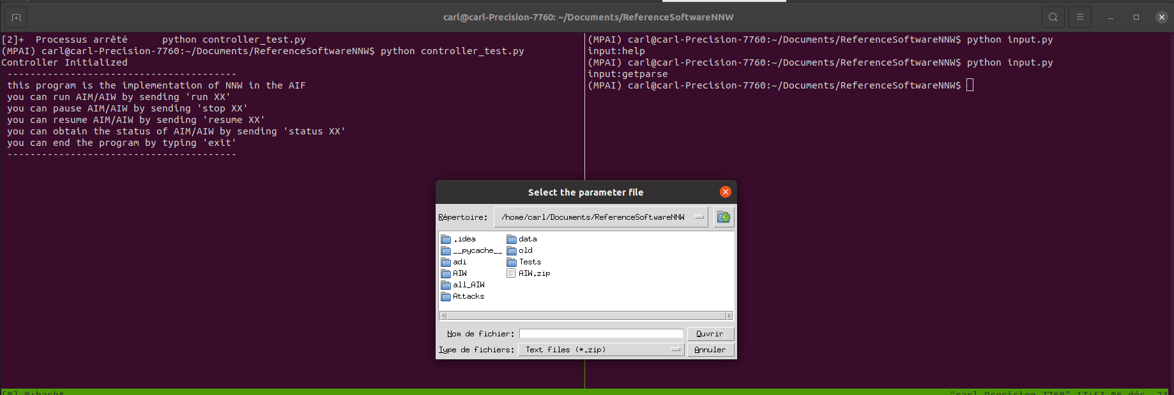
MPAI-NNW Reference software: Upgrading convention MPAI workflows with watermarking functionalities
Main novelty of MPAI-NNW RS v1.1
Python-based MPAI AIF implementation
AIMs represented as Python classes with attributes being the ports and a “run” function
Controller and User Agent built as server/client program
*getparse command asks for a .zip folder containing the AIMs and the JSON

Slide 14
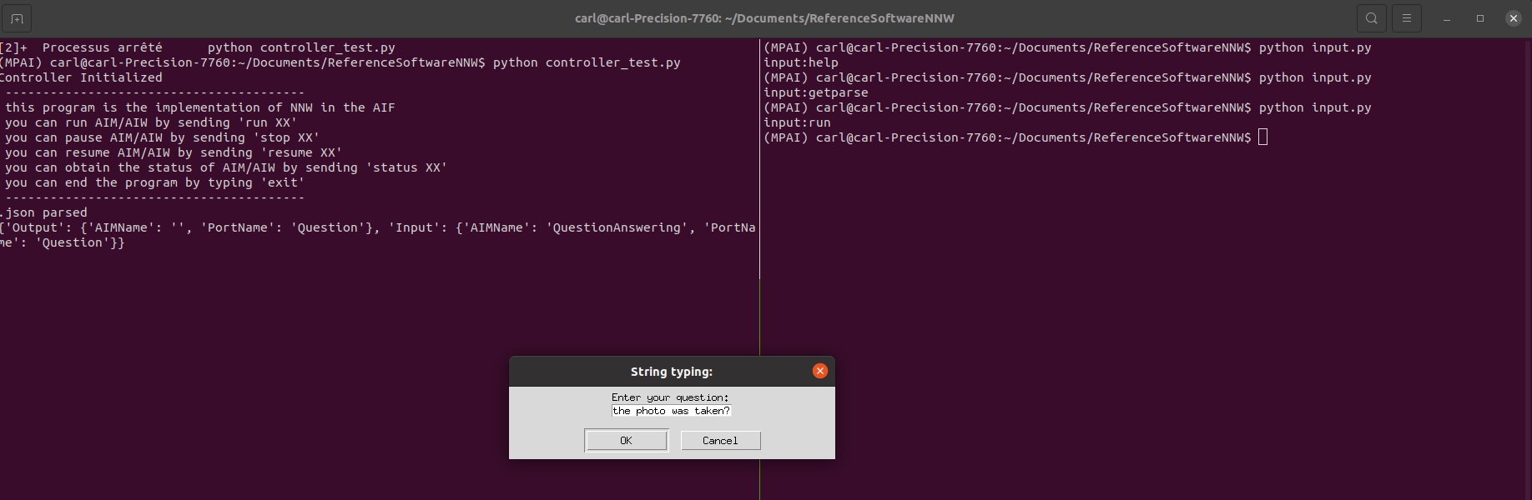
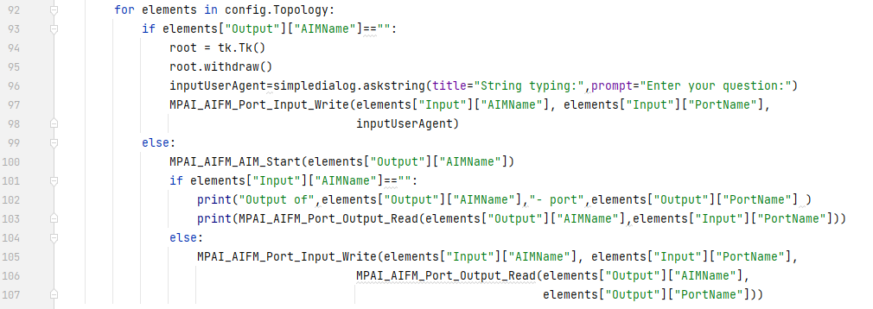
MPAI-NNW Reference software: Upgrading convention MPAI workflows with watermarking functionalities
Main novelty of MPAI-NNW RS v1.1
Python-based MPAI AIF implementation
AIMs represented as Python classes with attributes being the ports and a “run” function
Controller and User Agent built as server/client program
JSON AIM/AIW metadata parsed in fully automatized manner for standard topologies (written from top to bottom and left to right)

Slide 15
MPAI-NNW Reference software: Upgrading convention MPAI workflows with watermarking functionalities
Main novelty of MPAI-NNW RS v1.1
Python-based MPAI AIF implementation
Achieves inference authentication through NNW
Answer
Singapore
Authenticity proof:
True

Slide 16
Next steps
Develop a set of API to facilitate use of MPAI-NNW Reference Software
Apply the MPAI-NNW Reference Software for other MPAI use cases
The MPAI-NNW Standard is an IEEE Standard (3304)

Slide 17
https://www.mpai.community/
https://mpai.community/how-to-join/
http://nnw.mpai.community/
MPAI-NNW RS available at:
https://experts.mpai.community/software/mpai-nnw
Join MPAI
Share the fun
Build the future
17
17
17
17

Slide 18
Join MPAI
Share the fun,
Build the future!
https://mpai.community/how-to-join/
https://www.mpai.community/
more about NNW at http://nnw.mpai.community/

