Slide 1
AI-based Compression and Understanding of Industrial Data (MPAI-CUI) Company Performance Prediction use case
Online Conference Presentation
25 November 2021 - 15:00 UTC
.

Slide 2
Agenda
Introduction to MPAI
The MPAI CUI standard
Applications of the MPAI-CUI standard
Demo of MPAI-CUI for a set of anonymous companies
Questions and Answers
Notes:
Introduction to MPAI: 5’
The MPAI CUI standard: 5’
Applications of the MPAI-CUI standard: 5’
Demo of MPAI-CUI for a set of anonymous companies: 10’
Questions and Answers: 15’

Slide 3
Work based on 4 pillars
Moving Picture, Audio and Data Coding by Artificial intelligence
International, unaffiliated, not-for-profit organisation developing AI-centred data coding standards
Data coding: transformation of data from a format into another more suitable to an application
# | Pillar
1 | Develop standards based on a rigorous process
2 | Execute aggregated AI modules (AIM) in a standard AI Framework (AIF)
3 | Set IPR Guidelines before a developing a standard
4 | Check implementations an MPAI standard for conformance and performance

Slide 4
Rigorous standards development process
All
Principal Members
Stage 0
Stage 1
Stage 2
Stage 3
Use Cases
Proposal
Interest
Collection
Functional
Requirements
Commercial
Requirements
Standard
MPAI
Standard
Community
Comments
Standard
Development
Call for
Technologies
Stage 7
Stage 6
Stage 5
Stage 4
Principal Members
All
All Members

Slide 5
MPAI-AIF: AI Framework
AI Workflow (AIW)
User Agent
User Agent
AI Module (AIM)
AI modules (AIM)
AI Module AIM
Inputs
Outputs
Video analysis
Emotion
Internal
Storage
AI Module AIM
AI Module AIM
Meaning
Controller
Access
Communication
Global Storage
Access
MPAI Store
AI Framework (AIF)

Slide 6
High-quality and timely available standards
Before initiating a standard, Active Members develop & adopt the Framework Licence (FWL) without values: $, %, dates etc.
During the development, any Member making a contribution declares it will make its licences timely available according to the FWL.
After the development, Members holding IP in the standard select preferred patent pool administrator.

Slide 7
If we want Good education for humans we should want Good training for AI
AI will impact humans more and more.
MPAI standards are not enough to guarantee users.
MPAI-appointed Assessors assess 4 Performance features of an implementation: Reliability, Robustness, Fairness and Replicability.
Users can make informed decisions about which MPAI implementation they should use.

Slide 8
2. The MPAI-CUI standard
Prof. Guido Perboli
Politecnico di Torino – Arisk srl

Slide 9
The «AI-based Compression and Understanding of Industrial Data» standard Company Performance Prediction use case
Powerful and extensible way to predict the performance of a company
Financial risks
Vertical risks (i.e., seismic and cyber)
Predicts the performance of a company, from its governance, financial and risks data in a given time horizon of prediction.
First standard released by MPAI
Notes:
Processo che ha portato allo std: UC-FR-FWL-CfT-CC-Std
I moduli, la loro funzione, in part. Prediction, significato del training e dell’affidabilità dei dati di input
What comes next (altri rischi)
Applications of CUI-CPP
Banca, assicurazione, ente pubblico

Slide 10
What does “performance” mean?
Default probability: the probability of the company default (e.g., crisis, bankruptcy) in a specified number of future months dependent on financial features
Organisational Model Index: the adequacy of the organisational model (e.g., board of directors, shareholders, familiarity, conflicts of interest)
Business continuity Index: the probability of an interruption of the operations of the company for a period of time less than 2% of the prediction horizon.

Slide 11
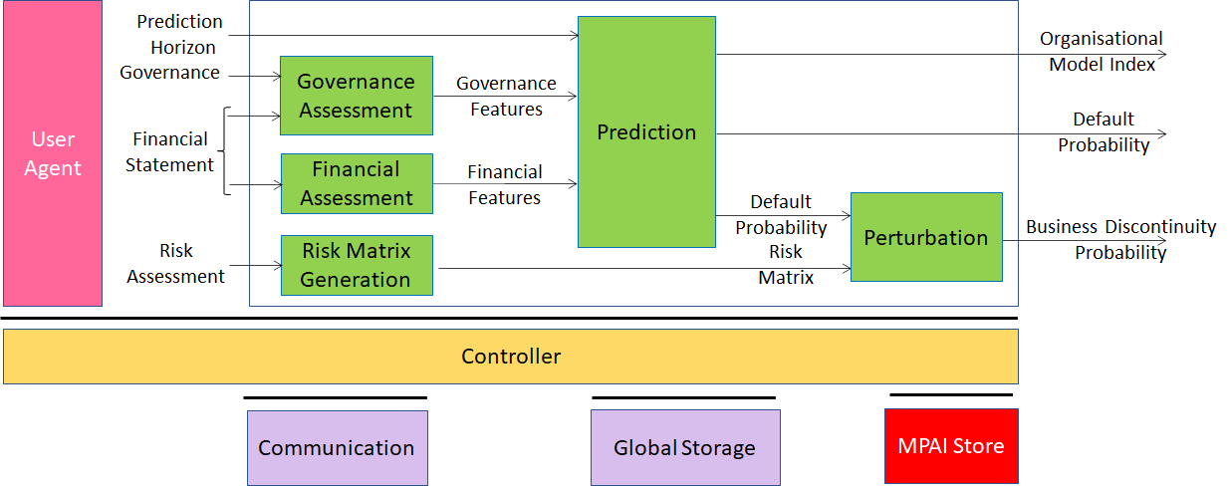
Workflow

Slide 12
Workflow
User defines a Prediction Horizon and feeds Governance, Financial Statement and Risk Assessment data.
Governance Assessment produces Governance Features by processing Governance and Finan­cial data.
Financial Assessment produces Financial Features by processing Financial Stat­ement data.
Risk Matrix Generation produces the Risk Matrix by processing Risk Assessment data.
Prediction produces Organisational Model Index and Default Probability by processing Governance Features and Financial Features.
Perturbation produces Business Discontinuity Probability by processing Default Probability and Risk Matrix.

Slide 13
AI-based standard
Prediction AIM is a neural network that has been trained with a large amount of company data of the same type as those used by the implementation
Back testing on a sample of 160.000 companies active and bankrupted
Accuracy 85% compared to 37% of the traditional techniques
Approved by the scientific community
See further details in G. Perboli and E. Arabnezhad. A Machine Learning-based DSS for mid and long-term company crisis prediction. Expert Systems with Applications, 174, 114758, 2021

Slide 14
AI-based standard
Novelties of MPAI-CUI
Ability to analyse through AI, the sheer amount of data required by regulation, with a controlled loss of information and extract the most relevant one
Allows extending the time horizon of prediction up to 60 months, using AI.

Slide 15
Standard development process
What next?
Future versions or other use cases that will comprise other vertical risks (e.g., Environmental, Social) not included in the present version of the standard and for which AI-based solutions are under development.

Slide 16
3. Applications of the MPAI- CUI standard
Prof. Guido Perboli
Politecnico di Torino – Arisk srl

Slide 17
How MPAI-CUI is going to be used?
Company boards: in deploying efficient strategies and identifying possible clues to the crisis or risk of bankruptcy years in advance. It may help the board of directors and decision-makers to make recovery decisions, conduct what-if analysis, and devise efficient strategies.
Banks and financial institutions: to assess the financial health of companies that apply for funds/financial help. This aids the financial institution to take the right decision in funding or not that company, having a broad vision of its situation.

Slide 18
How MPAI-CUI is going to be used?
Public authorities: to assess public policies in advance and scenarios of public interventions, as well as identify proactive actions to increase resiliency of countries.
Society: consumers are guided into selecting state of the art and reliable application using the results of Performance Assessors who competitively rate AIMs from different implementers using Performance Assessment.

Slide 19
A real application: the case study in the Piedmont region of Italy
329 companies in Piedmont that applied for Tranched Cover funding (i.e., Investment in production and infrastructures, Working capital requirements, liquidity stocks, and corporate capitalization; Financial recovery)
Initiative to support the competitiveness and employment, as well as access to finance of SMEs
See further details in G. Perboli et al. Using machine learning to assess public policies: a real case study for supporting SMEs development in Italy. TEMSCON 2021

Slide 20
A real application: the case study in the Piedmont region of Italy
Forward-looking predictive analysis according to investigate the effects of the financial engineering instruments in supporting the financial health of the beneficiary SMEs in Piedmont
Ex-ante (2015) and ex-post (2019) evaluation of the socio-economic impact of regional policies, using artificial intelligence
Need of the Regional Council of Piedmont for a strategic tool
Supporting decision makers in assessing company performance and predict in advance the risk of bankruptcy
Favor an efficient allocation of public financial resources

Slide 21
4. Demo of MPAI-CUI for a set of anonymous companies

Slide 22
5. Questions & Answers
?

Slide 23
Thank you for joining

Slide 24
Support slides

Slide 25
The 4 Performance attributes
Fairness: extent of applicability of Implementation can be assessed by making the training set and/or network open to testing for bias and unanticipated results.
Reliability: Implementation that performs as specified by the Application Standard, profile and version the Implementation refers to, e.g., within the application scope, stated limitations, and for the period of time specified by the Implementer.
Replicability: Implementation whose Performance, as Assessed by a Performance Assessor, can be replicated, within an agreed level, by another Performance Assessor.
Robustness: Implementation that copes with data outside of the stated application scope with an estimated degree of confidence.

