Slide 1
Connected Autonomous Vehicle (MPAI-CAV)
Leonardo Chiariglione, MPAI
15:00 UTC 13 March 2024

Slide 2
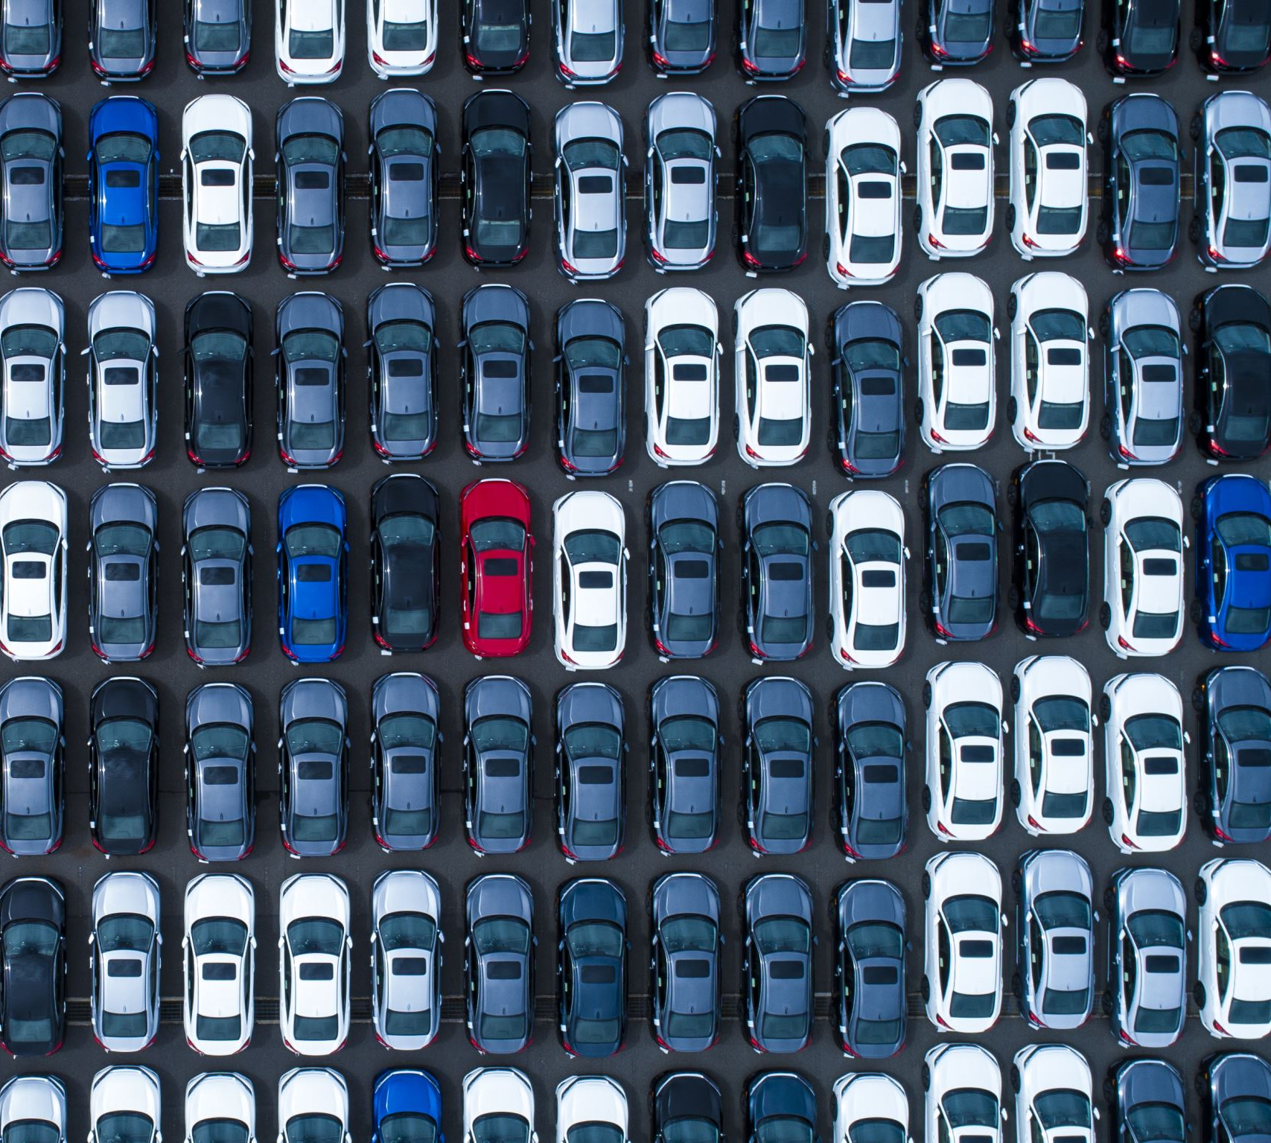
Connected Autonomous Vehicles (MPAI-CAV)
Many benefits from CAVs:
Machine errors rate can be lower than human error rate.
More time to humans for rewarding activities.
More efficient use of vehicles, infrastructure
Better traffic management.
Reduced congestion and pollution.
Better life for elderly and disabled people.

Slide 3
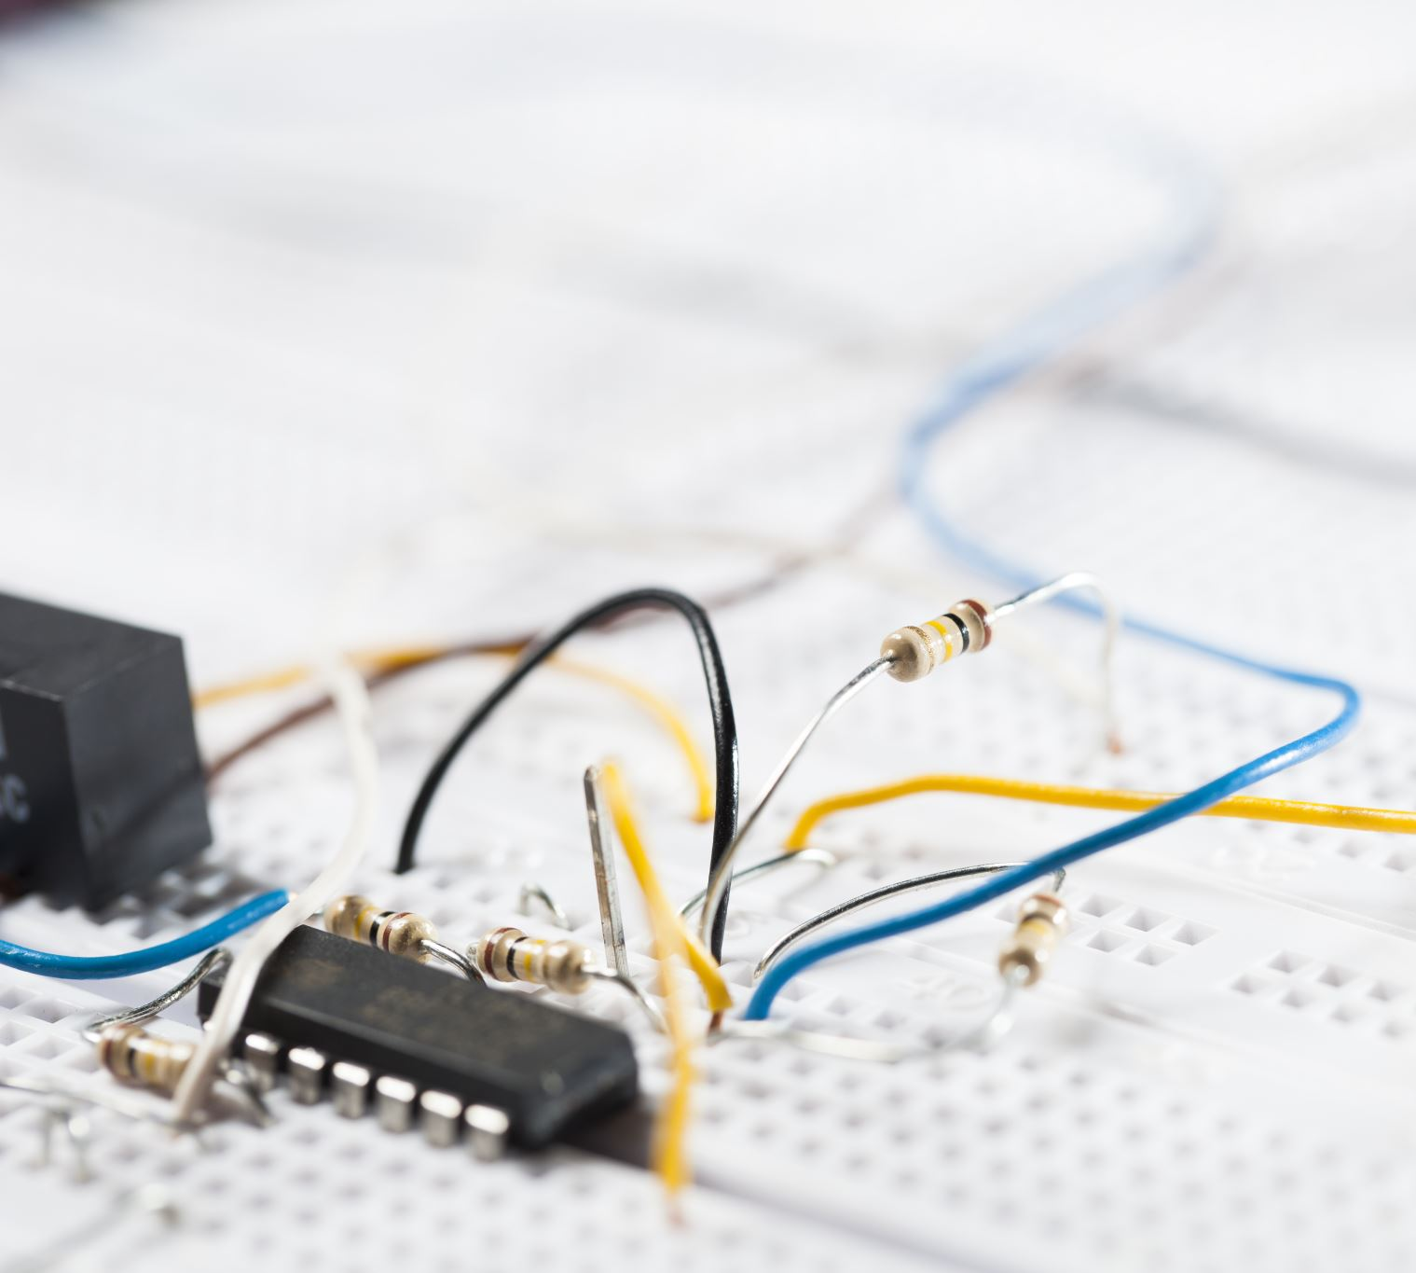
The MPAI-CAV Strategy
Step 1
Specify:
A CAV Reference Model broken down into Subsystems.
The Functions of each Subsystem.
The data exchanged between
Subsystem ↔ Subsystem
Subsystem ↔ human.

Slide 4
The MPAI-CAV Strategy
Step 2
Break down Subsystems in Components.
For each Component, specify:
The Functions of the Component.
The Data exchanged between Components.
The Topology of Components and Connections.

Slide 5
The MPAI-CAV Strategy
Step 3
For each Component, specify:
The Functional Requirements of the Data exchanged.
The Technologies implied by the Data.

Slide 6
Iterate using the CAV Reference Model
Research can:
Concentrate on single Components.
Optimise their operation keeping the interfaces’ Functional Requirements.
Industry can promote the definition of Data Formats when:
Research results are mature.
A Component is needed.
Users can explain how the machine works.

Slide 7
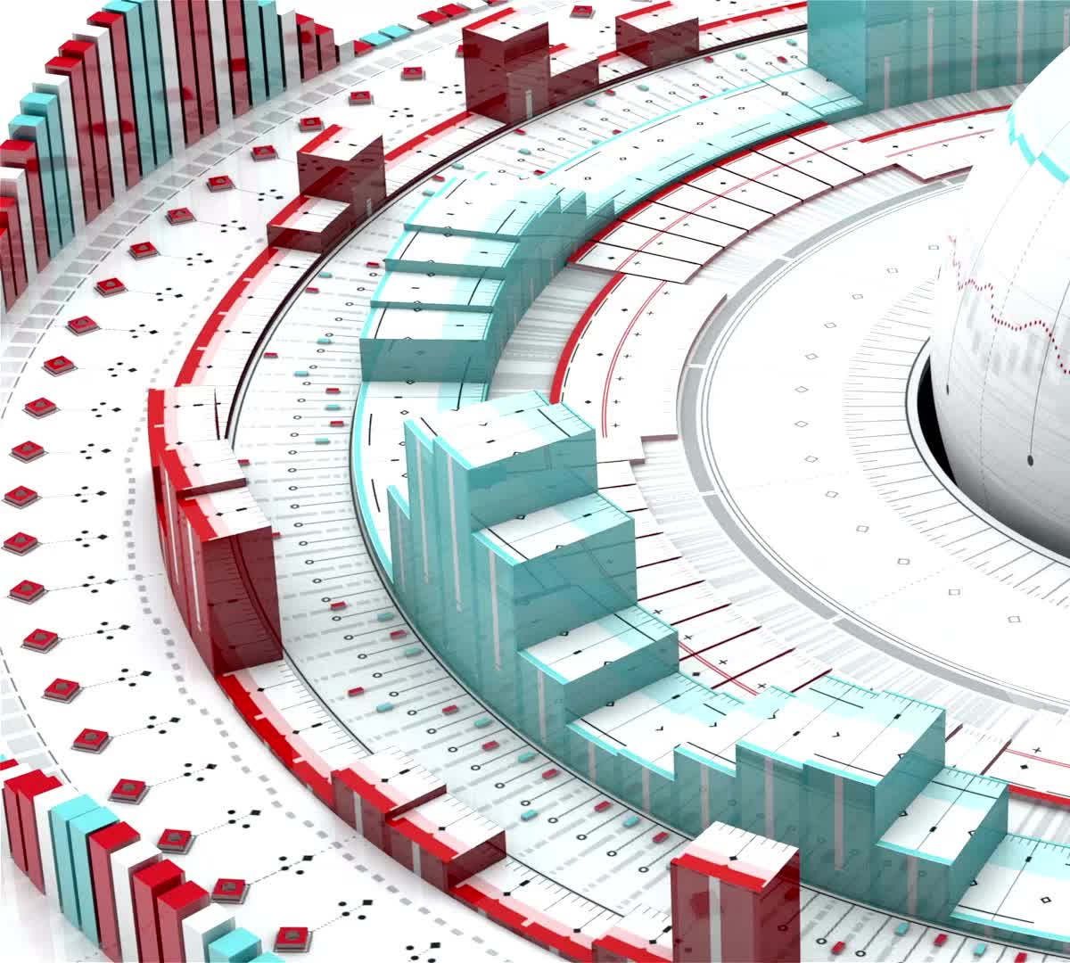
Benefits of an MPAI-CAV standard
Accelerate creation of a high-tech market (as in MPEG) because standards can:
Foster higher quality vehicles.
Lower the prices of vehicles.
Enable explanation of system operation.
Assuage consumer concerns.
Provide tools for regulation by including:
Conformance Testing.
Performance Assessment.

Slide 8
Benefits of Reference Model to market
Component manufacturers can:
Develop optimised solutions based on publicly available specifications.
Put their standard AIM components to a marketplace.
Car manufacturers can:
Access a global component market:
Based on standard functions and interfaces.
Tested for conformance using standard procedures.
Regulators can communicate with market development and provide guidance.

Slide 9
Players in the CAV domain
Research
Component Manufacturing
Vehicle Manufacturing
Service Providers
End Users
Standardisation
Regulation

Slide 10
Scope of Connected Autonomous Vehicle (MPAI-CAV) – Architecture
Technical Specification: Connected Autonomous Vehicle (MPAI-CAV) – Architecture V1.0 (in the following also called MPAI-CAV – Architecture) specifies the Architecture of a Connected Autonomous Vehicle (CAV) based on a Reference Model comprising:
A CAV broken down into Subsystems for each of which Functions, Input/output Data, and Topology of Components are specified
Each Subsystem broken down into Components of which Functions and Input/output Data are specified.
Each Subsystem is implemented as an AI Workflow (AIW) and Components implemented as AI Modules (AIM) executed in an AI Framework (AIF) as specified by the AI Framework (MPAI-AIF) Technical Specification.

Slide 11
Define a CAV
A system that:
Interacts with a human and understands the utterances setting the mission (e.g., take me to lunch).
Plans a Route (e.g., from here to there).
Senses and represents the external Environment (the space around the CAV).
Exchanges Environment representations with other CAVs and CAV-aware entities.
Decides how to execute the steps of the Route.
Implements decisions by issuing commands to actuate the motion decisions.

Slide 12
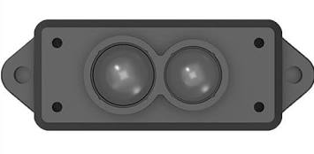
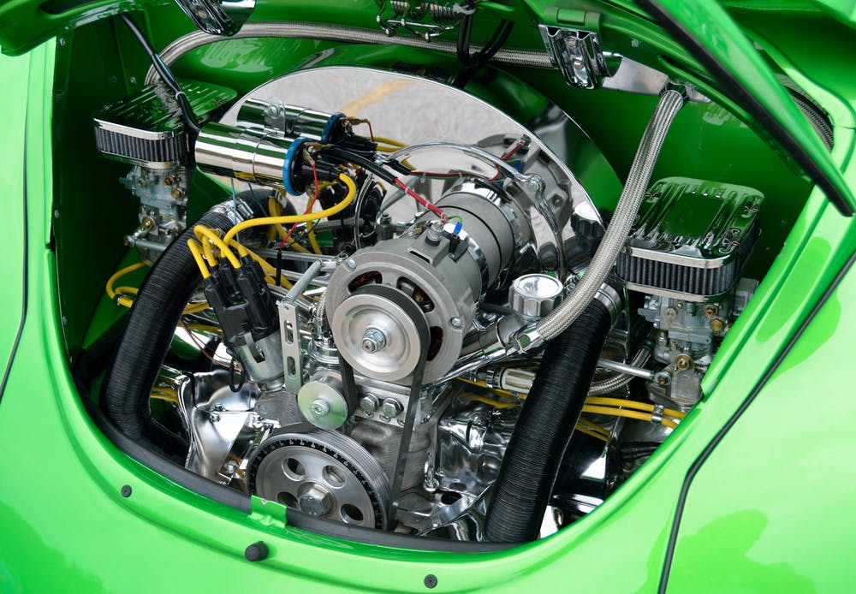
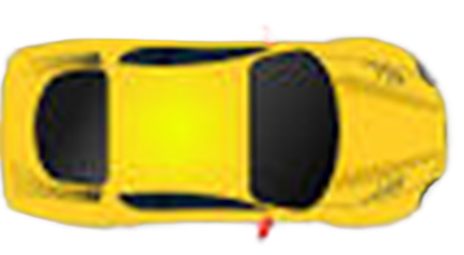
Reference model of Connected Autonomous Vehicle
Environment Sensing Subsystem
(ESS)
Motion Actuation Subsystem
(MAS)
Autonomous Motion Subsystem (AMS)
Human-CAV Interaction
(HCI)

Slide 13
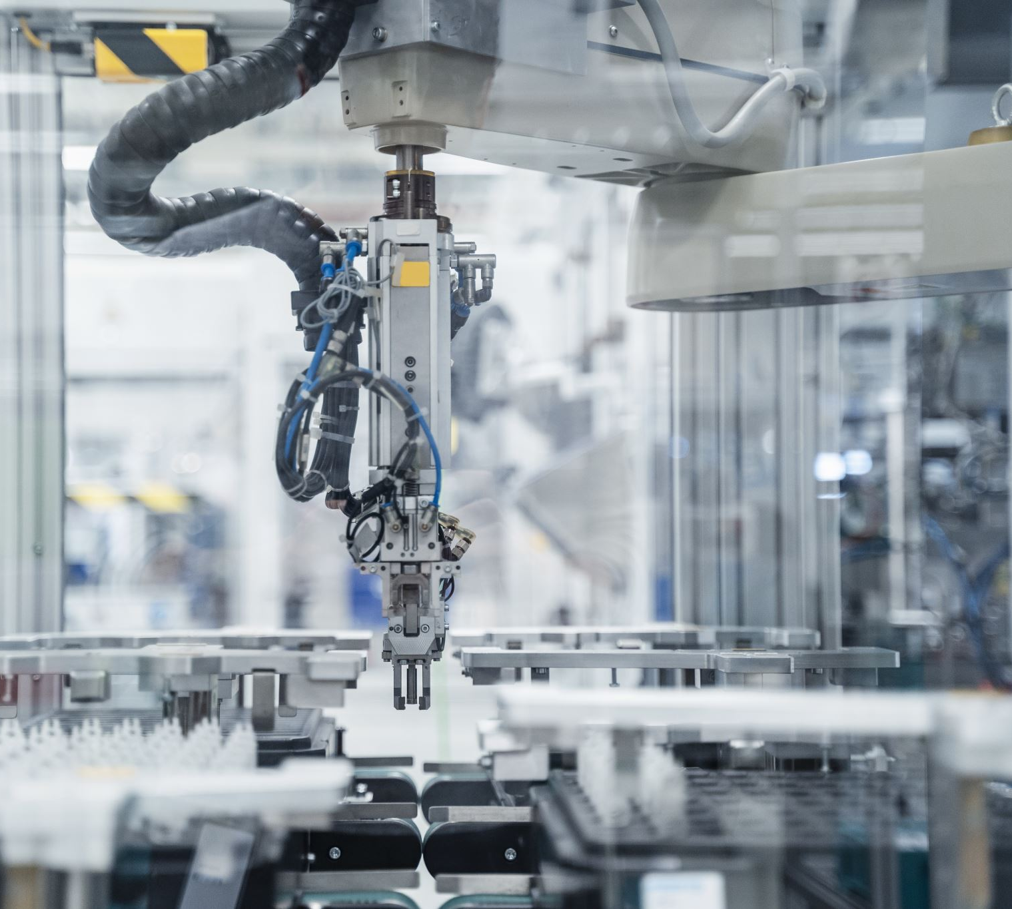
Disclaimer
MPAI
MPAI
At this stage, does not include the CAV’s mechanical parts of the Connected Autonomous Vehicle – Architecture standard.
Only references the interfaces of the Motion Actuation Subsystem interacting with such mechanical parts.

Slide 14
Terms and definitions
Use Cases and Functional Requirements collects > 100 terms and definitions.
Here we will use a few Acronyms:
HCI
ESS
AMS
MAS
EST
BER
FER
Human-CAV Interaction (Subsystem)
Environment Sensing Subsystem
Autonomous Motion Subsystem
Motion Actuation Subsystem
Environment Sensing Technology
Basic Environment Representation
Full Environment Representation

Slide 15
Elements of MPAI-CAV - Architecture
For each Subsystem
The functions.
The reference architecture.
The input and output data.
The topology of the Components.
For each Component:
The functions
The reference architecture.
The input and output data.
Components can be merged if the external interfaces of the merged Components are preserved

Slide 16
Table of Contents of MPAI-CAV – Architecture
Introduction
Scope
Definitions
References
Reference Model
Human-CAV Interaction
Environment Sensing Subsystem
Autonomous Motion Subsystem
Motion Actuation Subsystem
CAV-to-Everything

Slide 17
1. Functions of Human-CAV Interaction
Authenticates humans, e.g., to let them into the CAV.
Converses with humans interpreting utterances based on humans’ Personal Statuses, e.g., to go to a destination, or during a conversation.
Converses with the Autonomous Motion Subsystem to implement human conversation and execute commands.
Enables passengers to navigate the Full Environment Representation.
Appears as a speaking avatar showing a Personal Status dependent on:
The content of the conversation.
The information it is aware of.
The Personal Status of the human it converses with..

Slide 18
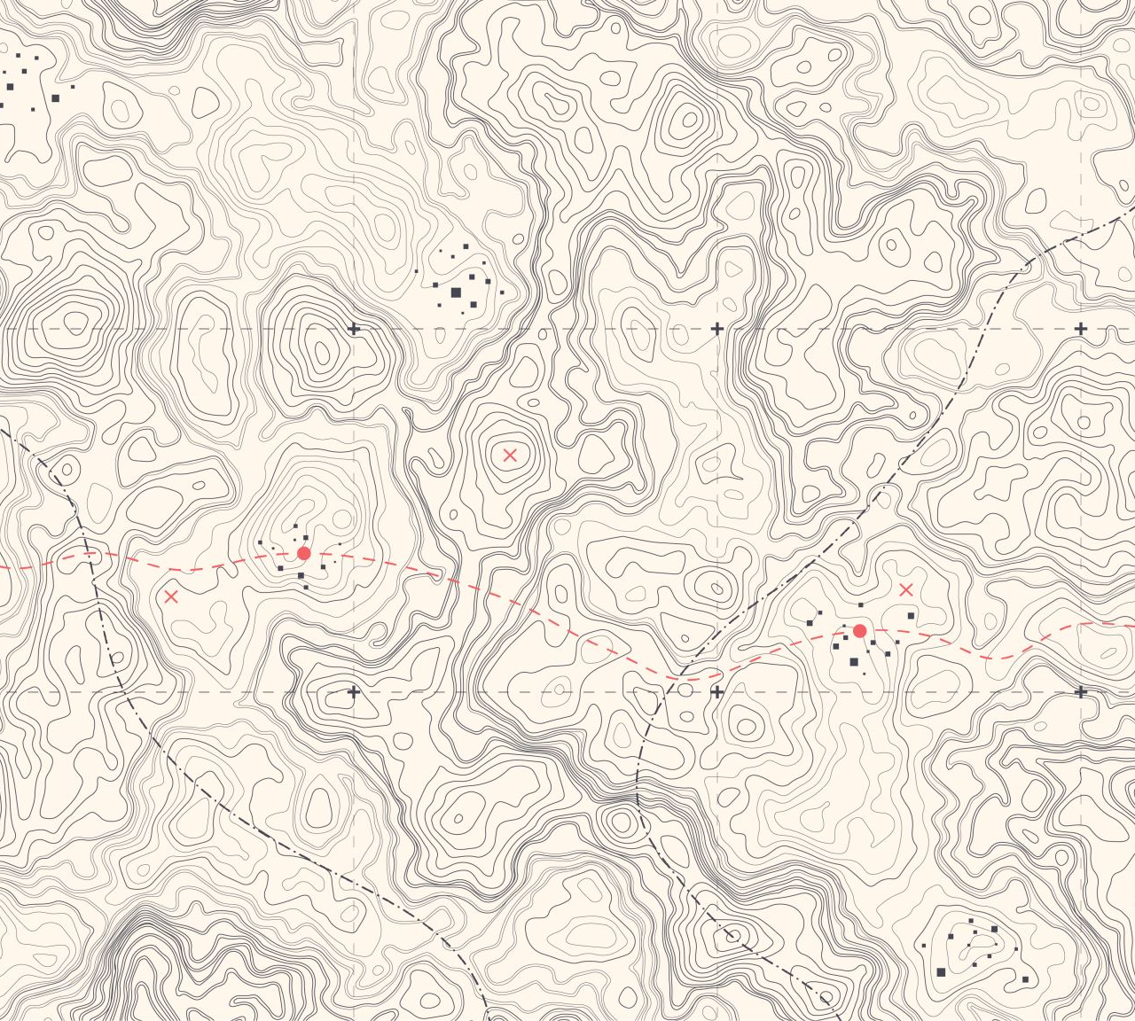
1. Functions of Environment Sensing Subsystem
Acquires Environment information using Subsystem’s RADAR, LiDAR, Cameras, Ultrasound, Offline Map, Audio, GNSS,…
Receives Ego CAV’s Spatial Attitude and Environment Data (temperature, humidity, etc.) from Motion Actuation Subsystem.
Produces Environment Sensing Technology Scene Descriptors in a common format
Produces the Basic Environment Representation by integrating Scene Descriptors during the travel.
Passes the BERs, including Alerts, to the Autonomous Motion Subsystem.

Slide 19
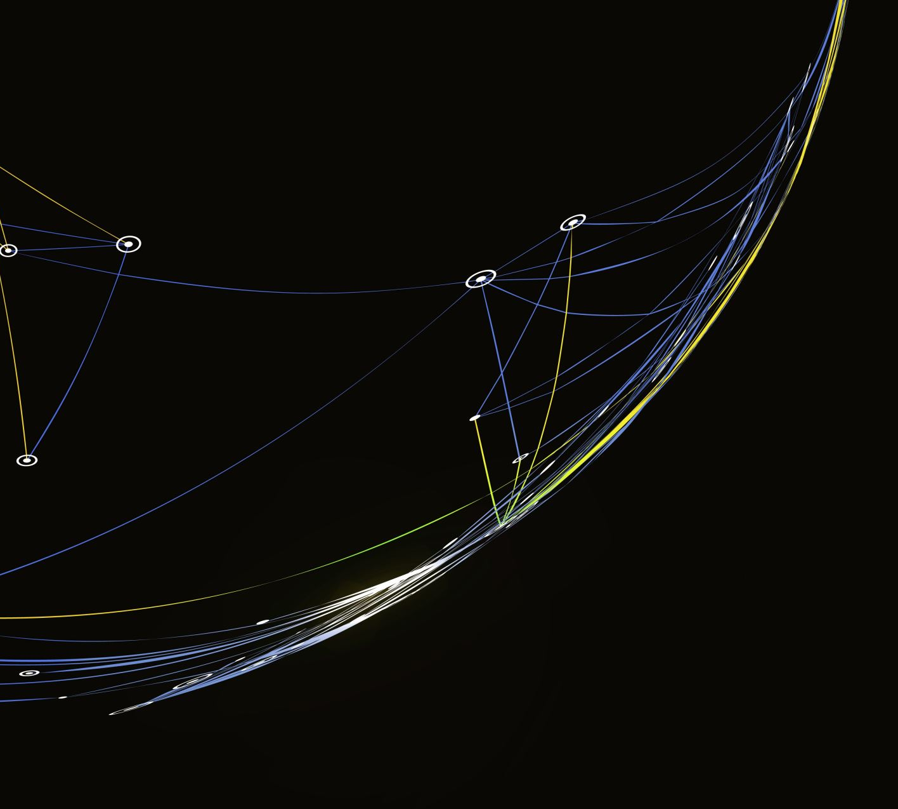
1. Functions of Autonomous Motion Subsystem
Computes human-requested Route(s).
Receives current BER from Environment Sensing Subsystem.
Communicates with other CAVs’ AMSs (e.g., exchanges subsets of BER and other data).
Produces Full Environment Representation by fusing its own BER with info from other CAVs in range.
Sends Commands to Motion Actuation Subsystem to take the CAV to the next Pose.
Receives and analyses responses from MAS.

Slide 20
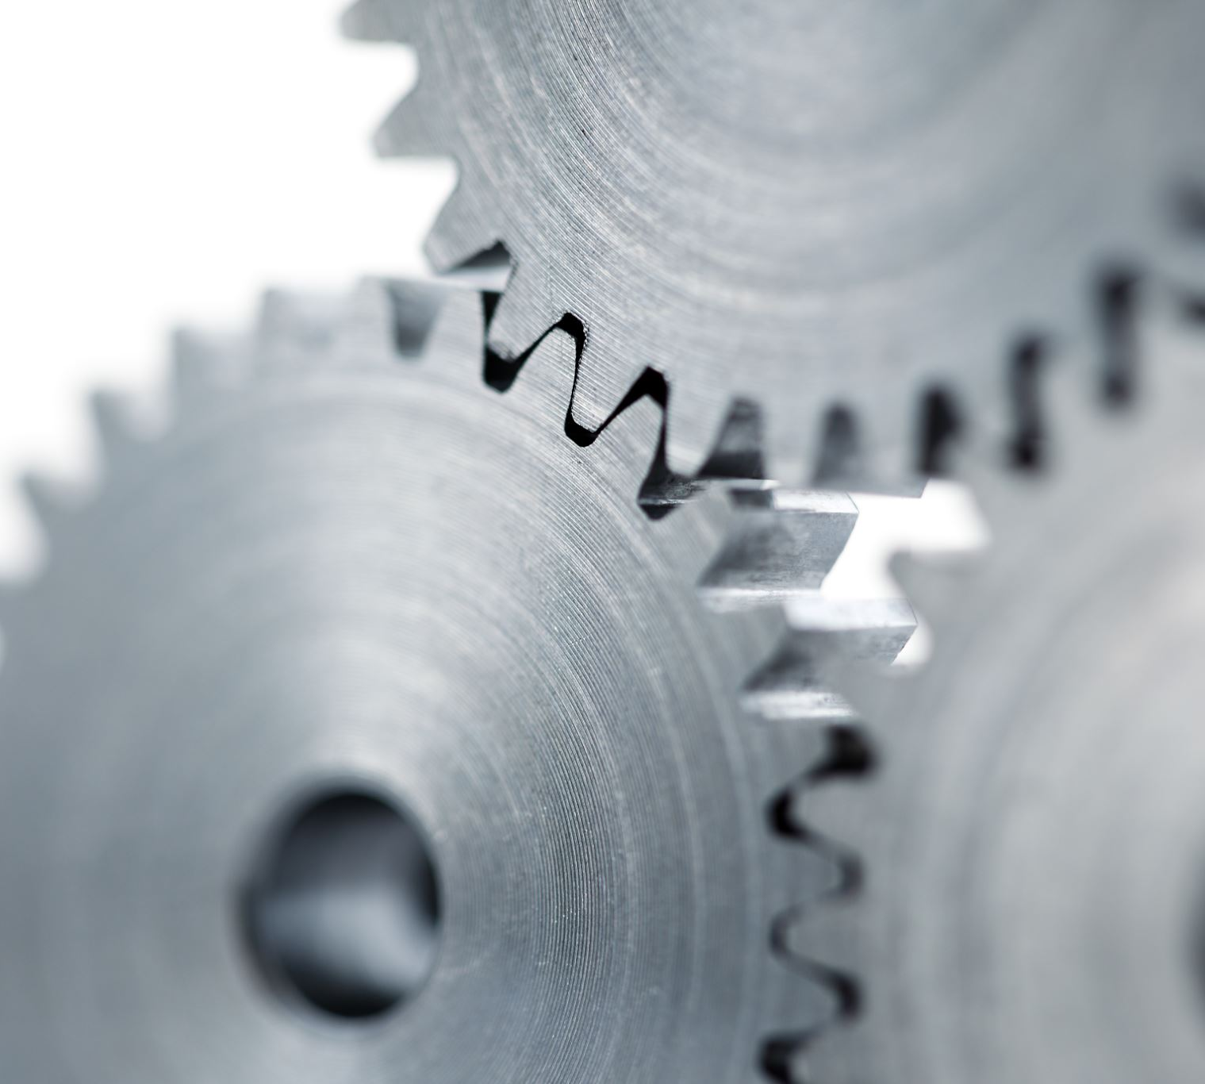
1. Functions of Motion Actuation Subsystem
Transmits spatial/environmental information from sensors/mechanical subsystems to Environment Sensing Subsystem.
Receives Autonomous Motion Subsystem Commands.
Translates Commands into specific Commands to its own mechanical subsystems, e.g., brakes, wheel directions, and wheel motors.
Receives Responses from its mechanical subsystems.
Sends Responses to Autonomous Motion Subsystem about execution of commands.

Slide 21
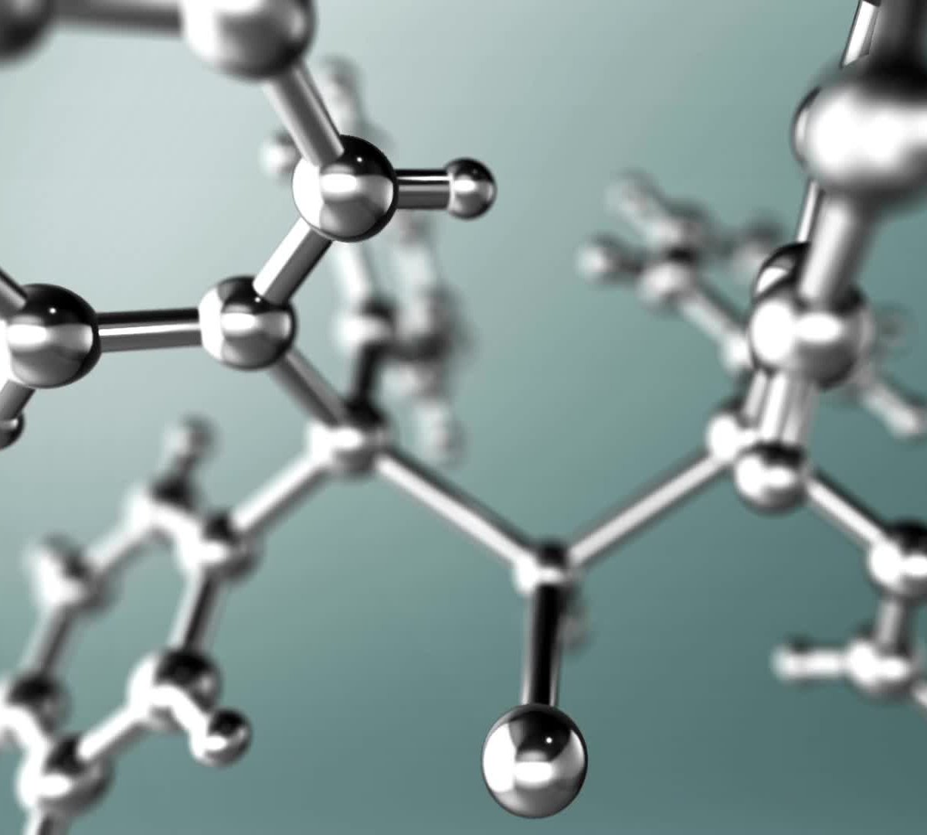
MPAI and the metaverse
Metaverse is an ICT platform composed of Processes performing some/all of the functions:
Sense data from U-Locations.
Process the sensed data.
Produce M-Environments populated by Objects.
Process Objects in this or other M-Instances.
Affect U- and/or M-Locations in ways:
Consistent with the goals set for the M-Instance.
Effected within the capabilities of the M-Instance.
Complying with the Rules set for the M-Instance.

Slide 22
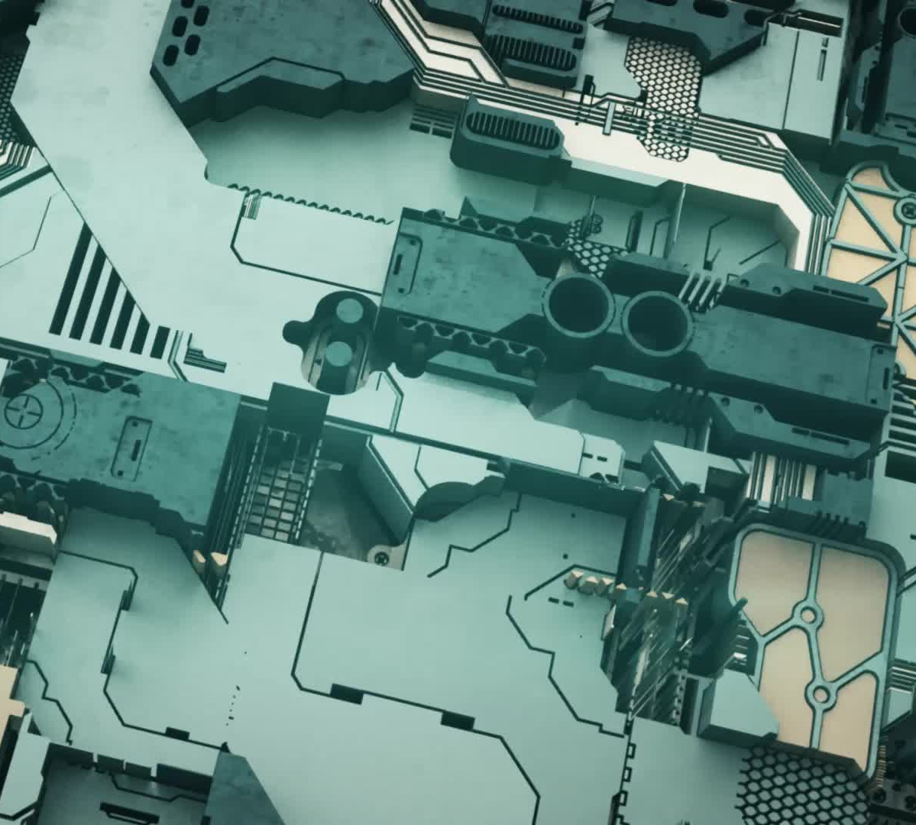
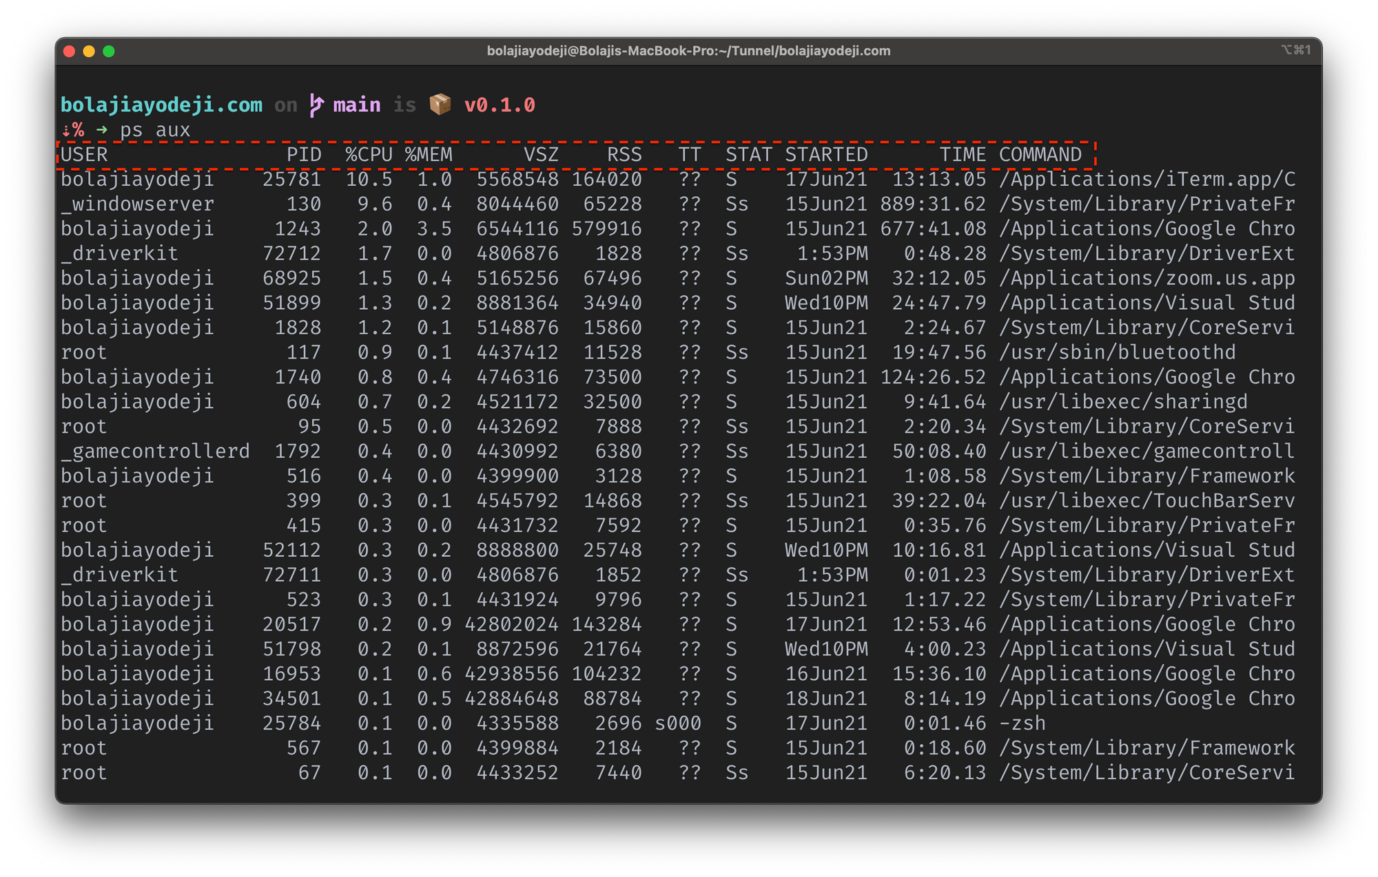
The MPAI Metaverse Model (MPAI-MMM)
Processes – Users, Devices, Apps, Services – perform Actions on Items (supported data and metadata).
The “User” Process represents a Human’s agency.
A human can be represented by many Users.
A User can only represent one human
Universe
Metaverse
Persona
Process
Human Device User

Slide 23
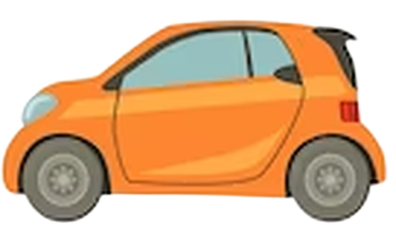
A CAV-oriented MPAI-MMM use case
Authentication
AMS_{A}
AMS_{B}
CAV_{A}‘s User
Environment
Representations
CAV_{B}‘s User
Environment
Representation
Request
Options
Selection
Authentication
CAV_{A}
HCI_{A}
HCI_{B}
CAV_{b}
CAV_{A}‘s User
CAV_{B}‘s User
Environment
Representation
Take me
there
Options
Selection

Slide 24
A CAV-oriented MPAI-MMM use case
HCI_{A} | Authenticates humans (e.g., recognises their voice). Interprets human’s message (“I want to go to lunch”). Sends corresponding command to AMS_{A} (represents human in CAV_{A}‘s M-Instance)
AMS_{A} | Gets a representation of the real world from ESS_{A} (understands where it is). Asks Route Planner for “Routes to restaurant”. Sends selection of Routes to HCI_{A}.
HCI_{A} | Communicates choices of Route to human (e.g., spoken version of AMS_{A}‘s response). Interprets human’s final choice (e.g., recognises their voice). Sends command to AMS_{A} (e.g., execute Route #2).
AMS_{A} | Mutually authenticates AMS_{B} (nearby CAV). Improves its real-world perception by “watching” AMS_{B}’s perspective PoV. Activates AMS_{A}’s Processes eventually sending a resulting command to MAS_{A}.
AMS_{B} | Improves its real-world perception by watching AMS_{A}’s perspective PoV. Activates AMS_{B}’s Processes eventually sending a resulting command to MAS_{B}.
HCI_{A} | Mutually authenticates HCI_{B}. Watches CAV_{B}’s Full Environment Representation.

Slide 25
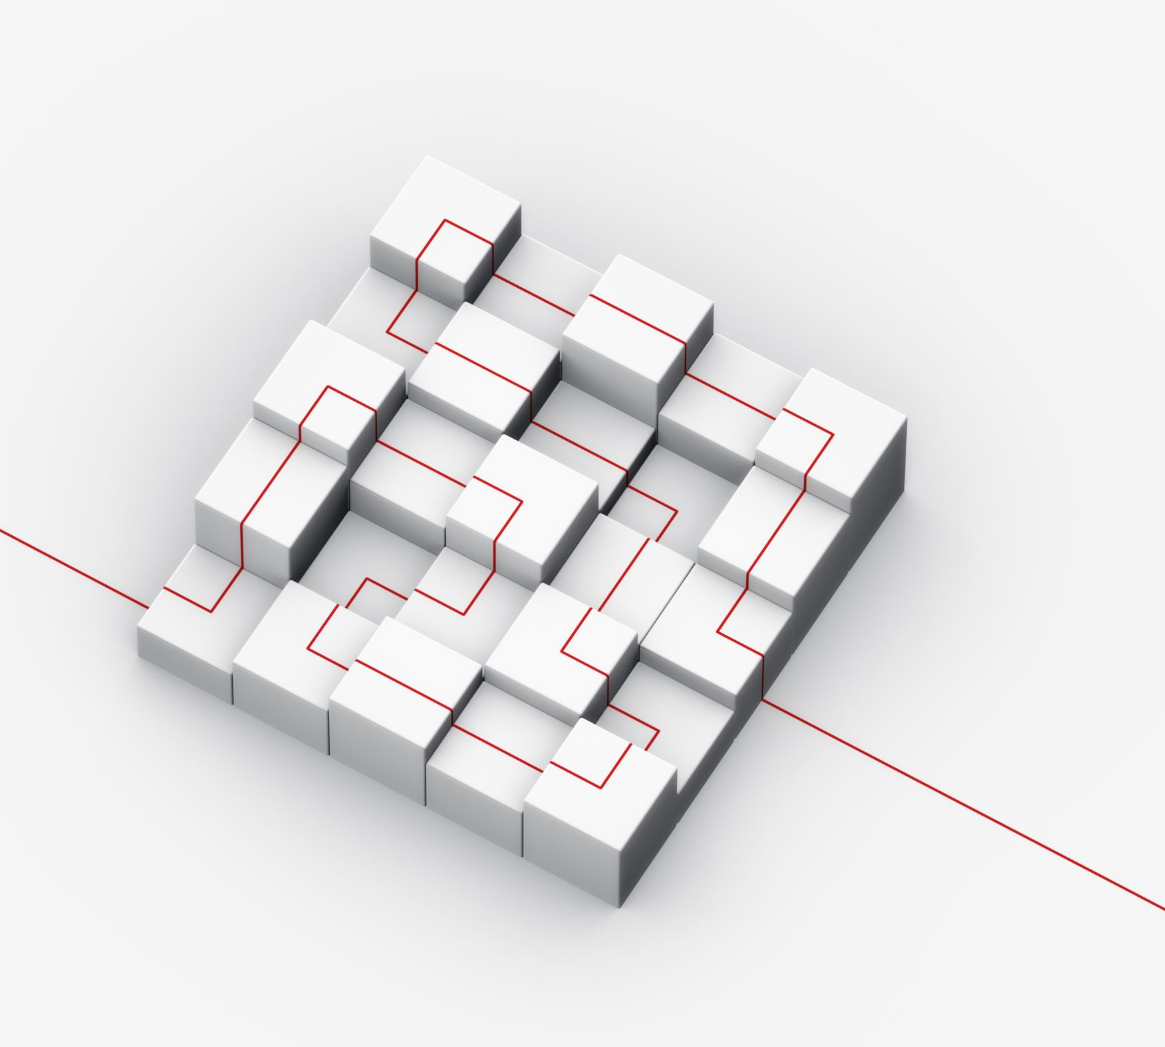
And now?
Develop Functional Requirements of Connected Autonomous Vehicle.
First analysis shows that MPAI has many technologies that can be adapted to the CAV context.
Develop Call for Technologies.
Develop Framework Licence.
MPAI plans on publishing MPAI-CAV- Data Call for Technologies at the 44th General Assembly (15 May 2024).

Slide 26
Human-Cav Interaction
AIM | Input Data | Output Data
Audio-Visual Scene Description | Input Audio Input Visual | Speech Object, AV Scene Descriptors , Face Descriptors , Body Descriptors, Face Object
Speech Recognition | Speech Object | Recognised Text
Visual Object Identification | AV Scene Descriptors Body Descriptors | Recognised Text, Visual Object ID
Natural Language Understanding | Recognised Text Visual Object ID | Text Descriptors, Refined Text, Participant ID
Speaker Recognition | Speech Object | Speaker ID
Personal Status Extraction | Speech Object, Text Descriptors, Participant ID, Face Descriptors, Body Descriptors | Personal Status Participant ID
Face Recognition | Face Object | Face ID
Entity Dialogue Processing | Speaker ID, AV Scene Geometry, Text Descriptors, Refined Text, Participant ID, Visual Object ID, Personal Status, AMS-HCI Message | Inter-HCI Information Machine Personal Status Machine Text HCI-AMS Message
Personal Status Display | Machine Personal Status Machine Text | Machine Portable Avatar
Audio-Visual Scene Rendering | Point of View, AV Scene Descriptors (FER), Machine Portable Avatar | Output Audio Output Visual

Slide 27
Environment Sensing Subsystem
AIM | Input Data Type | Output Data
Spatial Attitude Generation | GNSS Data, MAS-ESS Spatial Attitude | Spatial Attitude
Radar Scene Description | Radar Data, Scene Descriptors (BER) | Alert, Radar Scene Descriptors
Lidar Scene Description | Lidar Data, Scene Descriptors (BER) | Alert, Lidar Scene Descriptors
Traffic Signalisation Recognition | Visual Data, Scene Descriptors (BER) | Alert, Road Topology
Visual Scene Description | Visual Data, Scene Descriptors (BER) | Alert, Lidar Scene Descriptors
Ultrasound Scene Description | Ultrasound Data, Scene Descriptors (BER) | Alert, UltraSound Scene Descriptors
Offline Map Scene Description | Offline Map Scene Descriptors (BER) | Alert, Map Scene Descriptors
Audio Scene Description | Audio Data, Scene Descriptors (BER) | Alert, Audio Scene Descriptors
ESS Data Fusion | RADAR Scene Descriptors, LiDAR Scene Descriptors, Road Topology, Ultrasound Scene Descriptors, Offline Map Scene Descriptors, Audio Scene Descriptors Spatial Attitude, Other Environment Data | Alert Scene Descriptors (BER)

Slide 28
Autonomous Motion Subsystem
CAV/AIM | Input | Output
Environment Representation Fusion | ESS-AMS Scene Descriptors (BER) AMS-R-AMS Scene Descriptors (BER) AMS-to-RAMS | Scene Descriptors (FER)
Remote AMSs | See V2X | See V2X
Route Planner | Scene Descriptors (FER), Offline Maps, Road State | Route, Estimated time of arrival
Path Planner | Route, Scene Descriptors (FER), Offline Maps, Road State | Paths
Motion Planner | Paths, Scene Descriptors (FER), Road State | Trajectory
Obstacle Avoider | Trajectory, Scene Descriptors (FER), Alert Road State | Trajectory
Command Issuer | Trajectory, MAS-AMS Message | AMS-MAS Message
Decision Recorder | Route, Path, Trajectory, AMS-MAS Message | Recorded Data

Slide 29
Motion Actuation Subsystem
CAV/AIM | Input | Output
MAS Spatial Attitude Generation | Odometer Data Speedometer Data Accelerometer Data | Spatial Attitude
AMS Command Interpreter | AMS-MAS Message | Brake Command Wheel Motor Command Steering Wheel Command
MAS Response Analyser | Brake Response Steering Wheel Response Wheel Motor Response | MAS-AMS Message

Slide 30
We look forward to working
with you
on this exciting MPAI project!
Join MPAI
Share the fun
Build the future
https://mpai.community/
30
30
30
30

