Slide 1
MPAI Metaverse Model (MPAI-MMM) - Architecture
Leonardo Chiariglione
15 UTC 15 March 2024
.

Slide 2
What is the business of MPAI with the metaverse?
Metaverse is the ultimate shape of the digitisation process of the last 100 years
The design of metaverse
requires many sophisticated media coding technologies

Slide 3
What is MPAI’s relationship with the Metaverse?
Industry interest in the Metaverse → New jobs-opportunities-experiences.
Standards & AI main drivers for the development of the Metaverse → MPAI is in both.
A variety of standards needed → MPAI has already quite a few.
Metaverse requires more standards → MPAI has technologies and may develop more.
Technology integration for metaverse → MPAI develops reference software.

Slide 4
What does “metaverse interoperability” mean?
Prescriptive interoperability (as in media). The metaverse context is fast-evolving; technology has many configurations.
Metaverse Instance #1
Standard format
Metaverse Instance #2
Mediated interoperability.
Format1
Format2
Metaverse Instance #1
Format
Conversion Service
Metaverse Instance #2
Format1
Format2
Conversion services do not guarantee interoperability for all cases.

Slide 5
Functional interoperability
In general, data format conversion is possible when data formats reference the same functionalities.
We should specify the functional requirements of:
The data provided by an M-Instance to another M-Instance or to a Device.
The operation model of an M-Instance.
In general, data format conversion is possible when data formats reference the same functionalities.
We should specify the functional requirements of:
The data provided by an M-Instance to another M-Instance or to a Device.
The operation model of an M-Instance.
data_{A.1}
data_{A.1}
data_{B.1}
data_{B.1}
data_{B.1}
data_{A.1}
data_{B.2}
?
Functional interoperability enables the conversion of data with the format of M-Instance_{A} to data with the format of M-Instance_{B}.

Slide 6
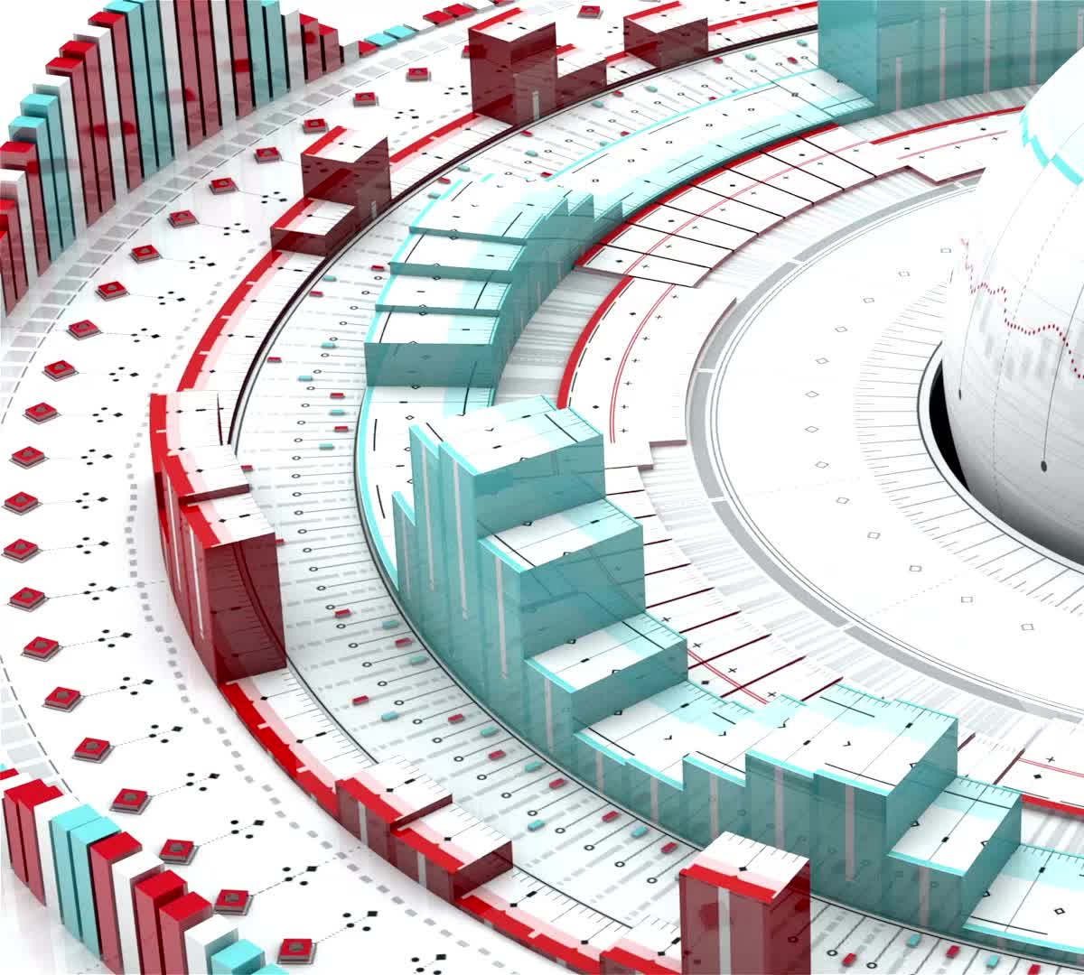
Scope of MPAI Metaverse Model (MPAI-MMM) – Architecture
Enables Interoperability of two or more M-Instances if they:
Rely on the Operation Model
Use the same Profile Architecture,
and
Either the same technologies, or
Independent technologies if Conversion Services to losslessly transform Data of an M-Instance_{A} to Data of an M-Instance_{B}.
Note: Full Interoperability may not be achieved if the M-Instances implement different Profiles.

Slide 7
MPAI-MMM – Architecture Table of Contents
Introduction
Scope
Definitions
References
Functionalities
Operation Model
Functional Requirements
Processes
Actions
Items
Data Types
Scripting Language
Use Cases
Functional Profiles

Slide 8
Functionalities of MPAI-MMM – Architecture
1 M-Instance
2 Processes
3 Rules
4 Registration
5 Rights
5.1 General Rights
5.2 Perception Rights
5.3 Interaction Rights
5.4 Service access Rights
5.5 Acquisition of Rights
6 Personae
7 Locations
8 Objects and Scenes
9 Identifiers

Slide 9
MPAI-MMM – Architecture

Slide 10
M-Instance: ICT platform performing the functions:
Senses data from U-Locations.
Processes the sensed data and produce Data.
Produces ≥ 1 M-Environments populated by Objects that can be either digitised or virtual, the latter with or without autonomy.
Processes Objects from the M-Instance or potentially from other M-Instances.
Affects U- and/or M-Environments using Objects in ways that are:
Consistent with the goals set for the M-Instance.
Within the Capabilities of the M-Instance.
According to the Rules of the M-Instance.
Respecting applicable laws and regulations.
Operates according to and provides the Functionalities of this Technical Specification.

Slide 11
M-Instance Operation Model/1
An M-Instance:
May make its Capabilities known.
May be administratively subdivided in M-Environments.
May allow a human to Register with the M-Instance or an M-Environment.
May request a Registering human to provide a subset of their Personal Profile.
Is implemented as a set of Processes:
Providing Functionalities defined by this Technical Specification.
Composed of:
A Program having a Format supported by the M-Instance.
Metadata describing the Program and containing the following as a minimum:

Slide 12
M-Instance Operation Model/2
Table 2 - Minimum Metadata set of a Process
Metadata elements | Details
ProcessID | The ID of the Process.
UserID | The ID of the User having Rights to Act on the Process.
InRightsID | The ID of the User’s Rights to Act granted to the Process.
OutRightsID | The ID of the Rights a User may acquire on the Process.
DescrMdata | Any description of the Process.

Slide 13
M-Instance Operation Model/3
(Is implemented as a set of Processes)
Performing Actions on Items if they hold the Rights to do that.
Requesting other Processes to perform Actions by transmitting a standard Request-Action Item and responding to a Request-Action with a Response-Action:
Request-Action | Response-Action | Details
Request-Action ID | Response-Action ID | Unique ID
Emission Time | Emission Time | Tine of Issuance
Source Process ID | Source Process ID | Requesting Process ID
Destination Process ID | Destination Process ID | Requested Process ID
InItems | OutItems | In/Output Items required by the Action
InLocations |  | Locations of InItems
OutLocations |  | Locations of OutItems
OutRights |  | Expected Rights on OutItems

Slide 14
M-Instance Operation Model/7
(Is implemented as a set of Processes)
Performing the Request if:
The requesting Process holds the Rights that are required to perform the request.
The requested Process holds Rights to perform the requested Action on the Item.
Enables a Process:
To communicate to a Process in another M-Instance through an M-Instance’s Resolution Service.
To obtain conversion of the Format of an Item’s Data by calling a Conversion Service.
To specify their communication needs by:
Requesting the needed maximum and average bitrate value.
Reserving the needed bitrate for a time and a location.
Requesting that the same simultaneous Experience be provided to a specified number of Devices.

Slide 15
M-Instance Operation Model/8
Request-Action_{A1}
Resolution Service_{A}
Resolution Service_{B}
Response-Action_{A2}
Request-Action_{A1}
Response-Action_{A3}
Response-Action_{A2}
Request-Action_{A1}
Process_{A3}
Process_{B2}
Process_{A2}
Process_{A1}
Process_{A4}
Process_{B4}
Process_{B1}
Process_{B3}
M-Instance_{A}
M-Instance_{B}
Item_{A3}
Item_{A2}
Item_{A2}
Item_{A1}
Conversion Service
Conversion Service

Slide 16
M-Instance Operation Model/9
May support four types of Process:
Device is one or more Processes running on a physical device connecting M-Locations to U-Locations, specifically the Registered human, by:
Capturing scenes as Media and providing Media as Data/Metadata – U-Location to M-Location). Data/Metadata shall be Identified as an Item to enable Processes to perform Actions.
Receiving an Entity and rending it as Media with a Spatial Attitude (Position and Orientation) – M-Location to a U-Location.
The User Process represents and is under the control of a human Registered with the M-Instance. A User may run on the M-Instance or on a Device connected to the M-Instance.
Service provides specific functionalities.
App runs on a Device. A Device may run the User Process as an App.

Slide 17
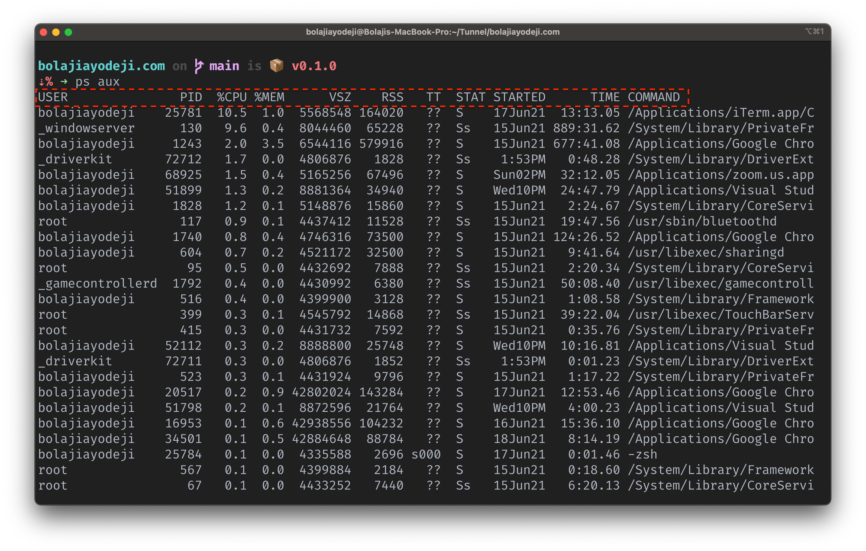
M-Instance Operation Model/10
Universe
Metaverse
App
User
Persona
Process
Human Device User

Slide 18
M-Instance Operation Model/11
Provides Functionalities through Processes performing Actions on Items containing:
Data whose Format is supported by the M-Instance.
Metadata describing the Item and containing the following as a minimum:
Table 4 - Minimum Metadata for Item
Metadata elements | Details
ItemID | The ID of the Item.
UserID | The ID of the User having Rights to Act on the Item.
DescrMdata | Any description of the Item.

Slide 19
M-Instance Operation Model/12
Identifies Processes/Items with one Identifier and, optionally, with more than one Identifier. Each Identifier uniquely refers to one Process/Item.
Creates Items by processing the sensed data and the autonomously produced data.
Employs Data Types to represent entities such as Amount (of a Currency), length, area, volume, etc.
Gives a Registered human the Rights to deploy one or more:
Users and Devices each with M-Instance-specific Rights.
Personae, i.e., human-like, or humanoid Models used by deployed Users to render themselves.
Establishes Rules that the Users in the M-Instance shall comply with.

Slide 20
M-Instance Operation Model/13
May penalise Users for lack of compliance with the Rules.
May allow a Process to perform, or request another Process to perform, Actions on Items even in the absence of Rights.
May require that Processes be certified for use in the M-Instance.
Future versions of this document may specify:
Profiles and Levels of Actions and Items.
Additional Actions, Items, and Data Types.

Slide 21
Functional Requirements: Processes

Slide 22
Functional Requirements: Processes
1 App
2 Device
3 Service
4 User

Slide 23
Functional Requirements: Actions/1
1 General Actions | 2 Call a Service
1.1 Register | 2.1 Author
1.2 Change | 2.2 Discover
1.3 Hide | 2.3 Inform
1.4 Authenticate | 2.4 Interpret
1.5 Identify | 2.5 Post
1.6 Modify | 2.6 Transact
1.7 Validate | 2.7 Convert
1.8 Execute | 2.8 Resolve

Slide 24
Functional Requirements: Actions/2
3 Metaverse to Metaverse | 4 Metaverse to Universe
3.1 MM-Add | 4.1 MU-Actuate
3.2 MM-Animate | 4.2 MU-Render
3.3 MM-Disable | 4.3 MU-Send
3.4 MM-Embed | 4.4 Track
3.5 MM-Enable | 5 Universe to Metaverse
3.6 MM-Send | 5.1 UM-Animate.
 | 5.2 UM-Capture.
 | 5.3 UM-Render
 | 5.4 UM-Send

Slide 25
Functional Requirements: Items/1
1 General | 3 Interaction
1.1 M-Instance | 3.1 Message
1.2 M-Capabilities | 3.2 P-Capabilities
1.3 M-Environment | 3.3 Request-Action
1.4 Identifier | 3.4 Response-Action
1.5 Rules | 4 Service Access
1.6 Rights | 4.1 AuthenticateIn
1.7 Program | 4.2 AuthenticateOut
1.8 Contract | 4.3 DiscoverIn
2 User | 4.4 DiscoverOut
2.1 Account | 4.5 InformIn
2.2 Activity Data | 4.6 InformOut
2.3 Personal Profile | 4.7 InterpretIn
2.4 Social Graph | 4.8 InterpretOut
2.5 Personal Data

Slide 26
Functional Requirements: Items/2
5 Finance | 6 Perception
5.1 Asset | 6.1 Event
5.2 Ledger | 6.2 Experience
5.3 Provenance. | 6.3 Interaction
5.4 Transaction | 6.4 Map.
5.5 Value | 6.5 Model
5.6 Wallet | 6.6 Object
7 Space | 6.7 Scene
7.1 M-Location | 6.8 Stream
7.2 U-Location | 6.9 Summary

Slide 27
Functional Requirements: Data Types
1 For location/time | 2 For Transactions
1.1 Address | 2.1 Amount
1.2 Coordinates | 2.2 Currency
1.3 Orientation | 3 For internal state
1.4 Point of View | 3.1 Cognitive State
1.5 Position | 3.2 Emotion
1.6 Spatial Attitude | 3.3 Social Attitude
1.7 Time | 3.4 Personal Status

Slide 28
Use Cases/1
MPAI has developed MPAI-MMM – Architecture based on 18 application domains.
Automotive | Hospitality
Enterprise | Remote work
Finance | Travel
Healthcare | Education
Real estate | Events
Social media | Gaming
Defence | Professional training
eSports | Retail
Food | Virtual spaces

Slide 29
Use Cases/2
After developing MPAI-MMM – Architecture, MPAI has used 9 use cases to test the specification.
To do this efficiently, MPAI has developed a language – MMM-Script to analyse all the steps of eaxh Use Case.

Slide 30
Use Case Scripting Language (MMM-Script)
In a Use Case:
Processes (e.g., Users) are sequentially identified by one subscript.
Items Acted on by a Process are identified by Process subscript & sequential number.
Locations are identified by Process subscript & sequential number.
Actions in different M-Instances, Processes/Items/Locations are prefixed by a letter.
For instance:
User_{i} MM-Embeds Persona_{i,j} at M-Location_{i.k}.
User_{i} MU-Renders Entity_{i,j} at U-Location_{i.k}.
User_{A,i} MM-Sends Object_{A,i.j} to User_{B.k}.

Slide 31
Nine Use Cases
3 Virtual Lecture. 3.1 Description 3.2 MMM-Script representation 3.3 Actions, Items, and Data Types | 4 Virtual Meeting 4.1 Description 4.2 MMM-Script representation 4.3 Actions, Items, and Data Types | 5 Hybrid working 5.1 Description 5.2 MMM-Script representation 5.3 Actions, Items, and Data Types
6 eSports Tournament 6.1 Description 6.2 MMM-Script representation 6.3 Actions, Items, and Data Types | 7 Virtual performance 7.1 Description 7.2 MMM-Script representation 7.3 Actions, Items, and Data Types | 8 AR Tourist Guide 8.1 Description 8.2 MMM-Script representation 8.3 Actions, Items, and Data Types
9 Virtual Dance 9.1 Description 9.2 MMM-Script representation 9.3 Actions, Items, and Data Types | 10 Virtual Car Showroom 10.1 Description 10.2 MMM-Script representation 10.3 Actions, Items, and Data Types | 11 Drive a Connected Autonomous Vehicle 11.1 Description 11.2 MMM-Script representation 11.3 Actions, Items, and Data Types

Slide 32
Functionality Profiles
High Profile
Management Profile
Baseline Profile
Finance Profile

Slide 33
Baseline Profile
Enables a human equipped with a Device supporting the Baseline Profile to allow their Users to perform the functions of following Table.
Supports basic forms of lecture, meeting, and hang-out.
Has the following Levels:
Audio only
Audio-Visual
Audio-Visual-Haptic.

Slide 34
Basic Profile: Actions, Items, and Data Types
Actions | Author | Identify | MM-Add | MM-Embed
 | MM-Disable | MM-Enable | MM-Send | MU-Actuate
 | MU-Render | MU-Send | Track | UM-Animate
 | UM-Capture | UM-Render | UM-Send
Items | Identifier | Message | M-Instance | M-Location
 | Model | Object | Scene | Stream
 | U-Location
Data Types | Address | Coordinates | Orientation | Position
 | Spatial Attitude

Slide 35
Finance Profile: Actions, Items, and Data Types
Actions | Authenticate | Author | Change | Discover
 | Hide | Identify | Inform | MM-Add
 | MM-Disable | MM-Embed | MM-Enable | MM-Send
 | Modify | MU-Actuate | MU-Render | MU-Send
 | Post | Register | Transact | UM-Capture
 | UM-Render | UM-Send
Items | Account | Activity Data | Asset | Identifier
 | Ledger | Map | M-Environment | Message
 | M-Instance | M-Location | Model | Object
 | Personal Profile | Provenance | AuthenticateIn | AuthenticateOut
 | DiscoverIn | DiscoverOut | InformIn | InformOut
 | Rights | Rules | Scene | Social Graph
 | Stream | Transaction | U-Location | Personal Data
 | Value | Wallet
Data Types | Address | Amount | Coordinates | Currency
 | Orientation | Position | Spatial Attitude | Time

Slide 36
Management Profile: Actions, Items, and Data Types
Actions | Authenticate | Author | Change | Discover
 | Hide | Identify | Inform | Interpret
 | MM-Add | MM-Animate | MM-Disable | MM-Embed
 | MM-Enable | MM-Send | Modify | MU-Actuate
 | MU-Render | MU-Send | Post | Register
 | Track | Transact | UM-Animate | UM-Capture
 | UM-Render | UM-Send
Items | Account | Activity Data | Asset | AuthenticateIn
 | AuthenticateOut | DiscoverIn | DiscoverOut | Event
 | Experience | Identifier | InformIn | InformOut
 | Interaction | InterpretIn | InterpretOut | Ledger
 | Map | M-Environment | Message | M-Instance
 | M-Location | Model | Object | Personal Profile
 | Provenance | Rights | Rules | Scene
 | Social Graph | Stream | Summary | Transaction
 | U-Location | Value | Wallet
Data Types | Address | Amount | Cognitive State | Coordinates
 | Currency | Emotion | Map | Orientation
 | Personal Status | Point of View | Position | Social Attitude
 | Spatial Attitude | Time

Slide 37
High Profile: New Actions, Items, and Data Types
Actions | Convert | Execute | Resolve | Validate
Item | Contract | M-Capabilities | P-Capabilities | Program
Data Types

Slide 38
We look forward to working
with you
on this exciting MPAI project!
Join MPAI
Share the fun
Build the future
https://mpai.community/
38
38
38
38

