Slide 1
Portable Avatar Format (MPAI-PAF)
Andrea Bottino, Politecnico di Torino
14:00 UTC 14 March 2024

Slide 2
Why a standard for digital humans
Many computer-created objects called “digital humans” rendered with a human appearance.
If creation, animation, and rendering happens in a closed environment. → No need for standards.
In a communication context, e.g., in an interoperable metaverse, digital humans may not be constrained to be in a closed environment.
Standards are needed when a sender requires that a remote receiving client reproduce a digital human as intended by the sender,.
Technical Specification: Portable Avatar Format V1.1 is a first response to this need.

Slide 3
Scope of MPAI-PAF V1.1
Technical Specification: Portable Avatar Format (MPAI-PAF) V1.1 specifies:
The Portable Avatar Format and related Data Formats enabling a receiver to decode and render an Avatar as intended by the sender.
The Personal Status Display Composite AI Module allowing the conversion of Text and Personal Status to a Portable Avatar.
The Audio-Visual Scene Rendering Basic AI Module enabling the rendering of Audio-Visual Scene Descriptors from a Point of View.

Slide 4
Table of Contents of MPAI-PAF
Introduction
Scope
Definitions
References
Use Case
Composite AIMs
Data Types

Slide 5
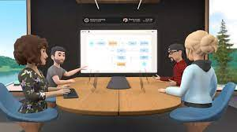
MPAI-PAF specifies AIWs and AIMs of the Avatar-Based Videoconference (PAF-ABV) Use Case. PAF-ABV uses Data Types and AIMs from other MPAI standards.

Slide 6
Reference Model of Avatar-Based Videoconference
Virtual Meeting Secretary
Portable Avatars
Portable VS Avatar
Summary
Point of View
Language Preference
Client Transmitter
Avatar Videoconference Server
Client Receiver
Speech Object
Summary
Visual
Output
Audio & Text
Face Object
Speech and Text
Portable Avatar
Portable Avatars
Output
Visual
Avatar Model
Summary
AV Scene
Descriptors
Spatial
Attitudes

Slide 7
Functions of Avatar-Based Videoconference AIWs/2
Transmitting Clients
At the beginning sends to server:
Portable Avatars containing:
Avatar Model
Language Preference.
Speech Object and Face Object for Authentication.
Then continuously sends to Server PAs containing:
Text and Speech
Face Descriptors
Body Descriptors.

Slide 8
Functions of Avatar-Based Videoconference AIWs/2
Virtual Meeting Secretary
At the beginning
Sends to server:
Portable Avatars containing:
Avatar Model
Language Preference.
Receives from Server PA containing
AV Scene Descriptors
Avatar Models
Avatar Models’ Spatial Attitudes
Then continuously sends to Server PAs containing:
Receives PAs containing
Text and Speech
Participants’ Avatar Descriptors.
Recognises participants’ Text and Speech.
Refines Recognised Text, extracts Meaning.
Extracts Avatars’ Personal Status.
Produces and edits Summary.
Produces Text and Personal Status.
Produces Speech and Avatar Descriptors

Slide 9
Functions of Avatar-Based Videoconference AIWs/2
Avatar Videoconference Server
At the beginning:
Selects Audio-Visual Scene Descriptors of
meeting room
objects, i.e., meeting table and chairs.
Places the Avatar Models around the table.
Distributes to all receiving Clients and VMS PAs containing
Audio-Visual Scene Descriptors
Avatars
Avatars’ Spatial Attitudes.
Authenticates Speech and Face Objects
Then continuously:
Translates participants’ Text and Speech according to Language Preferences.
Sends to all receiving Clients and VMS PAs containing:
Text and Speech
Face Descriptors
Body Descriptors.

Slide 10
Functions of Avatar-Based Videoconference AIWs/4
Receiving Clients:
At the beginning receives:
Environment Model
Avatar Models
Spatial Attitudes
Continuously:
Creates Audio and Visual Scene Descriptors.
Renders the Audio-Visual Scene from the Point of View selected by Participant.

Slide 11
PAF-ABV Client Transmitter (PAF-CTX)
Language
Preference
User Agent
Portable Avatar Multiplexing
Avatar Model
Input Text
Speech Objects
Audio-Visual Scene Description
Input Speech
Input Audio
Input Speech
Personal Status Extraction
Input Audio
Automatic Speech Recognition
Natural Language
Understanding
Input Speech
Recognised Text
Meaning
Personal Status
Input
Portable Avatar
Participant
IDs
Participant
IDs
Participant
IDs
Participant
IDs
Face Descriptors
Input Visual
Body Descriptors
Face Descriptors
Body Descriptors
Face Objects
Controller
MPAI Store
Communi-cation
Global Storage
Access
Communication Service
Encryption Service
Attestation Service

Slide 12
PAF-ABV Avatar Videoconference Server (PAF-AVS)
User Agent
Summary
S
Summary
AV Scene
Descriptors
Portable Avatar Multiplexing
Spatial
Attitudes
Input+VS Portable Avatars
Portable Avatar Demulti-plexing
Input
Text
Text and Speech Translation
Translated
Text
Input
Speech
Translated
Speech
Portable
Afatars
Input+VS Portable Avatars
Languages
Preference
Participant
ID
Service Participant Authentication
Speech
Object
Avatar ID
Face Object
Controller
MPAI Store
Communi-cation
Global Storage
Access
Communication Service
Encryption Service
Attestation Service

Slide 13
Virtual Meeting Secretary (MMC-VMS)
S
User Agent
Portable Avatar Demultiplexing
Input Text
Entity Dialogue Processing
Automatic Speech Recognition
Natural Language Understanding
Refined Text
Meaning
Summary
Input Speech
Recognised Text
Meaning
Summary Creation Module
VS Avatar Model
Personal Status Display
Refined Text
Edited
Summary
Portable
Avatars
Input Text
Meaning
Personal Status Extraction
VS Personal Status
Avatar ID
Input Speech
VS Portable Avatar
Summary
Avatar ID
Input
Personal Status
VS Text
Body Descriptors
Input Personal Status
Face Descriptors
Controller
MPAI Store
Communi-cation
Global Storage
Access
Communication Service
Encryption Service
Attestation Service

Slide 14
PAF-ABV Client Receiver (PAF-CRX)
User Agent
S
Portable Avatar Demultiplexing
Avatar ID
Visual Scene Creation
Audio-Visual Scene Rendering
Visual Scene
Descriptors
AV Scene Descr.
Point of View
Avatar Model
Spatial Attitude
Audio Scene Creation
Portable
Avatar
Mouth Spatial
Attitude
Output
Audio
Body Descriptors
Face Descriptors
Audio Scene
Descriptors
Avatar ID
Output
Visual
Input Speech
Controller
MPAI Store
Communi-cation
Global Storage
Access
Communication Service
Encryption Service
Attestation Service

Slide 15
JSON metadata
An AIF downloads a suitable AIW and its AIMs from the MPAI Store.
JSON Metadata provides information on.
The capabilities of the AIF described by standard JSON metadata.
The capabilities of the AIW described by standard JSON metadata.
The capabilities of (Composite) AIMs described by a standard JSON metadata (like AIW metadata).

Slide 16
Personal Status Extraction (MMC-PSE)
Text Selector
S
PS-Text Interpretation
Personal Status Multiplexing
Input Text Description
Text Object
Text Descriptors
PS-Text
Text Descriptors
Speech Selector
PS-Speech Interpretation
Input Speech Description
Speech Object
Speech Descriptors
PS-Speech
Speech Descriptors
Personal Status
Face Selector
PS-Face Interpretation
Input Face Description
Face Object
Face Descriptors
PS-Face
Face Descriptors
Body Selector
PS-Gesture Interpretation
Input Body Description
Body Object
Body Descriptors
PS-Gesture
Gesture Descriptors

Slide 17
Personal Status Display (PAF-PSD)
Machine ID
S
Portable Avatar Multiplexing
Machine Text
Machine Text
Text-To-Speech
Input Face Description
PS-Speech
Machine Speech
Avatar Model
Machine Face Descriptors
Portable Avatars
PS-Face
Machine Text
Input Body Description
Avatar Model
Machine Body Descriptors
PS-Gesture
Avatar Model
17

Slide 18
MPAI-PAF Data Types
Avatar | Avatar Model | Body Descriptors | Body Object
Face Descriptors | Face Object | Gesture Descriptors | Portable Avatar

Slide 19
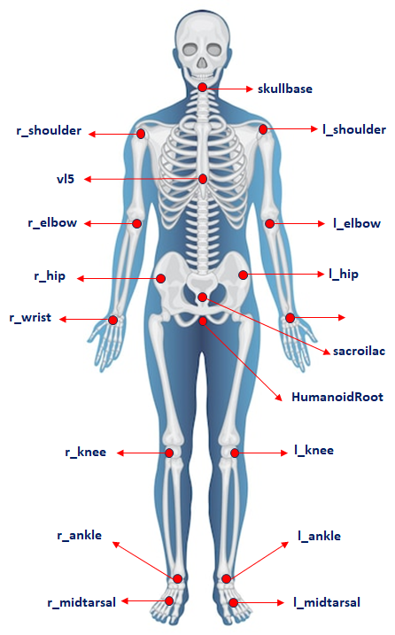
Body Model

Slide 20
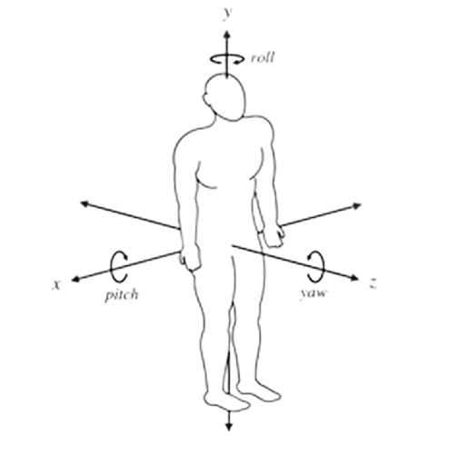
Body Descriptors
Body Descriptors describe the movement of the root and joints:
Position and Orientation of the root with respect to the Position.
Rotation angle of the y axis in the Figure.
Rotation angles of the joints.
The rotation of the head is treated as any other joint.

Slide 21
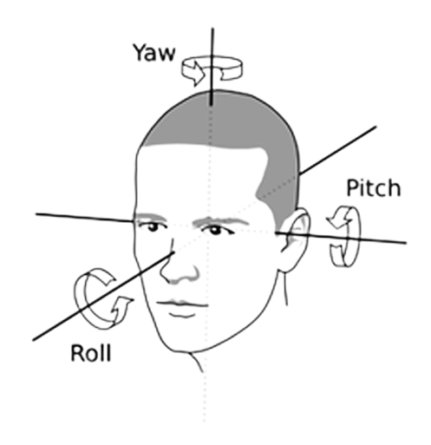
Head Descriptors
z
The Head is described by:
Roll: head moves toward one of the shoulders.
Pitch: head moves up and down.
Yaw: head rotates left to right (around the vertical axis of the head).
Roll, Pitch, and Yaw of a Head in Figure.
y
x

Slide 22
Face Descriptors/1
AU | Description | Facial muscle
1 | Inner Brow Raiser | Frontalis, pars medialis
2 | Outer Brow Raiser | Frontalis, pars lateralis
4 | Brow Lowerer | Corrugator supercilii, Depressor supercilii
5 | Upper Lid Raiser | Levator palpebrae superioris
6 | Cheek Raiser | Orbicularis oculi, pars orbitalis
7 | Lid Tightener | Orbicularis oculi, pars palpebralis
9 | Nose Wrinkler | Levator labii superioris alaquae nasi
10 | Upper Lip Raiser | Levator labii superioris
11 | Nasolabial Deepener | Zygomaticus minor
12 | Lip Corner Puller | Zygomaticus major
13 | Cheek Puffer | Levator anguli oris (a.k.a. Caninus)
14 | Dimpler | Buccinator
15 | Lip Corner Depressor | Depressor anguli oris (a.k.a. Triangularis)
16 | Lower Lip Depressor | Depressor labii inferioris
17 | Chin Raiser | Mentalis
18 | Lip Puckerer | Incisivii labii superioris and Incisivii labii inferioris
20 | Lip stretcher | Risorius with platysma

Slide 23
Face Descriptors/2
AU | Description | Facial muscle
22 | Lip Funneler | Orbicularis oris
23 | Lip Tightener | Orbicularis oris
24 | Lip Pressor | Orbicularis oris
25 | Lips part** | Depressor labii inferioris or relaxation of Mentalis, or Orbicularis oris
26 | Jaw Drop | Masseter, relaxed Temporalis and internal Pterygoid
27 | Mouth Stretch | Pterygoids, Digastric
28 | Lip Suck | Orbicularis oris
41 | Lid droop** | Relaxation of Levator palpebrae superioris
42 | Slit | Orbicularis oculi
43 | Eyes Closed | Relaxation of Levator palpebrae superioris; Orbicularis oculi, pars palpebralis
44 | Squint | Orbicularis oculi, pars palpebralis
45 | Blink | Relaxation of Levator palpebrae superioris; Orbicularis oculi, pars palpebralis
46 | Wink | Relaxation of Levator palpebrae superioris; Orbicularis oculi, pars palpebralis
61 | Eyes turn left
62 | Eyes turn right
63 | Eyes up
64 | Eyes down

Slide 24
Portable Avatar
Variable name
Avatar ID
Time
Audio-Visual Scene Descriptors
Spatial Attitude
Avatar Model
Body Descriptors
Face Descriptors
Language Preference
Speech Type
Speech Segment
Text
Personal Status

Slide 25
What’s next?
PAF-ABV Reference Software
PAF-ABV Conformance Testing
Compressed Avatar Descriptors

Slide 26
We look forward to working
with you
on this exciting MPAI project!
Join MPAI
Share the fun
Build the future
https://mpai.community/
26
26
26
26

