Slide 1
An introduction to Moving Picture, Audio, and Data Coding by Artificial Intelligence (MPAI)
Leonardo Chiariglione – President and Chairman of the Board, MPAI
.

Slide 2
Who we are
Mission
Procedures
Standardisation method
Patents in standards
Structure
Standards
Ecosystem governance
Execution of AI apps
Connected autonomous vehicles
Audio enhancement
Company performance prediction
Human & Machine Communication
Multimodal conversation
Metaverse architecture
Neural Network Watermarking
Objects and scenes
Portable avatars
AI Module Profiles
Development
AI for health
Online gaming
XR venues
Research
AI-based end-to-end video coding
AI-enhanced video coding

Slide 3
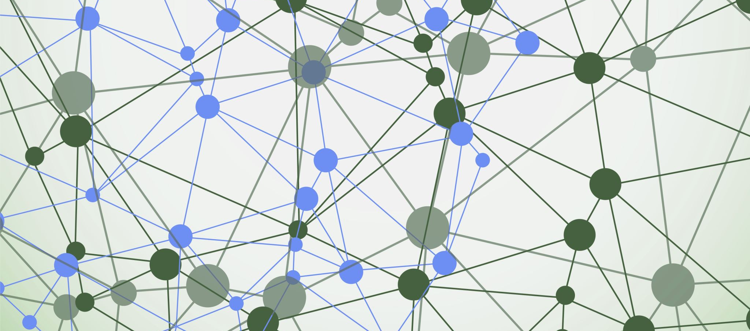
Who we are

Slide 4
MPAI: what it is
International, unaffiliated, non-profit SDO.
MPAI: what it does
Develops AI-based data coding standards.
MPAI: how it does it
With clear Intellectual Property Rights licensing frameworks.

Slide 5
1. Rigorous standards development process
All
Principal Members
Stage 0
Stage 1
Stage 2
Stage 3
Use Cases
Proposal
Interest
Collection
Functional
Requirements
Commercial
Requirements
Technical
Specification
Reference
Software
Community
Comments
Standard
Development
Call for
Technologies
Conformance
Testing
Reference
Software
Performance
Assessment
Stage 6
Stage 5
Stage 4
Stage 7
Principal Members
All
All Members
5

Slide 6

2. Explainable standards
AI module (AIM)
AI Workflow (AIW)
Speech analysis
AI Module (AIM)
AI Module AIM
Text
Speech
Inputs
Outputs
Emotion
AI Module AIM
AIM
Storage
AI Module AIM
Access

Slide 7

3. Accessible & timely available standards
Before initiating a standard, Active Principal Members develop & adopt its Framework Licence (FWL), a licence without values: $, %, dates etc. declaring that the eventual licence will be issued
Not after products are on the market.
At a price comparable with similar standard technologies.
During the development, any Member making a contribution declares it will make its licence available according to the FWL.
After the development, Members holding IP in the standard select the preferred patent pool administrator.
Read the MPAI Patent Policy
4/12/2024
7

Slide 8
The MPAI organisation
General Assembly
Board of Directors
Membership& Nominating
Finance & Audit
Industry & Standards
IPR Support
Communication
Secretariat
Standing Committees
Development Committees
Requirements Standing Committee
AIF-DC
AIH-DC
CAE-DC
CUI-DC
GME-DC
MMC-DC
NNW-DC
PAF-DC
XRV-DC
HMC
CAV
MMM
EEV
EVC
SPG

Slide 9

What has been done so far

Slide 10
MPAI standards developed so far
Standard Name | Acronym | TS | RS | CT | PA
Governance of the MPAI Ecosystem | MPAI-GME | 1.1
AI Framework | MPAI-AIF | 2.0 | 1.0
Compression and Understanding of Financial Data | MPAI-CUI | 1.1 | 1.0 | 1.0 | 1.0
Context-Based Audio Enhancement | MPAI-CAE | 2.1 | 1.4
Connected Autonomous Vehicle - Architecture | MPAI-CAV | 1.0
Human and Machine Communication | MPAI-HMC | 1.0
Multimodal Conversation | MPAI-MMC | 2.1
MPAI Metaverse Model – Architecture | MPAI-MMM | 1.1
Neural Network Watermarking | MPAI-NNW | 1.0 | 1.0
Object and Scene Description | MPAI-OSD | 1.0
Portable Avatar Format | MPAI-PAF | 1.1
AI Module Profiles | MPAI-PAF | 1.0
4/12/2024
10

Slide 11
Governance of the MPAI Ecosystem (MPAI-GME) V1.1
Technical Specification: Governance of the MPAI Ecosystem sets the rules governing the MPAI Ecosystem:
1 - MPAI 2 – Implementers 3 - MPAI Store 4 - Performance Assessors 5 - Users
The MPAI Store has been established in Scotland as a Company Limited by Guarantee.
Some of the roles of the MPAI Store:
  Managing the “Implementer ID” Registration Authority.
  Verifying Security, Testing Conformance, and posting Implementations for download.
Performance Assessors are appointed by MPAI but independent of it
Read more about MPAI-GME. Download the MPAI-GME standard.

Slide 12
The MPAI ecosystem
MPAI
Implementer
Store
End User
Implementation
Standards (TS-RS-CT-PA)
Develops Implem-entations
Verifies security
Tests Conformance
Checks Performance
Down-loads Implem-entation
Performance Assessor
Technical Specification
Implementation
OK
Assesses Perfor-mance
OK
Implementation
Experience
Score
Performance Assessment
Conformance Testing

Slide 13
AI Framework (MPAI-AIF) V2.0
Standard AI Framework enabling dynamic configuration, initialisation, and control of mixed AI and data processing workflows.
Hierarchical structure:
AI Framework (AIF) includes AI Workflows (AIW) includes AI Modules (AIM).
AIWs may be proprietary or standard, i.e., with standard functions and interfaces, with an explicit computing workflow.
Developers can offer “better” AIMs compared to other implementations.
AIMs can execute AIMs implemented in hardware, software, or hybrid hardware/software.

Slide 14
AI Framework (MPAI-AIF) V2.0
User Agent
AI Module (AIM)
AI Module (AIM)
Inputs
Outputs
AIM/AIW Storage
(non-secure)
AI Module (AIM)
AIM/AIW Storage
(secure)
AI Module (AIM)
Controller (Non-secure/Secure)
SAL
MPAI Store
Communi-cation
Global Storage
Access
Communication Service
Encryption Service
Attestation Service

Slide 15
Context-based Audio Enhancement (MPAI-CAE V2)
Improves the user experience for audio applications – teleconferencing, post-production, restoration – in different contexts – in the home, in the studio, etc.
Technical Specification includes:
  4 Use cases: Emotion Enhanced Speech, Audio Recording Preservation, Speech Restoration System, and Enhanced Audioconference Experience (and Reference Software).
  1 Composite AIM: Audio Scene Description and Data types.
Reference software.
Conformance Testing.

Slide 16
Audio Recording Preservation (CAE-ARP)
User Agent
Packager
Tape Audio Restoration
Restored
Audio Files
Preservation
Audio File
Editing
List
Access Copy
Files
Audio Analyser
Irr. Audio File
Irreg. File
Tape Irregularity Classification
A. Irreg. File
A. Irreg. File
V. Irreg. File
Preservation
Master Files
V. Irreg. File
A. Irreg. File
Irreg. Images
Irregularity
Images
Video Analyser
Preservation Audio-Visual File
V. Irreg. File
Controller
Communication
Global Storage
MPAI Store

Slide 17
Audio Scene Description (Composite AIM)
Audio Description Multiplexing
Microphone
Array Geometry
Audio Synthesis Transform
Audio Separation and Enhancement
Audio Source Localisation
Audio Analysis Transform
Transform
Multichannel Audio
Audio Spatial Attributes
Transform Enhanced Audio
Audio Objects
Audio Scene
Descriptors
Multichannel
Audio
Transform Multichannel Audio
Audio Scene Geometry

Slide 18
Connected Autonomous Vehicle – Architecture (MPAI-CAV) V1
Specification of the Architecture of Connected Autonomous Vehicles (CAV) based on a Reference Model comprising:
A CAV broken down into Subsystems.
Subsystems broken down into Components.
Specification of:
 | Functions | I/O Data | Topology
Subsystems | X | X | X
Components | X | X

Slide 19
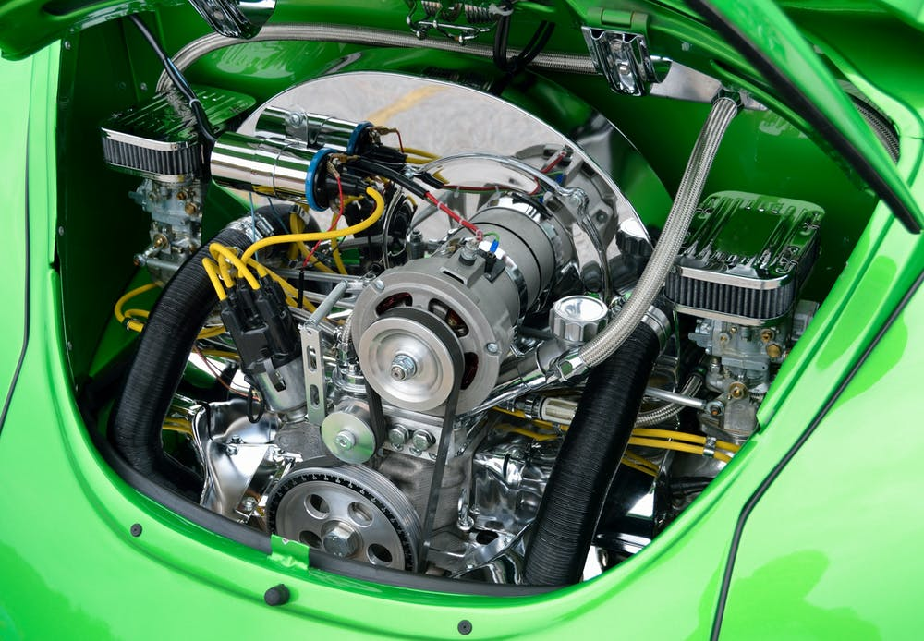
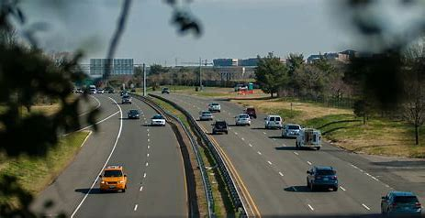


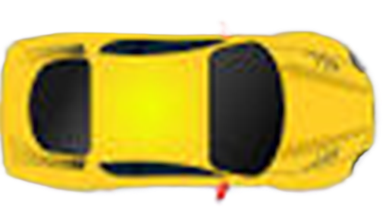



MPAI-CAV – Architecture V1.0
RADAR
Environment Sensing Subsystem
(ESS)
Motion Actuation Subsystem
(MAS)
Steering
Wheel
LiDAR
Visual
Wheel
Motors
Usound
Autonomous Motion Subsystem (AMS)
Brakes
Audio
Human-CAV Interaction
(HCI)

Slide 20
MPAI-CAV – Architecture V1.0
Autonomous Motion Subsystem
User Agent
Environment Sensing Subsystem
Environment Representation Fusion
Environment
Representation
Remote AMSs
Basic
Environment
Representation
Environment Sensing Subsystem
FER
FER
FER
FER
Response
Human-CAV Interaction
Route Planner
Path Planner
Motion Planner
Obstacle Avoider
Alert
HCI-AMS
Command
Route
Path
Trajectory
Trajectory
Command Issuer
Command
AMS-HCI
Response
Motion Actuation Subsystem
Road
State
Road
State
Road
State
Road
State
Response
Route
Path
Trajectory
Trajectory
Response
Command
Decision Recorder
Controller
MPAI Store
Communication
Global Storage
Access
Communication Service
Encryption Service
Attestation Service

Slide 21
The «AI-based Compression and Understanding of Industrial Data» standard
Company Performance Prediction use case
Compression and Understanding of Financial Data (MPAI-CUI V1.1)
Predicts the performance of a company in a given time horizon based on:
  Financial risks
  Vertical risks (i.e., seismic and cyber)
  Governance data.
Performance is:
  Default probability
  Business discontinuity probability
  Organisational Model Index
Notes:
Processo che ha portato allo std: UC-FR-FWL-CfT-CC-Std
I moduli, la loro funzione, in part. Prediction, significato del training e dell’affidabilità dei dati di input
What comes next (altri rischi)
Applications of CUI-CPP
Banca, assicurazione, ente pubblico

Slide 22
MPAI-CUI V1.1 – Reference Model
User Agent
Prediction
Horizon
Discontinuity and Default Prediction
Organisational
Model Index
Governance
Governance Data Assessment
Governance Features
Default Probability
Financial Statement
Financial Data Assessment
Financial Features
Default Probability
Prediction Result Perturbation
Business
Discontinuity Probability
Risk
Assessment
Risk Matrix Generation
Risk Matrix
Controller
Communication
Global Storage
MPAI Store

Slide 23
Human and Machine Communication
Enables new forms of communication between communicating participants called Entities
Entities are
  humans present in a real space or represented in a Virtual Space, or
  Machines represented in a Virtual Space or rendered in a real space as speaking avatars.
Each Entity acts in a Context using text, speech, face, gesture, and the audio-visual scene in which they are embedded.

Slide 24





#2
Virtual Scene
#3
Virtual Scene
Machine
In a Virtual Scene or
rendered as a real scene
#1
Real scene or representation
in a Virtual Scene
#4
Real or virtual scene

Slide 25
MPAI-HMC Reference Model
User Agent
AV Scene Integration & Description
Entity and Context Understanding
Entity Dialogue Processing
Personal Status Display
Entity ID
Input Portable
Avatar
AV Scene
Descriptors
Machine
Avatar ID
Output
Portable
Avatar
Text
Input
Selector
Meaning
Personal Status
Machine
Personal Status
Audio-Visual Scene Rendering
Input
Text
Output Text
Audio-Visual Scene Description
AV Scene Geometry
Input
Audio
Output Portable
Avatar
Output Audio
AV Scene
Descriptors
Instance ID
Machine
Text
Input
Visual
Output Visual
Controller
MPAI Store
Communication
Global Storage
Access
Communication Service
Encryption Service
Attestation Service

Slide 26
Multimodal Conversation (MPAI-MMC) V2
Technical Specification: Multimodal Conversation (MPAI-MMC) V2 specifies:
Data Formats for analysis of text, speech, and other non-verbal components as used in human-machine and machine-machine conversation applications.
Use Cases implemented in the AI Framework
  Using Data Formats from MPAI-MMC and other MPAI standards.
  Providing recognised applications in the Multimodal Conversation domain.
MPAI-MMC V2 includes
Ten use cases (Conversation with Emotion, Human-CAV Interaction,…)
One composite AIM (i.e., an AIM that includes AIMs)
Several Data types (i.e., standards of data formats).

Slide 27
Conversation with Personal Status
User Agent
Point of View
S
Audio-Visual Scene Rendering
Visual Scene Description
Visual Scene Descriptors
Input
Speech
Input Speech
Personal Status
Extraction
Entity Dialogue Processing
Body Descriptors
Output Visual
Input Visual
Face Descriptors
Input Personal Status
Body Descriptors
Visual Object Identification
Natural Language Understanding
Meaning
Visual Scene
Geometry
Instance ID
Visual
Objects
Personal Status Display
Meaning
Machine Personal Status
Automatic Speech Recognition
Machine Portable Avatar
Input
Speech
Recognised
Text
Refined Text
Machine Text
Controller
MPAI Store
Communi-cation
Global Storage
Access
Communication Service
Encryption Service
Attestation Service

Slide 28
Virtual Meeting Secretary
S
User Agent
Portable Avatar Demultiplexing
Input Text
Entity Dialogue Processing
Automatic Speech Recognition
Natural Language Understanding
Refined Text
Meaning
Summary
Input Speech
Recognised Text
Meaning
Summary Creation Module
Refined Text
VS Avatar Model
Personal Status Display
Edited
Summary
Portable
Avatars
Input Text
Meaning
Personal Status Extraction
VS Personal Status
Input Speech
Avatar ID
VS Portable Avatar
Avatar ID
Summary
Input
Personal Status
Body Descriptors
VS Text
Face Descriptors
Input Personal Status
Controller
MPAI Store
Communi-cation
Global Storage
Access
Communication Service
Encryption Service
Attestation Service

Slide 29

MPAI Metaverse Model (MPAI-MMM) – Architecture
Technical Specification: MPAI Metaverse Model (MPAI-MMM) – Architecture enables Interoperability of two or more metaverse instances (M-Instances) if they rely on the same Operation Model, and use:
  The same Profile specified by MPAI-MMM – Architecture, and
  Either the same Technologies, or
  Independent Technologies while accessing Conversion Services that losslessly transform Data of M-Instance_{A} to Data of M-Instance_{B}.

Slide 30



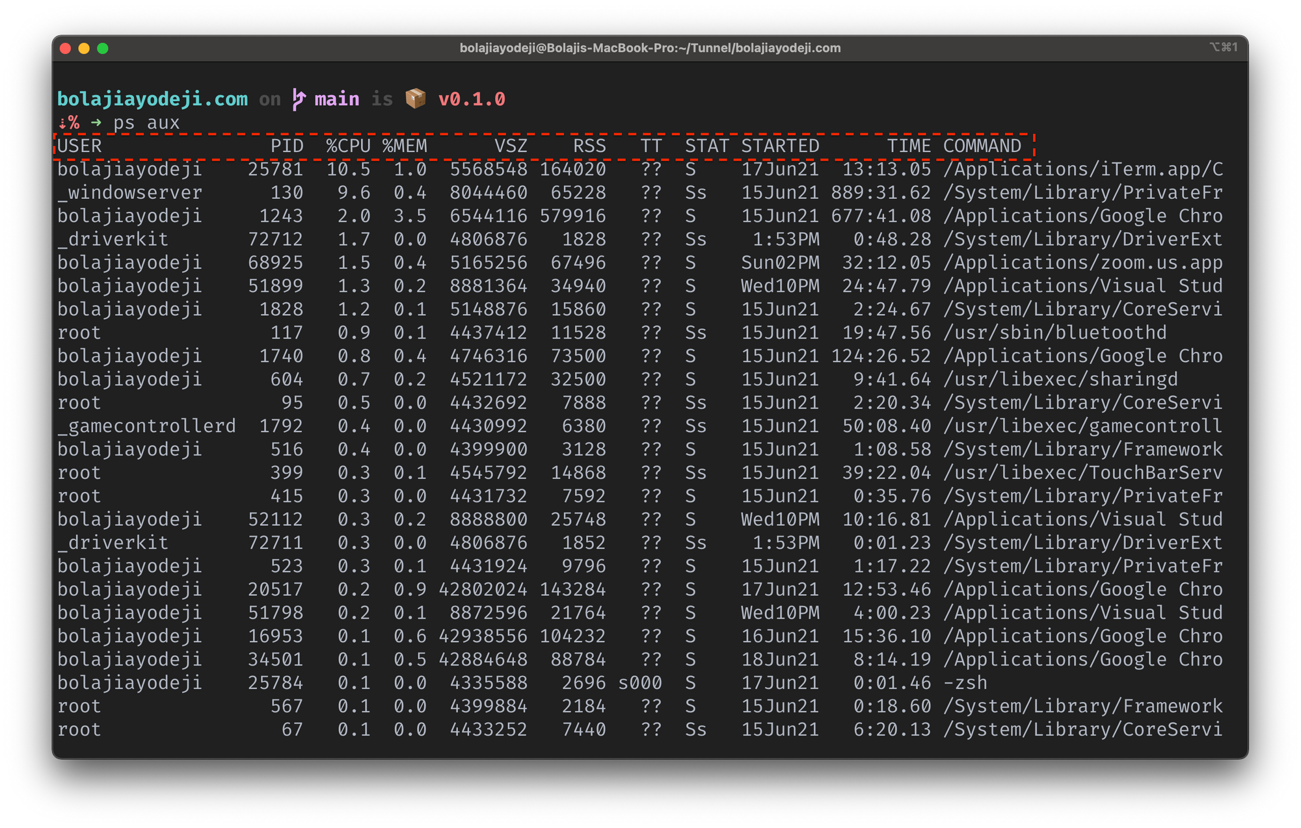

Inter-Process Communication:
Human-Device-User
M-Instance
Request-Action
Process₁
Process₂
Response-Action
Universe
Metaverse
App
User
Persona
Process
Human Device User

Slide 31

Human1
Human2
Device2.1
User2.1
Device1.1
Object1
Device2.2
Service1
Object1.2
Object3.1
Persona2.1.1
Device3.1
Persona2.1.2
User2.2
User1.1
M-Instance
Persona1.1.1
Object1.1
Human3
Service2
Service3
Persona2.2.1

Slide 32
Neural Network Watermarking (MPAI-NNW)
Technical Specification: Neural Network Watermarking (MPAI-NNW) specifies methodologies to evaluate a neural network watermarking technology in terms of:
The impact on the performance of a watermarked neural network and/or on its inference.
The ability of a neural network watermarking detector/decoder to detect/decode a payload when the watermarked neural network has been modified.
The computational cost of injecting, detecting or decoding a payload in the watermarked neural network.

Slide 33


Watermarking of generative AI
AIMs
Watermark Embedder
NNW
Decoder
Watermark Provider
User Agent
Speech
ASR
Text
Answer to question module
Text
Proof
User Agent
Text2Speech
Vocal answer
NNW
Decoder
Image
End-user
End-user
WATERMARKED
Controller
Controller
Checker
Communication
Global Storage
Access
MPAI Store
MPAI-AIF

Slide 34
Portable Avatar Format (MPAI-PAF) V1
Avatar ID
Portable Avatar Multiplexing
Specifies
  Portable Avatar and related Data Formats enabling a receiver to decode and render an Avatar in a Virtual Environment as intended by the sender.
  Personal Status Display Composite AI Module allowing the conversion of a Text and a Personal Status to a Portable Avatar.
  AI Workflows and AI Modules composing the Avatar-Based Videoconference Use Case also using Data Types from other MPAI Technical Specifications.
Time
Visual Enviornment
Spatial Attitude
Avatar Model
Body Descriptors
Portable
Avatar
Face Descriptors
Language Preference
Speech Type
Speech
Text
Personal Status

Slide 35
Avatar-Based Videoconference Use Case
Virtual Secretary
Portable
Avatars
Portable
VS Avatar
Summary
Point of View
Transmitting Client
Server
Receiving Client
Language Preferences
Speech Object
Summary
Visual
Output
Audio & Text
Face Object
Environment
Speech and Text
Portable Avatar
Portable Avatars
Output
Visual
Avatar Model
Summary
Environment
Model
Spatial
Attitudes

Slide 36
Personal Status Display (PAF-PSD)
Avatar ID
Portable Avatar Multiplexing
Machine Text
Avatar ID
Machine Text
Speech Synthesis (PS)
Machine
Speech
Avatar Model
PS-Speech
Machine
Speech
Face
Description
Avatar Model
Machine
Face Descriptors
Portable Avatar
PS-Face
Machine Text
Machine Text
Machine Text
Avatar Model
Body Description
Personal Status
Machine
Body Descriptors
PS-Gesture
Avatar Model

Slide 37
Object and Scene Description (MPAI-OSD)
Technical Specification: Object and Scenes Description (MPAI-OSD) specifies
  Data Formats to describe uni- and multimodal Objects and Scenes, and their localisation in space.
  MPAI-OSD V1 specifies common technologies for uniform use across MPAI Technical Specifications.
Important Data Formats:
  Spatial Attitude
  Audio, Visual, and Audio-Visual Object
  Audio, Visual, and Audio-Visual Scene Descriptors

Slide 38
Visual Object Identification
Body
Descriptors
Direction Identification
Object Extraction
Object Instance Identification
Direction
Visual Scene
Geometry
Physical Object
Instance ID
Visual Scene
Geometry
Visual Objects

Slide 39

New projects

Slide 40
AI for Health (MPAI-AIH)
Architecture of an AI Health Platform composed of:
  End User Front Ends tasked with
    Acquiring, AI-based processing,
    Licensing Health Data to Back End.
  A Back End tasked with
    Collecting, AI-based processing
    Enabling Third-Party Users through Licences to process Health Data,
    Updating AI Models via federated learning techniques.
  A Blockchain tasked with managing Licences as Smart Contracts.
The format of the Licences
The API
The Taxonomy of AIH Processing functions
The Data Formats

Slide 41






Technical Specification: AI for Health (MPAI-AIH)
Blockchain and Distributed Ledger Technologies
Global Secure Data Vault
Licensing & Governance Services
Authentication & Access Control Services
Record of transactions on the B&DLT that can be used for audition purposes
User Agent
AI Module (AIM)
AI Module (AIM)
Access to multiple services from smartphone (data storage, permissions, licenses, etc.)
AIM/AIW Storage
(non-secure)
AI Module (AIM)
AI Module (AIM)
AIM/AIW Storage
(secure)
Auditing Services
Controller
Communi-cation
Global Storage
Access
MPAI Store
Trusted Services
Communication Service
Encryption Service
Attestation Service
API
API
AIM Security Engine
AIM Storage Service
AIM Model Service
Other sources
of health-
related data
Data Storage & Access Services
De-Identification & Anonymization Services
Access to data (de-identified and anonym), processing of data through AI to extract knowledge
AIH Federated
Learning System
Third-Party
Health-related
Entities
User Agent
AI Module (AIM)
AI Module (AIM)
AIM/AIW Storage
(non-secure)
AI Module (AIM)
AIM/AIW Storage
(secure)
AI Module (AIM)
Controller
Communi-cation
Global Storage
Access
MPAI Store
Communication Service
Encryption Service
Attestation Service

Slide 42





End User Device
Anomaly Detection & Risks Alert
End-user input data
Specific Biometric
Sensors
Biometric
Signals
Smartbands, Smartwatches, …
Other installed health-related apps
AI-Health App
Interaction
w/ Backend
Secure Data Vault
User Agent
AI Module (AIM)
AI Module (AIM)
AIM/AIW Storage
(non-secure)
AI Module (AIM)
AI Module (AIM)
AIM/AIW Storage
(secure)
Controller
Communi-cation
Global Storage
Access
MPAI Store
Communication Service
Encryption Service
Attestation Service

Slide 43
AI Module Profiles (MPAI-PRF)
Technical Specification: AI Module Profiles (MPAI-PRF) enables the signalling of AI Module Attributes – input data, output data or functionality – that uniquely characterise an AIM instance.
An AIM Profile is thus a label that uniquely identifies the set of AIM Attributes that are either supported or not supported by that AIM instance.
An Entity Dialogue Processing AIM responds to an Entity by
  Generating Text and its own Personal Status.
  Extracting Text from Speech and Personal Status from Speech, Face, and Gesture
  Using spatial information of the Entity
An Entity Dialogue Processing AIM may not have functionality #3.

Slide 44
Server-based Predictive multiplayer Gaming (MPAI-SPG)
Technical Report: Guidelines for mitigation of data loss and cheating in online multiplayer gaming provides guidelines on the design and use of neural networks for the purpose of creating reliable and accurate prediction of absent or malicious players’ control data in an authoritative server context.
Context:
  In an online authoritative multiplayer game, each player uses a client to send control data to a server.
  The server updates the current game state with the data from all clients, and then broadcasts the updated game state to all clients.
  The data originating from a client may be properly or maliciously generated and properly received or not received.

Slide 45

















MPAI-SPG Reference Model
Server-based Predictive
Multiplayer Gaming
Online Game Server
$${\text{GS}}_{\text{t}}^{}$$
$${\text{CD}}_{}^{}$$
Game State Engine
- Dmux
$${\text{CD}}_{}^{}$$
Game State Engine
Client 1
$${\text{GM}}_{\text{t}}^{\text{p}\text{∗}}$$
$${\text{GM}}_{\text{t}\text{+1, }\text{p}}^{\text{p}\text{∗}}$$
$${\text{GS}}_{\text{t}\text{+1,}\text{p}}^{}$$
$${\text{GS}}_{\text{t}\text{+1}}^{}$$
Physics
Engine-AI
Game State Engine- Mux
$${\text{GM}}_{\text{t}}^{\text{p}}$$
Physics Engine
$${\text{CD}}_{}^{}$$
$${\text{GM}}_{\text{t}\text{+1}}^{\text{p}}$$
Client 2
$${\text{GM}}_{\text{t}}^{\text{r}\text{∗}}$$
Rules
Engine-AI
$${\text{GM}}_{\text{t}\text{+1, }\text{p}}^{\text{r}\text{∗}}$$
$${\text{GM}}_{\text{t}}^{\text{b}}$$
$${\text{GS}}_{\text{t}\text{+1}}^{}$$
Behaviour Engine
$${\text{GM}}_{\text{t}}^{\text{b}\text{∗}}$$
Behaviour Engine-AI
$${\text{GM}}_{\text{t}\text{+1, }\text{p}}^{\text{b}\text{∗}}$$
$${\text{GM}}_{\text{t}\text{+1}}^{\text{b}}$$
$${\text{CD}}_{}^{}$$
Client N
$${\text{GM}}_{\text{t}}^{\text{r}}$$
$${\text{GS}}_{\text{t}\text{+1}}^{}$$
Rules Engine
$${\text{GM}}_{\text{t}\text{+1}}^{\text{r}}$$
Controller
Communication
Global Storage
MPAI Store

Slide 46
Extended Reality Venues (MPAI-XRV) – Live Theatrical Stage Performance
Extended Reality Venues (MPAI-XRV) – Live Theatrical Stage Performance is an MPAI standard project seeking to define interfaces of AI Modules (AIM) facilitating live multisensory immersive stage performances.
Purpose: specify AI Modules able to perform functions that facilitate live multisensory immersive stage performances which ordinarily require extensive on-site show control staff to operate.
Advantage: obtain a more direct, precise yet spontaneous show implementation and control of multiple complex systems to achieve the show director’s vision.

Slide 47
User Agent
Volumetric
InputAV
Virtual Environment Experience Generation
Virtual
Environment
Virtual
Environment
Controller
Participants Description
Participants Status Interpretation
Virtual Env.
Descriptors
Action Generation
App Data
Participants Descriptors
Action Descriptors
Venue Data
Participants
Status
Output A/V
R&V Venue Spec
R&V Venue Spec
Scene Descriptors
Scene Descriptors
Input AV
Performance Description
VE Venue
Specification
Biometric Data
Lidar
MoCap Data
Sensor Data
Venue Data
Performance Status Interpretation
Scene Descriptors
Cue Point
Real
Environment
Real Environment Experience Generation
Scene Descriptors
Scene Descriptors
Real
Environment
Volumetric
RE Venue
Specification
Operator Command
Interpretation
Audio/VJ/DJ
Interpreted Operator
Controls
Action Descriptors
FX
Lighting
Output A/V
Show Control
Lighting/FX
Volumetric
Skeleton/Mesh
R&V Venue Spec
Script
Show Asset Repository (AW/AIM Storage)
Controller
MPAI Store
Communi-cation
Global Storage
Access
Communication Service
Encryption Service
Attestation Service

Slide 48
MPAI explorations

Slide 49
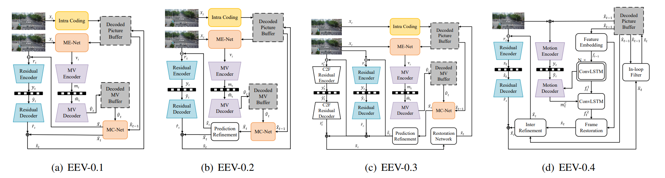
AI-based End-to-End Video Coding (MPAI-EEV)
Compressed video representation that exploits AI-based end-to-end data coding technologies, i.e., without being constrained by how data coding has traditionally been applied in the of video coding context.
Goal: to achieve 20% performance improvement compared to VVC.

Slide 50
AI-Enhanced Video Coding (MPA-EVC)
Compressed video representation by enhancing or replacing compression tools – intra prediction, super resolution, and in-loop filter – of an existing video codec (MPEG-5 EVC) with AI-based tools.
  4K-resolution bicubic-enhanced
  4K-resolution SR-enhanced
Comparison scheme: HD upscaled with bicubic Vs. HD enhanced with NN-Intra and upscaled with NN-SR
  Bicubic
  vs.
  NN-SR
  HD-resolution native anchor
  HD-resolution NN-Intra enhanced
Resolution | NN-Intra only | NN-SR only | Combined
SD2HD | -6.92% | -16.5% | 24.57%
HD24K | -6.43% | -7.22% | -11.40%

Slide 51
AI-Enhanced Video Coding (MPA-EVC)
Bicubic Down-sampling
Encoding
(EVC-VVC)
Decoding
(EVC-VVC)
Super Rresolution Up-sampling
-
Error
BD-rate gain results (BD-PSNR, luminance)
EVC Baseline Profile | VVC Main 10 profile
HD24K: -7,44 | HD24K: -6,36
SD2HD: -21,62 | SD2HD: -26,05

Slide 52
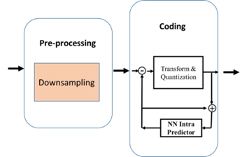
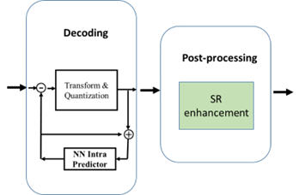
In Super Resolution with Intra Prediction exploration, study performance improvement of EVC modified by enhancing/replacing existing coding tools with AI-based tools.
Codec | Resolution | NN Intra Vs. Original Codec | Original Codec + SR Vs. Original Codec + bicubic | NN Intra + SR Vs. Original Codec + bicubic
EVC | SD2HD | -6.89% | -21,62% | -25,86%
EVC | HD24K | -6.89% | -7,44% | -11.99%

Slide 53


Join MPAI
Share the fun
Build the future
We look forward to working
with you in MPAI on our and your projects!
https://mpai.community/how-to-join/
53
53
53
53

