Slide 1
Neural Network Watermarking
.
2024/04/16 T15:00UTC
http://nnw.mpai.community

Slide 2
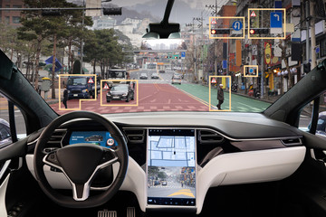
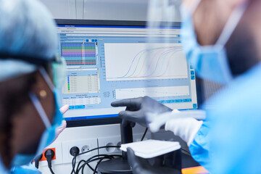
Neural Networks today
Deployed in an increasing variety of domains
Continuously renewed (industry & academia)
At the heart of various autonomous systems:
Autonomous robots
Unmanned vehicles
Deployed in more and more critical domains:
Medical decisions
Autonomous vehicles with passengers

Slide 3
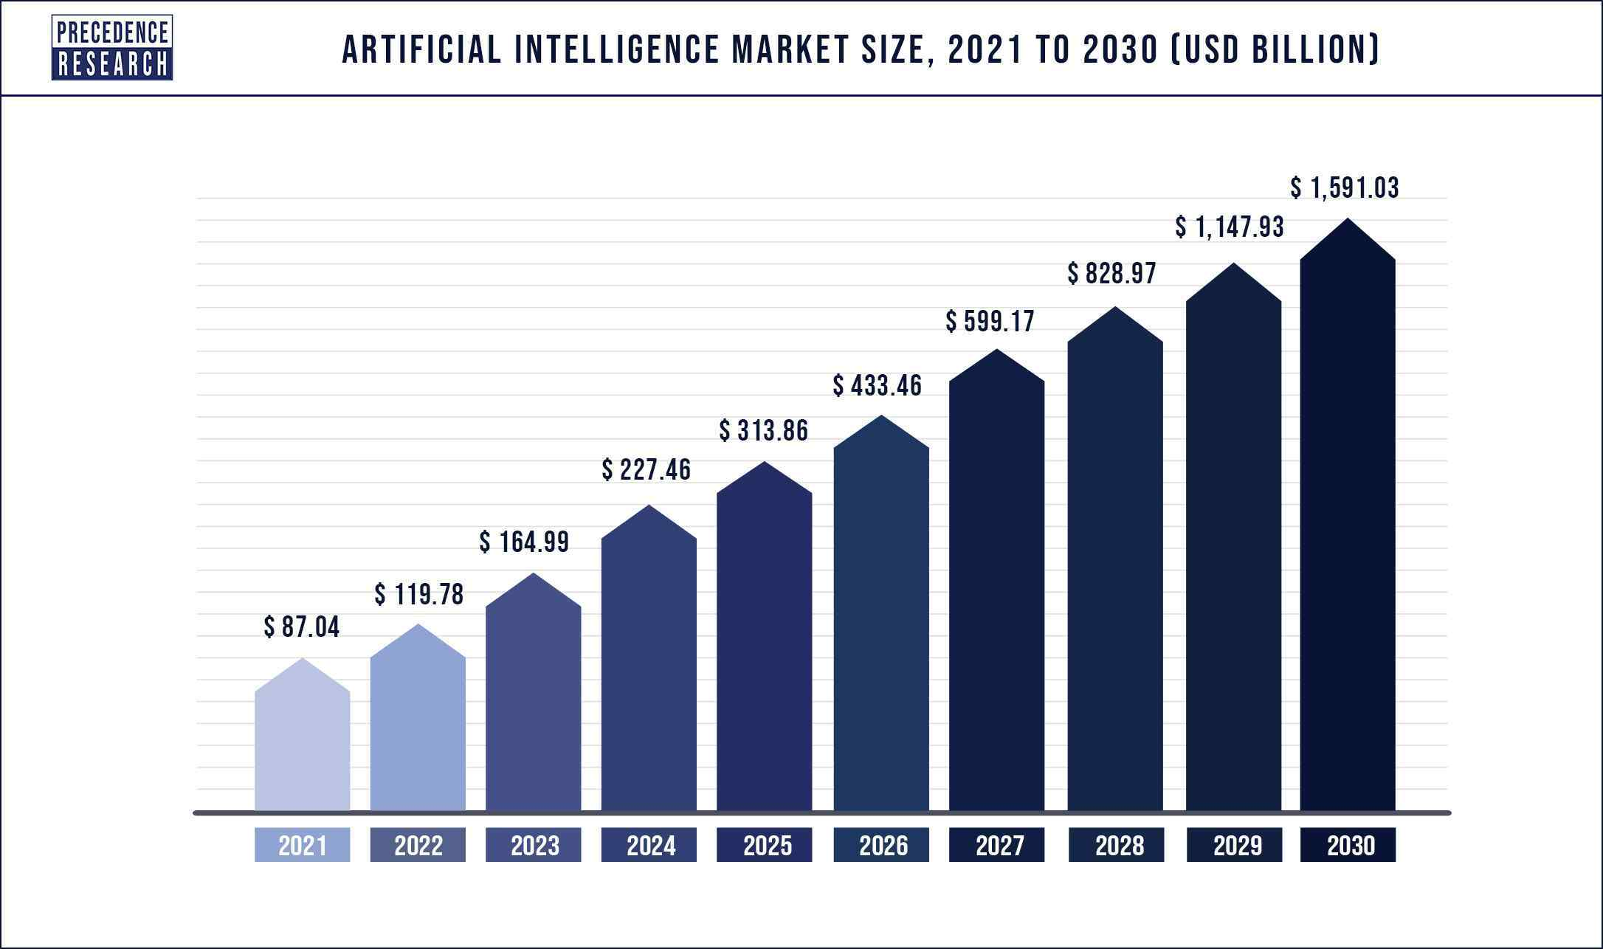
Why watermarking is useful for Neural Networks
Machine learning is a costly field:
Buying AI solution ranges from $ 6000 to $300.000
Renting a pre-built module costs around $ 40.000/year
An AI solution could:
use multiple alternative Neural Networks to provide an inference -> identifying the one that actually produced the inference is important
be shared among multiple users -> keeping track of this process is useful
be altered or maliciously attacked -> identifying such modifications avoid faulty functioning
Ensuring traceability and integrity of Neural Networks becomes mandatory

Slide 4
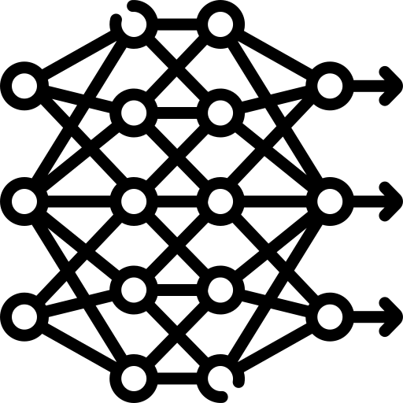
Neural Network Watermarking synopsis
Watermarking provides tools allowing to imperceptibly and persistently insert some data into original content
Watermarking Neural Network is a new challenge:
Watermark insertion is not static (as it was for media) but dynamic, as the watermark can also be:
inserted during training
detected from inference
Evaluation of watermark impact on inference is much more complex than on multimedia quality
Imperceptibility
Watermarking
Robustness
Data payload

Slide 5
Neural Network Watermarking use cases
Identify an NN
The retrieved data conveys information about the NN itself.
Identify the actors of an NN
The retrieved data conveys information about some or all the actors.
Verify the integrity of an NN
The retrieved data conveys information about NN integrity.
NN - 007
input
output
Detector
MPAI
property
modification
Integrity
checker

Slide 6
Scope of the MPAI-NNW Standard
MPAI-NNW specifies methodologies to evaluate the following aspects of a Neural Network Watermarking technology:
the impact on the performance of a watermarked neural network and/or on its inference;
how well a neural network watermarking detector/decoder can detect/decode a payload when the watermarked neural network has been modified;
the computational cost of injecting, detecting or decoding a payload in the watermarked neural network.
s
NNW - Evaluate performances of watermarking NN
Modification of performance induced by the watermarking process
0 1 0 0 0 1 1
injector
Processing cost of the insertion
injector
Trained NN
Watermarked NN
detector
detector
decoder
Yes
Performance criteria for the detector/decoder
decoder
MPAI Tester
detector
Watermark provider
No
decoder
0 1 0 0 0 1 1
Processing cost of the detection/decoding phase

Slide 7
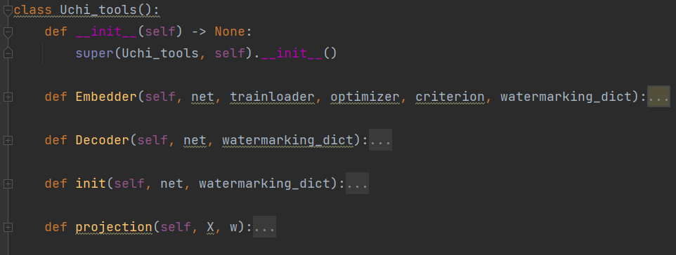
MPAI-NNW Reference Software
The purposes of MPAI-NNW Reference software is
to provide an instance of MPAI-NNW Software for the image classification task
to upgrade conventional AI-based processing workflows with traceability and integrity checking functions
Two key software components
A recorded video is available at
injector
decoder
Inputs
start
Property Evaluation
end
MPAI User

Slide 8
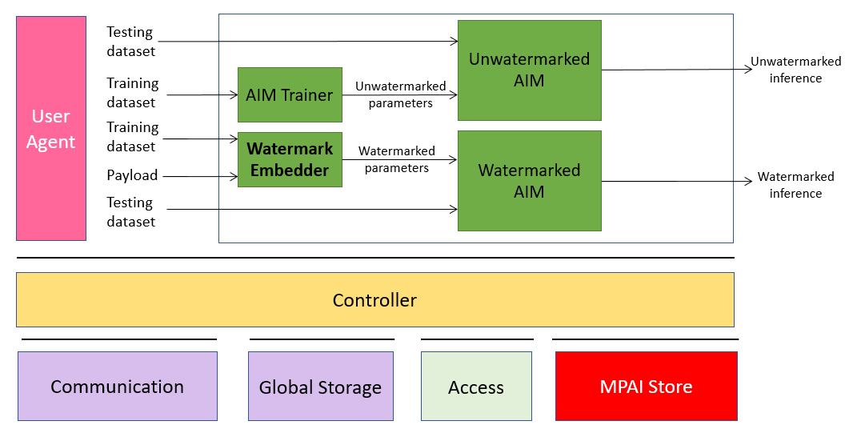
MPAI-NNW Reference Software v1.1 Upgrading conventional MPAI workflows with watermarking functionalities
Main novelty
Python-based MPAI AIF implementation
AIMs represented as Python classes with attributes being the ports and a “run” function
Controller and User Agent built as server/client program
JSON AIM/AIW metadata parsed in fully automatized manner for standard topologies (written from top to bottom and left to right)
Hooks for C/C++ code provided
Controller.py
Input.py
APIs.py
JSON & AIMs

Slide 9
MPAI-NNW Reference Software v1.1 Upgrading conventional MPAI workflows with watermarking functionalities
AIMs
Principle: NNW operations are structured as AIMs
and orchestrated as abstract MPAI AIF workflows
Example: Multi-modal question-answering application
NNW Embedder
NNW
Decoder
Watermark Provider
User Agent
ASR
Text
Answer to question module
Speech
User Agent
Text
Text2Speech
Vocal answer
NNW
Decoder
Proof
Image
WATERMARKED
End-user
End-user
Controller
Checker
Communication
Global Storage
Access
MPAI Store

Slide 10
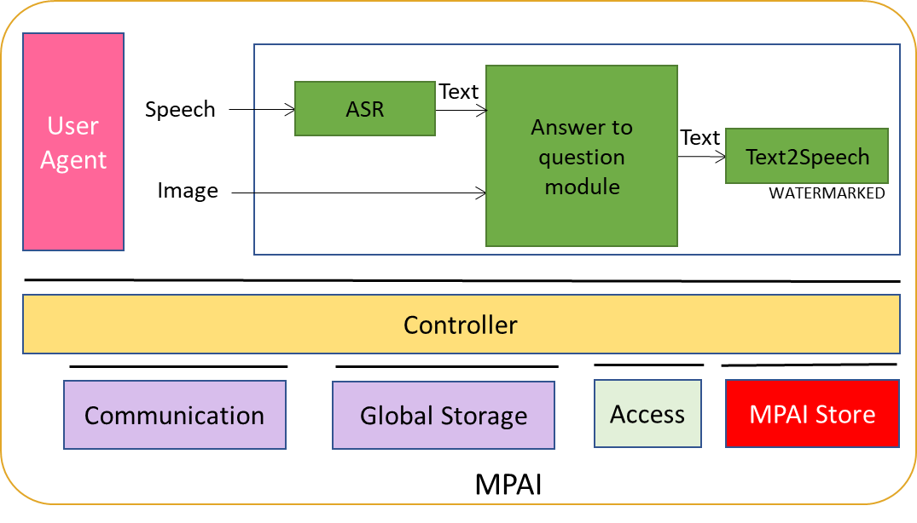
MPAI-NNW Reference Software v1.1 Upgrading conventional MPAI workflows with watermarking functionalities
Live demo

Slide 11
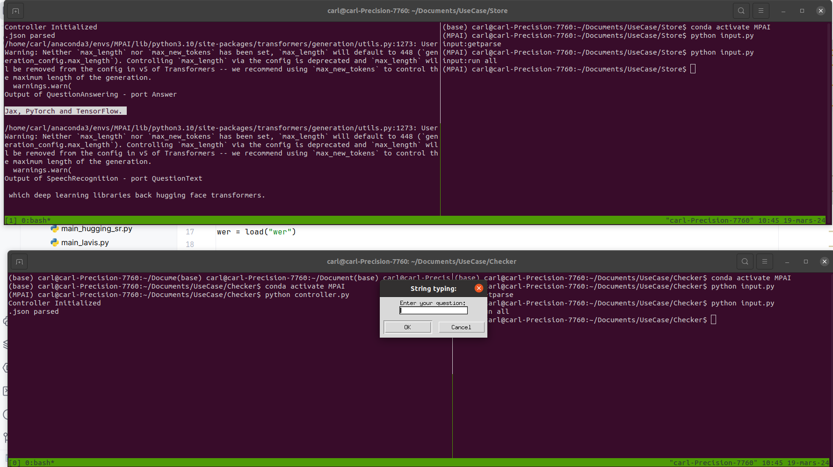
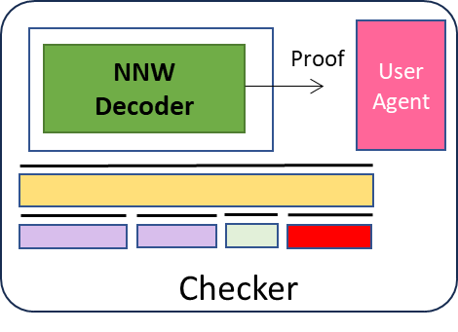
MPAI-NNW Reference Software v1.1 Upgrading conventional MPAI workflows with watermarking functionalities
Live demo

Slide 12
MPAI-NNW Reference Software v1.1 MPAI-NNW beyond MPAI AIF
Making provisions for NNW deployment on MCUs

Slide 13
Next steps
XXXX
XXXX

Slide 14
https://www.mpai.community/
https://mpai.community/how-to-join/
http://nnw.mpai.community/
MPAI-NNW RS available at:
https://experts.mpai.community/software/mpai-nnw
Join MPAI
Share the fun
Build the future
14
14
14
14

Slide 15
Join MPAI
Share the fun,
Build the future!
https://mpai.community/how-to-join/
https://www.mpai.community/
more about NNW at http://nnw.mpai.community/

