Slide 1
An AIW for Watermarking of Generative AI
.
2024/04/16 T15:00UTC
http://nnw.mpai.community

Slide 2
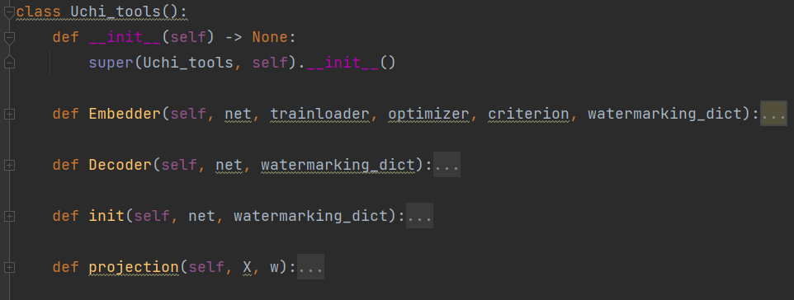
MPAI-NNW Reference Software
The purposes of MPAI-NNW Reference software is
to provide an instance of MPAI-NNW Software for the image classification task
to upgrade conventional AI-based processing workflows with traceability and integrity checking functions
Two key software components: “injector” and “detector”
Recorded video is available at:
injector
decoder
Inputs
start
Property Evaluation
end
MPAI User

Slide 3
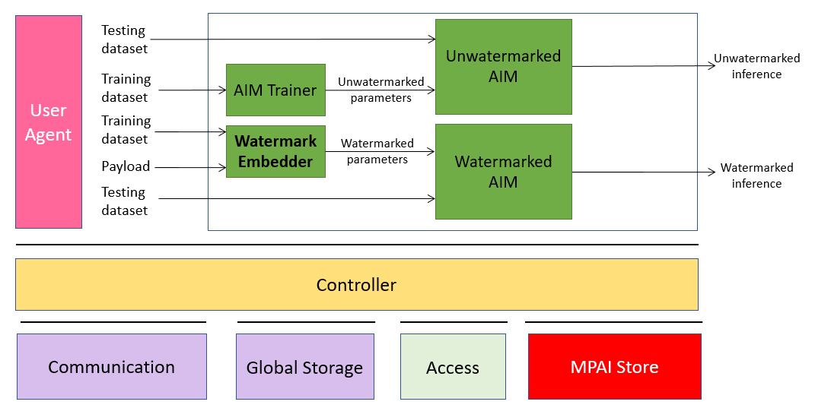
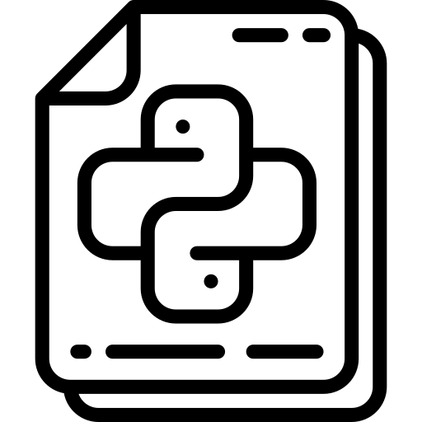
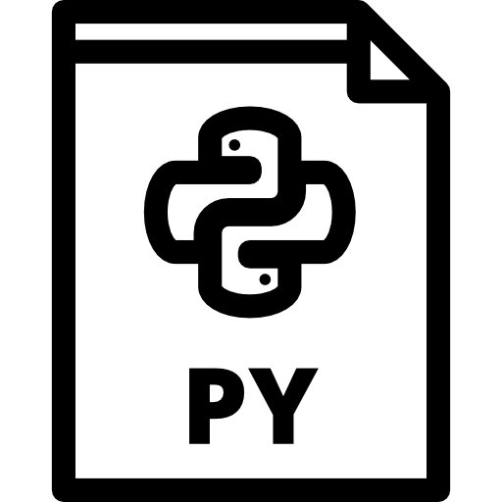
MPAI-NNW Reference Software v1.1 Upgrading conventional MPAI workflows with watermarking functionalities
Main novelty
Python-based MPAI AIF implementation
AIMs represented as Python classes with attributes being the ports and a “run” function
Controller and User Agent built as server/client program
JSON AIM/AIW metadata parsed in fully automatized manner for standard topologies (written from top to bottom and left to right)
Hooks for C/C++ code provided
Controller.py
Input.py
APIs.py
JSON & AIMs

Slide 4
MPAI-NNW Reference Software v1.1 Upgrading conventional MPAI workflows with watermarking functionalities
AIMs
Principle: NNW operations are structured as AIMs
and orchestrated as abstract MPAI AIF workflows
Example: Multi-modal question-answering application
NNW Embedder
NNW
Decoder
Watermark Provider
User Agent
ASR
Text
Answer to question module
Speech
User Agent
Text
Text2Speech
Vocal answer
NNW
Decoder
Proof
Image
WATERMARKED
End-user
End-user
Controller
Checker
Communication
Global Storage
Access
MPAI Store

Slide 5
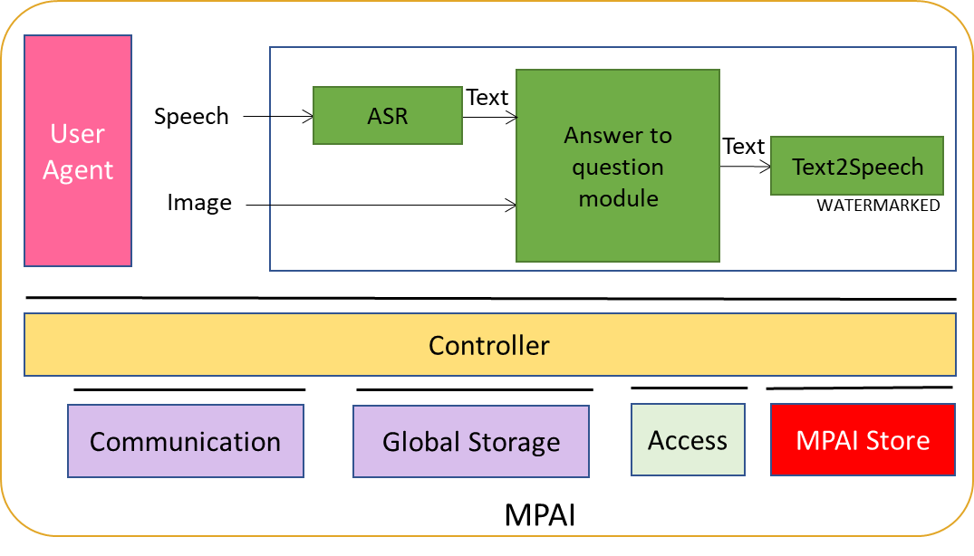
MPAI-NNW Reference Software v1.1 Upgrading conventional MPAI workflows with watermarking functionalities
Live demo

Slide 6
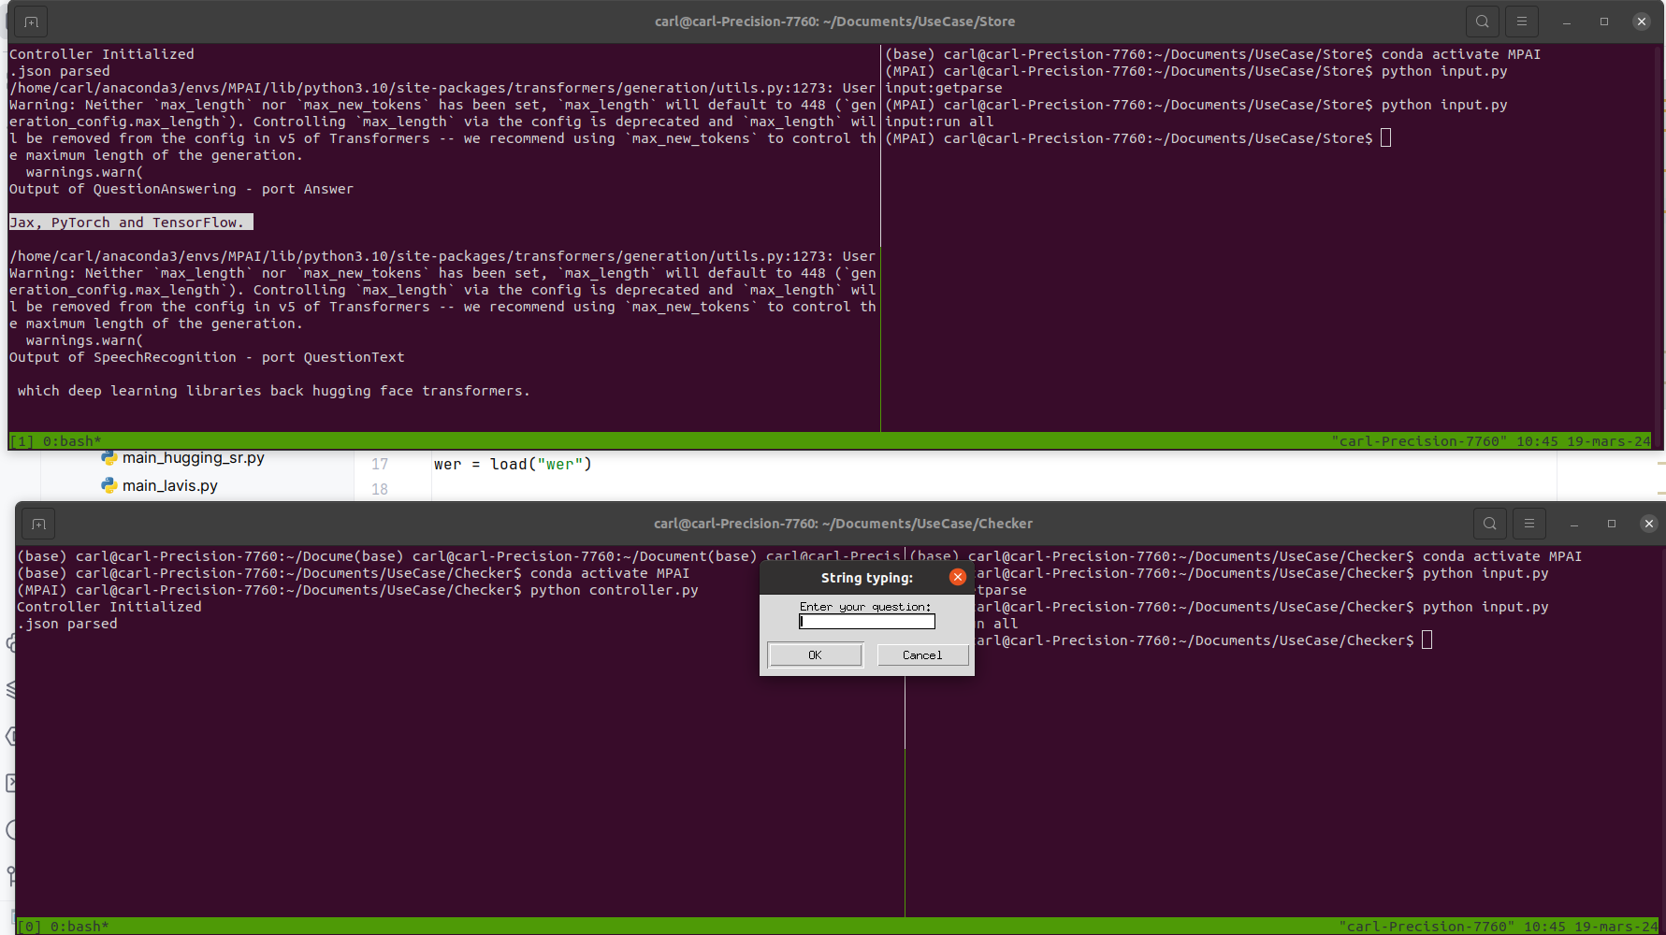
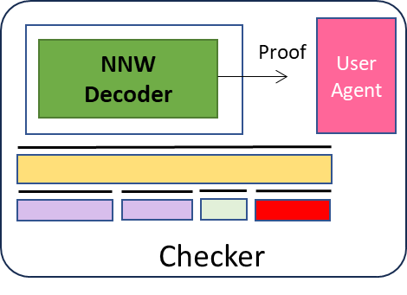
MPAI-NNW Reference Software v1.1 Upgrading conventional MPAI workflows with watermarking functionalities
Live demo

