Slide 1
Neural Network Watermarking
.
2023/04/16 T15:00UTC
http://nnw.mpai.community

Slide 2
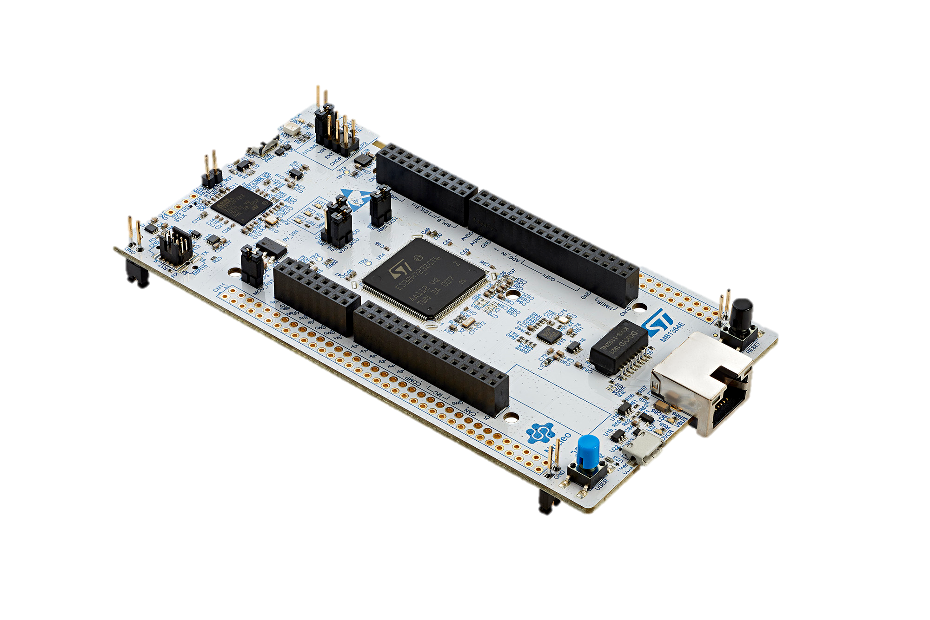
From a Centralized Intelligence to a Distributed Intelligence
Centralized Intelligence
Distributed Intelligence
Application
Artificial Intelligence
Application
Artificial Intelligence
Gateway
Gateway
Gateway
Gateway
Gateway
Gateway
Sense&Act
Unit
Sense&Act
Unit
Sense&Act
Unit
Sense&Act
Unit
Sense&Act
Unit
Sense&Act
Unit
Sense&Act
Unit
Sense&Act
Unit
Scalability
Energy
Scalability
Bandwidth
Latency
Units
Units
Intrusions
Bandwidth
Privacy
Intrusions
Responsiveness
Energy

Slide 3
From a Centralized Intelligence to a Distributed Intelligence
Centralized Intelligence
Distributed Intelligence
Application
Artificial Intelligence
Application
Artificial Intelligence
Gateway
Gateway
Gateway
Gateway
Gateway
Gateway
Sense&Act
Unit
Sense&Act
Unit
Sense&Act
Unit
Sense&Act
Unit
Sense&Act
Unit
Sense&Act
Unit
Sense&Act
Unit
Sense&Act
Unit
Scalability
Energy
Scalability
Bandwidth
Latency
Units
Units
Intrusions
Bandwidth
Privacy
Intrusions
Responsiveness
Energy

Slide 4
TinyML definition and challenge
tinyML is broadly defined as the machine learning architectures, techniques, tools and approaches able to perform low-power device analytics for variety of data (visual, auditory, motion, etc.).
tinyML Foundation is a non-profit organization with the mission to accelerate the growth of a prosperous and integrated Global Community of people developing leading edge energy efficient machine learning computing.
tinyML Challenges:
Tiny resources
Ultra low-power
To achieve high accuracy
Live without floating point numbers
Automated deployments
Resources and effort put this challenge are huge
Intellectual Property shall be protected!

Slide 5
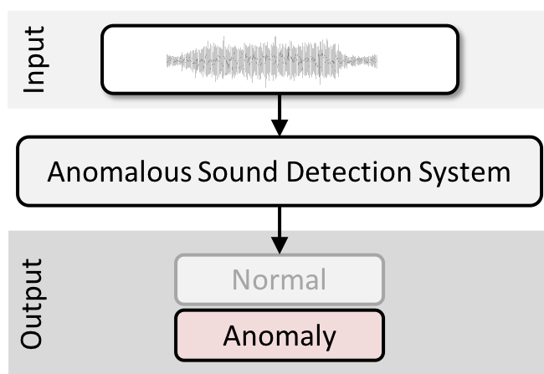
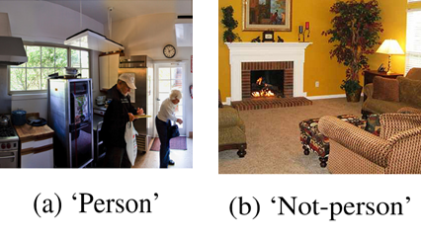
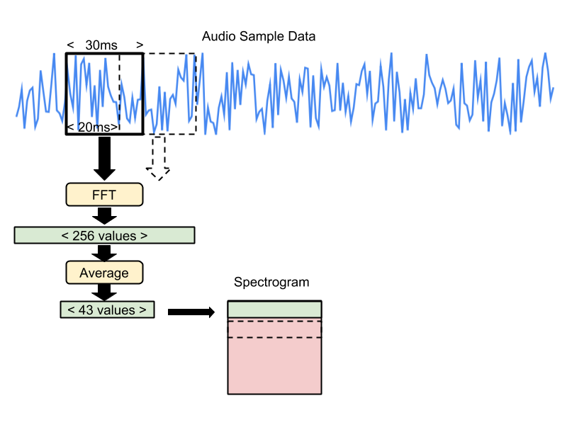
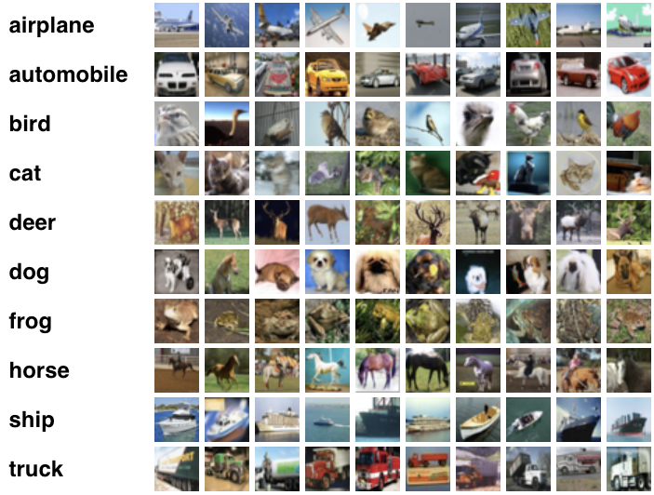
Use case
1
2
Use cases from MLCommon Performance Inference Tiny Benchmark:
Keyword Spotting
Visual Wake Words
Anomaly Detection
Image Classification
The MLCommon foundation’s aim is delivering open, useful measures of quality and performance to help guide responsible AI development.
3
4

Slide 6
Deployability and MPAI robustness evaluation of Watermarked NN Models on MCUs
Used data from CIFAR-10 and an incoherently labeled trigger dataset
MLCommon Tiny NN model for image classification (ResNet-8)
Watermark embedded following a state of the art method
Attack simulation following MPAI NNW standardized robustness evaluation procedures
Evaluation using AI frameworks and ST Edge AI Unified Core technology on MCUs

Slide 7
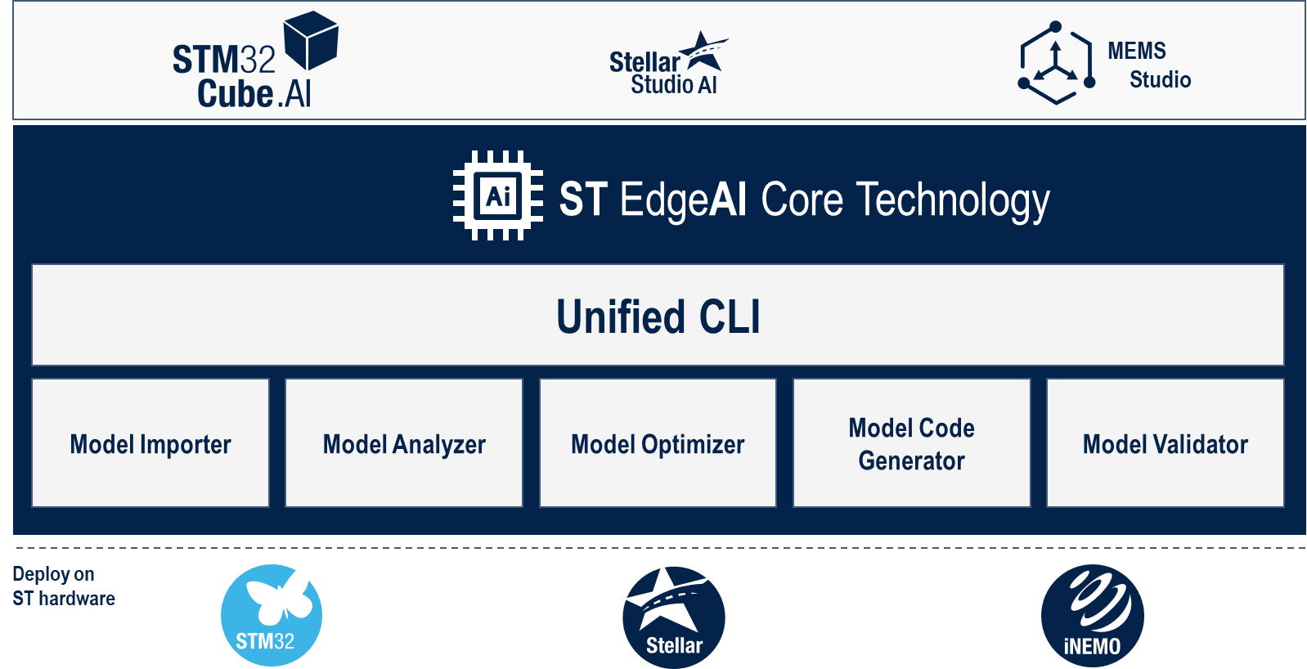
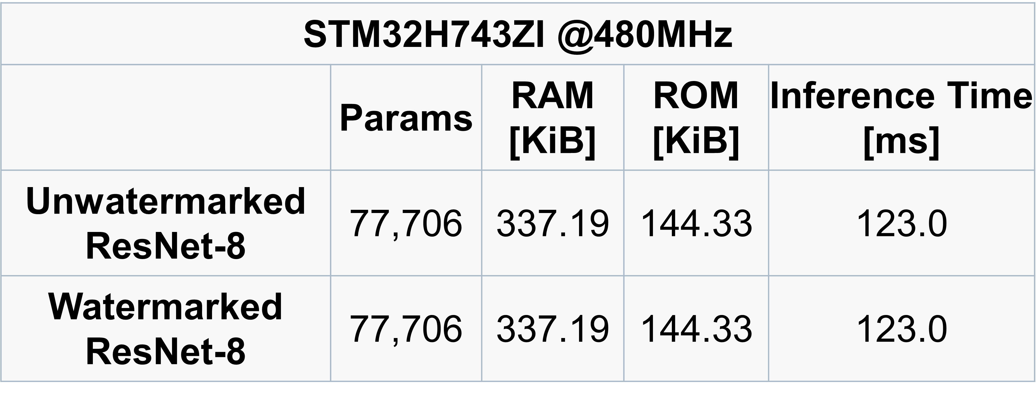
MCU’s resources
Order of magnitude changes from CPU/GPU to MCU
TB/GB -> MB/ kB size
GHz - > MHz clock frequency
XX - > 1 or 2 Core
Tests done using ST MCU STM32H743ZI Nucleo board:
RAM 1MB
ROM 2MB
SINGLE CORE
Clock Frequency 480 MHz
No extra resources needed to deploy the watermarked NN on the MCU with respect to the unwatermarked NN

Slide 8
NN Watermark detection on MCU
Robustness evaluation done combining:
NN Model:
Watermarked
Pre-trained
Watermarked + attack simulation following MPAI NNW standard
Data:
trigger dataset to evaluate watermark robustness (cells highlighted in green show W detected)
CIFAR 10
Using different AI frameworks on different devices
SAME RESULT!

Slide 9
Live Demo
What is required to make this project replicable in one Python Notebook (available soon)
Explanation and description
Source code

Slide 10
Conclusion
What we did:
Successfully watermarked Tiny NN model
What we demonstrated:
Watermarked NN deployment on the MCU does not need extra resources with respect to the unwatermarked NN
Ownership can be proved: the watermark was detected in the model with and without MPAI attack simulations until the test set accuracy dropped therefore
How you can replicate:
What is required to make this project replicable in one Python Notebook
THANKS FOR YOUR ATTENTION

