Slide 1
MPAI Call for Technologies: Connected Autonomous Vehicle (MPAI-CAV) – Technologies (CAV-TEC)
Leonardo Chiariglione – MPAI
Online – 2024/06/06
.

Slide 2
Two words about MPAI
MPAI – Moving Picture, Audio, and Data Coding by Artificial Intelligence.
What it is: international, unaffiliated, non-profit standard developing organization.
What it does: standards for AI-enabled data coding with clear IP guidelines.
What it has done: Portfolio of 11 standards and about to publish a new one.
Outreach: Five standards adopted by IEEE as IEEE standards and more to come

Slide 3
Rigorous standard development process
Stage 0
Stage 1
Stage 2
Stage 3
Use Cases
Interest
Collection
Functional
Requirements
Commercial
Requirements
Technical
Specification
Reference
Software
Community
Comments
Standard
Development
Call for
Technologies
Conformance
Testing
Reference
Software
Performance
Assessment
Stage 7
Stage 6
Stage 5
Stage 4
Principal Members
All
All Members

Slide 4
An overview of approved MPAI standards
Category | Title | Acronym
System | AI Framework | MPAI-AIF
Audio | Context-based Audio Enhancement | MPAI-CAE
Automotive | Connected Autonomous Vehicle – Architecture | MPAI-CAV
Finance | Compression and Understanding of Industrial Data | MPAI-CUI
System | Governance of the MPAI Ecosystem | MPAI-GME
Human-machine | Human and Machine Communication | MPAI-HMC
Human-machine | Multimodal Conversation | MPAI-MMC
Metaverse | MPAI Metaverse Model – Architecture | MPAI-MMM
Watermarking | Neural Network Watermarking | MPAI-NNW
Objects & Scenes | Object and Scene Description | MPAI-OSD
Avatars | Portable Avatar Format | MPAI-PAF

Slide 5
On the way to become standards
Category | Title | Acronym
System | AI Module Profiles | MPAI-PRF
Health | AI for Health | MPAI-AIH
Entertainment | XR Venues – Live Theatrical Performance | MPAI-XRV
Online Gaming | Server-based Predictive Multiplayer Gaming | MPAI-SPG
Video | End-to-End Video Coding | MPAI-EEV
Video | Up-sampling Filter for Video Application | MPAI-UFV
MPAI is launching a projects for CAV Technologies CAV-TEC), MMM Technologies (MMM-TEC), and CAE Six Degrees of Freedom (CAE-6DF). All include:
Call for Technologies Use Cases and Functional Requirements
Framework Licence Template for Responses

Slide 6
CAV-TEC Call for Technologies

Slide 7
MPAI vision for CAVs
Autonomous vehicles greatly contribute to improving human life and environment.
Standards facilitate the conversion of CAVs from siloed systems to systems made of standard components that
Component-based CAVs are more reliable, explainable, and affordable.
MPAI-CAV is the series of standards addressing componentisation of CAVs.

Slide 8
Call for Technologies/1
Call for Technologies: Connected Autonomous Vehicle (MPAI-CAV) – Technologies (CAV-TEC) invites any party able and willing to contribute to the development of the planned MPAI CAV Technical Specification to submit a response.
If they own technologies relevant to this Call, they will eventually be required to license their technologies according to the CAV Framework Licence if their technologies are selected by MPAI for possible modification and inclusion in the planned CAV Technical Specification.
Any respondent who is not an MPAI member and wishes to participate in the development of CAV shall join MPAI. If they own accepted technologies and do not join MPAI, they lose the opportunity to have their technologies included in the planned CAV-TEC.

Slide 9
Call for Technologies/2
The scope of this Call is restricted to responses whose specification in the planned MMM-TEC conforms to Use Cases and Functional Requirements.
Respondents are welcome to additionally :
Provide comments on any technical element of Use Cases and Functional Requirements.
Propose technologies not requested by the CAV-TEC Call if based on motivated proposals to extend or add new functional requirements, provided they:
Are within the scope of the Functional Requirements.
Satisfy the Framework Licence.

Slide 10
Dates
Step | Date | Time
CAV-TEC Call for Technologies issued. | 2024/05/15 | 17:00 UTC
CAV-TEC Call for Technologies presented online. | 2024/06/06 | 15:00 UTC
Notification of intention to submit proposal (Annex A). | 2024/06/07 | 23:59 UTC
Response submission deadline. | 2024/07/06 | 23:59 UTC
Start of response evaluation. | 2024/07/10 | (MPAI-46)

Slide 11
CAV-TEC Use Cases and Functional Requirements

Slide 12
The path to CAV-TEC
Early days of MPAI (October 2020)B project on Connected Autonomous Vehicle (MPAI-CAV) kicked off.
September 2023 – Technical Specification: Connected Autonomous Vehicle – Architecture published.
January 2024 – MPAI-CAV Architecture submitted to IEEE
May 2024 – MPAI CAV Technologies Call published.

Slide 13
Current state of CAV standardisation in MPAI
Technical Specification: Connected Autonomous Vehicle (MPAI-MMM) – Architecture specifies the Architecture of a Connected Autonomous Vehicle (CAV) based on a Reference Model comprising:
A CAV broken down into Subsystems for each of which Functions, Input/output Data, and Topology of Components are specified:
Each Subsystem broken down into Components of which Functions and Input/output Data are specified:
Each Subsystem is assumed to be implemented as an AI Workflow (AIW) made of Components implemented as AI Modules (AIM) executed in an AI Framework (AIF) as specified by AI Framework (MPAI-AIF).

Slide 14
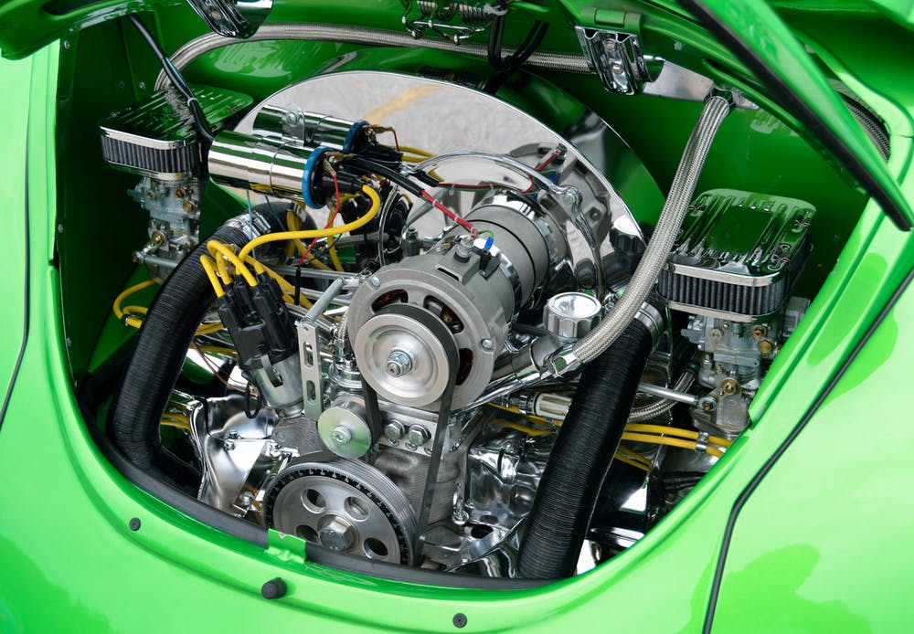
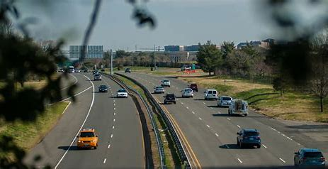
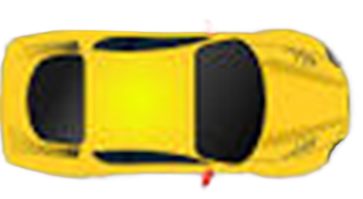
Connected Autonomous Vehicle
RADAR
Environment Sensing Subsystem
(ESS)
Motion Actuation Subsystem
(MAS)
Steering
Wheel
LiDAR
Visual
Wheel Motors
Usound
Autonomous Motion Subsystem (AMS)
Brakes
Audio
Human-CAV Interaction
(HCI)

Slide 15
Autonomous Motion
Subsystem
Point
of View
Audio=-Visual Scene Rendering
Full Environment Descriptors
Output Text
Audio-Visual Scene Description
Speaker ID Recognition
Entity Dialogue Processing
Personal Status Display
Speech Object
Speaker ID
Machine
Personal Status
Output Audio
AV Scene Descriptors
Machine Portable
Avatar
Speech Object
Personal Status Extraction
Output Visual
Input Text
Machine Text
Natural Language Understanding
Meaning
Meaning
Environment Sensing Subsystem
Input Audio
Aut. Speech Recognition
Speech
Object
Recognised Text
Remote HCIs
NLU Text
E-HCI o R-HCI
Message
Input Lidar
Visual Scene
Geometry
Visual Object Identification
R-HCI o E-HCI
Message
Visual
Object ID
Participant IDs
Participant
IDs
Input Visual
AV Scene Descriptors
Visual Object ID
Autonomous Motion Subsystem
User Agent
Face Descriptors
HCI-AMS
Message
Personal Status
Body Descriptors
Face ID Recognition
AMS-HCI
Message
Face Object
Face ID
Controller
MPAI Store
Communi-cation
Global Storage
Access
Communication Service
Encryption Service
Attestation Service

Slide 16
AIM | Input | Output
Audio -Visual Scene Description | - Input Audio - Input Visual | - AV Scene Descriptors
Automatic Speech Recognition | - Speech Object | - Recognised Text
Visual Object Identification | - AV Scene Descriptors - Visual Objects | - Visual Object Instance ID
Natural Language Understanding | - Recognised Text - AV Scene Descriptors - Visual Object ID - Input Text | - NLU Text - Meaning
Speaker Identity Recognition | - Speech Object | - Speaker ID
Personal Status Extraction | - Meaning - Input Speech - Face Descriptors - Body Descriptors | - Personal Status
Face Identity Recognition | - Face Object | - Face ID
Entity Dialogue Processing | - Ego-Remote HCI Message - AMS-HCI Message - Speaker ID - Meaning - NLU Text - Personal Status - Face ID | - Ego-Remote HCI Message - HCI-AMS Message - Machine Text - Machine Personal Status
Personal Status Display | - Machine Personal Status - Machine Text | - Machine Portable Avatar
Audio-Visual Scene Rendering | - AV Scene Descriptors - Machine Portable Avatar - Point of View | - Output Text - Output Audio - Output Visual

Slide 17
Motion Actuation Subsystem
Environment Data
Basic Environment Description
Spatial
Attitude
Spatial Attitude Generation
Spatial
Attitude
Spatial Attitude
Input
GNSS
Audio Scene Description
Audio Scene Descriptors
Alert
Input
Audio
Basic Environment Descriptors
Visual Scene Description
Visual Scene Descriptors
Input
Visual
Alert
Autonomous Motion Subsystem
Basic Environment Descriptors
RADAR Scene Description
RADAR Scene Descriptors
Alert
Input
RADAR
Alert
Basic Environment Descriptors
LiDAR Scene Description
LiDAR Scene Descriptors
Input
LiDAR
Alert
Basic
Environ. Descriptors
(BED)
Basic Environment Descriptors
Ultrasound Scene Descriptors
Ultrasound Scene Description
Alert
Input
Ultrasound
Basic Environment Descriptors
OfflineMap Scene Description
OfflineMap Scene Descriptors
Input
OfflineMap
Alert
Basic Environment Descriptors
Traffic Signalisation Description
Traffic Signalisation Descriptors
Alert
Basic Environment Descriptors
Controller
MPAI Store
Communi-cation
Global Storage
Access
Communication
Service
Encryption
Service
Attestation
Service

Slide 18
AIM | Input | Output
Audio Scene Description | - Audio Data - Spatial Attitude - Basic Environment Descriptors | - Alert - Audio Scene Descriptors
Visual Scene Description | - Visual Data - Spatial Attitude - Basic Environment Descriptors | - Alert - Lidar Scene Descriptors
Lidar Scene Description | - Lidar Data - Spatial Attitude - Basic Environment Descriptors | - Alert - Lidar Scene Descriptors
Radar Scene Description | - Radar Data - Spatial Attitude - Basic Environment Descriptors | - Alert - Radar Scene Descriptors
Ultrasound Scene Description | - Ultrasound Data - Spatial Attitude - Basic Environment Descriptors | - Alert - Ultrasound Scene Descriptors
Map Scene Description | - Offline Map Data - Spatial Attitude - Basic Environment Descriptors | - Alert - Map Scene Descriptors
Traffic Signalisation Description | - Visual Data - Spatial Attitude - Basic Environment Descriptors | - Alert - Traffic Signalisation Descriptors
Spatial Attitude Generation | - GNSS Data - Spatial Attitude from MAS | - Spatial Attitude
Basic Environment Descriptors | - RADAR Scene Descriptors - LiDAR Scene Descriptors - Traffic Signalisation Descriptors - Lidar Scene Descriptors - Ultrasound Scene Descriptors - Map Scene Descriptors - Audio Scene Descriptors - Spatial Attitude - Other Environment Data | - Alert - Basic Environment Descriptors

Slide 19
Autonomous Motion Subsystem
Environment Sensing Subsystem
Full Environment Description
Full
Environment
Descriptors
Remote AMSs
Basic
Environment
Descriptors
Environment Sensing Subsystem
FED
FED
FED
FED
Human-CAV Interaction
Road State
Alert
HCI-AMS
Message
Route Selection Planner
Path Selection Planner
Motion Selection Planner
Traffic Obstacle Avoider
Route
Path
Trajectory
Trajectory
AMS Command Issuer
AMS-MAS msg
AMS-HCI
Message
Motion Actuation Subsystem
Road
State
Road
State
Road
State
Road
State
MAS-AMS msg
User Agent
Trajectory
AMS-MAS msg
Route
Path
Trajectory
MAS-AMS msg
AMS Decision Recorder
File
Controller
MPAI Store
Communi-cation
Global Storage
Access
Communication
Service
Encryption
Service
Attestation
Service

Slide 20
AIM | Input | Output
Full Environment Description | - Basic Environment Descriptors - Other data from Remote AMSs | - Full Environment Descriptors
Route Selection Planner | - Poses - Full Environment Descriptors - Offline Map Data - Road State - Selected Route | - Route
Path Selection Planner | - Route - Full Environment Descriptors - Offline Maps - Road State | - Set of Paths
Motion Selection Planner | - Set of Paths - Full Environment Descriptors - Road State | - Trajectory
Traffic Obstacle Avoider | - Trajectory - Full Environment Descriptors - Alert - Road State | - Trajectory
AMS Command Issuer | - Trajectory - MAS-AMS Message | - AMS-MAS Message
AMS Decision Recorder | - Route - Path - Trajectory - AMS-MAS Message - MAS-AMS Message | - File of Recorded Data

Slide 21
Autonomous Motion Subsystem
User Agent
Odometer Data
MAS Spatial Attitude Generation
Environment Sensing Subsystem (ESS)
Speedometer Data
Spatial
Attitude
Accelerometer Data
Other Environment Data
Motor command
Autonomous Motion Subsystem
(AMS)
AMS Command Interpreter
AMS-MAS Message
Steering command
Brake command
Motor response
MAS Response Analyser
MAS-AMS Message
Steering response
Brake response
Controller
MPAI Store
Communi-cation
Global Storage
Access
Communication Service
Encryption Service
Attestation Service

Slide 22
AIM | Input | Output
MAS Spatial Attitude Generation | - Odometer - Speedometer - Accelerometer | - Spatial Attitude
AMS Command Interpretation | - AMS-MAS Message | - Brake Command - Wheel Motor Command - Steering Wheel Command
MAS Response Analysis | - Brake Response - Steering Wheel Response - Wheel Motor Response | - MAS-AMS Message

Slide 23
The scope of MMM - Technologies
Specify the JSON syntax and semantics of all Data Types.
Identify the Formats used to represent Data Types.
Identify the Attributes attached to Data Types.
Identify the Formats used to represent Attributes.
Request proposals for Technologies used to represent Data Types and Attributes.

Slide 24
CAV-TEC AI Modules
Environment Sensing | Autonomous Motion | Motion Actuation
Audio Scene Description | Full Environment Description | Spatial Attitude Generation
Visual Scene Description | Route Selection Planning | AMS Command Interpretation
RADAR Scene Description | Path Selection Planning | MAS Response Analysis
LiDAR Scene Description | Motion Selection Planning
Ultrasound Scene Description | Traffic Obstacle Avoidance
OnlineMap Scene Description | AMS Command Issuance
Traffic Signalisation Description | AMS Decision Recording
Spatial Attitude Generation
Basic Environment Description

Slide 25
CAV-TEC Data types/1
Human-CAV Interaction (HCI)
Personal Preferences | Personal Profile | Input Text | Spatial Attitude | Spatial Attitude
Point of View | Audio Object | Visual Object | Audio-Visual Object | Audio-Visual Object
Audio-Visual Basic Scene Descriptors | Audio-Visual Scene Descriptors | Audio Scene Descriptors | Visual Scene Descriptors | Visual Scene Descriptors
Body Descriptors | Face Descriptors | Face ID | Speaker ID | Speaker ID
Audio Object ID | Visual Object ID | Meaning | Personal Status | Personal Status
Avatar Model | Speech Model | Output Audio | Output Visual | Output Visual
Ego-Remote HCI Message | HCI-AMS Message
Environment Sensing Subsystem (ESS)
Input Audio | Input Visual | Input RADAR | Input LiDAR | Input LiDAR
Input Ultrasound | Input GNSS | Offline Map Data | Audio Scene Descriptors | Audio Scene Descriptors
Visual Scene Descriptors | RADAR Scene Descriptors | Lidar Scene Descriptors | Ultrasound Scene Descriptors | Ultrasound Scene Descriptors
Offline Map Scene Descriptors | Traffic Signal Descriptors | Basic Environment Descriptors | Alert | Alert

Slide 26
CAV-TEC Data types/2
Autonomous Motion Subsystem (AMS)
CAV Identifier | Basic Environment Descriptors | Full Environment Descriptors | AMS-HCI Message | AMS-HCI Message
Path | Pose | Trajectory | HCI-AMS Message | HCI-AMS Message
Route | Goal | Road State | Ego-Remote AMS Message | Ego-Remote AMS Message
Motion Actuation Subsystem (MAS)
Odometer Data | Speedometer Data | Accelerometer Data | Spatial Attitude | Spatial Attitude
Other Environment Data | MAS-AMS Message | Brake Command | Brake Response | Brake Response
Steering Command | Steering Response | Motor Command | Motor Response | Motor Response

Slide 27
The scope of CAV

Slide 28
MPAI-MMM for Connected Autonomous Vehicles (CAV)
A CAV uses sensors to acquire data from the environment it traverses and create a representation of it.
CAV-TEC calls this representation Basic Environment Descriptors (CAV-BED).
CAV-BED is represented by Audio-Visual Scene Descriptors (OSD-AVS).
A CAV exchanges portions of its BED with CAVs in range.
Eventually it produces Full Environment Descriptors,an environment representation with the same format as BED..
CAV-TEC intends to use the technologies specified by MPAI-MMM Technologies for CAV-TEC purposes.

Slide 29
CAV Framework Licence

Slide 30
CAV-6DF Framework Licence - Coverage
The CAV-TEC Framework Licence includes guidelines to be used for the drafting of the commercial licence by Standard Essential Patent (SEP) holders.
The CAV-TEC Framework Licence applies to Technical Specification: Connected Autonomous Vehicle (CAV) – Technologies (CAV-TEC) (in the following “Standard”) as approved by Moving Picture, Audio and Data Coding by Artificial Intelligence (MPAI).
The Standard may include technologies that have been standardised by other MPAI Technical Specifications. Use of the Essential IPR of the Standard will be based on the Conditions of use of the Essential IPR’s.

Slide 31
Conditions of use of the Essential IPR’s/1
The Standard Essential IPR holders commit themselves to issue a Licence with the following conditions:
The Licence will be in compliance with generally accepted principles of competition law and the MPAI Statutes.
The Licence will cover:
All claims to Essential IPR and copyright of a Licensor that are practised by a Licensee of the Standard.
Development Rights and Implementation Rights.
The Licence will grant access to Essential IPRs of the Standard in a non-discriminatory fashion.

Slide 32
Conditions of use of the Essential IPR’s/2
The scope of the Licence may be subject to legal, bias, ethical and moral limitations.
Royalties will apply:
To all profiles of the Standard including the Baseline Profile.
To any Implementation that is based on the Standard, with the exclusion of the types of implementations specified in clause 7.1.
On a worldwide basis.
An Implementation of the Standard may use other IPR to extend the Implementation Standard or to provide additional functionalities.

Slide 33
Conditions of use of the Essential IPR’s/3
Exemptions:
A Licence for Development and Implementation Rights, to the extent it is developed and implemented only for the purpose of evaluation or demo solutions or technical trials, will be free of charge.
A Licence may be granted free of charge for particular uses if so decided by the licensors.
A free of charge Licence for a limited time and a limited amount of forfeited royalties will be granted on request.
Holders of Standard Essential Patents (SEP) will express a preference on the entity that should administer the patent pool of their SEPs.

Slide 34
Conditions of use of the Essential IPR’s/4
The Licence will be issued before commercial implementations of the Standard become available on the market. Commercial implementation implies General Availability to any users and does not include trials.
The total cost of the Licences issued by IPR holders will be in line with the total cost of the Licences for similar technologies standardised in the context of Standard Development Organisations.
The total cost of the Licences will consider the market value of the SEPs.

Slide 35
Template for Responses

Slide 36
Template for Responses
This document is provided as a help to those who intend to submit a response to Call for Technologies: Connected Autonomous Vehicle (MPAI-CAV) – Technologies (CAV).
It contains mandatory text that a proposal shall include.
In particular reference to the CAV Framework Licence.
Responses shall be submitted by 2024/07/05 T23:59 UTC to the MPAI Secretariat

Slide 37
We look forward to working
with you
on the exciting
CAV project!
Join MPAI
Share the fun
Build the future
https://mpai.community/community/join/
37
37
37
37

