Slide 1
Neural Network Traceability
.
2024/12/10 T15:00UTC
http://nnw.mpai.community

Slide 2
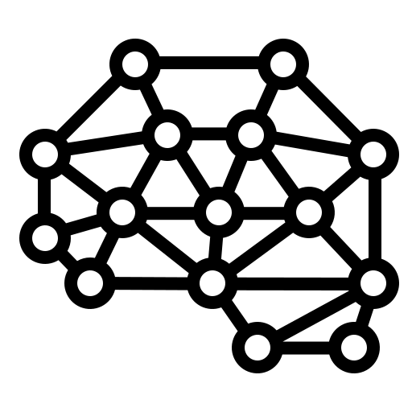
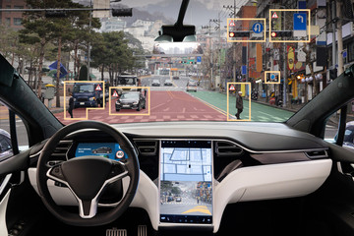
Neural Networks today
Deployed in an increasing variety of domains
Continuously renewed (industry & academia)
At the heart of various autonomous systems:
Autonomous robots
Unmanned vehicles
Deployed in more and more critical domains:
Medical decisions
Autonomous vehicles with passengers

Slide 3
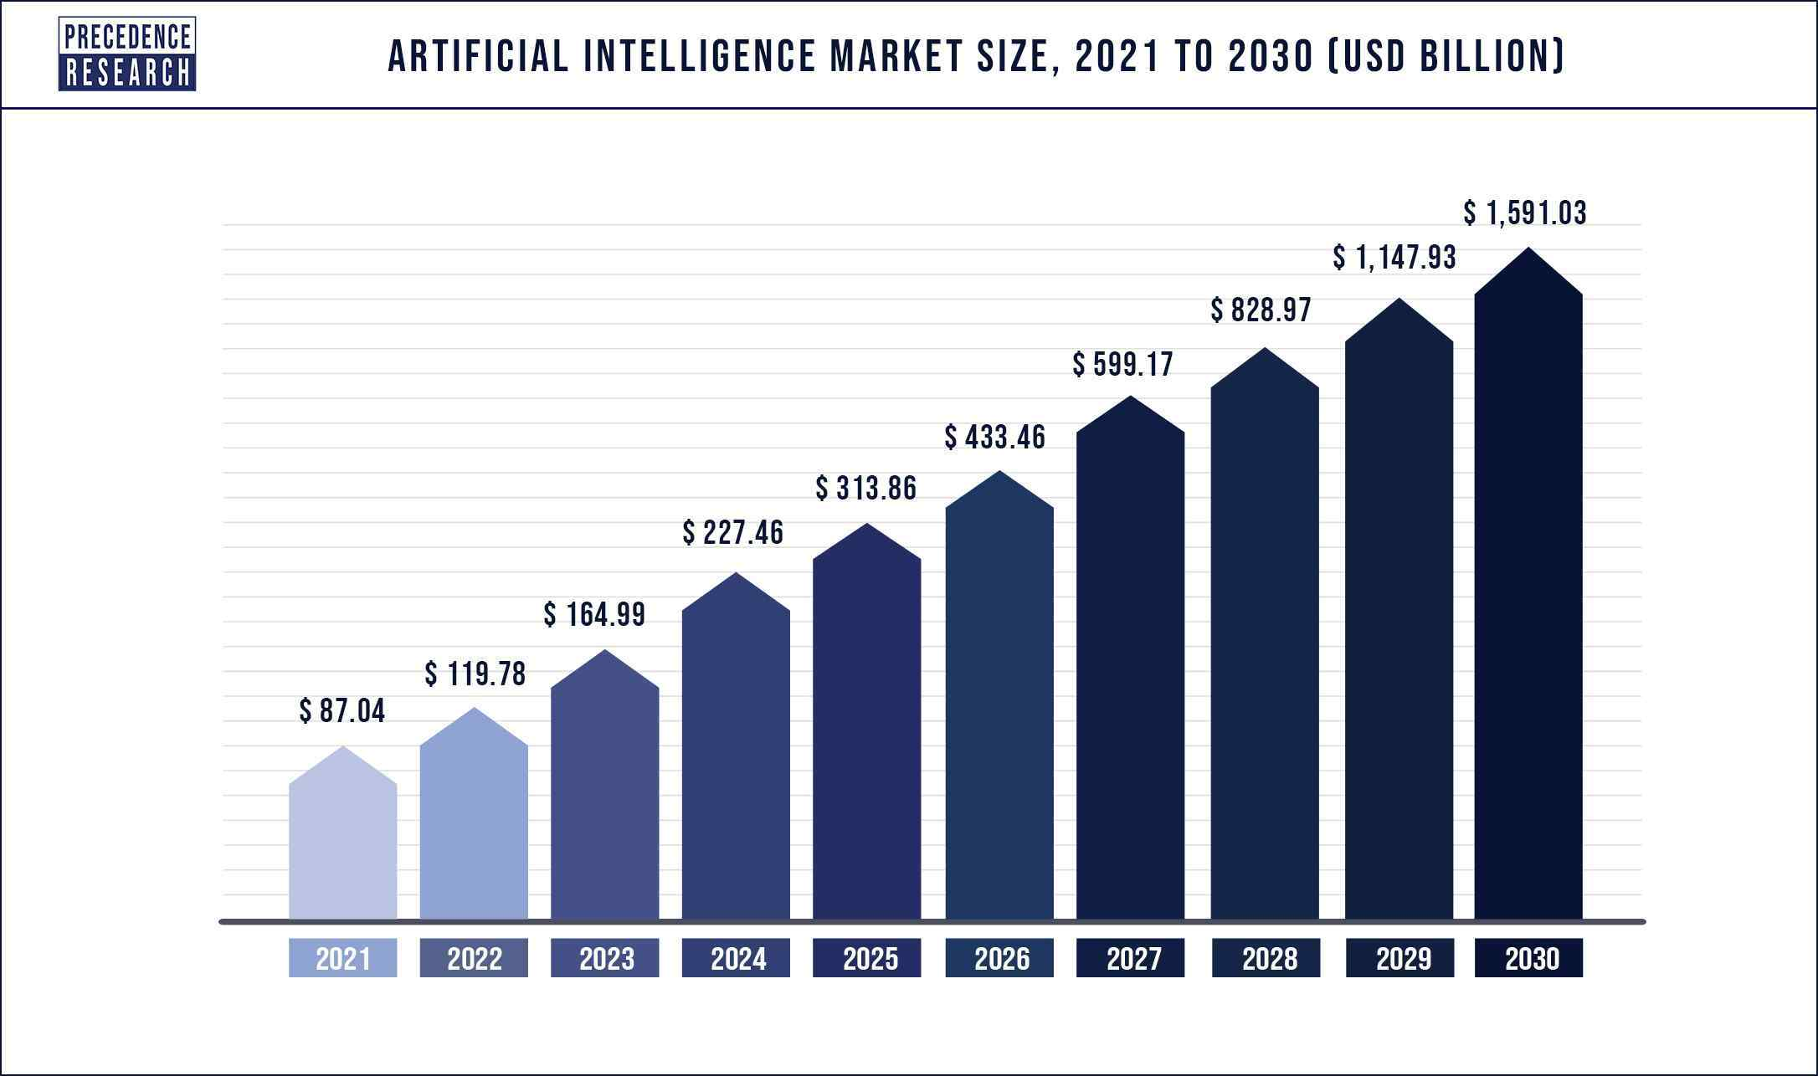
Why watermarking is useful for Neural Networks
Machine learning is a costly field:
Buying AI solution ranges from $ 6000 to $300.000
Renting a pre-built module costs around $ 40.000/year
An AI solution could:
use multiple alternative Neural Networks to provide an inference -> identifying the one that actually produced the inference is important
be shared among multiple users -> keeping track of this process is useful
be altered or maliciously attacked -> identifying such modifications avoid faulty functioning
Ensuring traceability and integrity of Neural Networks becomes mandatory

Slide 4
Neural Network Traceability synopsis
Traceability enables identification of the origin or verification of the integrity of data.
For NN, Traceability enables understanding and tracking the distribution, storage, exchange, use, and evolution of NN models.
NN Traceability can be divided into 2 categories:
Watermarking (active) which alters the model
Fingerprinting (passive) which does not alter the model
Watermarking
Fingerprinting

Slide 5
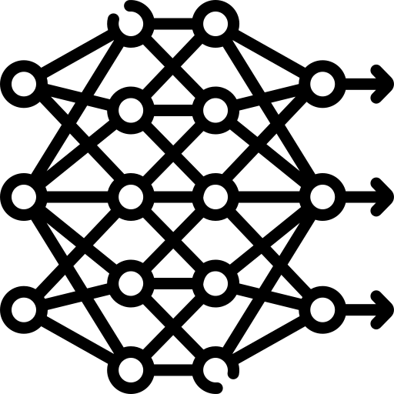
Neural Network Watermarking synopsis
Watermarking provides tools allowing to imperceptibly and persistently insert some data into original content
Watermarking Neural Network is a challenge:
Watermark insertion is not static (as it was for media) but dynamic, as the watermark can also be:
inserted during training
detected from inference
Evaluation of watermark impact on inference is much more complex than on multimedia quality
Imperceptibility
Watermarking
Robustness
Data payload

Slide 6
Neural Network Fingerprinting synopsis
Fingerprinting provides tools allowing to extracts NN identification data from the NN parameters or its inference and matches it to a known repository.
Fingerprint extractor
Fingerprint
detector
Uniqueness
Fingerprinting
Attacks
Robustness
Search efficiency
data
Training

Slide 7
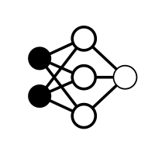
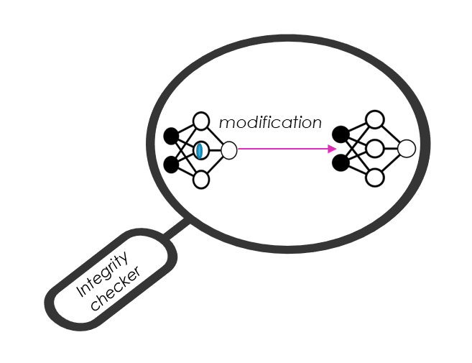
Neural Network Traceability use cases
Identify an NN
The retrieved data conveys information about the NN itself.
Verify the integrity of an NN
The retrieved data conveys information about NN integrity.
Identify the actors of an NN
The Payload conveys information about some or all the actors.
Multiple Watermarking
The Payload conveys information about how multiple users may change the NN.
input
output
Detector
NN - 007
input
output
Detector
MPAI
property

Slide 8
Scope of the MPAI-NNT Standard
MPAI-NNT specifies methodologies to evaluate the following aspects of a neural network Traceability technology:
How well a Neural Network Traceability detector/decoder/matcher can detect/decode/match a Traceability Data when the traced neural network has been modified.
The computational cost of injecting, extracting, detecting, or matching of a neural network.
Specifically for active method (watermarking) - The impact on the performance of a watermarked neural network and/or on its inference.

Slide 9
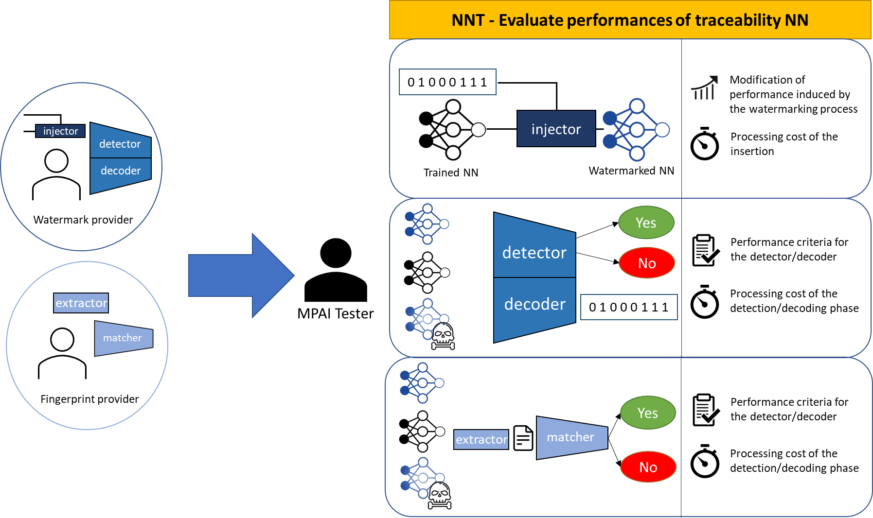
Scope of the MPAI-NNT Standard

Slide 10
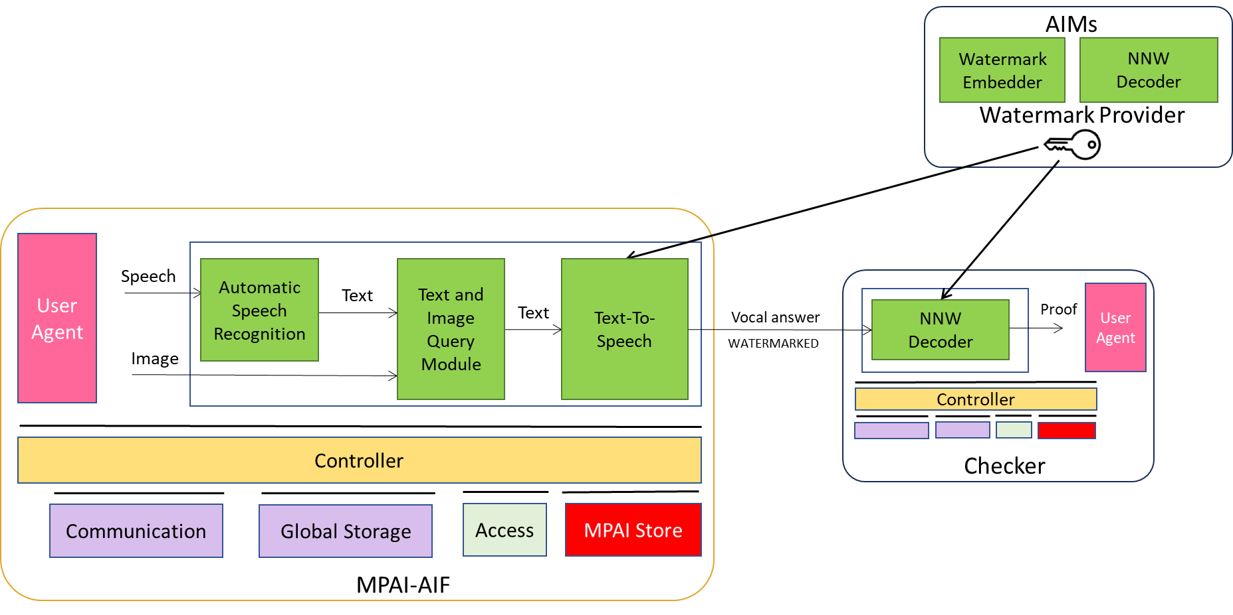
NNW-DC history (1/2)
Timeline of the group:
January 2022
Interest collection
GA16
April 2023
Reference Software
GA30
January 2024
AMQ watermarking
GA39
September 2024
Towards UI for AMQ
GA48
Reference Software for NNT
January 2023
Technical specification NNW
GA28
November 2023
IEEE 3304
April 2024
MCUs watermarking GA43
November 2024
Technical Specification NNT
GA50

Slide 11
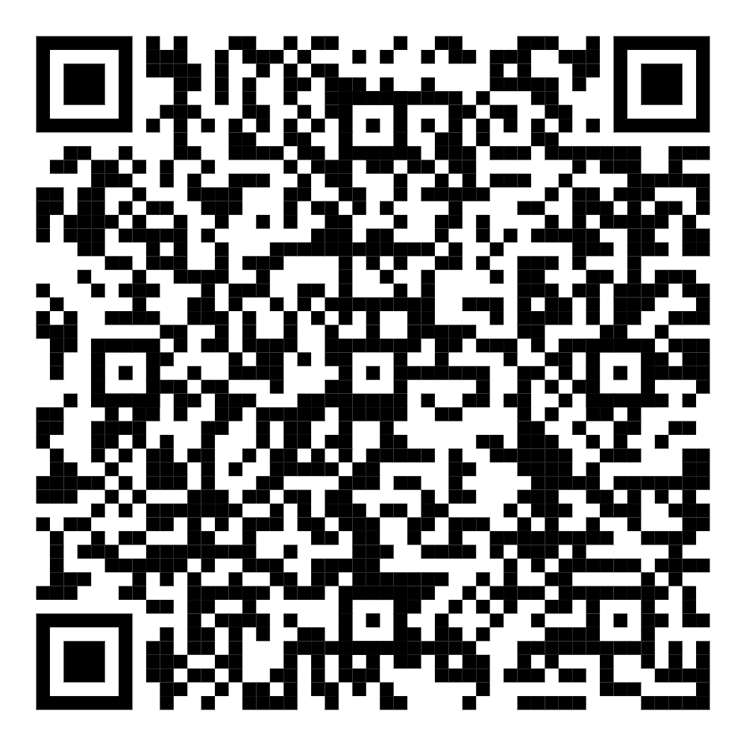
NNW-DC history (2/2)
Current state of the Reference Software (v1.2):
Case 1: implementation of the standard on a classification task and two watermarking methods
Case 2: extension of Case 1 under AIF (in Python)
Case 3: AI generative use case: “multimodal query with watermarking”
Case 4: NN-based image classification methods for low power and low resources devices
Join the fun:
https://experts.mpai.community/software/mpai-nnw/referencesoftwarev12

Slide 12
NNW-DC Next steps
Creation of the Neural Network Traceability Reference Software
Create the IEEE SA Open Reference Software of our project
Keep on exploring complementary security use cases

Slide 13
https://www.mpai.community/
https://mpai.community/how-to-join/
https://mpai.community/standards/mpai-nnw/
MPAI-NNW RS available at:
https://experts.mpai.community/software/mpai-nnw
Join MPAI
Share the fun
Build the future
13
13
13
13

