Slide 1

MPAI Context-based Audio Enhancement (MPAI-CAE)
Six Degrees of Freedom (CAE-6DF) Audio For XR
Prof. Marina Bosi
MPAI Founding Director and MPAI-CAE Chair
CCRMA, Stanford University
LASIGGRAPH-Emerging AI Standards for XR

Slide 2
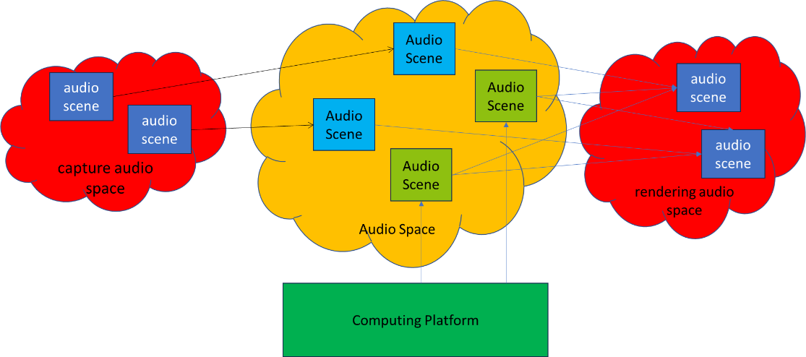
CAE-6DF Concept
The audio scenes captured in an audio space (e.g., a concert hall, theatre, church) or audio objects with specific spatial acoustical attributes are converted to CAE-6DF Audio Scenes in CAE-6DF Audio Space
CAE-6DF Audio Scenes in CAE-6DF Audio Space are rendered in a rendering audio space (e.g., a user’s living room) and interact with the end user

Slide 3
Scope of CAE-6DF
Goal:
  To develop Technical Specifications (CAE-6DF TS) for immersive audio that shall enable realistic auditory experiences in real/virtual environments, responding to locomotive/translational motion of sources and users
Key Aspects:
  Representation of both static and dynamic (i.e., moving) audio entities
  Provisions for integration with visual elements (e.g., volumetric visual content) to support audiovisual immersion
  Low latency and high responsiveness

Slide 4
Use Cases Overview
Immersive Content
  Enhances the sense of presence and realism
  Allow users to interact naturally within the virtual environment
  Diverse applications in, for example, entertainment and education:
    Examples: concerts, radio dramas, lectures, opera/theatre/dance performances, documentaries

Slide 5
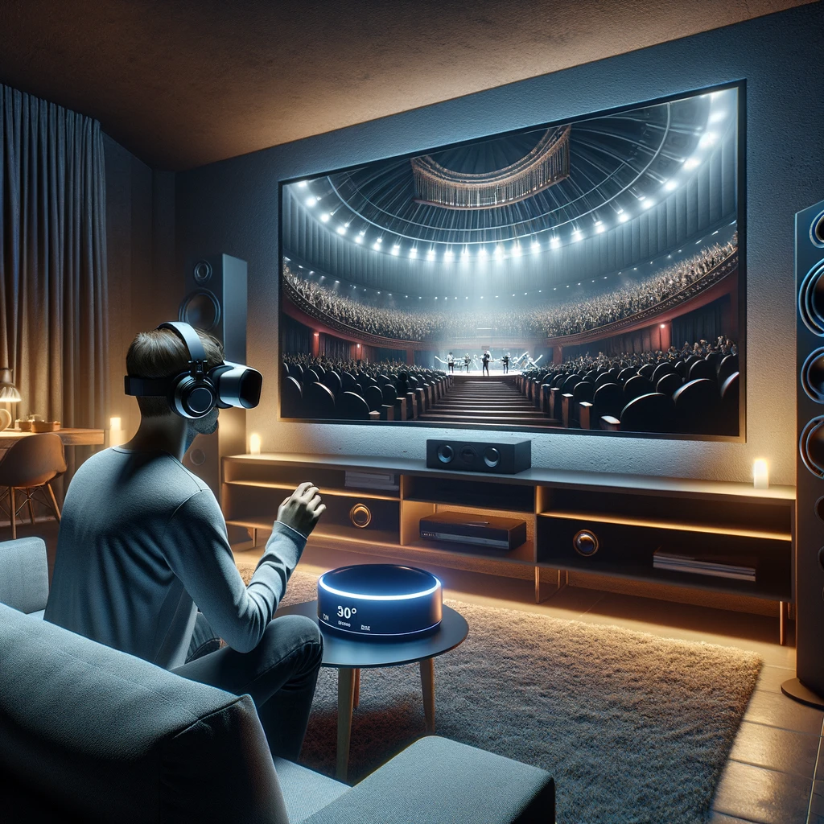
Use Case 1
Immersive Concert Experience
User experiences a concert as if they are in a concert hall
Key Features:
Immersive audio rendering replicates the concert hall acoustics
Spatial and temporal synchronization with 360° video
User movement within the living room corresponds to changes in the audio experience
This image was generated with the assistance of AI.

Slide 6
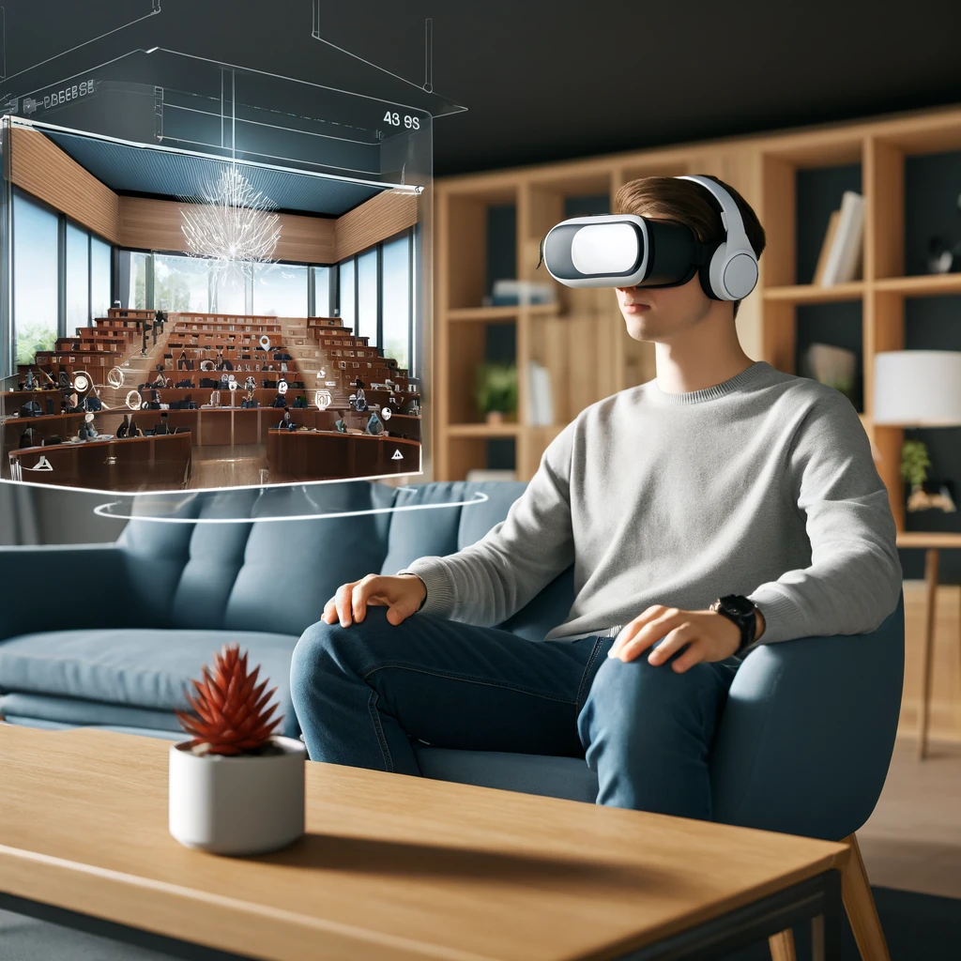
Use Case 2
Virtual Lecture
User uses an immersive audio-visual display to attend a virtual lecture
Key Features:
Audio to accompany 360° videos captured at different points in a lecture theatre
User can physically walk or be virtually teleported to different perspectives
Synchronization with 360° video enhances the learning experience
This image was generated with the assistance of AI.

Slide 7
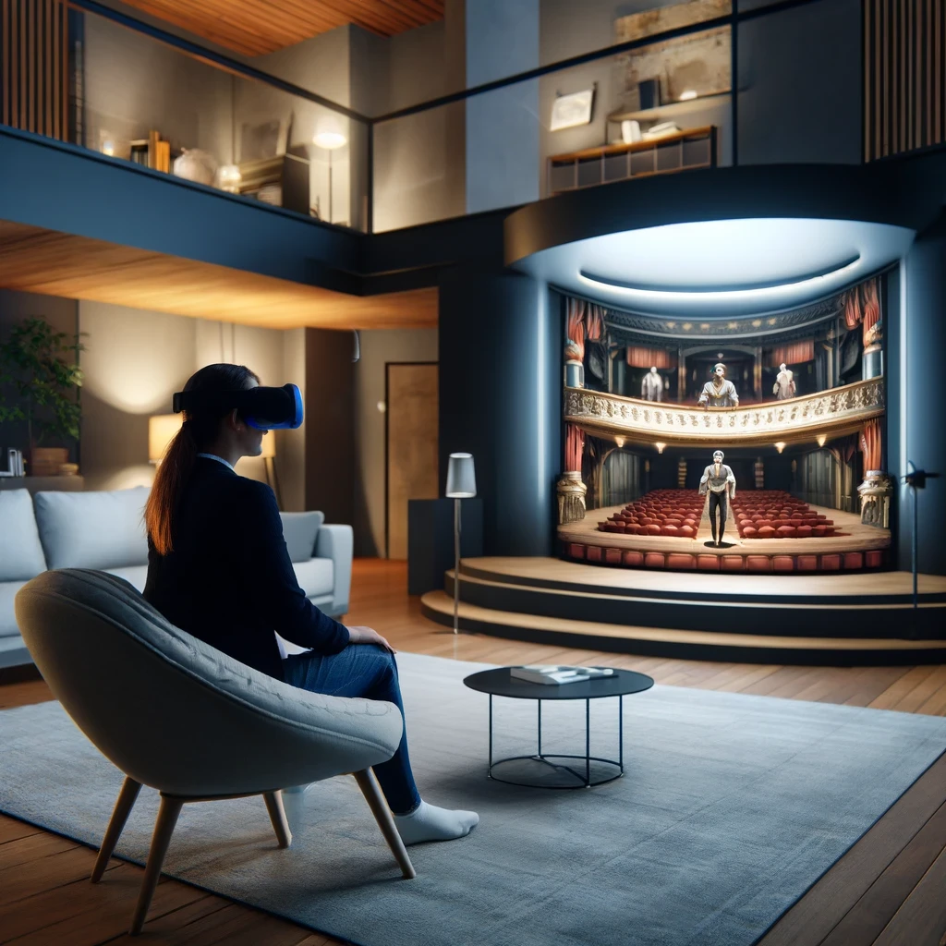
Use Case 3
Immersive Theatre Experience
User experiences opera, ballet, dance, or theatre in 360° or 6DoF
Key Features:
Move within the living room to experience different perspectives (e.g., on stage, different seats)
Immersive audio recorded during an actual performance brings user-defined listening perspectives
This image was generated with the assistance of AI.

Slide 8

CAE-6DF Call for Technologies issued | 2024/05/15 | 17:00 UTC
Response evaluation | 2024/09/30
MPAI-CAE 6DF Technical Specifications | 2025/12/30 | (Estimate)

Slide 9
CAE-6DF Submissions
Proposal 1: Object-based
Audio Objects and metadata for perceptual representation
Allows for creative and flexible audio experiences
Proposal 2: Scene-based
Accurate reconstruction of the audio scene
High degree of correspondence to the original acoustic environment

Slide 10
CAE-6DF Technical Specifications Profiles
1. Object-based:
Audio Objects and metadata for perceptual representation
Allows for creative and flexible audio experiences
2. Scene-based:
Accurate reconstruction of the audio scene
High degree of correspondence to the original acoustic environment
3. Hybrid:
Combination of scene-based and object-based content
Enhances the richness and depth of the audio experience

Slide 11
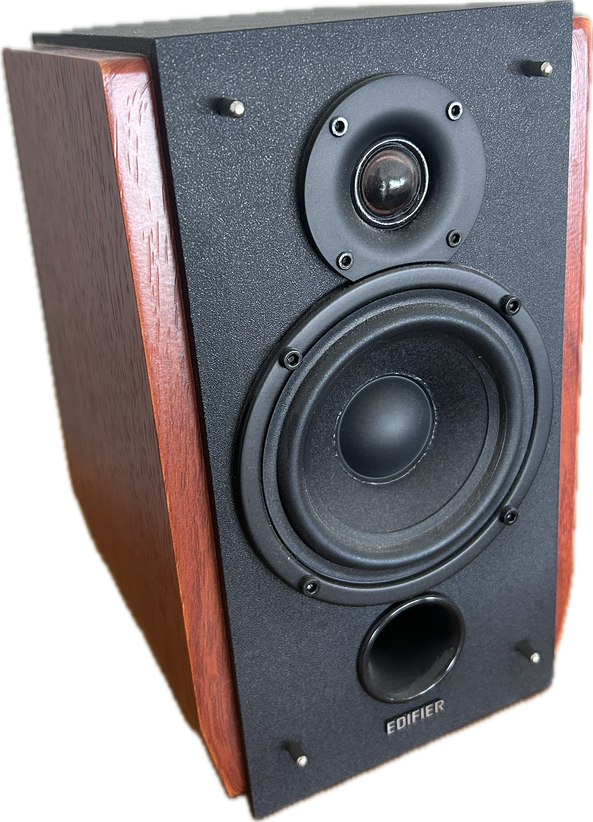
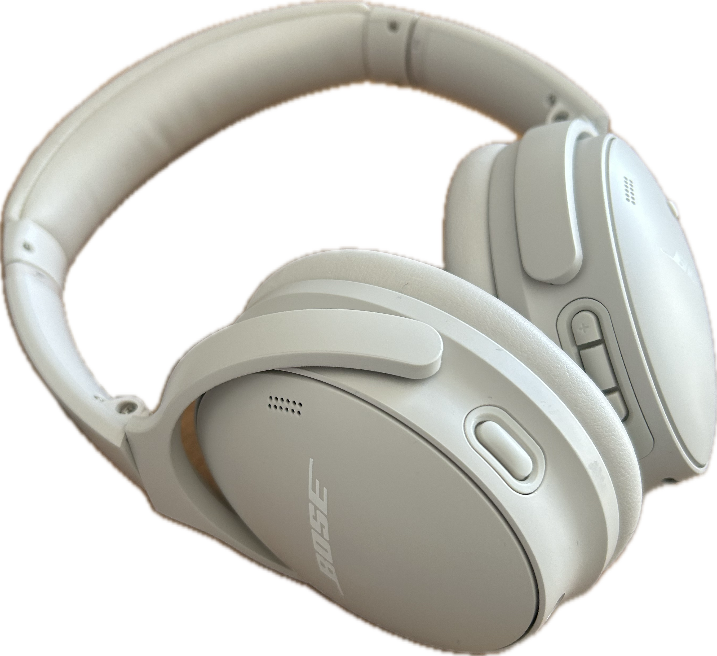
Rendering Modalities
Loudspeaker-based:
Content delivered through (at least two but potentially more) loudspeakers
Provides a room-filling audio experience
Headphone-based:
Content delivered through headphones
Ensures immersive audio experience without external disturbances

Slide 12
Latency Requirements
Ideal Range of Latency:
20 ms (up to 50 ms) from movement to rendering
The technology shall…
Ensure high responsiveness to user movements
Minimize delay to enhance the immersive experience

Slide 13
Summary - MPAI-CAE 6DF
Provide full auditory immersion for XR Venues
Be compatible with immersive visual content and state-of-the-art VR systems and controllers
Provide both loudspeaker and headphone-based rendering capabilities
Provide low latency (20-50 ms) and be highly responsive

Slide 14

Marina Bosi
This Photo by Unknown Author is licensed under CC BY-NC

Slide 15

Join the fun, build the future!
https://www.mpai.community/
15

