Slide 1
The MPAI Metaverse Model (MPAI-MMM) standard
Andrea Bottino, MPAI
SIGGRAPH LA Panel: Emerging AI Standards for XR
Online, 2025/01/18
.

Slide 2

M-Instance: an ICT platform populated by Processes
  Sense data from U-Locations (real world)
  Produce/act on Items from its own or other M-Instances.
  Affect U- & M-Environments using Items in ways that are:
    Consistent with the M-Instance goals.
    Within the M-Instance Capabilities.
    According to the M-Instance Rules.
    Respecting applicable laws & regulations.
  Operate to provide the MPAI-MMM Functionalities.

Slide 3
A metaverse instance (M-Instance)
Is administratively subdivided in M-Environments.
Allows humans to Register with the M-Instance or its M-Environments:
  Requesting a subset of their Personal Profiles.
  Obtaining a set of Rights.
Behaves as if implemented as a set of Processes:
  Having Process Capabilities to perform Process Actions on Items (if they hold the Rights to do that).
  Requesting other Processes to perform Actions (inter-Process Protocol)
Enables a Process:
  To communicate with another M-Instance (Inter-M-Instance Protocol.
  To obtain conversion of an Item’s Data Format via a Conversion Service.

Slide 4

Inter-M-Instance Protocol
Request-Action_{A1}
Resolution Service_{A}
Resolution Service_{B}
Response-Action_{A2}
Request-Action_{A1}
Response-Action_{A3}
Response-Action_{A2}
Request-Action_{A1}
Process_{A3}
Process_{B2}
Process_{A2}
Process_{A1}
Process_{A4}
Process_{B4}
Process_{B1}
Process_{B3}
M-Instance_{A}
M-Instance_{B}
Item_{A3}
Item_{A2}
Item_{A2}
Item_{A1}
Conversion Service
Conversion Service

Slide 5
Four Types of Processes
Four types of Processes:
  Device: a Process running on a physical device connecting M-Locations to U-Locations, including humans, by:
    Capturing scenes as Media and providing Media as Data/Metadata to be Identified as an Item to enable application of Actions (U-Location to M-Location).
    Receiving and rendering an Item as Media with a Spatial Attitude, i.e., Position and Orientation (M-Location to a U-Location).
  User: represents and is under the control of a human Registered with the M-Instance. May run on the M-Instance or on a Device connected to the M-Instance.
  Service: provides specific functionalities.
  App: runs on a Device that may also run the User Process as an App.

Slide 6


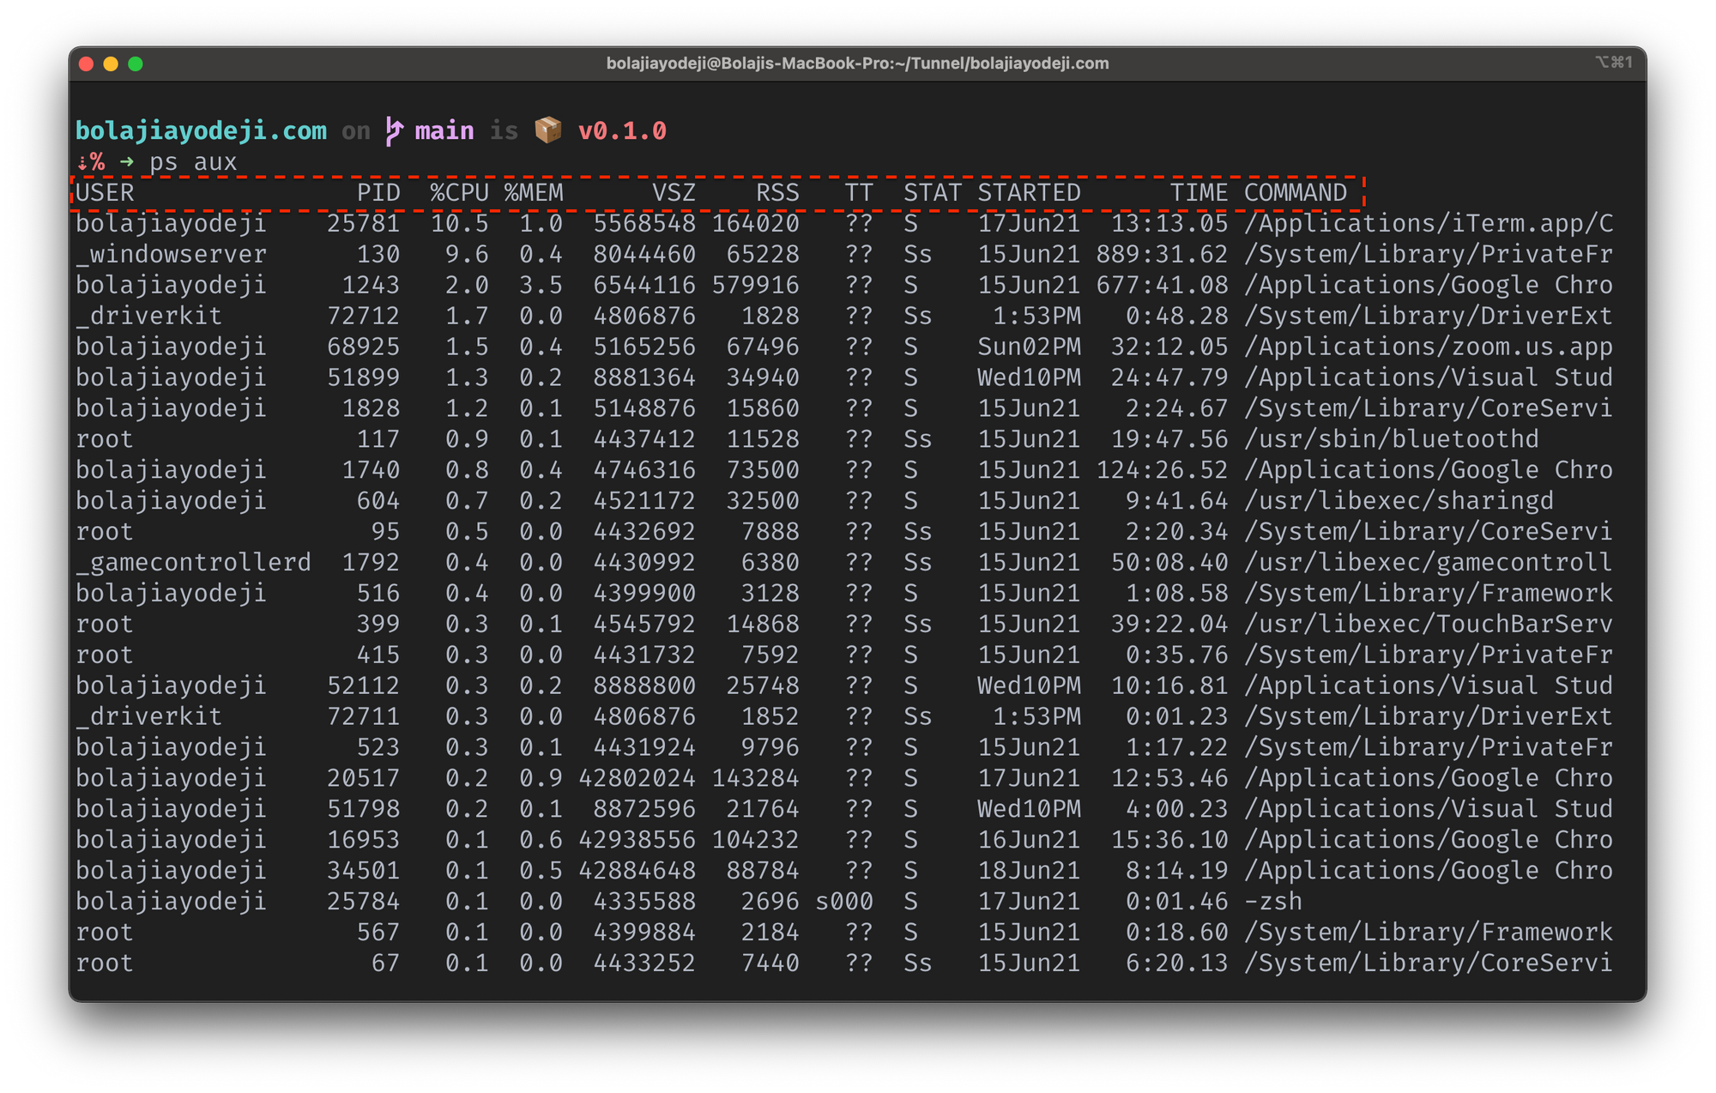


Devices – Users – Services – Personae
Universe
Metaverse
Human Device User
App
User
Persona1
Device
User
Service
Persona2

Slide 7





Summary of the main MPAI-MMM elements
Persona
Auton.User
Device
User
Resolut.Service
Resolut.Service
User
Item
Device
App
Metaverse A
Metaverse B
Service
Service
Persona

Slide 8
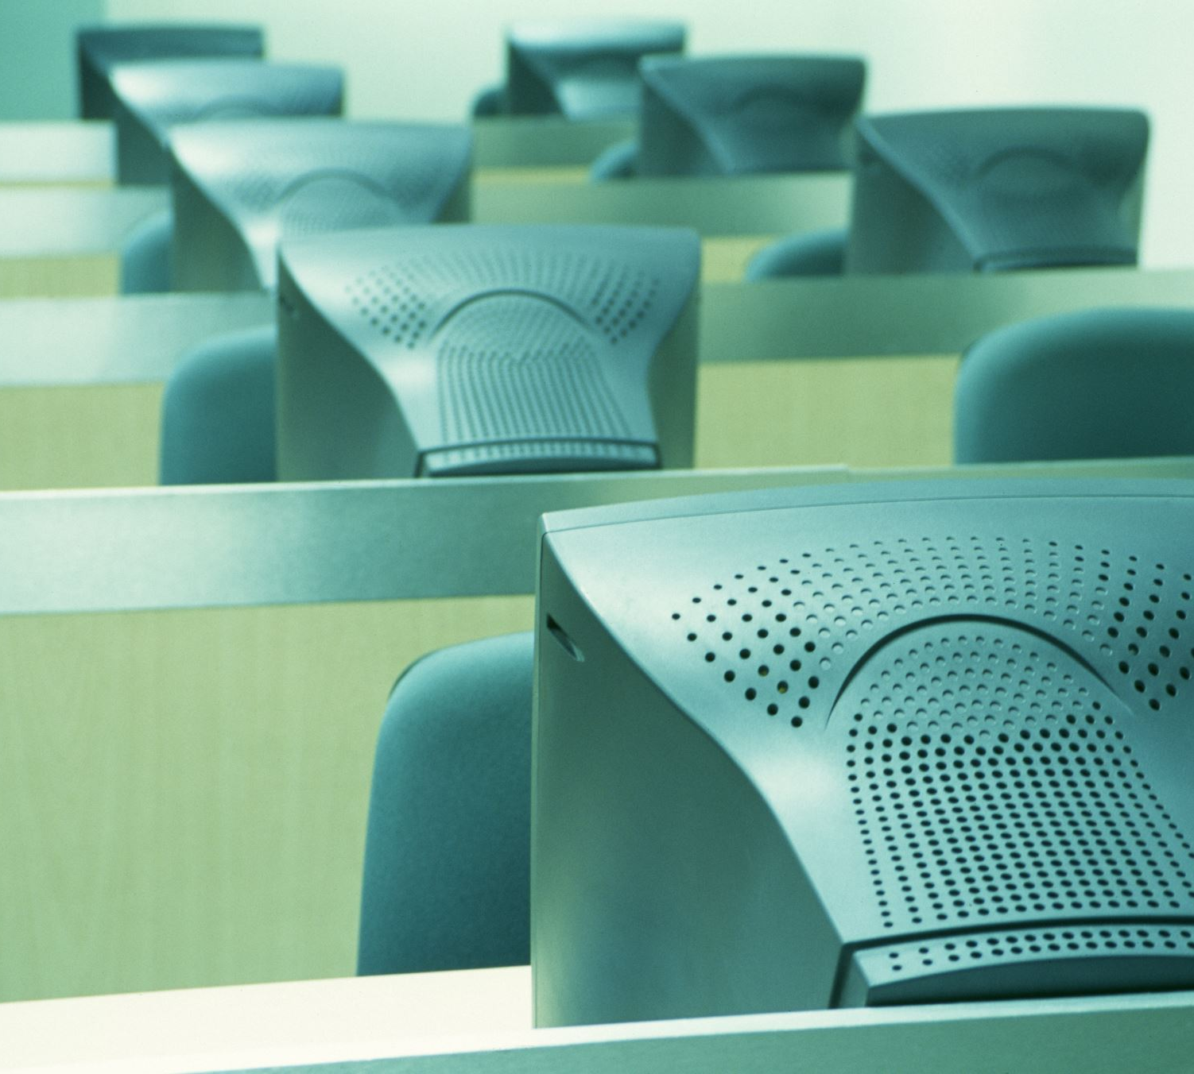
Functional Requirements: Processes
App
Device
Service
User

Slide 9
Functional Requirements: Actions
General Actions | Call a Service | MV to MV | MV to UV | UV to MV
Register | Author | MM-Add | MU-Actuate | UM-Animate
Change | Discover | MM-Animate | MU-Embed | UM-Capture
Hide | Inform | MM-Disable | MU-Send | UM-Embed
Authenticate | Interpret | MM-Embed | Track | UM-Send
Identify | Post | MM-Enable
Modify | Transact | MM-Send
Validate | Convert
Execute | Resolve

Slide 10
Items/1
General | Contract | E-Capabilities | Identifier | M-Capabilities
 | M-Environment | M-Instance | Program | Rights
 | Rules | U-Environment
Human & User | Account | Activity Data | Personal Profile | Personal Data
Process Interaction | Message | P-Capabilities | Process Action | Request-Action
 | Response-Action
Service Access | Authentication | Discovery | Information | Interpretation
Finance | Amount | Asset | Currency | Provenance
 | Transaction | Value | Wallet

Slide 11
Items/2
Perception | Audio Basic Scene Descriptors | Audio Object | Audio Scene Descriptors | Audio-Visual Basic Scene Descriptors
 | Audio-Visual Event Descriptors | Audio-Visual Object | Audio-Visual Scene Descriptors | Model
 | Stream | Visual Basic Scene Descriptors | Visual Object | Visual Scene Descriptors
 | Summary
Internal State | Cognitive State | Emotion | Personal Status | Social Attitude
Space &Time | Basic M-Location | Basic U-Location | M-Location | Orientation
 | Point of View | Position | Space-Time | Spatial Attitude
 | Time | U-Location | Universe-Metaverse Map

Slide 12
MPAI-MMM uses many data types
Data types specified by
MPAI-MMM, but also by:
MPAI-CAE (Audio)
MPAI-MMC (Human-Machine-Conversation)
MPAI-OSD (Object and Scene Description)
MPAI-PAF (Portable Avatar Format)

Slide 13
MPAI-OSD V1.2 Data Types
Audio-Visual Object
Audio-Visual Basic
Scene Descriptors
OSD
Instance Identifier
Coordinates
Space-Time
…

Slide 14
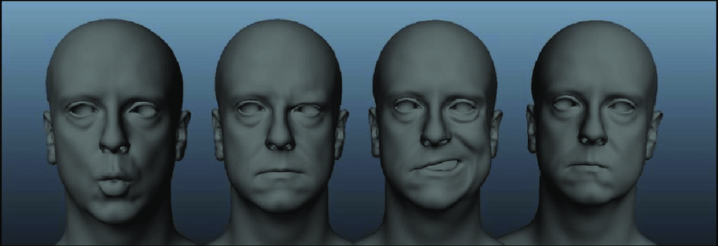
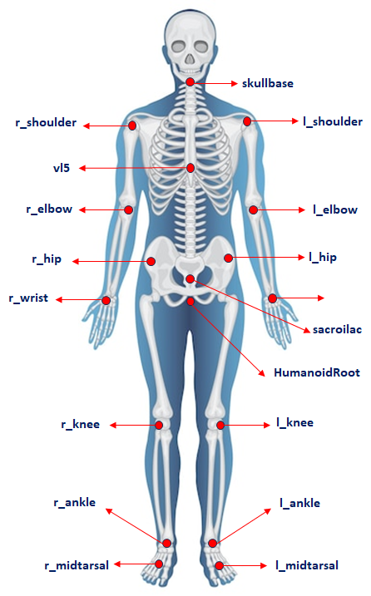


PAF V1.3 Data Types
Face Descriptors
PAF
3D Model Object
Portable Avatar
Body Descriptors
Gesture Descriptors

Slide 15
PAF V1.3 Data Types
3D Model Object | Avatar | 3D Model Basic Scene Descriptors | 3D Model Basic Scene Geometry
3D Model Scene Descriptors | 3D Model Scene Geometry | Body Descriptors | Face Descriptors
Gesture Descriptors | Portable Avatar

Slide 16
MPAI-OSD V1.2 Data Types
Annotation | Audio-Visual Basic Scene Descriptors | Audio-Visual Basic Scene Geometry | Audio-Visual Event Descriptors
Audio-Visual Object | Audio-Visual Scene Descriptors | Audio-Visual Scene Geometry | Basic Location
Bounding Box | Coordinates | Instance Identifier | Location
Orientation | Path | Perceptible Entity | Point of View
Position | Right Parallelepiped | Selector | Space-Time
Spatial Attitude | Time | Trajectory | Visual Basic Scene Descriptors
Visual Basic Scene Geometry | Visual Object | Visual Scene Descriptors | Visual Scene Geometry

Slide 17
Avatar Interoperability: Portable Avatar
Portable Avatar coveys the following information:
Avatar Data The M-Instance in which the Avatar is located.
  The Space-Time of the Avatar.
  The Language Preference of the Avatar.
  The Text the Avatar is associated with, or which will be converted into a Speech Object.
  The Speech Model used to synthesise Text.
  The Speech Object that the Avatar utters.
  The Personal Status of the Avatar.
Environment The ID of the Virtual Space
The Space-Time information of the Avatar in the Audio-Visual Scene.

Slide 18
Process Action
The Action that a Process has performed or can/will (ask to) perform.
Specifying: the Item or Data acted on and Time or Action
The Complements related to additional Items
At | Service | User | MLoc | ULoc | The location of the Item (with Spatial Attitude).
By | Service | Service Used by Process to perform Action.
From | Address | ULoc | The location of the Item.
Into | Item | The Item resulting from the Action.
Of | User | The User the Item refers to.
To | Address | Device | Process | User | The location of the Item (with Spatial Attitude).
With | Data | Stream | Additional Item required to perform Action.

Slide 19
Practicing Process Actions
Composite Action | Process_{A} | Actions | Item | Indirect object
 | User | Identifies | Data | Into Item
 | User | Transacts | Item | To User To Service By Service
 | User | Modifies | Item | Into Item
 | User | MM-Animates | Item | With Stream
 | User | Converts | Item | By Service Into Item At User
MM-Embed | User | - MM-Adds | Item | At M-Location With SpAtt
 | User | - MM-Enable | Item | At M-Location
MU-Embed | User | - MM-Sends | Item | To Device
 | Device | - MU-Actuates | Item | At U-Location With SpAtt
UM-Embed | Device | - UM-Captures | Media | From U-Location
 | Device | - UM-Sends | Data | To User
 | User | - Identifies | Data | Into Item
 | User | - MM-Embeds | Item | At M-Location With SpAtt

Slide 20
A use case: Dancing in the metaverse/1
Dance teacher
  Places Persona_{1.1} (an NPC playing virtual secretary) at MLoc_{1.1}
Student #1:
  Shows up as Persona_{2.1} at MLoc_{2.1}
  Greets Persona_{1.1}.
Persona_{1.1} reciprocates.
Dance teacher:
  Places and drives haptic Persona_{1.2} at MLoc_{1.2} close to Persona_{2.1}.
  Dances with Persona_{2.1}.
Student #2 shows up as Persona_{3.1} at MLoc_{3.1}
Dance Teacher:
  Places and drives Persona_{1.2} at MLoc_{1.3} close to Persona_{3.1}.
  Places haptic Persona_{1.3} at MLoc_{1.2}.
  Animates Persona_{1.3} with agent to dance with student #1.
  Dances with Persona_{3.1}

Slide 21
A use case: Dancing in the metaverse/2
Who | Process | ActsOn | Item | Secondary object
Teacher | User₁ | Tracks | Persona_{1.1} | At MLoc_{1.1} (H) With SpAtt
 |  | MM-Embeds | Persona_{1.1} | At MLoc_{1.2} (S) With SpAtt
 |  | MM-Disables | Persona_{1.1} | From MLoc_{1.1} (H)
 |  | MM-Embeds | Persona_{1.2} | At MLoc_{1.3} (S) With SpAtt
 |  | MM-Animates | Persona_{1.2}
Student#1 | User₂ | Tracks | Persona_{2.1} | At MLoc_{2.1} (H) With SpAtt
 |  | MM-Embeds | Persona_{2.1} | At MLoc_{2.2} (S) With SpAtt
 |  | MM-Disables | Persona_{2.1} | From MLoc_{2.1} (H)
Teacher | User₁ | MM-Embeds | Persona_{1.1} | At MLoc_{1.4} (S) With SpAtt
Student#2 | User₃ | Tracks | Persona_{3.1} | At MLoc_{3.1} (H) With SpAtt
 |  | MM-Embeds | Persona_{3.1} | At MLoc_{3.2} (S) With SpAtt
 |  | MM-Disables | Persona_{3.1} | From MLoc_{3.1} (H) Home
Teacher | User₁ | MM-Embeds | Persona_{1.3} | At MLoc_{1.5} (S) With SpAtt
 |  | MM-Embeds | Persona_{1.1} | At MLoc_{1.4} (S) With SpAtt
 |  | MM-Disables | Persona_{1.1} | From MLoc_{1.5} (S)
 |  | MM-Embeds | Persona_{1.1} | At MLoc_{1.1} (H) With SpAtt
H=Home, S= School

Slide 22
Implementing MPAI-MMM
User1 | User2
Calls Activity Service and posts User₁=On
Calls Parcel Service and gets Parcel_{1.1}
Calls Author Service and gets Room_{1.1}
Places Room_{1.1} at Parcel_{1.1} (MLoc_{1.1})
Places and animates Persona_{1.1} at MLoc_{1.2} (Room_{1.1})
Calls Activity Service Posts User₂=? Receives User₂=On
Sends text message to User₂ “come to Room_{1.1}” | Sends text message to User₁ “OK”
Enables User₂ to enter Room_{1.1} | Places Persona_{2.1} at MLoc_{1.2} (Room_{1.1})
Converses | Converses
 | Leaves Room_{1.1}
Disables User₂ from entering Room_{1.1}.

Slide 23
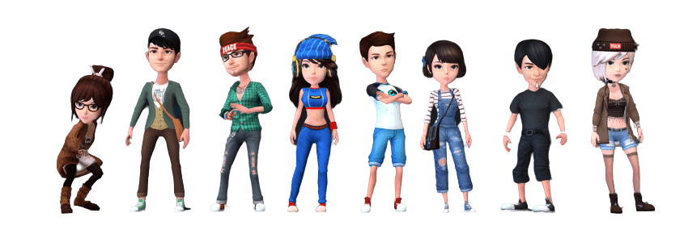








MPAI-MMM – Implementation (Phase 0)
User1
Persona1
User2
Persona2
MMM-CLIENT-1
MMM-Client2
Unity1
Device1
Unity2
Device2
Phase 0
human1
human2
Activity Service
Author Service
Right Service
MMM Service
Parcel Service
Registration Service
Identify Service
Unity
Unity
DB
WEB API SERVER
MMM SERVER
[Square]
MMM SERVER
[ROOM N]
METAVERSE SERVER
23

Slide 24


We look forward to working
with you
on this exciting MPAI project!
https://mpai.community/standards/mpai-mmm/
Join MPAI
Share the fun
Build the future
24
24
24
24

