Slide 1
AI-Powered XR Venues (MPAI-XRV)
2025 January 18
Ed Lantz
Vortex Immersion
ed@vortexdomes.com

Slide 2
What is an XR Venue?
“XR”: Extended Reality (Virtual Reality, Augmented Reality, Mixed Reality etc.)
“Venue”: Synonym for both real and virtual environments.
XR venues can host events spanning both Real and Virtual Environments
Elements of the Real Environment are mirrored in the Virtual Environment
  Digital Twins (including avatars and environmental elements)
  Various HMI’s: VR headsets, desktop, mobile
Elements of the Virtual Environment are mirrored in the Real Environment
  Immersive displays: spheres, domes and rectilinear spaces
  AR glasses, mobile AR
  Projection mapping onto architectural surfaces
Participants can attend and interact in the Real or Virtual Environment

Slide 3
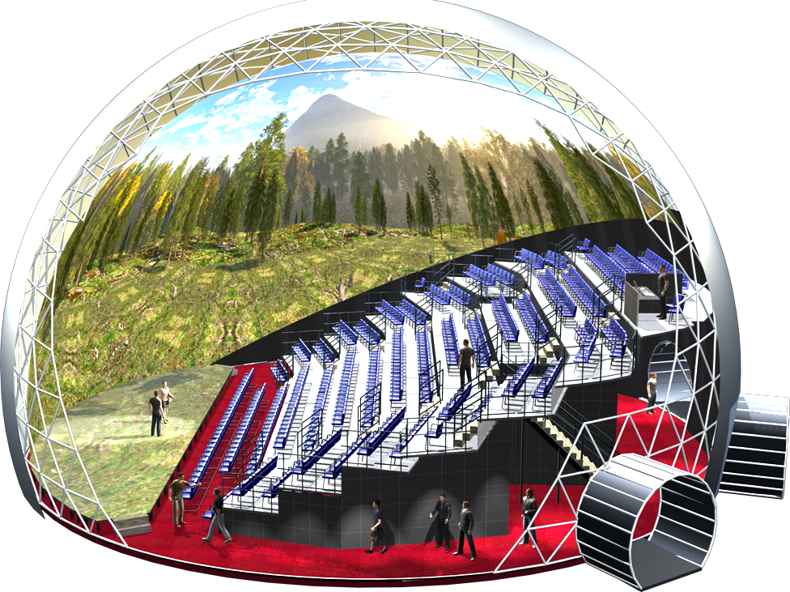
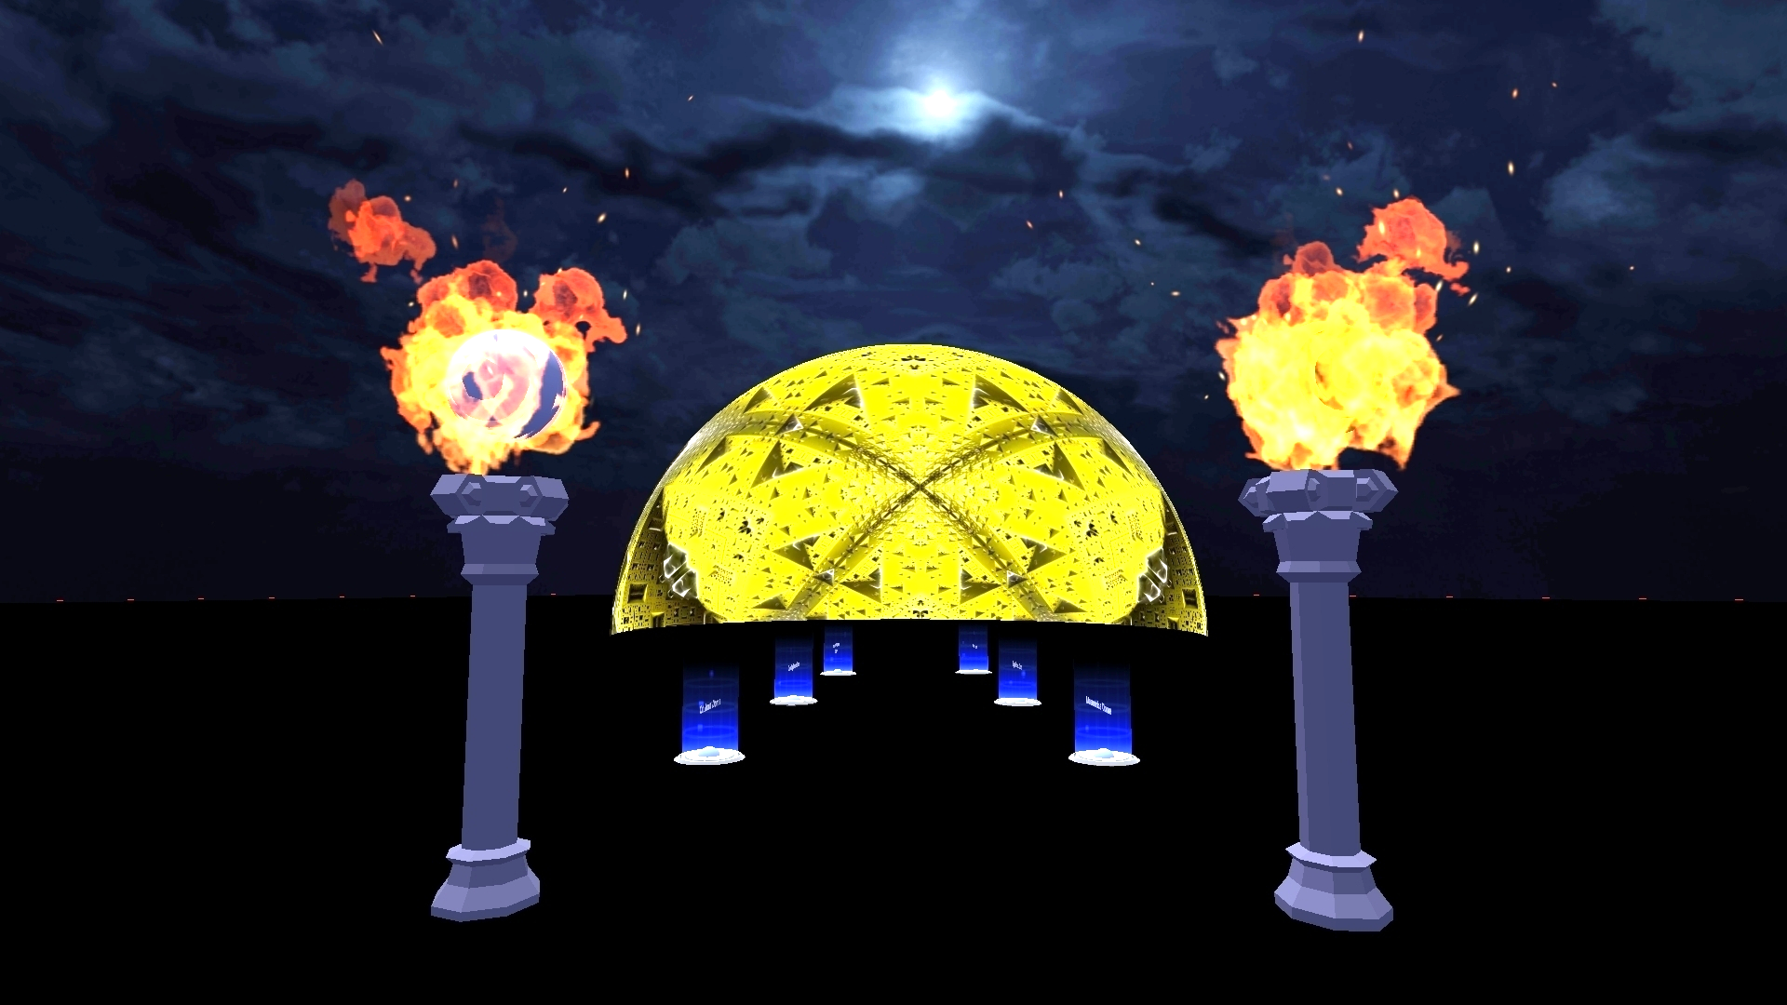

XR Venue Example
VR/AR EXPERIENCES
VR Theater
Mixed Reality
AR Experiences
FULLDOME CINEMA & LIVE SHOWS
Digital Dome Cinemas
Planetariums
Giant Screen Theaters
Dome CineTheaters
Real Environment
(Immersive Theater)
Concurrent
Event
Virtual Environment
(Metaverse)
VIRTUAL ENVIRONMENTS
Metaverse
MMORPG’s
Games
STREAMING
Mobile Media
Streaming Events
OTT Television

Slide 4
XR Venues (MPAI-XRV)
Use cases considered so far:
Live Theatrical Stage Performance
eSports Tournament
Experiential retail/shopping
Collaborative immersive laboratory
Immersive art experience
DJ/VJ performance at a dance party
Live concert performance
Experiential marketing/branding
Meetings/presentations

Slide 5
Live Theatrical Performance Use Case (LTP)
Purpose: Define interfaces and functions of AI Modules to facilitate live multisensory immersive performances integrating Real & Virtual Environments
  Live events require extensive on-site show control staff to operate
Theatrical performances (Broadway theatre, musicals, dramas, operas, etc.) increasingly use video scrims, backdrops, and projection mapping to create digital sets, reducing the cost of mounting shows
  Immersion domes/ LED volumes surround live audiences with Virtual Sets that performers inhabit and interact with
  Portal into the Metaverse for a live theater audience
  Live performers in the Real Environment are brought into the Metaverse

Slide 6
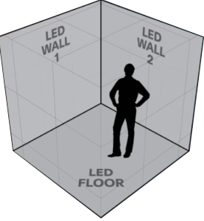
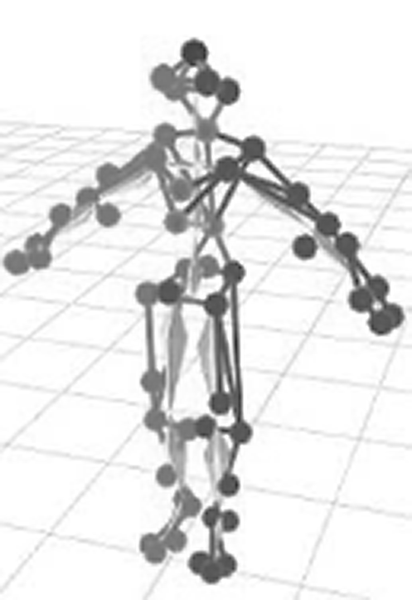
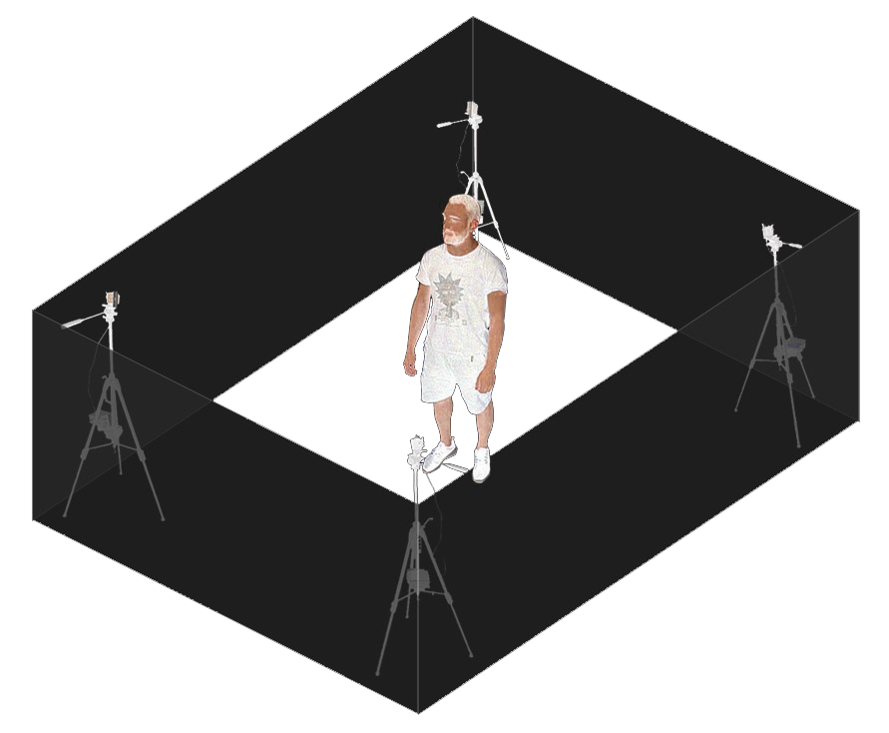

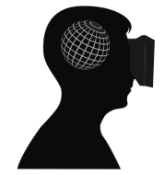

XR Venue
System
Remote Performers
XR Stage Mocap Stage Volumetric Stage
Web5
Decentralized
Backend
VR/AR EXPERIENCES
VR Theater
Mixed Reality
AR Experiences
XR
Metaverse
Participants
XR Dome
Participants
FULLDOME CINEMA & LIVE SHOWS
Digital Dome Cinemas
Planetariums
Giant Screen Theaters
Dome CineTheaters
XR
Social Networks
Virtual Environment
Real Environment
VIRTUAL ENVIRONMENTS
Metaverse
MMORPG’s
Games
Remote Participants
STREAMING
Mobile Media
Streaming Events
OTT Television

Slide 7
A Real-Virtual Interaction Model
Real Environment
R-Envir. = Real Environment
V-Envir. = Virtual Environment
R-Envir.
Data Capture
R-Envir.
Feature Extraction
R-Envir.
Feature Interpretation
R-Envir.
Signals
Data
Features
Virtual Environment
Interpretation
R-Envir. Delivery
R-Envir.
Experience Generation
Action Generation
V- Envir.
Experience Generation
V-Envir. Delivery
R-Envir.
Signals
R-Envir. Experience
Action
Action
V-Envir.
Experience
V-Envir.
Data
Interpretation
V-Envir.
Feature Interpretation
V-Envir.
Feature Extraction
V-Envir.
Data Capture
Features
Data
V-Envir.
Data
Script
Participant Data Management
Participant Engagement Engine (Commerce, Social,…)

Slide 8
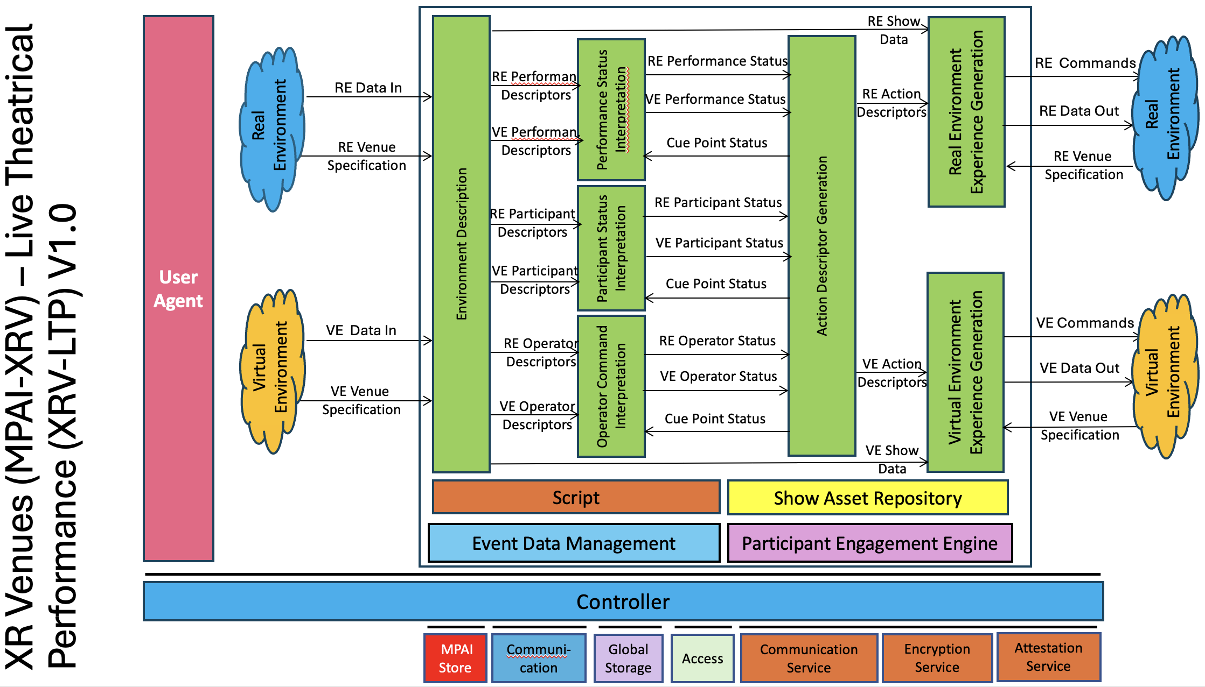
Reference Model

Slide 9
Benefits of the use of AI
Automation of complex lighting, video, audio FX cues that must adapt to the pace of live performers reducing staff requirements
Reduced staff allows large, complex shows to play in smaller venues
Facilitates audience interactivity in both the Real and Virtual Environment
More direct connection between performers and participants by allowing performers to easily orchestrate many complex experiential elements
Performers can incorporate massive data from opted-in participants into the performance, enhancing participant engagement and making each show unique

Slide 10
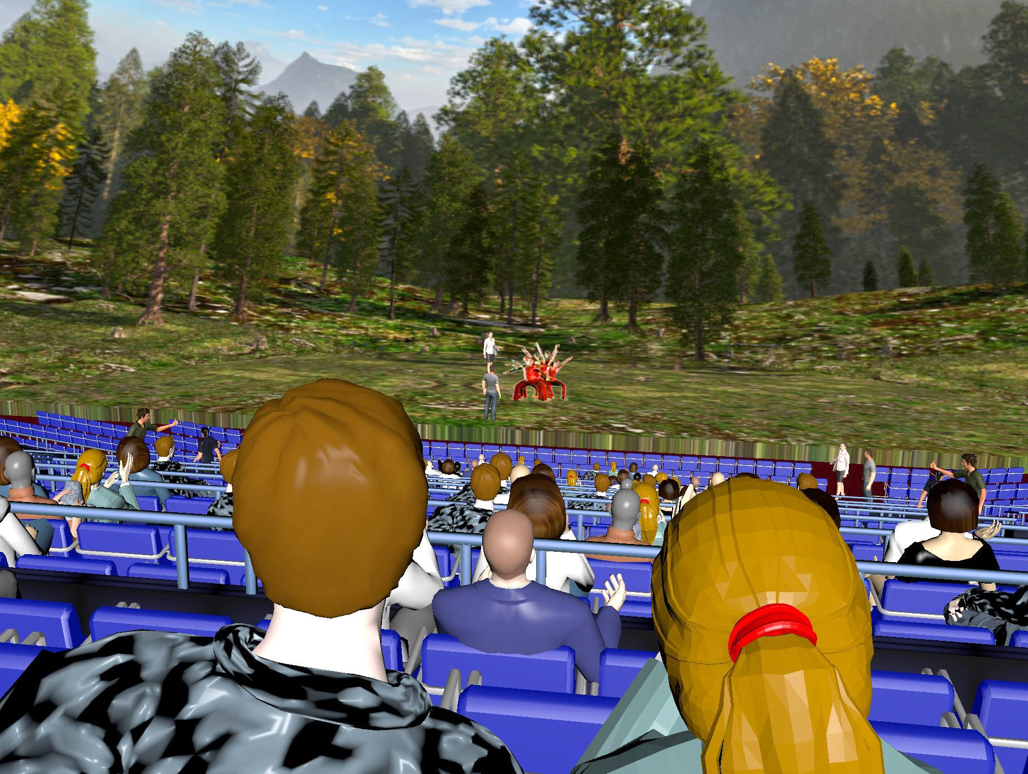
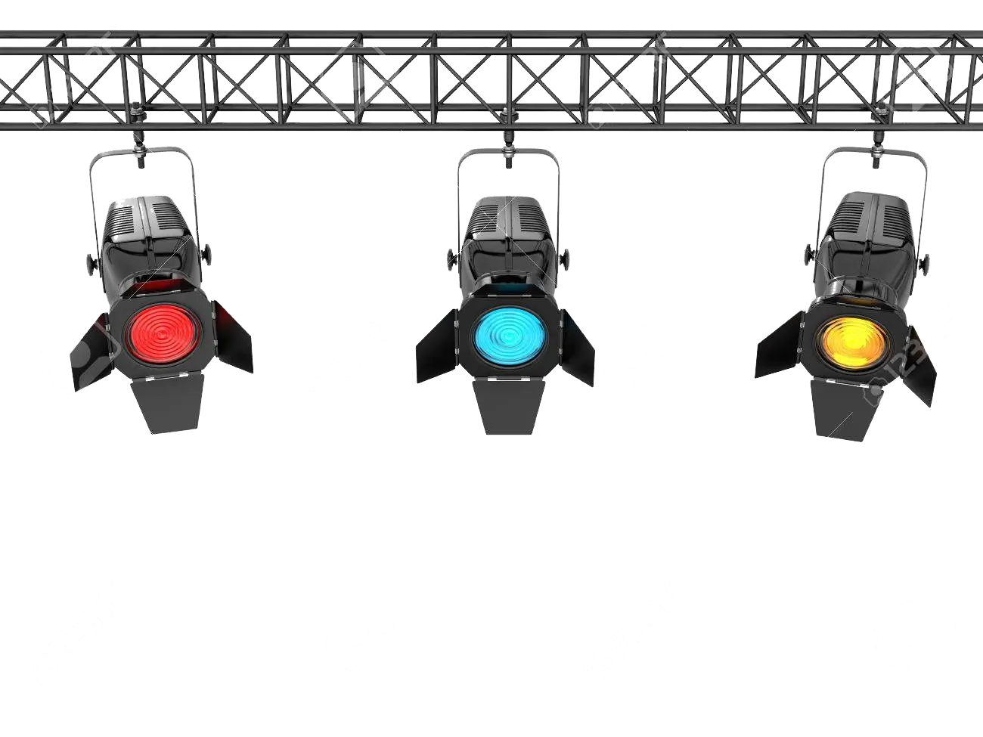

Typical set up/1
A physical performance area with live performers
Lighting, video, sets and FX
Participants (standing or seated) in the real and virtual venue and external audiences via interactive streaming and metaverse
Human-machine interfaces that allow participant interactivity (e.g., voting, branching, gesture control for real-virtual experience generation)
Multi-sensory experience delivery system (immersive video and spatialised audio, touch, smell)
Capture of biometric data from participants and/or performers from wearables, seat sensors, remote sensing (e.g., audio, video, lidar)
Show operator(s) to allow manual augmentation and oversight of an AI that has been trained by show operator activity
Stage with Performers and Audience
Stage Lights and SFX
Biometric Capture

Slide 11
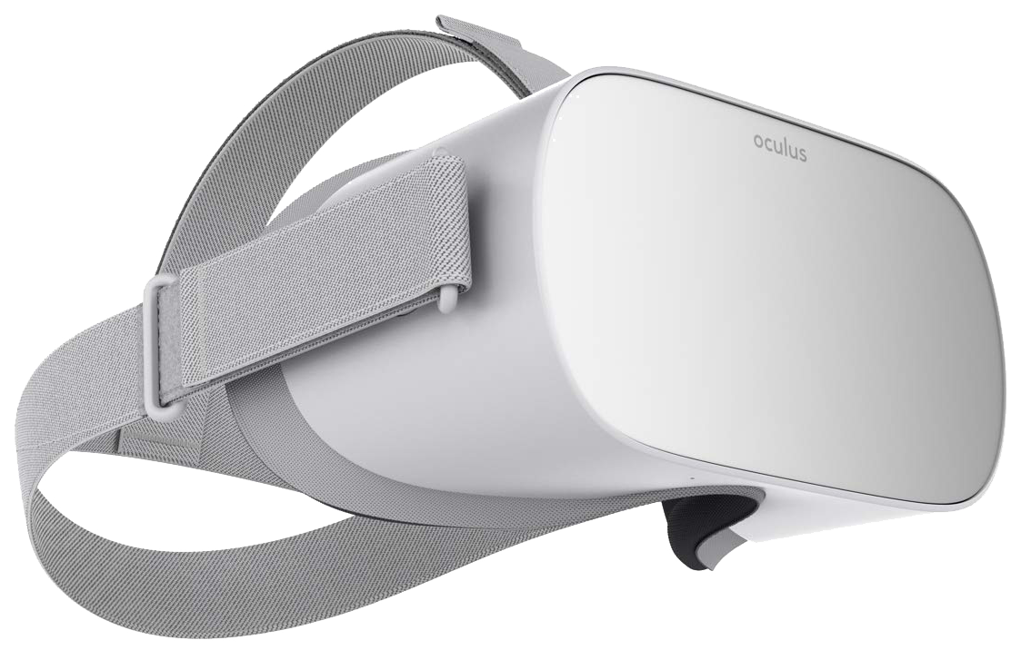
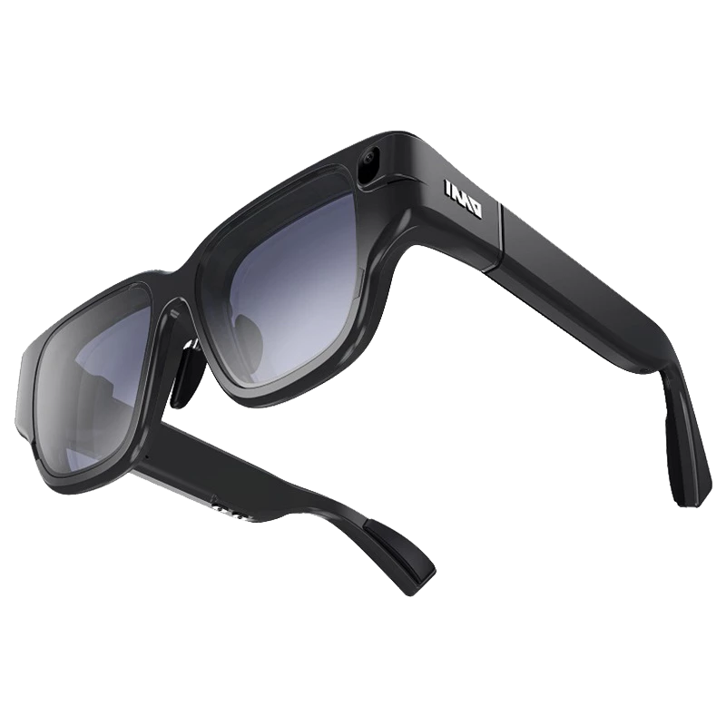
Typical set up/2
Metaverse mirrors selected elements of the Real Environment via real-time digital twins using:
  Capture body motion (MoCap) to animate an avatar
  Keyed 2D image mapped on a plane
  Volumetrically captured 3D images
Real Environment mirrors selected elements of the Metaverse (similar to virtual productions) including:
  Immersive dome or wrap-around display volume
  Stage floor and set pieces may be video-mapped to integrate them into the immersive environment
  Augmented reality 3D overlays using AR glasses
  Lighting and SFX
The physical stage and set pieces blend seamlessly into the virtual 3D backdrop to create a seamless immersive environment.
MoCap
Volumetric Capture
Headset
(for Metaverse)
Immersive
Display with Video
Mapped Stage
AR Glasses
(for 3D overlays)

Slide 12
Typical set up/3
AI Modules extract selected features from Real and Virtual Environments such as performer gestures, audience responses, avatar behavior etc.
AI Modules interpret these features according to the dictates of the Script
AI Modules drive actions in the Real and Virtual Environments according to the Script
The Script (cue list) describes the show events and guide and synchronize the actions of all AI Modules (AIM) as the show evolves from scene to scene.
Human Operators control show flow, augmenting or overriding AIM’s

Slide 13
Plans
Call for Technologies Released on August 23, 2022 (closed)
Currently Working on Technical Specification: XR Venues (MPAI-XRV) - Live Theatrical Performance WD0.15
  AI Workflows
  AI Modules
  Data Types
  Definitions & References

Slide 14

We look forward to your
participation in this
exciting project!
Join MPAI
Share the fun
Build the future!
https://mpai.community/
https://mpai.community/standards/mpai-xrv/ltp/v1-0/

