Slide 1
An introduction to Moving Picture, Audio, and Data Coding by Artificial Intelligence (MPAI)
Leonardo Chiariglione – President and Chairman of the Board, MPAI
.

Slide 2
MPAI at-a-glance
Who we are
Mission | Procedures | Method | Patents | Organisation
Approved Standards
Ecosystem governance | Execution of AI apps | CAV – Architecture
CAV – Technologies | Audio enhancement | Company performance prediction
Human-Machine Communication | Multimodal conversation | Metaverse – Architecture
Metaverse – Technologies | Neural Ntwk Watermarking | Objects and scenes
Portable avatars | AI Module Profiles | Data Types, Formats & Attributes
Being developed
AI for Health | Online Gaming | XR Venues
About to start
Six Degrees of Freedom Audio | Up-sampling Fiter for Video | End-to-End Video Coding

Slide 3

Who we are

Slide 4
MPAI: what it is
International, unaffiliated, non-profit SDO.
MPAI: what it does
Develops AI-based data coding standards.
MPAI: how it does it
With clear Intellectual Property Rights licensing frameworks.

Slide 5

Explainable standards
AI module (AIM)
AI Workflow (AIW)
Speech analysis
AI Module (AIM)
AI Module AIM
Text
Speech
Inputs
Outputs
Identity
AI Module AIM
AIM
Storage
AI Module AIM
Access

Slide 6

Accessible & timely available standards
Before initiating a standard, Active Principal Members develop & adopt its Framework Licence (FWL), a licence without values: $, %, dates etc. declaring that the eventual licence will be issued
Not after products are on the market.
At a price comparable with similar standard technologies.
During the development, any Member making a contribution declares it will make its licence available according to the FWL.
After the development, Members holding IP in the standard select the preferred patent pool administrator.
Read the MPAI Patent Policy
5/11/2025
6

Slide 7
Rigorous standards development process
All
Principal Members
Stage 0
Stage 1
Stage 2
Stage 3
Use Cases
Proposal
Interest
Collection
Functional
Requirements
Commercial
Requirements
Technical
Specification
Reference
Software
Community
Comments
Standard
Development
Call for
Technologies
Conformance
Testing
Reference
Software
Performance
Assessment
Stage 6
Stage 5
Stage 4
Stage 7
Principal Members
All
All Members
7

Slide 8
The MPAI organisation
General Assembly
Board of Directors
Membership& Nominating
Finance & Audit
Industry & Standards
IPR Support
Communication
Secretariat
Standing Committees
Development Committees
Requirements Standing Committee
AIF-DC
AIH-DC
CAE-DC
CUI-DC
GME-DC
MMC-DC
NNW-DC
PAF-DC
XRV-DC
HMC
CAV
MMM
SPG
EVC
EEV

Slide 9
Approved standards

Slide 10
MPAI standards, so far
Standard Name | Acronym | TS | RS | CT | PA
Governance of the MPAI Ecosystem | MPAI-GME | 1.1 | 1.0
AI Framework | MPAI-AIF | 2.1 | 1.0
Compression and Understanding of Financial Data | MPAI-CUI | 1.1 | 1.0 | 1.0 | 1.0
Context-Based Audio Enhancement | MPAI-CAE | 2.3 | 1.4 | 1.4
Connected Autonomous Vehicle | MPAI-CAV | 1.0
Human and Machine Communication | MPAI-HMC | 2.0
Multimodal Conversation | MPAI-MMC | 2.3
MPAI Metaverse Model | MPAI-MMM | 2.0 | 2.0
Neural Network Traceability | MPAI-NNT | 1.0
Neural Network Watermarking | MPAI-NNW | 1.0 | 1.2
Object and Scene Description | MPAI-OSD | 1.3 | 1.3
Portable Avatar Format | MPAI-PAF | 1.4
AI Module Profiles | MPAI-PRF | 1.0
Server-based Predictive multiplayer Gaming | MPAI-SPG | 1.0 | 1.0
Data Types, Formats, and Attributes | MPAI-TFA | 1.3
5/11/2025
10

Slide 11

Governance of the MPAI Ecosystem
(MPAI-GME) V1.1
Technical Specification: Governance of the MPAI Ecosystem sets the rules governing the MPAI Ecosystem:
1 - MPAI 2 – Implementers 3 - MPAI Store 4 - Performance Assessors 5 - Users
The MPAI Store has been established in Scotland as a Company Limited by Guarantee – independent from MPAI.
Some of the roles of the MPAI Store:
  Managing the “Implementer ID” Registration Authority (also for implementations of IEEE versions of MPAI standards).
  Verifying Security, Testing Conformance, and posting Implementations for download.
Performance Assessors are appointed by but independent of MPAI
Read more about MPAI-GME. Download the MPAI-GME standard.

Slide 12
The MPAI ecosystem
MPAI
Implementer
Store
End User
Implementation
Standards (TS-RS-CT-PA)
Develops Implem-entations
Verifies security
Tests Conformance
Checks Performance
Down-loads Implem-entation
Performance Assessor
Technical Specification
Implementation
OK
Assesses Perfor-mance
OK
Implementation
Experience
Score
Performance Assessment
Conformance Testing

Slide 13

AI Framework (MPAI-AIF) V2.1
Standard AI Framework enabling dynamic configuration,
initialisation, and control of mixed AI and data processing workflows.
Hierarchical structure:
  AI Framework (AIF)
    AI Workflows (AIW)
      AI Modules (AIM).
AIWs may be proprietary or standard, i.e., with standard functions and interfaces, with an explicit computing workflow.
AIMs are specified by their function and interfaces not by their internals.
AIMs can be implemented in hardware, software, hybrid hardware/software.

Slide 14
AI Framework (MPAI-AIF) V2.1
User Agent
AI Module (AIM)
AI Module (AIM)
Inputs
Outputs
AIM/AIW Storage
(non-secure)
AI Module (AIM)
AIM/AIW Storage
(secure)
AI Module (AIM)
Controller (Non-secure/Secure)
SAL
MPAI Store
Communi-cation
Global Storage
Access
Communication Service
Encryption Service
Attestation Service

Slide 15

Context-based Audio Enhancement
(CAE-USC) V2.3
Improves the user experience for audio applications –
teleconferencing, post-production, restoration – in different contexts – in the home, in the studio, etc.
Technical Specification includes:
  4 Use cases: Emotion Enhanced Speech, Audio Recording Preservation, Speech Restoration System, and Enhanced Audioconference Experience (and Reference Software).
  1 Composite AIM: Audio Scene Description
  Data Types.
Reference software.
Conformance Testing.

Slide 16

Audio Recording Preservation (CAE-ARP)
User Agent
Packager
Tape Audio Restoration
Restored
Audio Files
Preservation
Audio File
Editing
List
Access Copy
Files
Audio Analyser
Irr. Audio File
Irreg. File
Tape Irregularity Classification
A. Irreg. File
A. Irreg. File
V. Irreg. File
Preservation
Master Files
V. Irreg. File
A. Irreg. File
Irreg. Images
Irregularity
Images
Video Analyser
Preservation Audio-Visual File
V. Irreg. File
Controller
Communication
Global Storage
MPAI Store

Slide 17
Audio Scene Description (Composite AIM)
Space-Time
Audio Descriptors Multiplexing
Audio Analysis Transform
Audio Source Localisation
Audio Separation and Enhancement
Audio Synthesis Transform
Audio Object (Transform)
Spatial Attitudes
Enhanced Audio Objects (Transform)
Enhanced Audio Objects
Audio Object
Audio Scene
Descriptors
Audio Object (Transform)
Audio Scene Geometry
Audio Scene Descriptors

Slide 18

MPAI-CAE – Six Degrees Audio
(CAE-6DF)
Project targeting digital representations of acoustical
scenes and other synthetic Audio Objects for rendering arbitrary user-
selected points of the audio scene in a perceptually veridical fashion.
capture audio space
Audio Space
audio scene
Audio Scene
audio scene
rendering audio space
Audio Scene
audio scene
Audio Scene
Audio Scene
audio scene
Computing Platform

Slide 19

Connected Autonomous Vehicle –
Technologies (CAV-TEC) V1.1
Technical Specification: Connected Autonomous Vehicle
(MPAI-CAV) – Architecture V1.0 specifies the Architecture of a CAV based on a Reference Model comprising:
A CAV broken down into Subsystems for each of which the following is specified:
  Functions
  Input/output Data
  Topology of Components
Each Subsystem broken down into Components of which the following is specified:
  Functions
  Input/output Data.
Subsystems/Components are assumed to be implemented as AIWs/AIMs.

Slide 20
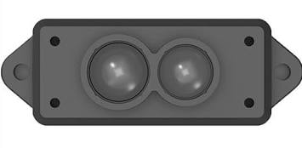
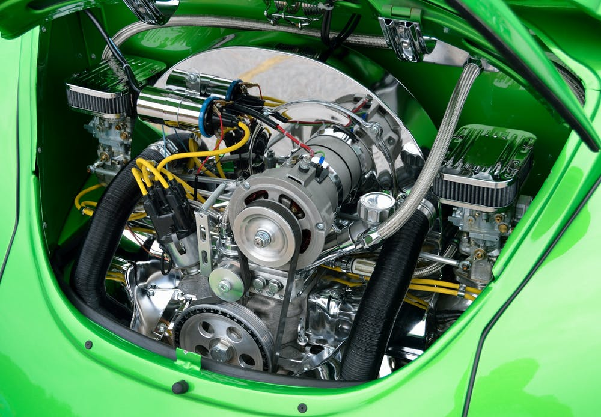


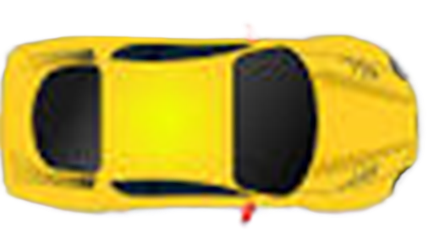



CAV-TEC – Reference Model
Environment Sensing Subsystem
(ESS)
Motion Actuation Subsystem
(MAS)
Autonomous Motion Subsystem (AMS)
Human-CAV Interaction
(HCI)

Slide 21
Reference Model: Environment Sensing Subsystem
Weather Data
Basic Environment Description
Autonomous Motion Subsystem
Motion Actuation Subsystem
Basic Env. Descriprors
Spatial Attitude
Spatial Attitude Generation
Spatial
Attitude
GNSS Object
Audio Scene Descriptors
Audio Scene Description
Alert
Alert
Audio Object
Basic Environment Descriptors
Visual Scene Description
Visual Scene Descriptors
Visual Object
Alert
Alert
Basic Environment Descriptors
RADAR Scene Description
RADAR Scene Descriptors
RADAR Object
Alert
Alert
Basic Environment Descriptors
LiDAR Scene Description
LiDAR Scene Descriptors
LiDAR Object
Alert
Alert
Basic Environment Descriptors
Ultrasound Scene Descriptors
Ultrasound Scene Description
Alert
Alert
Ultrasound Object
Basic Environment Descriptors
Offline Map Object
OfflineMap Scene Description
Offline Map Scene Descriptors
Full Env. Descriprors
Controller
MPAI Store
Communi-cation
Global Storage
Access
Communication
Service
Encryption
Service
Attestation
Service

Slide 22
Reference Model: Autonomous Motion Subsystem
Environment Sensing Subsystem
Basic Environ.
Descriptors
Full Environment Description
Remote AMSs
Full Environ.
Descriptors
Full Environ.
Descriptors
FED
FED
Road &
CAV State
AMS
Data
FED
FED
FED
AMS-MAS msg
Motion Actuation Subsystem
Route Selection Planning
Route
Path Selection Planning
Path
Motion Selection Planning
Trajectory
Traffic Obstacle Avoidance
Human-CAV Interaction
AMS-HCI
Message
AMS-MAS msg
Request
Req.
Request
Alert
Environment Sensing Subsystem
User Agent
AMS
Data
AMS
Data
AMS
Data
Road &
CAV State
AMS
MAS msg
AMS
Data
Route
Path
Trajectory
Alert
FED
AMS Memory
AMS Data
Controller
MPAI Store
Communication
Global Storage
Access
Communication
Service
Encryption
Service
Attestation
Service

Slide 23
Connected Autonomous Vehicles (MPAI-CAV) – Technologies V1.0
To execute its mission, a CAV uses a range of sensors to create a digital twin of the environment it traverses.
MPAI-CAV represents the environment’s digital twin with a Data Type called Basic Environment Descriptors (CAV-BED).
CAV-BED includes:
  Audio-Visual Scene Descriptors (OSD-AVS).
  CAV-specific data, e.g., Other Environment Data (humidity, etc.) and Road State.
A CAV exchanges portions of its BED with other CAVs in range.
Therefore, the CAV produces Full Environment Descriptors, yet another OSD-AVS environment representation integrated by other CAV-specific data.

Slide 24
CAV Data Types
HCI | ESS | AMS | MAS
3D Model Object | Alert | AMS-MAS Message | Brake Command
AMS-HCI Message | Basic Environment Descriptors | AMS Data | Brake Response
Annotation | Bounding Box | CAV Identifier | Motor Command
Audio Object | Coordinates | CAV State | Motor Response
AV Scene Descriptors | GNSS Object | Ego-Remote AMS Message | Spatial Data
Body Descriptors | LiDAR Object | Full Environment Descriptors | Weather Data
Ego-Remote HCI Message | LiDAR Scene Descriptors | Road Attributes | Wheel Command
Face Descriptors | Location | Route | Wheel Response
Instance Identifier | Offline Map Object | HCI | ESS
Meaning | Offline Map Scene Descriptors | Text Object | Spatial Attitude
Orientation | Path | Visual Object | Time
Perceptible Entity | Point of View |  | Traffic Rules
Personal Preferences | Position |  | Traffic Sign Objects
Personal Profile | RADAR Object |  | Trajectory
Personal Status | RADAR Scene Descriptors |  | Ultrasound Object
Portable Avatar | Road State |  | Ultrasound Scene Descriptors
Speech Object | Space-Time

Slide 25

The «AI-based Compression and Understanding of Industrial Data» standard
Company Performance Prediction
Compression and Understanding of
Financial Data (MPAI-CUI) V1.1
Predicts the performance of a company in a time horizon based on:
  Financial risks
  Vertical risks (i.e., seismic and cyber)
  Governance data.
Performance is Default probability, Discontinuity probability. Organisational Index
CUI-CPP Company Performance Prediction 2.0 is being developed.
Notes:
Processo che ha portato allo std: UC-FR-FWL-CfT-CC-Std
I moduli, la loro funzione, in part. Prediction, significato del training e dell’affidabilità dei dati di input
What comes next (altri rischi)
Applications of CUI-CPP
Banca, assicurazione, ente pubblico

Slide 26
MPAI-CUI V1.1 – Reference Model
User Agent
Prediction
Horizon
Discontinuity and Default Prediction
Organisational
Model Index
Governance
Governance Data Assessment
Governance Features
Default Probability
Financial Statement
Financial Data Assessment
Financial Features
Default Probability
Prediction Result Perturbation
Business
Discontinuity Probability
Risk
Assessment
Risk Matrix Generation
Risk Matrix
Controller
Communication
Global Storage
MPAI Store

Slide 27

Human and Machine Communication
(MPAI-HMC) V2.0
Enables new forms of communication between
communicating participants called Entities:
  humans present in a real space or represented in a Virtual Space, or
  Machines represented in a Virtual Space or rendered in a real space as speaking avatars.
Entities acts in a Context using text, speech, face, gesture embedded is audio-visual scenes.

Slide 28





#2
Virtual Scene
#3
Virtual Scene
Machine
In a Virtual Scene or
rendered as a real scene
#1
Real scene or representation
in a Virtual Scene
#4
Real or virtual scene

Slide 29
MPAI-HMC V2.0 Reference Model
User Agent
AV Scene Integration & Description
Entity and Context Understanding
Entity Dialogue Processing
Personal Status Display
Machine Avatar ID
Entity ID
Output
Portable
Avatar
Input Portable
Avatar
AV Scene
Descriptors
Machine Personal Status
Text Object
Meaning
Text-to-Text Translation
Input
Selector
Meaning
Audio-Visual Scene Rendering
Output Speech
Input
Text
Personal
Status
Machine
Translated Text Obj.
Output Portable
Avatar
Output Audio
Audio-Visual Scene Description
Machine
Text Obj.
AV Scene
Geometry
Input
Audio
Output Visual
AV Scene
Descriptors
Instance ID
Input
Visual
Machine Text Obj.
Output Text
Controller
MPAI Store
Communication
Global Storage
Access
Communication Service
Encryption Service
Attestation Service

Slide 30

Multimodal Conversation (MPAI-MMC)
V2.3
Technical Specification: Multimodal Conversation (MPAI-MMC) V2 specifies:
Data Formats for analysis of text, speech, and other non-verbal components as used in human-machine and machine-machine conversation applications.
Use Cases implemented in the AI Framework
  Using Data Formats from MPAI-MMC and other MPAI standards.
  Providing recognised applications in the Multimodal Conversation domain.
MPAI-MMC V2 includes
Seven use cases (Conversation with Emotion, Human-CAV Interaction,…)
One composite AIM (i.e., an AIM that includes AIMs)
Several Data Types (i.e., standard data formats).

Slide 31
Reference Model: Human-CAV Interaction V2.3 (MMC-HCI)
Point of View
Audio=-Visual Scene Rendering
Autonomous Motion
Subsystem
AV Scene Descriptors
Output Speech
Audio-Visual Scene Description
Speech Object
Speaker ID Recognition
Entity Dialogue Processing
Personal Status Display
Output Audio
Speaker ID
Machine
Personal Status
Speech Scene Geometry
Output Visual
AV Scene Descriptors
Machine Portable
Avatar
Speech Object
Personal Status Extraction
Input Text
Machine Text
Aut. Speech Recognition
Natural Language Understanding
Meaning
Meaning
Environment Sensing Subsystem
Speech
Object
Recognised Text
Output Text
Input Audio
NLU Text
Visual Scene
Descriptors
Remote HCIs
Input Visual
Visual Object Identification
Ego-Remote HCI Message
Visual Scene Descriptors
Visual
Object ID
Visual Object ID
Participant
IDs
Participant IDs
User Agent
Face Descriptors
Autonomous Motion Subsystem
Personal Status
Body Descriptors
AMS-HCI
Message
Face Object
Face ID Recognition
Face ID
Visual Scene Geometry
Controller
MPAI Store
Communication
Global Storage
Access
Communication Service
Encryption Service
Attestation Service

Slide 32
Virtual Meeting Secretary (MMC-VMS) V2.3
S
User Agent
Portable Avatar Demultiplexing
Input Text
Entity Dialogue Processing
Automatic Speech Recognition
Natural Language Understanding
Refined Text
Meaning
Summary
Input Speech
Recognised Text
Meaning
Summary Creation Module
Refined Text
VS Avatar Model
Personal Status Display
Edited
Summary
Portable
Avatars
Input Text
Meaning
Personal Status Extraction
VS Personal Status
Input Speech
Avatar ID
VS Portable Avatar
Avatar ID
Summary
Input
Personal Status
Body Descriptors
VS Text
Face Descriptors
Input Personal Status
Controller
MPAI Store
Communi-cation
Global Storage
Access
Communication Service
Encryption Service
Attestation Service

Slide 33
MPA Metaverse Model – Technologies (MMM-TEC) V2.0
MMM-TEC V2.0 specifies standard technologies that enable a metaverse instance (M-Instance) to interoperate with independently designed clients and M-Instances via the following elements:
Elements | Description | Type of Spec
Processes | Entities operating in an M-Instance. | Functional Requirements
Items | Data Types and Qualifiers recognised in an M-Instance. | Specification
Protocols | Enable a Process to communicate with a Process. | Specification
Process Actions | Payloads describing how a Process performs on Items. | Specification
Profiles | MMM-TEC subsets suiting specific needs. | Specification
Verific. Use Cases | To show MMM-TEC applicability to typical use cases. | Informative
API | Application Programming Interface for easy use. | Specification
Reference SW | Implements one of the Verification Use Cases. | Specification

Slide 34







M-Instance at-a-glance
Persona
Auton.User
Item
Device
User
Resolut.Service
Resolut.Service
User
Item
Device
App
Metaverse A
Metaverse B
Service
Service
Persona

Slide 35

Process Action Request/Response
M-Instance_{A} to/from M-Instance_{B}
Request-Action_{A1}
Resolution Service_{A}
Resolution Service_{B}
Response-Action_{A2}
Request-Action_{A1}
Response-Action_{A3}
Response-Action_{A2}
Request-Action_{A1}
Process_{A3}
Process_{B2}
Process_{A2}
Process_{A1}
Process_{A4}
Process_{B4}
Process_{B1}
Process_{B3}
M-Instance_{A}
M-Instance_{B}
Item_{A3}
Item_{A2}
Item_{A2}
Item_{A1}
Conversion Service
Conversion Service

Slide 36

Neural Network Watermarking
(MPAI-NNW) V1.0
Neural Network Watermarking (MPAI-NNW) specifies
methodologies to evaluate a neural network watermarking technology in terms of:
The impact on the performance of a watermarked neural network and/or on its inference.
The ability of a neural network watermarking detector/decoder to detect/decode a payload when the watermarked neural network has been modified.
The computational cost of injecting, detecting or decoding a payload in the watermarked neural network.

Slide 37


Watermarking of generative AI
AIMs
Watermark Embedder
NNW
Decoder
Watermark Provider
User Agent
Speech
Automatic Speech Recognition
Answer to Question Module
Text-To-Speech
Text
User Agent
End-user
Text
Vocal answer
NNW
Decoder
Proof
Image
WATERMARKED
End-user
Controller
Controller
Checker
Communication
Global Storage
Access
MPAI Store
MPAI-AIF

Slide 38
Neural Network Traceability (MPAI-NNT) V1.0
Technical Specification: Neural Network Traceability (MPAI-NNT) V1.0 specifies methods to evaluate aspects of Active (Watermarking) and Passive (Fingerprinting) Neural Network Traceability Methods:
Ability of a Neural Network Traceability Detector/Decoder to detect/decode/ match Traceability Data when the traced Neural Network has been modified.
Computational cost of injecting, extracting, detecting, decoding, or matching Traceability Data.
Specifically for active tracing methods, impact on the performance of a neural network with inserted Traceability Data and its inference.

Slide 39
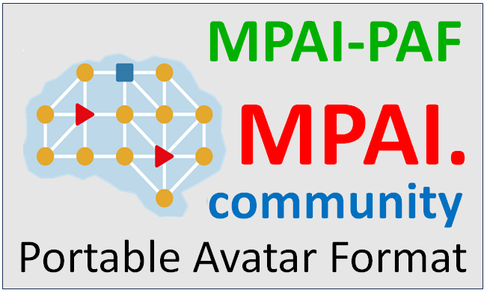
Portable Avatar Format (MPAI-PAF) V1.3
Specifies
  Portable Avatar and related Data Formats enabling a receiver to decode and render an Avatar in a Virtual Environment as intended by the sender.
  Personal Status Display Composite AI Module allowing the conversion of a Text and a Personal Status to a Portable Avatar.
  AI Workflows and AI Modules composing the Avatar-Based Videoconference Use Case also using Data Types from other MPAI Technical Specifications.
Avatar ID
Portable Avatar Demultiplexing
Avatar Space-Time
Avatar
Language Selection
Speech Object
Text Object
Portable
Avatar
Speech Model
Personal Status
AV Scene Space-Time
AV Scene Descriptors
Portable Avatar

Slide 40
Avatar-Based Videoconference Use Case
Virtual Meeting Secretary
Portable
Avatars
Portable
VMS Avatar
Summary
Input Selector
Client Transmitter
Avatar Videoconference Server
Client Receiver
Point of View
Speech Object
Summary
Output Text
Text
Speech
Face Object
Output Audio
Visual
Portable Avatar
Portable Avatars
Output Visual
Avatar Model
Summary
AV Scene
Descriptors
Spatial
Attitudes

Slide 41
Personal Status Display (PAF-PSD) V1.3
Machine ID
S
Portable Avatar Multiplexing
Speech Model
Text-To-Speech
Machine Speech
Text Object
Personal Status De-multiplexing
Speech
Personal Status
Machine Speech
Entity Face Description
Text Object
Machine Face Descriptors
Portable Avatar
Avatar Model
Personal Status
Face Personal Status
Gesture Personal Status
Entity Body Description
Text Object
Machine Body Descriptors
Avatar Model
Avatar Model

Slide 42
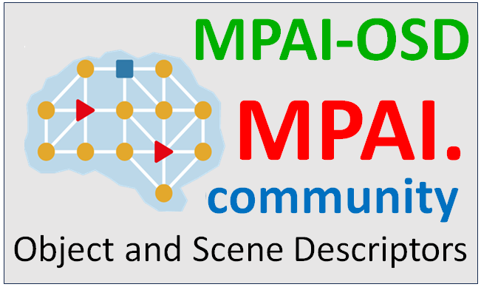
Object and Scene Description
(MPAI-OSD) V1.3
Object and Scenes Description (MPAI-OSD) specifies
  Data Formats to describe uni- and multimodal Objects and Scenes, and their localisation in space.
  Basic and Composite AI Modules Visual Object Identification and Audio-Visual Alignment.
  AI Workflow: Television Media Analysis
Important Data Formats:
  Spatial Attitude, Time
  Audio, Visual, and Audio-Visual Object
  Audio, Visual, and Audio-Visual Scene Descriptors

Slide 43
Television Media Analysis (OSD-TMA) V1.2
User Agent
Visual Change Detection
TV Splitter
Face ID Recognition
Face ID(s)
Audio-Visual Alignment
Aligned
Face ID
Audio-Visual Scene Description
Audio-Visual Event Description
Image
Video
Time
Bounding
Box
Bounding
Box(es)
Aux. Text
Face Time
Face Time
Aux. Text
Audio SA
Speaker ID Recognition
Speaker Time
AV Scene
Descrip.
AV Event
Descriptors
Audio-
Video-Text
Audio Segmentation
Speech
Visual SA
Sp. Time
Speaker ID
Aligned
Speaker ID
Audio
Speaker ID
Overlap
Aut. Speech Recognition
Recognis.
Text
Overlap
Speech
Speech
Speaker Time
Speaker Time
Auxiliary Text
Controller
Communication
Access
Global Storage
MPAI Store

Slide 44

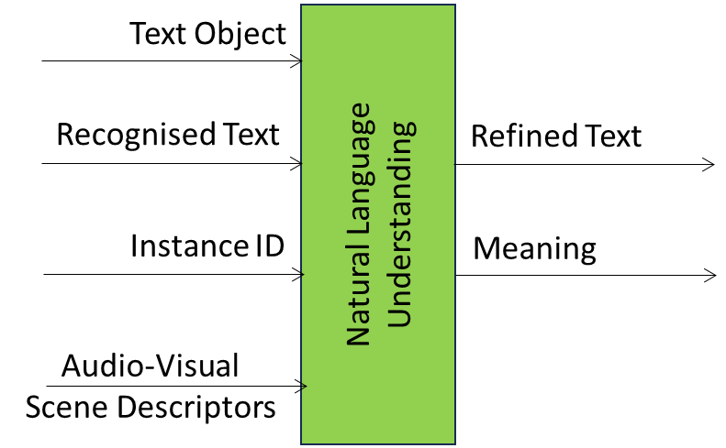
AI Module
Profiles
AI Module Profiles (MPAI-PRF) specifies a label that uniquely identifies the set of AIM Attributes – input data, output data and functionality – that characterises an AI Module instance.
Attribute | Code
Text Object | TXO
Recognised Text | TXR
Object Instance ID | OII
Audio-Visual Scene Descriptors | AVS
Text Descriptors | TXD
Profile signalling | Comment
MMC-TST-V2.1(NUL+TXO@TRN#eng->ita) | Signals unsupported Attributes
MMC-TST-V2.1(ALL-ISD@TRN#kor<->fra#ger->swa) | Signals supported Attributes

Slide 45
Data Types, Formats, and Attributes (MPAI-TFA) V1.2
AI Modules can process data better if they know better the data they process.
  A Visual Data Type instance can have different Sub-Types (colour space etc.)
  An Audio Data Type instance can have different content Format (MP3, AAC,…)
  A Speech Data Type instance can have different Attributes (to signal the language, the iD of the individual who generated the speech, etc.)
MPAI-TFA V1.0 defines JSON structures that convey information about Sub-Types, Formats, and Attributes of Media Types (e.g., Audio and Visual)
Currently, the following Data Types have Qualifier”: media, metaverse,and machine learning models.
MPAI digs deeply inside the nature of data….

Slide 46
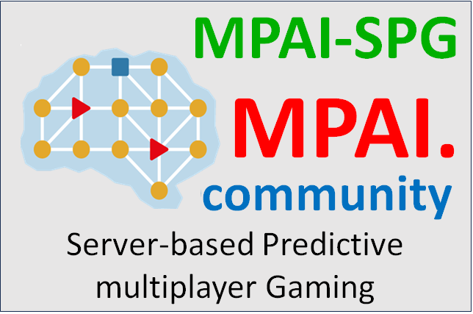
Server-based Predictive multiplayer
Gaming (MPAI-SPG)
Technical Report: Guidelines for data loss mitigation in online multiplayer gaming provides guidelines on the design and use of neural networks to reliably and accurately predict missing players control data in an authoritative server context.
Context:
  In an online authoritative multiplayer game, each player uses a client to send control data to a server.
  The server updates the current game state with the data from all clients, and then broadcasts the updated game state to all clients.
  The data originating from a client may be properly or maliciously generated and properly received or not received.

Slide 47



















MPAI-SPG Reference Model
Server-based Predictive
Multiplayer Gaming
Online Game Server
$${\text{GS}}_{\text{t}}^{}$$
$${\text{CD}}_{}^{}$$
Game State Engine
- Dmux
$${\text{CD}}_{}^{}$$
Game State Engine
Client 1
$${\text{GM}}_{\text{t}}^{\text{p}\text{∗}}$$
$${\text{GM}}_{\text{t}\text{+1, }\text{p}}^{\text{p}\text{∗}}$$
$${\text{GS}}_{\text{t}\text{+1,}\text{p}}^{}$$
$${\text{GS}}_{\text{t}\text{+1}}^{}$$
Physics
Engine-AI
Game State Engine- Mux
$${\text{GM}}_{\text{t}}^{\text{p}}$$
Physics Engine
$${\text{CD}}_{}^{}$$
$${\text{GM}}_{\text{t}\text{+1}}^{\text{p}}$$
Client 2
$${\text{GM}}_{\text{t}}^{\text{r}\text{∗}}$$
Rules
Engine-AI
$${\text{GM}}_{\text{t}\text{+1, }\text{p}}^{\text{r}\text{∗}}$$
$${\text{GM}}_{\text{t}}^{\text{b}}$$
$${\text{GS}}_{\text{t}\text{+1}}^{}$$
Behaviour Engine
$${\text{GM}}_{\text{t}}^{\text{b}\text{∗}}$$
Behaviour Engine-AI
$${\text{GM}}_{\text{t}\text{+1, }\text{p}}^{\text{b}\text{∗}}$$
$${\text{GM}}_{\text{t}\text{+1}}^{\text{b}}$$
$${\text{CD}}_{}^{}$$
Client N
$${\text{GM}}_{\text{t}}^{\text{r}}$$
$${\text{GS}}_{\text{t}\text{+1}}^{}$$
Rules Engine
$${\text{GM}}_{\text{t}\text{+1}}^{\text{r}}$$
Controller
Communication
Global Storage
MPAI Store

Slide 48
Being developed

Slide 49

AI for Health (MPAI-AIH)
AI Health Platform composed of:
  End User Front Ends tasked with
    Acquiring and AI-based processing
    Licensing Health Data to Back End.
  A Back End tasked with
    Collecting and AI-based processing
    Enabling Third-Party Users to process licensed Health Data,
    Updating AI Models via federated learning techniques.
  A Blockchain tasked with managing Licences as Smart Contracts.
Licence formats
API
Taxonomy of AIH Processing functions
Data Formats

Slide 50






Technical Specification: AI for Health (MPAI-AIH)
Blockchain and Distributed Ledger Technologies
Global Secure Data Vault
Licensing & Governance Services
Authentication & Access Control Services
Record of transactions on the B&DLT that can be used for audition purposes
User Agent
AI Module (AIM)
AI Module (AIM)
Access to multiple services from smartphone (data storage, permissions, licenses, etc.)
AIM/AIW Storage
(non-secure)
AI Module (AIM)
AI Module (AIM)
AIM/AIW Storage
(secure)
Auditing Services
Controller
Communi-cation
Global Storage
Access
MPAI Store
Trusted Services
Communication Service
Encryption Service
Attestation Service
API
API
AIM Security Engine
AIM Storage Service
AIM Model Service
Other sources
of health-
related data
Data Storage & Access Services
De-Identification & Anonymization Services
Access to data (de-identified and anonym), processing of data through AI to extract knowledge
AIH Federated
Learning System
Third-Party
Health-related
Entities
User Agent
AI Module (AIM)
AI Module (AIM)
AIM/AIW Storage
(non-secure)
AI Module (AIM)
AIM/AIW Storage
(secure)
AI Module (AIM)
Controller
Communi-cation
Global Storage
Access
MPAI Store
Communication Service
Encryption Service
Attestation Service

Slide 51





End User Device
Anomaly Detection & Risks Alert
End-user input data
Specific Biometric
Sensors
Biometric
Signals
Smartbands, Smartwatches, …
Other installed health-related apps
AI-Health App
Interaction
w/ Backend
Secure Data Vault
User Agent
AI Module (AIM)
AI Module (AIM)
AIM/AIW Storage
(non-secure)
AI Module (AIM)
AI Module (AIM)
AIM/AIW Storage
(secure)
Controller
Communi-cation
Global Storage
Access
MPAI Store
Communication Service
Encryption Service
Attestation Service

Slide 52

Up-sampling Filter for Video applications
(MPA-UFV)/1
Bicubic Down-sampling
Encoding
(EVC-VVC)
Decoding
(EVC-VVC)
Super Resolution Up-sampling
Error
BD-rate gain results (BD-PSNR, luminance)
EVC Baseline Profile | VVC Main 10 profile
HD24K: -7,44 | HD24K: -6,36
SD2HD: -21,62 | SD2HD: -26,05

Slide 53
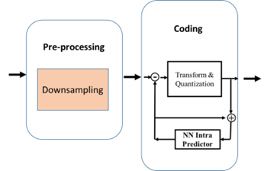
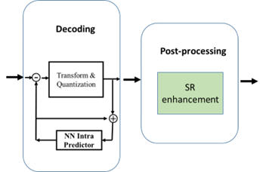
Up-sampling Filter for Video (MPA-UFV)/2
In Super Resolution with Intra Prediction, performance of EVC modified by enhancing/replacing existing coding tools with AI-based tools improves as in table.
Codec | Resolution | NN Intra Vs. Original Codec | Original Codec + SR Vs. Original Codec + bicubic | NN Intra + SR Vs. Original Codec + bicubic
EVC | SD2HD | -6.89% | -21,62% | -25,86%
EVC | HD24K | -6.89% | -7,44% | -11.99%

Slide 54

Extended Reality Venues (MPAI-XRV)
– Live Theatrical Stage Performance
Extended Reality Venues (MPAI-XRV) – Live Theatrical Performance defines interfaces of AI Modules (AIM) facilitating live multisensory immersive stage performances which ordinarily require extensive on-site show control staff to operate.
Goal: specify AIW, AIMs, and Data Types that enable
  Rapid mounting of a show in real and virtual venues.
  Orchestration of lighting, video, audio, and stage set cues adapted to live performers.
  Large shows to tour to smaller venues unable to support complex productions.
  Direct, precise yet spontaneous show implementation and control of multiple complex systems to achieve the show director’s vision.

Slide 55
XR Venues (MPAI-XRV) – Live Theatrical Performance (XRV-LTP) V1.0
Show Data
User Agent
Environment Description
Real Environment Experience Generation
Real
Environment
RE Performan.
Descriptors
Performance Status Interpretation
RE Performance Status
Action Descriptor Generation
RE Commands
Real
Environment
RE Data In
RE Action Descriptors
VE Performance Status
RE Data Out
VE Performan.
Descriptors
Cue Point Status
RE Venue
Specification
RE Venue
Specification
RE Participant
Descriptors
Participant Status Interpretation
RE Participant Status
VE Participant Status
VE Participant
Descriptors
Cue Point Status
Virtual Environment Experience Generation
Virtual
Environment
Virtual
Environment
VE Data In
Operator Command
Interpretation
VE Commands
RE Operator
Descriptors
RE Operator Status
VE Operator Status
VE Action Descriptors
VE Data Out
VE Venue
Specification
VE Operator
Descriptors
Cue Point Status
VE Venue
Specification
Show Data
Script
Show Asset Repository
Event Data Management
Participant Engagement Engine
Controller
MPAI Store
Communi-cation
Global Storage
Access
Communication Service
Encryption Service
Attestation Service

Slide 56
About to start

Slide 57
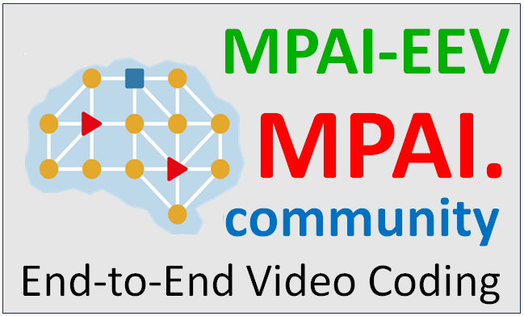
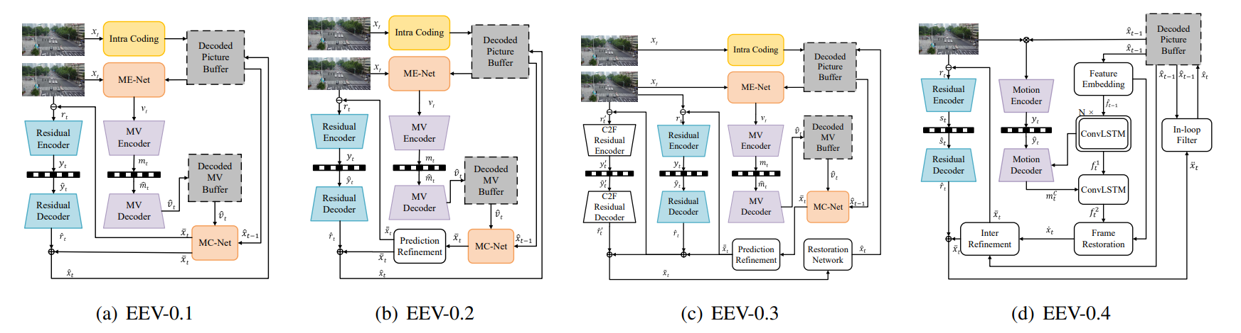
AI-based End-to-End Video Coding
(MPAI-EEV)/1
Compressed video representation that exploits AI-based
end-to-end data coding technologies, i.e., without being constrained by how data coding has traditionally been applied in the of video coding context.
Goal: to achieve 20% performance improvement compared to VVC.

Slide 58
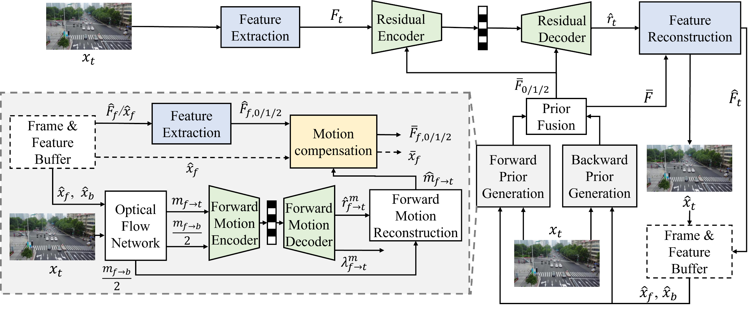
EEV-0.6
Scaling up the model sizes of the modules marked with red stars to yield better performance
Modules with red stars are given 2X learnable params.

Slide 59


We look forward to working
with you in MPAI on our workplan and your projects!
https://mpai.community/how-to-join/
Join MPAI
Share the fun
Build the future
59
59
59
59

