Slide 1
Technical Specification: Connected Autonomous Vehicle (MPAI-CAV) – Technologies (CAV-TEC) V1.0
Public online presentation
2025/05/08T15 UTC

Slide 2
Connected and Autonomous Vehicles promise to
Save lives and reduce injuries (human errors replaced by less frequent machine errors).
Give humans more time for rewarding activities (e.g., interpersonal communication).
Optimise use of vehicles and infrastructure (“CAVs as a transport infrastructure used on demand”).
Reduce congestion and pollution (CAVs run only for a purpose).
Support elderly and disabled people.
Widely diffused CAVs will positively impact society and individuals.

Slide 3
CAVs are important but the market is marginal?
It will take a long time for the CAV market to make a difference.
To positively impact society and individuals, today’s “niche market” must be transformed into tomorrow’s CAV “mass market” at an accelerated pace.
Early ‘900
Monolithic cars
Today Component cars
Today Monolithic CAVs
Tomorrow Component CAVs
Luxury market
Mass market
Luxury market
Mass market
Standards are a faster and more efficient route to achieve a market of interchangeable components than waiting for market forces to produce more “monolithic” cars with progressively higher SAE Levels.

Slide 4
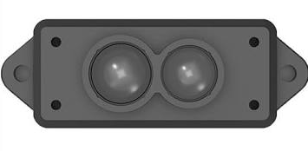
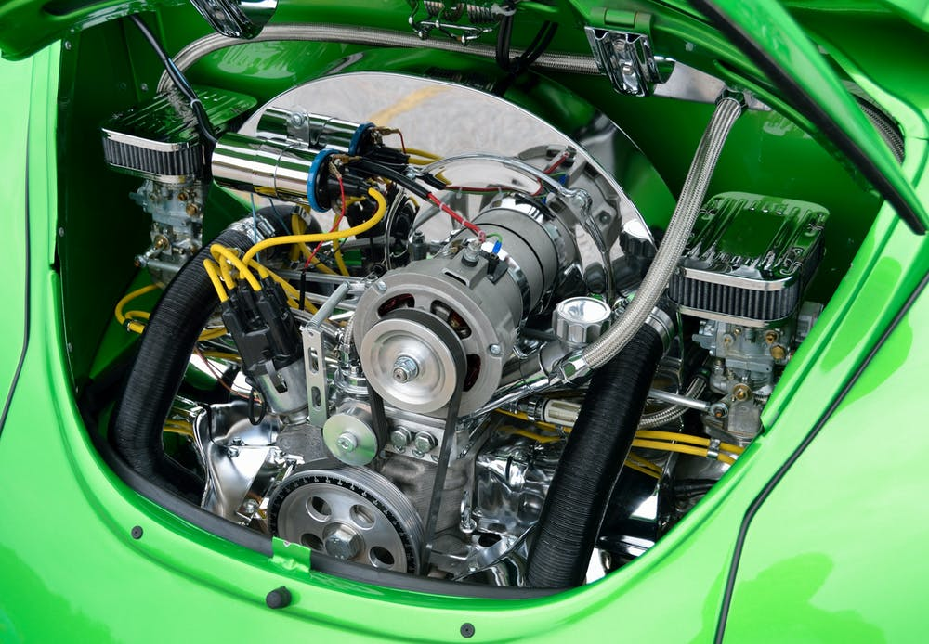


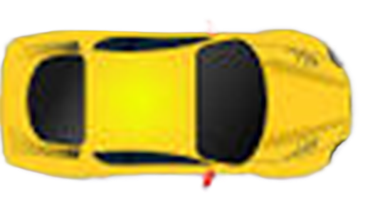



The standard Reference Model of Connected Autonomous Vehicle – Architecture (CAV-TEC V1.0)
CAV is partitioned into subsystems and components.
The Functional requirements of components are identified.
The formats of data exchanged by components are specified.
Environment Sensing Subsystem
(ESS)
Motion Actuation Subsystem
(MAS)
Autonomous Motion Subsystem (AMS)
Human-CAV Interaction
(HCI)

Slide 5
Interface Standard life cycle
Specification of
What the system does (“functional requirements”).
The formats of the data exchanged through the interfaces.
Technological progress ïs not frozen.
A competitive market is enabled.
Independent developers offer competing but interchangeable components that perform better and better over time.
Eventually, an improved reference model will replace the current one with another, kicking off a new sequence of performance improvements.

Slide 6
Benefits of an Interface Standard
Researchers optimise component technologies.
Component manufacturers bring their standard-conforming components to market once they are mature.
Car manufacturers access an open global market of interchangeable components.
Regulators oversee conformance testing of components following standard procedures.
Users rely on Connected Autonomous Vehicles whose operation they can explain (to some extent).

Slide 7
A CAV subsystem is not a black box
It could be designed as a black box
Humans would have little knowledge and control of what happens inside.
MPAI has developed the AI Framework standard (MPAI-AIF)
Specifies a set of standard APIs enabling access to system functionalities.
Supporting systems – called AI Workflows
Made of components – called AI Modules
Specified by function and interfaces, not by implementation.
Instances can be replaced by instances of a different make.
MPAI-AIF enables a component-based specification.

Slide 8
AI Framework (MPAI-AIF)
User Agent
AI Module (AIM)
AI Module (AIM)
Outputs
Inputs
AIM/AIW Storage
(non-secure)
AI Module (AIM)
AIM/AIW Storage
(secure)
AI Module (AIM)
Controller (Non-secure/Secure)
SAL
MPAI Store
Communi-cation
Global Storage
Access
Communication Service
Encryption Service
Attestation Service

Slide 9
Human-CAV Interaction (HCI) Functional Requirements
Recognises human owner or renter (physically present or remote).
Responds to humans’ commands and queries.
Converses with humans.
Manifests itself as a perceptible entity (avatar).
Exchanges information with the Autonomous Motion Subsystem in response to humans’ requests, e.g., passenger wants to:
Stop for errands.
See & hear the world perceived by CAV (Full Environment Descriptors - FED).
Communicates with HCIs of other CAVs.

Slide 10
Reference Model: Human-CAV interaction (CAV-HCI)
Point of View
Audio=-Visual Scene Rendering
Autonomous Motion
Subsystem
AV Scene Descriptors
Output Speech
Audio-Visual Scene Description
Speech Object
Speaker ID Recognition
Entity Dialogue Processing
Personal Status Display
Output Audio
Speaker ID
Machine
Personal Status
Speech Scene Geometry
Output Visual
AV Scene Descriptors
Machine Portable
Avatar
Speech Object
Personal Status Extraction
Input Text
Machine Text
Aut. Speech Recognition
Natural Language Understanding
Meaning
Meaning
Environment Sensing Subsystem
Speech
Object
Recognised Text
Output Text
Input Audio
NLU Text
Visual Scene
Descriptors
Remote HCIs
Input Visual
Visual Object Identification
Ego-Remote HCI Message
Visual Scene Descriptors
Visual
Object ID
Visual Object ID
Participant
IDs
Participant IDs
User Agent
Face Descriptors
Autonomous Motion Subsystem
Personal Status
Body Descriptors
AMS-HCI
Message
Face Object
Face ID Recognition
Face ID
Visual Scene Geometry
Controller
MPAI Store
Communication
Global Storage
Access
Communication Service
Encryption Service
Attestation Service

Slide 11

What does CAV-HCI specify?
HCI Subsystem
I/O data
Functional Requirements
Components’ functions and topology
Input data
Audio, Text, Visual
Point of View
Audio-Visual Scene Descriptors
Output data
Audio, Speech, Text, Visual
Ego-Remote HCI Messaging
AMS-HCI Messaging

Slide 12
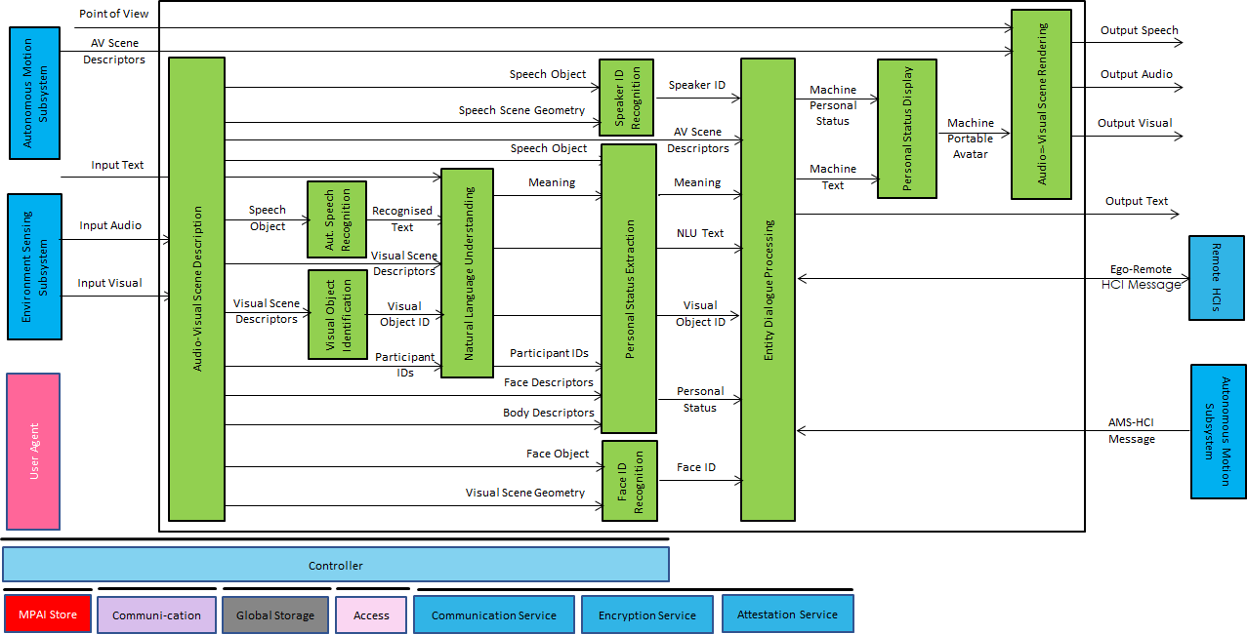
HCI input data
Input data | From | Description
Point of View | Passenger | Passenger's Point of View looking at environment.
Audio-Visual Scene Descriptors | AMS Subsystem | Audio-Visual representation of the environment.
Input Audio | Environment, Passenger Cabin | User authentication, command/interaction with HCI, etc. and environment Audio.
Input Text | User | Text complementing/replacing User input
Input Visual | Environment, Passenger Cabin | Environment perception, User authentication, command/ interaction with HCI, etc. and environment Visual.
AMS-HCI Message | AMS Subsystem | AMS response to HCI request.
Ego-Remote HCI Message | Remote HCI | Remote HCI to Ego HCI.

Slide 13
HCI output data
Output data | To | Description
Output Audio | Cabin Passengers | HCI’s avatar or FED Audio.
Output Speech | Cabin Passengers | HCT's avatar Speech.
Output Text | Cabin Passengers | HCI’s avatar Text.
Output Visual | Cabin Passengers | HCI’s avatar or FED Visual.
AMS-HCI Message | AMS Subsystem | HCI request to AMS, e.g., Route or Point of View.
Ego-Remote HCI Message | Remote HCI | Ego HCI to Remote HCI.

Slide 14
Components/1
AIM | Function
Audio-Visual Scene Description | 1. Receives Audio and Visual Objects from the appropriate Devices. 2. Produces Audio-Visual Scene Descriptors.
Automatic Speech Recognition | 1. Receives Speech Objects. 2. Produces Recognised Text.
Visual Object Identification | 1. Receives Visual Scenes Descriptors. 2. Provides Instance ID of indicated Visual Object.
Natural Language Understanding | 1. Receives Recognised Text. 2. Uses context information (e.g., Instance ID of object). 3. Produces Meaning & Natural Language Understanding Text, using Refined or Input.
Speaker Identity Recognition | 1. Receives Speech Object of a human and Speech Scene Geometry. 2. Produces Speaker ID.

Slide 15
Components/2
AIM | Function
Personal Status Extraction | 1. Receives Speech Object, Meaning, Face Descriptors and Body Descriptors of a human with a Participant ID. 2. Produces the human's Personal Status.
Face Identity Recognition | 1. Receives Face Object of a human and Visual Scene Geometry. 2. Produces Face ID.
Entity Dialogue Processing | 1. Receives Speaker ID, Face ID, AV Scene Descriptors, Meaning, Natural Language Understanding Text , Visual Object ID, and Personal Status. Moreover, it receives AMS-HCI Messages and Ego-Remote HCI Messages. 2. Produces Machine (HCI) Text Object and Personal Status. Moreover it produces AMS-HCI Messages and Ego-Remote HCI Messages.
Personal Status Display | 1. Receives Machine Text Object and Machine Personal Status. 2. Produces Machine’s Portable Avatar.
Audio-Visual Scene Rendering | 1. Receives AV Scene Descriptors, Portable Avatar, and Point of View. 2. Produces Output Speech, Output Audio, and Output Visual.

Slide 16
AI Modules/1
AIM | Input | Output
Audio-Visual Scene Description | - Input Audio - Input Visual | - AV Scene Descriptors
Automatic Speech Recognition | - Speech Object | - Recognised Text
Visual Object Identification | - AV Scene Descriptors - Visual Objects | - Visual Object Instance ID
Natural Language Understanding | - Recognised Text - AV Scene Descriptors - Visual Object Instance ID - Input Text | - NLU Text - Meaning
Speaker Identity Recognition | - Speech Object - Speech Scene Geometry | - Speaker ID
Personal Status Extraction | - Meaning - Input Speech - Face Descriptors - Body Descriptors | - Personal Status

Slide 17
AI Modules /2
AIM | Input | Output
Face Identity Recognition | - Face Object - Visual Scene Geometry | - Face ID
Entity Dialogue Processing | - Ego-Remote HCI Message - AMS-HCI Message - Speaker ID - Face ID - Meaning - NLU Text - Visual Object Instance ID - Personal Status | - Ego-Remote HCI Message - AMS-HCI Message - Machine Text - Machine Personal Status
Personal Status Display | - Machine Personal Status - Machine Text | - Machine Portable Avatar
Audio-Visual Scene Rendering | - AV Scene Descriptors - Machine Portable Avatar - Point of View | - Output Text - Output Speech - Output Audio - Output Visual

Slide 18
Data Types of CAV-HCI
3D Model Object | Orientation
AMS-HCI Message | Perceptible Entity
Annotation | Personal Preferences
Audio Object | Personal Profile
AV Scene Descriptors | Personal Status
Body Descriptors | Portable Avatar
Ego-Remote HCI Message | Speech Object
Face Descriptors | Text Object
Instance Identifier | Visual Object
Meaning

Slide 19
The blessing – and curse – of formats
Formats represent a particular type of data.
3D graphics, Audio, Visual, and a lot more …
A machine can understand data, if it knows how to interpret it.
A functionality depends on data type, much less on the format used.
CAV-TEC mostly specifies data types, not formats.
Qualifiers convey information about the features of a data type.
E.g., a Visual Data Type instance:
Uses a given colour space (Sub-Type).
Was produced by an AVC encoder and streamed with DASH (Format).
Is described by Dublin Core Metadata (Attribute).

Slide 20
The Environment Sensing Subsystem (CAV-ESS)
CAV-ESS acts as the CAV’s eyes, ears (and as a few more senses).
A CAV represents its environment using various specific Environment Sensing Technologies (EST) sharing the same Scene Representation Format.
The Basic Environment Description AIM integrates all EST-specific Object-based Scene Representations to produce Basic Environment Descriptors.
If an EST-specific AIM discovers a suspect object, it immediately sends an Alert to the Autonomous Motion Subsystem.
Spatial Attitude
LiDAR Scene Description
LiDAR Scene Descriptors
LiDAR Object
Other Scene Descriptors
Alert

Slide 21
Reference Model: Environment Sensing Subsystem
Weather Data
Basic Environment Description
Autonomous Motion Subsystem
Motion Actuation Subsystem
Basic Env. Descriprors
Spatial Attitude
Spatial Attitude Generation
Spatial
Attitude
GNSS Object
Audio Scene Descriptors
Audio Scene Description
Alert
Alert
Audio Object
Basic Environment Descriptors
Visual Scene Description
Visual Scene Descriptors
Visual Object
Alert
Alert
Basic Environment Descriptors
RADAR Scene Description
RADAR Scene Descriptors
RADAR Object
Alert
Alert
Basic Environment Descriptors
LiDAR Scene Description
LiDAR Scene Descriptors
LiDAR Object
Alert
Alert
Basic Environment Descriptors
Ultrasound Scene Descriptors
Ultrasound Scene Description
Alert
Alert
Ultrasound Object
Basic Environment Descriptors
Offline Map Object
OfflineMap Scene Description
Offline Map Scene Descriptors
Full Env. Descriprors
Controller
MPAI Store
Communi-cation
Global Storage
Access
Communication
Service
Encryption
Service
Attestation
Service

Slide 22
The data types of CAV-ESS
Alert | Offline Map Object | Space-Time
Basic Environment Descriptors | Offline Map Scene Descriptors | Spatial Attitude
Bounding Box | Path | Time
Coordinates | Point of View | Traffic Rules
GNSS Object | Position | Traffic Sign Objects
LiDAR Object | RADAR Object | Trajectory
LiDAR Scene Descriptors | RADAR Scene Descriptors | Ultrasound Object
Location | Road State | Ultrasound Scene Descriptors

Slide 23
Reference Model: Autonomous Motion Subsystem
Environment Sensing Subsystem
Basic Environ.
Descriptors
Full Environment Description
Remote AMSs
Full Environ.
Descriptors
Full Environ.
Descriptors
FED
FED
Road &
CAV State
AMS
Data
FED
FED
FED
AMS-MAS msg
Motion Actuation Subsystem
Route Selection Planning
Route
Path Selection Planning
Path
Motion Selection Planning
Trajectory
Traffic Obstacle Avoidance
Human-CAV Interaction
AMS-HCI
Message
AMS-MAS msg
Request
Req.
Request
Alert
Environment Sensing Subsystem
User Agent
AMS
Data
AMS
Data
AMS
Data
Road &
CAV State
AMS
MAS msg
AMS
Data
Route
Path
Trajectory
Alert
FED
AMS Memory
AMS Data
Controller
MPAI Store
Communication
Global Storage
Access
Communication
Service
Encryption
Service
Attestation
Service

Slide 24
CAV-AMS Data Types
AMS-MAS Message | Ego-Remote AMS Message
AMS Data | Full Environment Descriptors
CAV Identifier | Road Attributes
CAV State | Route

Slide 25
An example of AIM integration: Trajectory Planning and Decision AIM
AMS-MAS Message
Traffic Obstacle Avoidance
Alert
AMS-MAS Message
CAV State
FED
AMS
Data
Road State
Motion Selection Planning
Trajectory
Alert
Path Selection Planning
Path
FED
Route
Request
Request
Request

Slide 26
An example of CAV-TEC data type specification Ego-Remote AMS Message/1
Label | Size | Description
Header | N1 Bytes | Ego-Remote AMS Message Header
- Standard-EgoRemoteAMSMessage | 9 Bytes | The characters “MMM-ERA-V”
- Version | N2 Bytes | Major version – 1 or 2 Bytes
- Dot-separator | 1 Byte | The character “.”
- Subversion | N3 Bytes | Minor version – 1 or 2 Bytes
EgoRemoteAMSMessageID | N4 Bytes | Identifier of Ego-Remote-AMS Message.
RequestMessage | N5 Bytes | CAV's Request
- EgoCAVID | N6 Bytes | CAV ID
- ULocation | N7 Bytes | Specification of Remote CAV's Environment portion.
ResponseMessage | N8 Bytes | Data of Ego-Remote-AMS Message
- RemoteCAVID | N9 Bytes | M-Location in Remote AMS.
- RemoteFED | N10 Bytes | Subset of FED relevant to requested U-Location.

Slide 27
An example of CAV-TEC data type specification Ego-Remote AMS Message/2
Label | Size | Description
SenderInfoMessage | N11 Bytes | Message sent for information
- EgoCAVID | N12 Bytes | CAV ID
- Trajectory | N13 Bytes | Trajectory Ego AMS intends to adopt.
ReceiverInfoMessage | N14 Bytes | Message sent for information
- EgoCAVID | N15 Bytes | CAV ID
- Accept/Reject | N16 Bytes | Trajectory accepted/rejected by receiving Remote AMS
AMSAlertMessage | N17 Bytes | Messages alerting CAVs about Ego CAV status.
- EgoCAVID | N18 Bytes | CAV ID.
- AMSAlertMessage | N19 Bytes | One of Ambulance, Authority, Health, Evacuation Messages.
- Road State | N20 Bytes | Appropriate subset of Road State.
- CAV State | N21 Bytes | Appropriate subset of CAV State.
DescrMetadata | N22 Bytes | Descriptive Metadata

Slide 28
An example of CAV-TEC data type specification Ego-Remote AMS Message/3
https://schemas.mpai.community/CAV2/V1.0/data/EgoRemoteAMSMessage.json

Slide 29
Reference Model: Motion Actuation Subsystem
User Agent
MAS Spatial Attitude Generation
Spatial Attitude
Environment Sensing Subsystem (ESS)
Spatial Data
Spatial
Attitude
Weather Data
Ice Condition Analysis
Weather Data
Brake response
Motor response
Road State
Wheel response
Autonomous Motion Subsystem
(AMS)
MAS Response Analysis
Brake response
AMS-MAS Message
Motor response
Wheel response
Brake command
AMS-MAS Message Interpretation
AMS-MAS Message
Motor command
Wheel command
Controller
MPAI Store
Communication
Global Storage
Access
Communication Service
Encryption Service
Attestation Service

Slide 30
CAV-TEC V1.0 – an example of MPAI-wide collaboration
AI Framework | AI Framework applied to subsystems and underlying Security Abstraction Layer.
Context-based Audio Enhancement | Audio-related technologies.
Object and Scene Description | 3D Model, Audio, Audio-Visual, LiDAR, Offline Map, RADAR, Speech, Ultrasound, and Visual Object and Scene Descriptors.
Multimodal Conversation | Technologies enabling a human to converse with a machine.
Portable Avatar | 3D Graphics-related technologies.
MPAI Metaverse Model | Full Environment Descriptors.
Data Types, Formats, and Attributes | Qualifier support to CAV data.

Slide 31

CAV-TEC V1.0 is a stepping stone…
From the capabilities of the CAV specified by CAV-TEC V1.0:
Interact with humans
Perceive the environment
Create a model of the environment by collaboration
Move the CAV around to reach a destination.
To a CAV that is:
A full element of the Internet of Vehicles.
Interacting with various services.
Implemented as running (open-source software).

Slide 32


We look forward to working
with you
on this exciting MPAI project!
https://cav.mpai.community/
Join MPAI
Share the fun
Build the future
32
32
32
32

