Slide 1
Technical Specification: MPAI Metaverse Model (MPAI-MMM) – Technologies V2.0
Public online presentation
2025/05/09T15:00
.

Slide 2
Standards for metaverse
“Metaverse”: should be the next communication milestone.
New spaces for humans to populate and exploit.
Proprietary metaverse solutions do not fly
Lack of interoperability and immaturity of technology.
To be called a communication system, metaverse needs public standards.
Why are there no standards yet?
The scope of the term metaverse is not agreed.
Some metaverses, e.g., gaming metaverses, do not need standards.
Many standards organisations: ISO, IEC, ITU, IEEE, OMA3, OMF,…

Slide 3
MPAI decided that it should make one
MPAI: Moving Pictures, Audio , and Data Coding by Artificial Intelligence.
International, unaffiliated, non-profit organisation with AI-based data coding standards as its mission.
Year | Month | Title | Acronym
2022 | January | Start of MPAI Metaverse Model Project | MPAI-MMM
2023 | January | Technical Report on Functionalities | MMM-FNC
2023 | April | Technical Report on Functionality Profiles | MMM-FPR
2023 | October | Technical Specification on Architecture | MMM-ARC
2025 | April | Technical Specification on Technologies | MMM-TEC
MPAI combines communication and AI technology expertise.

Slide 4
Highlights of MMM – Technologies (MMM-TEC)
MMM-TEC specifies standard technologies that enable a metaverse instance (M-Instance) to interoperate with independently designed clients and M-Instances:
Elements | Description | Type of Spec
Processes | Entities operating in an M-Instance. | Functional Requirements
Items | Data Types and Qualifiers recognised in an M-Instance. | Specification
Protocols | Enable a Process to communicate with a Process. | Specification
Process Actions | Payloads describing how a Process performs on Items. | Specification
Profiles | MMM-TEC subsets suiting specific needs. | Specification
Verific. Use Cases | To show MMM-TEC applicability to typical use cases. | Informative
API | Application Programming Interface for easy use. | Specification
Reference SW | Implements one of the Verification Use Cases. | Specification

Slide 5
Features of the M-Instance platform/1
An M-Instance is:
Agnostic to transport infrastructure.
Populated by Processes and Items.
Includes Processes that
Produce Items in an M-Instance.
Acquire Data from the universe with Qualifier and Rights.
Data becomes Item when it is Identified.
Perform Actions on Items or Processes based on Rights.
May have the Rights to actuate Items into the universe.
Rights may be internal (intrinsic ), acquired (e.g., by Transaction), or granted.
Items may have Rights indicating Actions granted to specific Processes.

Slide 6
Features of the M-Instance platform/2
A Process
May request another Process to perform an Action on Items or Processes.
Makes the request using a protocol (Inter-Process Protocol - IPP).
A Process_{A} in M-Instance_{A} requests a Process_{B} in M-Instance_{B} to perform a Process Action by making an IPP request.
Process Action
Is the payload of an IPP Message – what a Process requests to do.
Includes the Action to be performed and the Items and Processes affected .
A conforming M-Instance may only implement an MMM-TEC subset (Profile).

Slide 7
M-Instance at-a-glance
Persona
Auton.User
Item
Device
User
Resolut.Service
Resolut.Service
User
Item
Device
App
Metaverse A
Metaverse B
Service
Service
Persona

Slide 8
Types of Process
A Device may:
Capture Data from a U-Location (real world or universe).
Actuate an Entity at a U-Location.
A Service may be:
One of the natively-supported Services of an M-Instance.
Hosted by the M-Instance but provided by a third party.
A User:
Acts as the interface of the human with the M-Instance.
Renders the User as a Persona animated by a Stream or an autonomous agent.

Slide 9
human₁
human₂
Device_{2.1}
User_{2.1}
Device_{1.1}
object₁
Device_{2.2}
Service₃
Item_{1.1}
Item_{3.1}
User_{3.1}
Device_{3.1}
Persona_{2.1.1}
Persona_{2.1.2}
User_{2.2}
User_{1.1}
M-Instance
human₃
Persona_{1.1.1}
Item_{1.2}
Service₂
Service₁
Persona_{2.2.1}

Slide 10
Inter-Process Protocol (IPP)
IPP Message Elements | Description
Message ID | ID of PA Request.
Response ID | Present when the Message is a PA Response.
Source Process ID | ID of Process issuing Message.
Process Action | Combination of Action, Items/Processes and Complement.
Resolution Service ID | (If the two Processes are in different M-Instances). Receives a Message from a Process in its M-Instance and forwards it to a peer Process in a different M-Instance. Sends a Message received from a peer Process in a different M-Instance to a Process in its M-Instance.
Destination Process ID | ID of Process to which the Message is intended to be sent.
Acknowledgement | Acknowledgement, if successful, or Error, if failure.

Slide 11
Process Action Request/Response (same M-Instance)
M-Instance
Process₆
Request-Action
Process₃
Process₁
Process₂
Response-Action
Process₅
Process₄

Slide 12
Process Action Request/Response (different M-Instances)
Request-Action_{A1}
Resolution Service_{A}
Resolution Service_{B}
Response-Action_{A2}
Request-Action_{A1}
Response-Action_{A3}
Response-Action_{A2}
Request-Action_{A1}
Process_{A3}
Process_{B2}
Process_{A2}
Process_{A1}
Process_{A4}
Process_{B4}
Process_{B1}
Process_{B3}
M-Instance_{A}
M-Instance_{B}
Item_{A3}
Item_{A2}
Item_{A2}
Item_{A1}
Conversion Service
Conversion Service

Slide 13
IPP Protocol Payload (Process Action)
PA Element | Description
Time | Time of PA request emission and Time of PA request execution.
Action | One of the standard Actions specified by MMM-TEC V2.0.
S-Complements | (Source Complement) One or more Items or a Process part in the Process Action execution at S-Process side. Items/Processes preceded by one of Nil, At, From, Of, To, With.
D-Complements | (Destination Complement) One or more Items or a Process part in the Process Action execution at the D-Process side. Items/Processes is preceded by one of Nil, At, From, Of, To, With.
Error message | Reasons why the requested Process did not perform PA request.

Slide 14
Actions
Authenticate | Author | Change | Convert | Discover
Execute | Hide | Identify | Inform | Interpret
MM-Add | MM-Anim | MM-Disable | MM-Embed | MM-Enable
MM-Move | MM-PropertyChange | MM-Send | Modify | MU-Actuate
MU-Send | Post | Register | Resolve | Track
Transact | UM-Capture | UM-Send | Validate

Slide 15
Items
Item is an instance of a Data Type recognised in an M-Instance.
Currently, some 60 Items have been specified:
Metaverse-specific, e.g., Process Item, Rights, Contract, specified by MMM-TEC.
Borrowed from other MPAI standards, e.g., 3D Model, Audio, Visual.
An Item can be represented in many ways, called Formats.
MMM-TEC specifies data types, occasionally formats.
Qualifiers convey information about, e.g., a Visual Data Type instance that:
Uses a given colour space (Sub-Type).
Was produced by an AVC encoder and streamed by DASH (Format).
Is described by Dublin Core Metadata (Attribute).

Slide 16
Items for General Use, Human & User, Process Interaction, and Service Access
General use | Basic Certificate | Certificate | Contract | Identifier
 | M-Capabilities | M-Environment | M-Instance | Program
 | Rights | Rules | U-Environment
Human & User | Account | Activity Data | Personal Profile | Personal Data
Process Interaction | IPP Message | Message | P-Capabilities | Process Action
 | Resolution
Service Access | Authentication | Basic Discovery | Basic Information | Basic Interpretation
 | Discovery | Information | Interpretation | Validation

Slide 17
Items for: Finance, Perception, Internal State, and Space & Time
Finance | Asset | Currency | Provenance | Transaction
 | Value | Wallet
Perception | Basic Object | Basic Scene Descriptors | Basic Scene Geometry | Event Descriptors
 | Object | Scene Descriptors | Scene Geometry | Summary
Internal State | Cognitive State | Emotion | Personal Status | Social Attitude
Space&Time | Basic M-Location | Basic U-Location | M-Location | Orientation
 | Point of View | Position | Space-Time | Spatial Attitude
 | Time | U-Location | Universe-Metaverse Map

Slide 18
Rights and Rules
In our societies humans are not allowed to do anything they want.
You may not take someone else’s property.
You may not enter someone else’s home.
unless they have, acquire, or are granted the rights to do so.
The same applies in an M-Instance:
When a human registers, their Processes are given Rights, called internal.
A Process may acquire Rights, called acquired, e.g., a concert ticket.
A Process may be granted Rights by another Process that holds them.
Rights are represented by a set of Process Actions.
Rules are represented as Process Actions preceded by Must-May-May not.

Slide 19
Specification of Change Process Action
Time | Time | Time of PA request emission and Time of PA request execution.
Action | Change | The Action of a User requesting a Rights Service to: Modify the Rights of a Process or an Item based on Rights. Grant the requesting User the Rights to further Change those Rights.
S-Complements | Process | Whose Rights are to be changed, or
 | Item | Whose Rights are to be changed
 | With MRights | If PA Request is successfully performed, Rights shall be granted based on Model Rights (MRights).
D-Complements | Rights | Granted to requesting User to further Modify Rights.
 | At User | The User with Changed Rights receives the new Rights.
Error Message | FaultyReq | The Request is Faulty
 | IDs | Incorrect
 | MRights | Insufficient

Slide 20
Specification of MM-Embed Process Action
Time | Time | Time of PA request emission and Time of PA request execution.
Action | Change | The Action of a User requesting a Rights Service to: Place an Item at an M-Location based on Rights. Grant the requesting User the Rights to further Change the Rights.
S-Complem. | Item | Item to be MM-Embedded.
 | From Process | Holding Item.
 | At M-Loc | M-Location where the Item is to be MM-Embedded.
 | With SA | The SA the MM-Embedded Item shall have at M-Location.
 | With MRights | If PA Request is successfully performed, Rights shall be granted based on MRights (Model Rights).
D-Complem. | Rights | Granted to requesting User to exercise the requested Rights.
 | At User | The User receives the new Rights to the MM-Embedded Item.

Slide 21
A Composite Action: Track
S-Process | Action | S-Complements | D-Processes | D-Complements
User | MM-Add | Persona At MLoc With SA | LOSrvc
LOSrvc |  |  | User
User | UM-Capture | Media At ULoc With SA | EISrvc | At User
EISrvc |  | Data With Qualifier | User
User | Identify | Data With Qualifier | IDSrvc | At User
IDSrvc |  | Stream | User
User | MM-Anim | Persona With Stream With SA | LOSrvc
LOSrvc |  |  | User
Process | UM-Actuate | MLoc At ULoc With SA | EISrvc
EISrvc |  |  | User

Slide 22
Basic Profile
Actions
General Actions | Identify
Metaverse to Metaverse | MM-Anim | MM-Disable | MM-Embed
 | MM-Send
Metaverse ←→ Universe | MU-Actuate | Track | UM-Capture
Items
General | Identifier | M-Instance
Process Interaction | IPP Message | Message | Process Action
Perception | Basic Object | Basic M-Location | Basic U-Location
Space & Time | Point of View | Space-Time | Time

Slide 23
Profiles
High Profile
Management Profile
Baseline Profile
Finance Profile

Slide 24
Implementing the MPAI Metaverse Model (MPAI-MMM API)
Alberto Cannavò
Politecnico di Torino, Italy

Slide 25
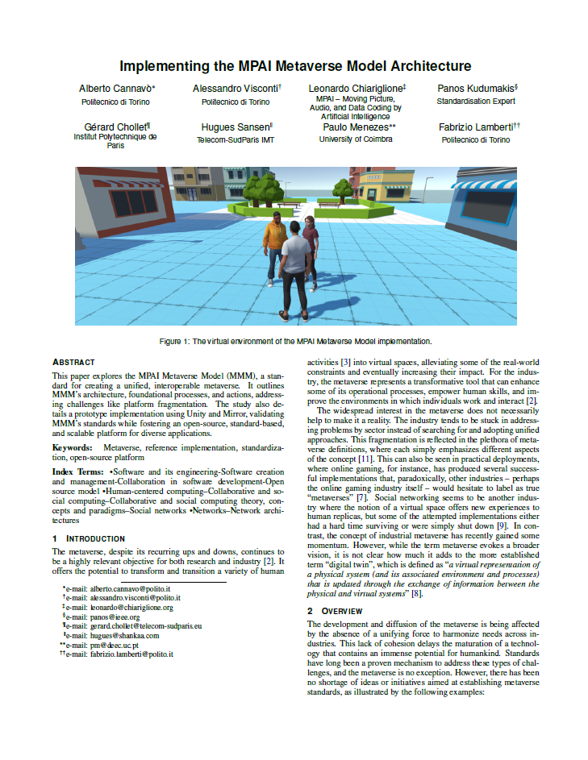
Implementing the MPAI-MMM
Goal: developing a prototypical implementation of the MMM to validate the proposed standards, establish a versatile open-source platform, and provide feedback for future refinements [1].
[1] Cannavo, Alberto, et al. "Implementing the MPAI Metaverse Model Architecture." IEEE Conference on Virtual Reality and 3D User Interfaces Abstracts and Workshops. IEEE, 2025.

Slide 26
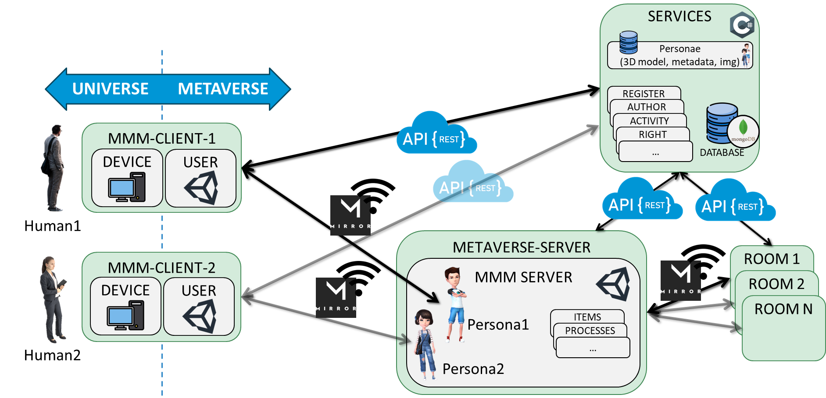
Architecture

Slide 27
Architecture
platform-agnostic components
Implementation-dependent components

Slide 28
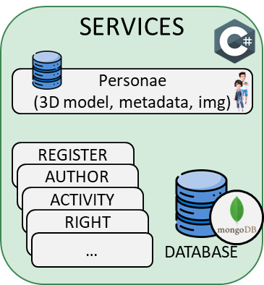
MMM Services
MMM Services such as Registration, Author, Rights, and others are implemented through RESTful APIs.
Advantages:
Platform-agnostic nature
Support for multiple data formats
Optimized for web communication
All services are hosted on the same web server that also include a MongoDB database and resources.

Slide 29
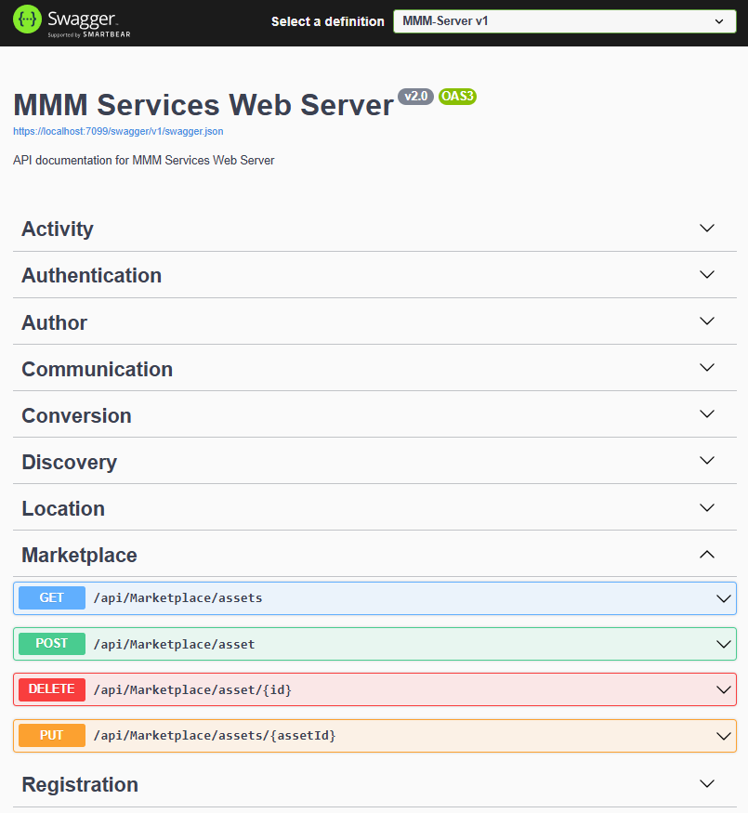
MMM - API
Base Path: /api
Format: application/json
Auth: TBD (no OAuth currently)
Developed in ASP.NET Core + MongoDB
> 10 services
> 50 endpoints
> 60 models
Models and services tested using Swagger UI

Slide 30
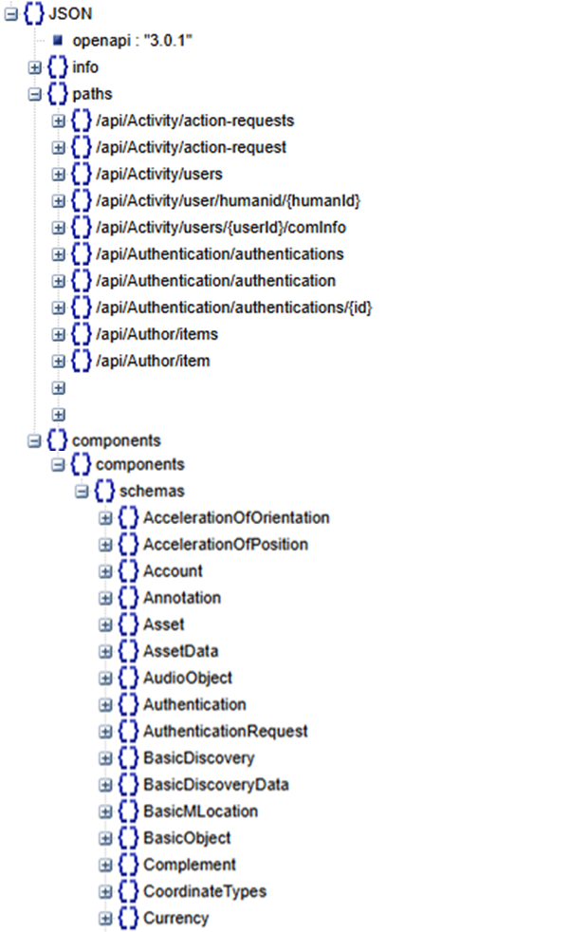
API Documentation
Documentation based on OpenAPI 3.0.1 specification
Section | Description
openapi | Specifies the OpenAPI version
info | Metadata about the API (title, version, description, contact info).
paths | Endpoints and operations (GET, POST, etc.).
components | Reusable objects like schemas, responses, parameters, security definitions.

Slide 31
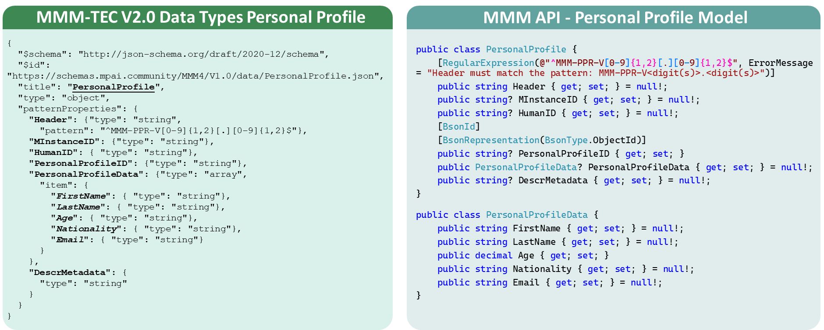
Components Personal Profile
This Item contains human’s Personal Data submitted when Registering with an M-Instance.

Slide 32
Paths Endpoint: /api/Author
Author Service allows Processes to create and manage Items
Endpoints are also available for specific Item, such as BasicObjects and Object.
Method | Path | Description
GET | /Author/items | Retrieve all the existing Items
POST | /Author/item | Create a new item according to its JSON representation reported in the request body
DELETE | /Author/item/{id} | Deletes an item identified by its ID.
…

Slide 33
Paths Endpoint: /api/Right
Right Service allows Processes to create and manage Rights
Endpoints are also available for others Item such as MLocation, BasicMLocation, Object, BasicObject
Method | Path | Description
GET/POST | /Right/right | Retrieve and create a new right according to its JSON representation reported in the request body
GET/POST/ DELETE | /Right/accounts/{accountId}/{userId}/rights | Retrieve, add, and remove a Right for the User of a specific Account, identified by userId and accountId, respectively"
…

Slide 34
A video demonstrating the implementation is available here

Slide 35
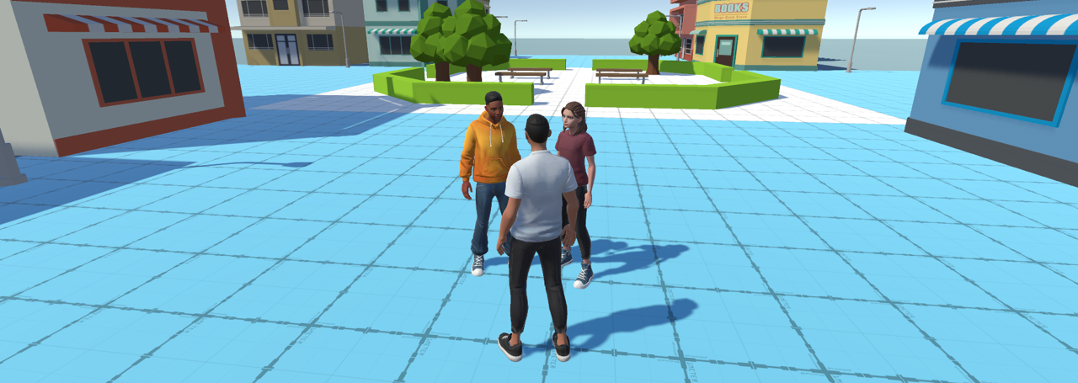
Thank you for your attention
Alberto Cannavò
Dept. of Control and Computer Engineering, Politecnico di Torino, Italy alberto.cannavo@polito.it

Slide 36
Verification Use Cases

Slide 37
Verification Use Case: Virtual Lecture
Actor | Does
School Mgr | Authors a virtual classroom
 | Makes transaction for the virtual classroom
 | Embeds the virtual classroom at an M-Location on which it has Rights.
 | Changes Teacher’s Rights to Classroom.
Teacher | Embeds their Persona at the classroom desk.
 | Embeds and animates a 3D Object for the lecture.
Student | Pays lecture fees with the rights to make a copy of the Audio-Visual Event.
School Mgr | Changes Student’s Rights to Classroom.
Student | Embeds their persona in classroom.
 | Approaches teacher’s desk to handle 3D Object with haptic gloves.
 | Stores the lecture’s Audio-Visual Event.
 | Leaves for home
School Mgr | Pays Teacher.
Teacher | Leaves for home.

Slide 38
Verification Use Case: Virtual Lecture-Code/1
S-Process | Action | S-Complements | D-Process | D-Compl.
User₁ | Author | With (Data_{1.1}, Qualifier, MRights_{1.1}) | AUSrvc₁ | At AUSrvc₁
AUSrvc₁ |  | Room_{1.1} | User₁
User₁ | Transact | With Transaction_{1.1} | TRSrvc₁ | At User₁
TRSrvc₁ |  | Rights_{1.1} | User₁
User₁ | MM-Add | Room_{1.1} From AUSrvc₁ At MLoc_{1.2} | LOSrvc₁
LOSrvc₁ |  |  | User₁
User₁ | MM-Enable | Room_{1.1} | LOSrvc₁
LOSrvc₁ |  |  | User₁
User₁ | Change | User₂ With MRights_{1.2} | RISrvc | At User₂
RISrvc |  | Rights_{1.2} | User₁

Slide 39
Verification Use Case: Virtual Lecture-Code/2
S-Process | Action | S-Complements | D-Process | D-Compl.
User₂ | Track | Persona_{2.1} From Uloc_{2.1} With SA At MLoc_{2.1} With SA | LOSrvc, Device, IDSrvc
User₂ | MM-Embed | Persona_{2.1} At MLoc_{2.2} With SA | LOSrvc
LOSrvc |  |  | User₂
User₂ | MM-Embed | Object_{2.1} At MLoc_{2.3} | LOSrvc₁
LOSrvc₁ |  |  | User₂
User₃ | Transact | With Transaction_{3.1} | User₁ | To User₃
TRSrvc₁ |  | Rights_{3.1} | User₃
User₁ | Change | User_{3.1} With MRights_{1.3} | RISrvc | At User₃
RISrvc |  | Rights_{1.3} | User₁

Slide 40
Verification Use Case: Virtual Lecture-Code/3
S-Process | Action | S-Complements | D-Process | D-Compl.
User₃ | Track | Persona_{3.1} From Uloc_{3.1} With SA At MLoc_{3.1} With SA | LOSrvc, Device, IDSrvc
User₃ | MM-PropertyChange | Persona_{3.1} With Personal Status | LOSrvc
LOSrvc
User₃ | MM-Move | Persona_{3.1} To MLoc_{3.2} With SA | LOSrvc
LOSrvc₁ |  |  | User₃
User₂ | MM-Embed | Speech_{2.1} At MLoc_{2.2} | LOSrvc₁
LOSrvc₁ |  |  | User₂
User₃ | MM-Move | Persona_{3.1} From MLoc_{3.2} To MLoc_{3.3} With SA | LOSrvc₁

Slide 41
Verification Use Case: Virtual Lecture-Code/4
S-Process | Action | S-Complements | D-Process | D-Compl.
User₃ | MU-Send | Event_{3.1} At URI_{3.1} | COSrvc₁
COSrvc₁ |  |  | User₃
User₃ | MM-Move | Persona_{3.1} From MLoc_{3.3} To MLoc_{3.1} With SA | LSrvc₁
LOSrvc₁ |  |  | User₃
User₁ | Transact | With Transaction_{1.2} | TRSrvc₁ | At User₂
TRSrvc₁ |  | Rights_{1.2} | User₁
User₂ | MM-Move | Persona_{2.1} From MLoc_{2.3} To MLoc_{2.1} With SA | LSrvc₁
LOSrvc₁ |  |  | User₂ | LOSrvc

Slide 42
MMM-TEC V2.0 – an example of MPAI-wide collaboration
Context-based Audio Enhancement | Audio-related technologies.
Object and Scene Description | Audio, Audio-Visual, Speech, and Visual Object and Scene Descriptors.
Multimodal Conversation | Technologies enabling a human to converse with a machine.
Portable Avatar | 3D Graphics-related technologies.
Data Types, Formats, and Attributes | Qualifier support to MMM data types.

Slide 43
MMM-TEC V2.0: what’s next?
MMM-TEC V2.0 is a solid foundation but is not the end point.
MPAI is working on strengthening MMM-TEC application support, e.g.,
Industrial metaverse: mapping an M-Location with its content to a U-Location with its “content”.
More support to realistic environments.
Development of a basic Rules set.
Security and Privacy.
More Verification Use Cases.
Enhancing the MMM-TEC Reference Software
MPAI is working on reusing some MMM Technologies in other projects, e.g.:
Live Theatrical Performance needs event detection and resulting actions.

Slide 44
We look forward to working
with you
on this exciting MPAI project!
https://mmm.mpai.community
Join MPAI
Share the fun
Build the future
44
44
44
44

