Slide 1
Technical Specification: Data Types, Formats, and Attributes (MPAI-TFA) V1.4
Public online presentation, 2025/09/17T15:00 UTC

Slide 2

Data Types, Formats, and Attributes (MPAI-TFA)
A standard project developed by Moving Picture, Audio, and Data Coding by Artificial Intelligence (MPAI)
MPAI is the Geneva-based
international, unaffiliated, not-for-profit association
developing standards for AI-bases data coding
  Using a rigorous development process.
  Attaching clear IP Rights licensing frameworks.

Slide 3

What is MPAI Metaverse Model – Technologies?
Technical Specification: Data Types, Formats, and Attributes (MPAI-TFA) V1.4
specifies Qualifiers, i.e., Data Types that:
  Provide information about Sub-Types, Formats, and Attributes of a Data Type instance.
  Facilitate/enable the operation of an AI Module receiving Data of specific characteristics
Currently, Qualifiers are defined for: Automotive, Avatar, Health, Machine Learning, Media, Metaverse, Space-Time, and Theatrical domains.

Slide 4
The MPAI standards portfolio
Acronym | Title
MPAI-AIF | AI Framework
MPAI-PRF | AI Module Profiles
MPAI-CUI | Compression and Understanding of Industrial Data
CAV-TEC | Connected Autonomous Vehicle - Technologies
CAE-USC | Context-based Audio Enhancement – Use Cases
MPAI-TFA | Data Types, Formats, and Attributes
EVC-UFV | AI-Enhanced Video Coding – Up-sampling Filter for Video applications
MPAI-GME | Governance of the MPAI Ecosystem
MPAI-HMC | Human and Machine Communication
MMM-TEC | MPAI Metaverse Model - Technologies
MPAI-MMC | Multimodal Conversation
NNW-NNT | Neural Network Watermarking - Traceability
MPAI-OSD | Object and Scene Description
MPAI-PAF | Portable Avatar Format
MPAI-SPG | Server-based Predictive multiplayer Gaming

Slide 5
Plans for new standards
Acronym | Name
AIH-HSP | AI for Health – Health Secure Platform
CAE-6DF | Context-based Audio Enhancement – Six Degrees of Freedom
CAE-AOR | Context-based Audio Enhancement – Audio Object Rendering
MPAI-EEV | AI-Enhanced Video Coding
XRV-LTP | XR Venues – Live Theatrical Performance

Slide 6

AI Framework
Foundational element of the MPAI’s AI-based Data Coding standards.
  A framework – called the AI Framework (AIF).
  Implementing systems – called AI Workflows (AIW).
  Composed of interconnected components – called AI Modules (AIM)
  Data Types – The types of data exchanged
AIMs
  Receive data from AIMs or outside of the AIW.
  Apply specific functions to data received
  Send data to AIMs or outside of the AIW.
AIMs can do a better job if they know more about the capabilities of the AIMs
  They are connected to.
  They receive data from.

Slide 7
The MPAI AI Framework (MPAI-AIF)
User Agent
AI Module (AIM)
AI Module (AIM)
Outputs
Inputs
AIM/AIW Storage
(non-secure)
AI Module (AIM)
AIM/AIW Storage
(secure)
AI Module (AIM)
Controller (Non-secure/Secure)
SAL
MPAI Store
Communi-cation
Global Storage
Access
Communication Service
Encryption Service
Attestation Service

Slide 8
AIMs can have different capabilities
Entity Dialogue Processing
Text
A baseline MPAI Entity Dialogue Processing (MMC-EDP) AIM
  Receives Text from Natural Language Understanding (MMC-NLU) AIM
  Produces Text.
There can be more sophisticated EDP AIMs that also use:
  Meaning
  Object identities referenced in the text.
  Scene Geometry in the relevant space.
AIM Profiles provide information about the AIM capabilities.
Scene Geometry
Meaning
Text
Object IDs
Natural Language Understanding
Recognised
Text
Automatic Speech Recognition
Speech
Object

Slide 9
The performance of an AIM can improve…
…if the AIM knows more about the characteristics of the data received.
For example:
  The CIE 1931 colour space of an instance of the Visual Data Type.
  The MP3 format of a speech segment.
  The WAV file format of an audio segment.
  The gamma correction applied to the device that produced a video.
  The ID of an object in an audio segment.
  The Text conveyed by a speech segment.
Data Qualifiers is the MPAI response to this need.

Slide 10

MPAI-TFA, the standard for Qualifiers
MPAI-TFA specifies the Qualifier of a growing number of Data Types.
For instance, a Qualifiers conveys that a video:
  Uses a given colour space (Sub-Type)
  Is produced by an AVC codec (Format).
  Includes an object of a given ID (Attribute).
~50% of MPAI standards handle data composed of “Content” and “Qualifiers”.
Qualifiers are human-readable but intended for AIM use.

Slide 11
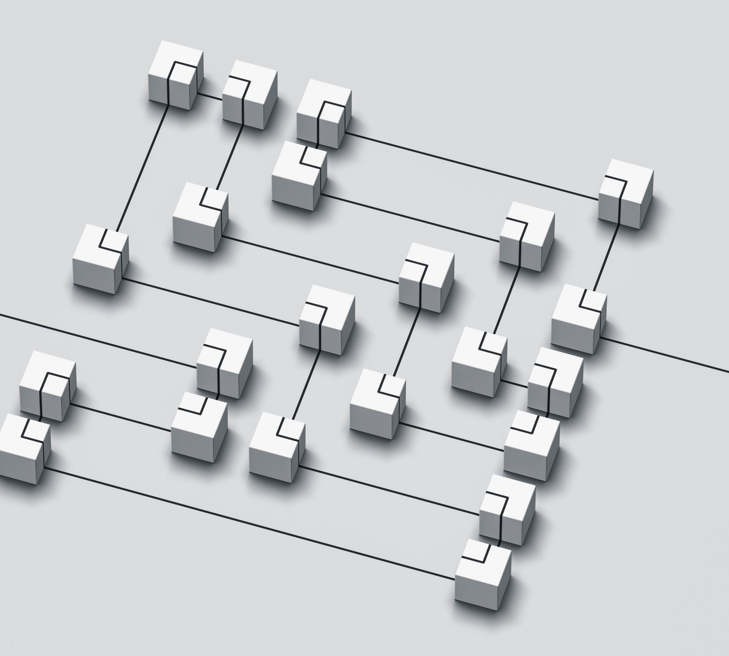
Qualifiers and Annotations
A Qualifier describes the intrinsic properties of a Data Type.
An Annotation attaches spatially and temporally local information to data.
New MPAI-TFA versions are published if
  An application standard requires Qualifiers.
  An existing Qualifier is extended.
Versioning of Qualifiers is a critical component of MPAI-TFA.

Slide 12
An initial set of Qualifiers
Qualifiers have a hierarchical structure from :
  Sub-Types
  Formats
  Attributes
Each hierarchy element may be missing or have a further hierarchy
MPAI-TMA is not exhaustive!
New entries may be added any time to new versions.

Slide 13
Domain-based Data Qualifiers/1
Automotive | TFA-GNQ | GNSS Qualifier | X | OSD-LIQ | LiDAR Qualifier | X
 | TFA-OMQ | Offline Map Qualifier | X | OSD-RAQ | RADAR Qualifier | X
 | TFA-USQ | Ultrasound Qualifier | X
Avatar | TFA-BDQ | Body Descriptors Qualifier | X | TFA-FCQ | Face Descriptors Qualifier | X
 | TFA-MCQ | MoCap Qualifier | X
Health | TFA-ECQ | ECG Qualifier | X | TFA-EEQ | EEG Qualifier | X
 | TFA-EHQ | EHR Qualifier | X | TFA-GEQ | Genomics Qualifier | X
 | TFA-MIQ | Medical Image Qualifier | X
Machine Learning | TFA-MLQ | ML Model Qualifier | X

Slide 14
Domain-based Data Qualifiers/2
Media | TFA-3MQ | 3D Model Qualifier | X | TFA-AUQ | Audio Qualifier | X
 | TFA-AVQ | Audio-Visual Qualifier | X | TFA-COQ | Colour Qualifier | X
 | TFA-SPQ | Speech Qualifier | X | TFA-TXQ | Text Qualifier | X
 | TFA-VIQ | Visual Qualifier | X
Metaverse | TFA-CRQ | Certificate Qualifier | X | TFA-CTQ | Contract Qualifier | X
 | TFA-CUQ | Currency Qualifier | X | TFA-DSQ | Discovery Qualifier | X
 | TFA-IFQ | Information Qualifier | X | TFA-ITQ | Interpretation Qualifier | X
 | TFA-MVA | Metaverse Qualifier | X | TFA-PRQ | Program Qualifier | X
Space-Time | TFA-LOC | Location Qualifier | X | TFA-TIM | Time Qualifier | X
Theatrical | TFA-CLQ | Control Qualifier | X | TFA-DAN | Dance Qualifier | X

Slide 15
MPAI-TFA for you
If you need additional entries in any of the V1.4 Qualifiers or support of new Qualifiers, please make a documented request to the MPAI Secretariat.
Requests will be considered by the appropriate MPAI committee and a response provided.

Slide 16
Publication of MPAI
Technical Specifications
As a series of web pages – one per chapter, hierarchically including:
One page for all AI Workflows, hierarchically including:
  One page for each AI Workflow.
  Each AI Workflows includes links to AI Modules and Data Types used by the AIW.
One page for AI Modules, hierarchically including:
  One page for each AI Module.
  Each AI Module includes links to Data Types used by the AIM.
  Links to AI Modules and Data Types provide If the AI Module is Composite.
One page for each Data Type

Slide 17

MPAI-TFA is available online
https://mpai.community/standards/mpai-tfa/v1-4/

Slide 18


Looking forward to welcoming you in this MPAI project!
https://mpai.community/how-to-join/
Join MPAI
Share the fun
Build the future
18
18
18
18

