Slide 1
Call for Technologies:
Pursuing Goals in metaverse (MPAI-PGM) –
Autonomous User Architecture (PGM-AUA)
Online 2025/11/17T09 and 16 UTC
.

Slide 2
Autonomous Agents in metaverse
Metaverses can host a variety of different “societies”, populated by “humans” and non-humans (NPCs,…).
Not a lot of autonomous agents around, though…
Interesting opportunities if autonomous agents are:
  Affordable – as product and operation.
  Reconfigurable – can swap/update modules independently from other modules.
  Extensible – can add/replace specific competences as needed.
Autonomous agents are complex systems integrating various technologies.
Standards can facilitate the integration of independently developed technologies into cohesive Autonomous Agents.

Slide 3

: what it is
International, unaffiliated, non-profit SDO.
: what it does
Develops AI-based data coding standards.
: how it does it
Within clear Intellectual Property Rights licensing frameworks.

Slide 4
How MPAI develops standards
Stage 0
Stage 1
Stage 2
Stage 3
Use Cases
Interest
Collection
Functional
Requirements
Commercial
Requirements
(FWL)
Technical
Specification
Reference
Software
Community
Comments
Standard
Development
Call for
Technologies
Conformance
Testing
Reference
Software
Performance
Assessment
Stage 7
Stage 6
Stage 5
Stage 4
Principal Members
All
All Members

Slide 5
The MPAI standards portfolio (as of 2025/11/17)
Acronym | Title
MPAI-AIF | AI Framework
MPAI-PRF | AI Module Profiles
MPAI-CUI | Compression and Understanding of Industrial Data
CAV-TEC | Connected Autonomous Vehicle - Technologies
CAE-USC | Context-based Audio Enhancement – Use Cases
MPAI-TFA | Data Types, Formats, and Attributes
EVC-UFV | AI-Enhanced Video Coding – Up-sampling Filter for Video applications
MPAI-GME | Governance of the MPAI Ecosystem
MPAI-HMC | Human and Machine Communication
MMM-TEC | MPAI Metaverse Model - Technologies
MPAI-MMC | Multimodal Conversation
NNW-NNT | Neural Network Watermarking - Traceability
MPAI-OSD | Object and Scene Description
MPAI-PAF | Portable Avatar Format
MPAI-SPG | Server-based Predictive multiplayer Gaming

Slide 6
Two foundational standards – AIF and MMM

Slide 7

What is the MPAI AI Framework?
Technical Specification: AI Framework (MPAI-AIF) V2.2 specifies Architecture, Interfaces, Protocols, and API of the AI Framework.
Enables seamless integration of AI Modules (AIM) with known interfaces into modular AI Workflows (AIW) executed in the standard AI Framework (AIF).
A “smart” autonomous agent is composed of “black boxes”
  With known interfaces.
  Including technologies from different fields.
A new standard for the industry of autonomous agents in virtual spaces.
7

Slide 8
AI Framework (MPAI-AIF V2.2)
User Agent
AI
Workflow
(AIW)
AI Module (AIM)
AI Module (AIM)
Outputs
Inputs
AIM/AIW Storage
(non-secure)
AI Module (AIM)
AIM/AIW Storage
(secure)
AI Module (AIM)
Controller (Non-secure/Secure)
SAL
MPAI Store
Communi-cation
Global Storage
Access
Communication Service
Encryption Service
Attestation Service
Large portfolio of AIWs, AIMs, and Data Types
AIWs, AIMs, and Data Types - MPAI community

Slide 9







MPAI Metaverse Model – Technologies (MMM-TEC)
MPAI Metaverse Model – Technologies (MMM-TEC) specifies an environment where Processes perform Actions on Processes and things called Items or request other Processes to perform Actions on their behalf (Process Actions)
Users can be driven by human (H-Users)
or be autonomous (A-Users)
Persona
Persona
Item
Device
H-User
Resolut.Service
Resolut.Service
H-User
Item
Device
Metaverse B
App
A-User
Metaverse A
Service
Service

Slide 10
MPAI-MMM-TEC - Processes
The Processes of an M-Instance may be characterised as:
Services, Devices, Apps, and
Users representing and acting on behalf of human entities possibly rendered as a Persona (avatar)
A human controls a User directly (H-User) or indirectly (A-User).
M-Instance Processes perform Actions on Items (things in the metaverse)
Authenticate | Author | Convert | Discover | Execute | Hide
Identify | Inform | Interpret | MM-Add | MM-Animate | MM-Move
MM-Send | Modify | MU-Actuate | MU-Add | MU-Animate | MU-Move
MU-Send | Post | Property Change | Register | Resolve | Rights Change
Transact | UM-Capture | UM-Send | Validate
Notes:
The Processes of an M-Instance may be characterised as:
• Services providing specific functionalities, such as content authoring.
• Devices connecting the universe to the M-Instance and the M-Instance to the universe.
• Apps running on Devices.
• Users representing and acting on behalf of human entities residing in the universe and possibly rendered as a Persona, i.e., an avatar animated directly by a human or indirectly by an autonomous process.
M-Instance Processes perform Actions on Items either on their own initiative or driven by the actions of humans or machines in the universe.
The table in this slide lists the 28 Actions that a Process can perform in an M-Instance that complies with MPAI-MMM-TEC

Slide 11
The PGM-AUA standard project
Use Cases and Functional Requirements
Call – Review – standard development

Slide 12

Pursuing Goals in metaverse (MPAI-PGM) – Autonomous User Architecture (PGM-AUA)
The PGM-AUA project intends to:
Specify
  The Architecture of an A-User (an AI-Workflow) and
  The components (AI Modules) in terms of functions and data types exchanged between AIMs.
Give the means to an A-User to “decide” what to do (in a metaverse).

Slide 13
A Use Case – Buying eye wear in metaverse
Entities | - H-Kate is a human wishing to buy eyewear. - A-Liam is a User acting as a sales agent in an optical store. - H-Mary is a human taking over customer interaction when requested by A-Liam.
Goals | - H-Kate: to buy eyewear that suits her face in outdoor conditions. - A-Liam: to sell high-priced eyewear rather than discounted eyewear. - H-Mary: to take over and conclude the sale if A-Liam fails at the highest price.
Workflow | - H-Kate explains her needs - A-Liam places samples on the counter - H-Kate tries on various samples in different lights and observes the effect. - A-Liam assesses and comments on Kate’s appearance. - H-Kate negotiates the cost of selected eyewear. - A-Liam applies negotiation training but fails. - A-Liam calls H-Mary when the negotiation fails. - H-Mary closes the sale with Kate.

Slide 14
A-Avatar Follows a Walking Avatar
Context | An A-User is rendered - As A-Persona MM-Added at an M-Location with a Spatial Attitude. - In a portion of the M-Instance occupied by randomly walking Personae. - Following an H-Persona walking in the M-Location.
Goal | A-Users drives its A-Persona to follow the H-Persona.
Constraints | A-Persona shall: - Stay at distance d from H-Persona with a tolerance of ±Δd. A-Persona shall not: - Intrude upon the personal space D of any other Persona in the M-Location. - Collide with any moving or static Object. - Exceed assigned maximum velocity and acceleration.

Slide 15
Marketing in metaverse
Entities | H-Fiona walks around the M-Instance, possibly meeting friends. A-Gary has the goal of promoting a product. H-Henry walks around the M-Instance to meet friends. A-Ian has the Goal of ensuring that H-Users are not disturbed by impertinent A-Users/H-Users. H-John takes over A-Ian’s role in difficult situations.
Goals | A-Gary has the following Goals: - Attract H-Users, e.g., by topping passers-by, attracting attention, intruding conversations, etc. - Acknowledge its artificiality. - Determine conversation opener by detecting availability of passers-by. - Determine how to try again after a first unsuccessful approach. - Determine when to give up to avoid security action. - Keep an eye on the surroundings to check for approaching security A-Users (mall cops). - Sustain conversation to convince H-User by changing words, intonation, face, and gestures. A-Ian has the following Goals: - Detect gatherings of people that look “suspicious” (e.g., A-Users bothering H-Users). - Apply convincing arguments to desist. - Refer to higher-level security if convincing fails.

Slide 16
Functional Requirements
1. The A-User shall be implementable with limited computing resources.
2. The A-User shall be able to:
1. Understand its surroundings including Audio, Visual, Text.
2. Converse with one User (either A-User and H-User) in contexts relevant to an M-Instance.
3. Move in space in a human fashion understanding its constraints.
4. Assume Personality: coherent Ethics, Commun. style, Appearance, Personal Status.
3. The A-User shall be implementable
1. For operation in an MMM-TEC M-Instance.
2. With relatively small Language Models.
3. Assuming access to the features available in MPAI standards.
4. Assuming access to domain knowledge.
4. The A-User should:
1. Rely on existing MPAI standards or extensions thereof.
2. Be able to deal with >1 User at a time in contexts likely to be relevant to an M-Instance.
3. Be able to handle haptic information.

Slide 17
Main use scenario
A virtual space (M-Instance) with audio-visual properties.
Including at least an A-User and a User (that can be an A-User or an H-User).
A-User deals with one User at a time, but may switch to another User.
The two Users
  Are engaged in a conversation, e.g., to solve a problem.
  Can perform Actions or Process Actions based on their Rights.
  Can access M-Instance Services based on its Rights e.g., a Discover Service.

Slide 18
The PGM-AUA Call for Technologies and its processing
Step | Deadline | Time
Call issued | 2025/10/29
Notification of intention to submit a Response by | 2025/12/29 | 23.59 UTC
Imperative deadline for submission of Responses by | 2026/01/19 | 23.59 UTC
Evaluation of Responses starts | 2026/01/21 | (MPAI-64)
MPAI working groups will thoroughly review the Responses and retain those appropriate for the future PGM-AUA standard.
MPAI will select suitable technologies from those submitted in Responses. Not obligated to select a particular proposal, or any proposal.
Respondents will be encouraged to join MPAI and those with accepted Responses, shall join MPAI or their proposals will be discarded.

Slide 19
Tentative Technical Specification (TTS)

Slide 20

Tentative Technical Specification (TTS)
The TTS is part of the package of Call for Technologies documents.
TTS uses the style but is NOT an MPAI Technical Specification.
Developed as an example of the result MPAI intends to achieve with The PGM-AUA Call for Technologies.
But it has no formal status otherwise.
Respondents are free to:
  Comment on/change/extend TTS
  Make proposals unrelated to TTS.

Slide 21
A PGM-AUA V1.0 Reference Model (Tentative Model in TTS)
Human Command
A-User Control
Human Command Status
Process Action response
Action
Process Action
Request
Human Agent
Avatar
Spatial
Directive
Personality Context Guide
Context Capture
Spatial Reasoning
Domain Access
Personality Alignment
A-User Rendering
Text
Context
User State Refinement
A-User
Personal
Status
Refined
Context
Guide
Expressive
State
Guide
Audio
Scene
Descript.
3D Model
Scene Descriptors
Initial
Response
DA-
Prompt
Enhanced
Response
UR-
Prompt
Refined
Response
PA-
Prompt
Final
Response
Visual
Context
Prompt Creation
Basic Knowledge (LLM)
PC-
Prompt
Controller (Non-secure/Secure)
MPAI Store
Communication
Global Storage
Access
Communication Service
Encryption Service
Attestation Service

Slide 22
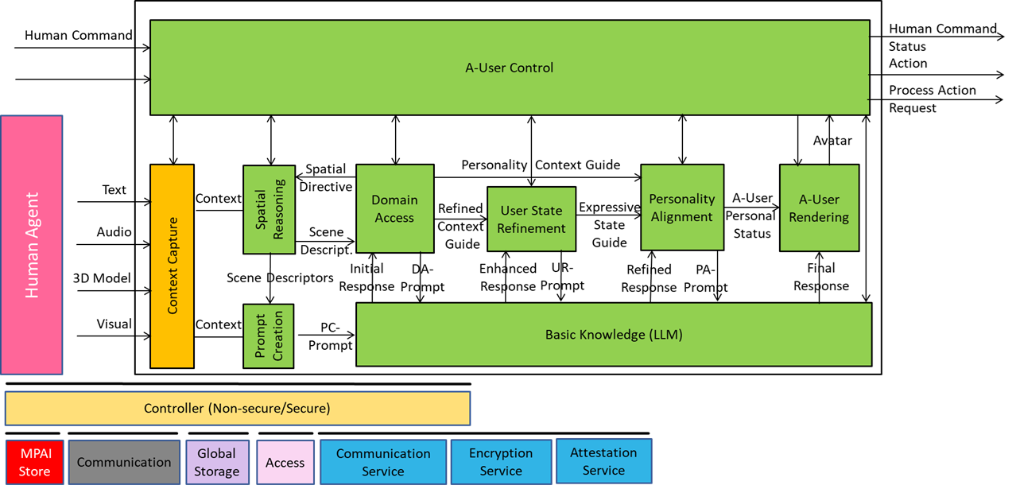
An example AIM specification: Context Capture

Slide 23
An example AIM specification: Context Capture/1
Receives
  Text Objects, Audio Objects, Visual Objects, 3D Model Objects.
  Context Capture Directives from A‑User Control guiding modality prioritization and acquisition strategy.
Extracts, refines, and interprets multimodal signals to construct Context, a representation of the User environment and User State, including:
  Scene grounding in spatio‑temporal coordinates.
  User localization (position, orientation, posture).
  Semantic tagging of objects, actions, and environmental features.
  Framing of cognitive, emotional, attentional, and temporal states.

Slide 24
An example AIM specification: Context Capture/2
Sends Context to
  Prompt Creation as Contextual Guide for multimodal prompt generation.
  Spatial Reasoning as for situational awareness and environment alignment.
  A‑User Control as Contextual Status in response to Context Capture Directives.
Enables
  Spatial Reasoning and Prompt Creation to operate with full awareness of the multimodal environment, supporting perception‑aligned interactions, context‑sensitive orchestration of AIMs
  A‑User Control to keep it informed about the implementation of Context Capture Directives.

Slide 25
An example AIM specification: Context Capture/3
Input | Description
Text Object | User input expressed in structured text form, including written or transcribed utterances.
Audio Object | Captured audio signals from the scene, covering speech, environmental sounds, and paralinguistic cues.
3D Model Object | Geometric and spatial data describing the environment, including structures, surfaces, and volumetric features.
Visual Object | Visual signals from the scene, encompassing gestures, facial expressions, and environmental imagery.
Context Capture Directive | Control instructions specifying modality prioritization, acquisition parameters, or framing rules to guide M‑Location perceptual processing.
Output | Description
Context | A structured, time‑stamped snapshot integrating multimodal inputs into an initial situational model of the environment and user posture.
Context Capture Status | Scene‑level metadata describing user presence, environmental conditions, and confidence measures for contextual framing.

Slide 26
An example AIM specification: Context Capture/4
Audio Scene Descriptors
Audio-Visual Alignment
Audio Scene Descriptors
Context Capture Output
Audio Scene Description
Audio
Object
Audio Object Identification
Audio Scene Descriptors
User State Extraction
Audio Objects
Audio Object
Types
Context
Capture
Directive
Context
Capture
State
Context
Capture
State
Context
Capture
Directive
Visual Scene Description
Visual Object Identification
Context
Capture
State
User
State
Visual Objects
Visual Object
Types
Visual
Object
Context
Visual Scene Descriptors
Visual Scene Descriptors
Visual Scene Descriptors

Slide 27
An example AIM specification: Context Capture/5
1. Audio Scene Description (ASD)
Is produced by parsing raw Audio Objects.
Serves to generate Audio Scene Descriptors (structured representation of ambient sounds, speech, and spatial audio sources).
Enables downstream modules (AOI, AVA) to work with semantically enriched audio data.
2. Visual Scene Description (VSD)
Is produced by parsing raw Visual Objects and 3D Model Objects.
Serves to generate Visual Scene Descriptors (structured representation of geometry, objects, and layout).
Enables VOI and AVA to reason over spatial and visual features.
3. Audio Object Identification (AOI)
Is produced by analysing Audio Scene Descriptors.
Serves to classify discrete Audio Object Types (speech segments, sound events, environmental cues).
Enables AVA and USE to align audio semantics with visual and contextual data.
4. Visual Object Identification (VOI)
Is produced by analysing Visual Scene Descriptors.
Serves to classify discrete Visual Object Types (gestures, facial expressions, environmental objects).
Enables AVA and USE to integrate visual semantics into context framing.

Slide 28
An example AIM specification: Context Capture/6
5. Audio‑Visual Alignment (AVA)
Is produced by combining Audio Scene Descriptors, Audio Object Types, Visual Object Types, Visual Scene Descriptors, and Context Capture Directive.
Serves to synchronise audio and visual streams into Aligned Audio Scene Descriptors and Aligned Visual Scene Descriptors.
Enables directive‑aware reasoning by generating Context Capture State (metadata on synchronisation, directive compliance, anchoring).
6. User State Extraction (USE)
Is produced by integrating Aligned Audio Scene Descriptors, Aligned Visual Scene Descriptors, Context Capture Directive, Context Capture State, and Personal Status (via internal PSE).
Serves to generate the User State (engagement, focus, temporal cues, intent, motivation, personal status).
Enables downstream AIMs to adapt reasoning and expressive stance based on the User’s posture.
7. Context Capture Output (CCO)
Is produced by consolidating User State and Context Capture State with aligned descriptors.
Serves as the final structured output of the CXC AIM.
Enables external AIMs (Prompt Creation, Domain Access, A‑User Control) to consume directive‑aware context frames.

Slide 29
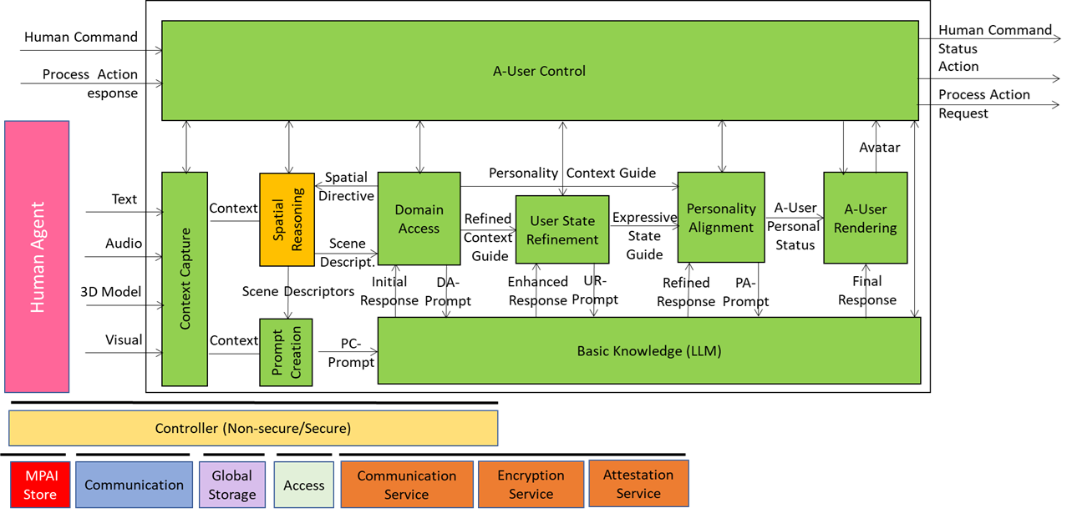
An example AIM specification: Visual Spatial Reasoning

Slide 30
An example AIM specification: Visual Spatial Reasoning/1
Function
Receives
  Context (Visual Scene Descriptors + User State) from Context Capture.
  Visual Spatial Directives from Domain Access
  Visual Action Directives from the A-User Control
Extracts, refines, interprets, and sends (to Prompt Creation and Domain Access) the Visual Scene Descriptors representing the environment and objects in it.
Enables Prompt Creation and Domain Access to operate in full awareness of the visual environment:
  Supporting location-aware interactions, alignment with User perception, and AIM coordination.
  Keeping A-User Control informed about Visual Action Directives implementation.

Slide 31
An example AIM specification: Visual Spatial Reasoning/2
Input/Output Data
Input | Description
Context | A structured and time-stamped snapshot representing the initial understanding that the A-User achieves of environment and of User posture.
Visual Spatial Directive | A dynamic modifier provided by the Domain Access AIM to help the interpretation of the Visual Scene by injecting constraints, priorities, and refinement logic.
Visual Action Directive | Visual-related actions and process sequences from PGM-AUC.
Output | Description
Visual Scene Descriptors | A structured, analytical representation of the Visual Scene with object geometry, 3D positions, depth, occlusion, and affordance data. It highlights salient objects, normalised positions, proximity, and interaction cues
Visual Action Status | Visual spatial constraints and scene anchoring from PGM-AUC.

Slide 32
An example AIM specification: Visual Spatial Reasoning/3
SubAIMs/1
Visual Descriptor Parsing
Depth & Occlusion Estimation
Salience Mapping
Visual Output Construction
Relative Depths
Relative Depths
Visual
Spatial
Directive
Ranked Visual Objects
Visual
Spatial
Status
Visual Objects +SA
Occlusion flags
Occlusion flags
Visual Spatial Status
Visual
Spatial
Directive
Visual Spatial Status
Affordance Inference
Visual Spatial Status
Visual
Scene
Descript.
Visual Objects +SA
Affordance tags
Affordance tags
Visual
Scene
Descript.
Salient Visual Objects
Visual
Spatial
Directive
Interaction
Potential
Interaction Potential

Slide 33
An example AIM specification: Visual Spatial Reasoning/4
SubAIMs/2
Acronym | Sub-AIM | Function
VDP | Visual Descriptor Parsing | Decomposes VSD into structured components: Visual Objects (VIO) and Spatial Attitudes (OSA)
DCE | Depth & Occlusion Estimation | Computes relative depth and occlusion flags
AFI | Affordance Inference | Determines actionable properties and interaction potential
SMP | Salience Mapping | Ranks objects by prominence and filters salient objects
VOC | Visual Output Construction | Builds output Visual Scene Descriptors from salient and full descriptors

Slide 34
An example AIM specification: Visual Spatial Reasoning/5
Functions Performed by Visual Spatial Reasoning AIM
# | Sub-AIM | Inputs | Outputs | To
VDP | Visual Descriptor Parsing | VisualSceneDescriptors | VisualObjects, SpatialAttitudes | DOE, AFI, SMP, VOC
DOE | Depth & Occlusion Estimation | VisualObjects, SpatialAttitudes, VisualSpatialDirective | RelativeDepth, OcclusionFlags, VisualSpatialStatus | SMP, VOC
AFI | Affordance Inference | VisualObjects, SpatialAttitudes, VisualSpatialDirective | AffordanceTags, InteractionPotential, VisualSpatialStatus | SMP, VOC
SMP | Salience Mapping | RelativeDepth, OcclusionFlags, AffordanceTags, InteractionPotential, SpatialAttitudes, VisualSpatialDirective | RankedVisualObject, SalientVisualObjects, VisualSpatialStatus | VOC
VOC | Visual Output Construction | RankedObjectList, SalientVisualObjects, RelativeDepth, OcclusionFlags, AffordanceTags, InteractionPotential, VisualObjects, SpatialAttitudes | VisualSceneDescriptors, VisualSpatialStatus | —

Slide 35
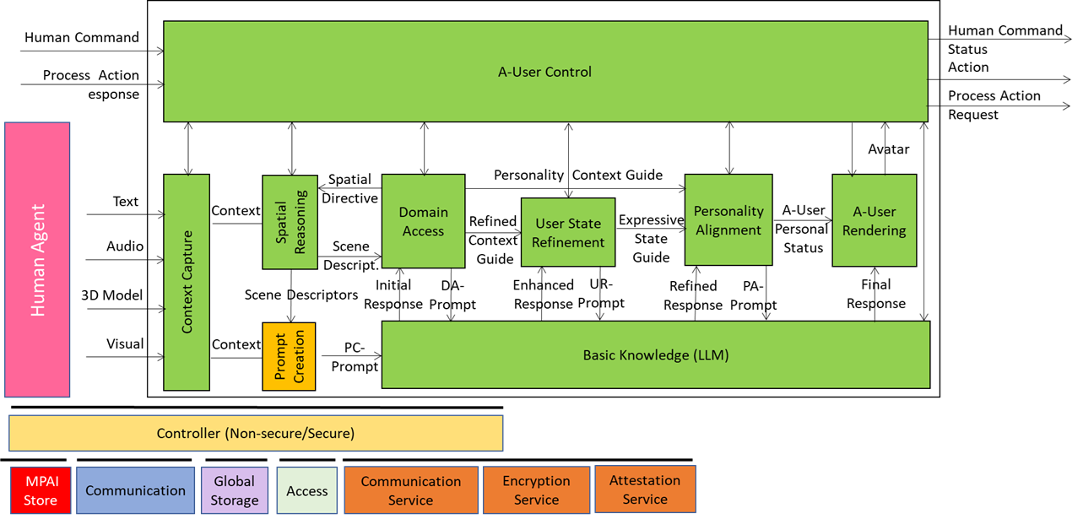
An example AIM specification: Prompt Creation

Slide 36
An AIM specification example: Prompt Creation/1
Function
Receives
  Text input and Audio and Visual Scene Descriptors from Spatial Reasoning AIMs
  Visual Scene Descriptors from Visual Spatial Reasoning and, indirectly, Domain Access (PGM-DAC).
Synthesises multimodal and contextual signals into natural language prompts describing User’s interaction, clarifying intent, and confirming inferred goals.
Provides textual PC-Prompt to Basic Knowledge LLM.
The outputs enable A-User Control, Personality Alignment, and Rendering AIMs to operate fully aware of the User’s communicative intent, supporting expressive coherence, goal-driven orchestration, and context-sensitive interaction.

Slide 37
An AIM specification example: Prompt Creation/3
Input/Output Data
Input | Description
Context | A structured and time-stamped snapshot representing the initial understanding that the A-User achieves of the environment and of the User posture.
Audio Scene Descriptors | A Data Type that conveys spatially grounded semantic audio data from the Spatial Reasoning AIM that enables the Prompt Construction AIM to generate context-aware and referentially precise prompts.
Visual Scene Descriptors | A Data Type that conveys spatially grounded semantic visual data from the Spatial Reasoning AIM that enables the Prompt Construction AIM to generate context-aware and referentially precise prompts.
Prompt Creation Directive | Trigger to initiates prompt generation or refinement from PGM-AUC.
Output | Description
PC-Prompt | Prompt to Basic Knowledge
Prompt Creation Status | Prompt readiness, alignment status, and semantic goal framing to PGM-AUA.

Slide 38
An AIM specification example: Prompt Creation/4
 | Potential SubAIMs for PGM-PRC
Sub-AIM | Function | Inputs | Outputs | To
PTA – Prompt Token Analyser | Parses and sequences user-generated tokens from multimodal input sources | Text, Audio | Token Stream | INF, RFR
INF – Intent Inference | Ranks candidate intents based on context and scene descriptors | Token Stream, Audio Scene Descriptors, Visual Scene Descriptors, User State | Intent Candidates | USA, GCD
USA – User State Adaptation | Modulates prompt tone and complexity based on cognitive/emotional state | User State, Intent Candidates | Tone Profile, Phrasing Hints | PFT, GCD, SCT
RFR – Referent Resolution | Resolves ambiguous expressions to scene entities | Token Stream, Audio Scene Descriptors, Visual Scene Descriptors, Spatial Guide | Resolved Referents, Resolution Confidence | PFT, SPE

Slide 39
An AIM specification example: Prompt Creation/5
Sub-AIM | Function | Inputs | Outputs | To
SPE – Spatial Primitive Extraction | Extracts spatial relationships for grounded phrasing | VisualSpatialGuide, AudioSpatialGuide | Spatial Primitives | PFT, GCD
GCD – Goal Constraint Derivation | Infers spatial goals and behavioral triggers | SpatialGuide, UserState, IntentCandidates | Goal Constraints, Prompt Triggers | PFT
SCT – Scene Context Tagging | Annotates User posture, gaze, and engagement for prompt timing | SpatialGuide, UserState | Scene Context Tags, Timing Hints | PFT
PFT – Prompt Planner | Aggregates semantic inputs into a structured PC-Prompt Plan (JSON) | IntentCandidates, ToneProfile, PhrasingHints,ResolvedReferents, ResolutionConfidence, SpatialPrimitives,GoalConstraints, PromptTriggers,SceneContextTags, TimingHints, TextFromContext | PC-Prompt Plan | PFT
PFT – Prompt Formatter | Converts PC-Prompt Plan into a prompt | PC-Prompt Plan | PC-Prompt | BKN
PFT – Prompt Formatter | Reports the outcome of Prompt Creation for lifecycle coordination | PromptPlanDirective, PC-Prompt, GoalConstraints, ToneProfile, ResolutionConfidence | Prompt Plan Status | AUC

Slide 40
An invitation

Slide 41
Where we are
MPAI is well equipped to handle this PGM-AUA standard project:
  AI Frameworks
  Context-based Audio Enhancement
  Multimodal Conversation
  Object and Scene Description
  Portable Avatar Format
But MPAI is keen to receive your proposals in the different technology areas required by PGM-AUA
Yearly membership fees : 2400 EUR (Principal) 480 EUR (Associate)
Join now – your membership will last until 31st December 2026!

Slide 42


Looking forward to welcoming you in this exciting MPAI project!
https://mpai.community/standards/mpai-pgm/aua/v1-0/
Join MPAI
Share the fun
Build the future
42
42
42
42

