Slide 1
The Compression and Understanding of Industrial Data standard (MPAI-CUI) – Company Performance Prediction Version 2.0
Guido Perboli – Politecnico di Torino

Slide 2
The MPAI way to AI-based data coding
MPAI Application Standards break up monolithic AI applications into a set of interacting components.
The semantics of the data exchanged between components is known (as far as possible).
Developers compete by offering “standard” components with “improved” performance.
The MPAI AI Framework standard makes possible a “Lego-type” approach:
  “Applications”, called AI Workflows – AIWs
  Composed of AI Modules called AIMs
  Executed in AI Frameworks called AIFs.

Slide 3

Technical Specification: MPAI AI Framework (MPAI-AIF)
Enables dynamic configuration, initialisation, and control of AI Workflows in a standard AI Framework.
  Architecture
  Metadata
  Common API Features
  Basic API
  Security API
  Profiles

Slide 4
The MPAI-AIF Reference Model
User Agent
AI Module (AIM)
AI Module (AIM)
Outputs
Inputs
AIM/AIW Storage
(non-secure)
AI Module (AIM)
AIM/AIW Storage
(secure)
AI Module (AIM)
Controller (Non-secure/Secure)
SAL
MPAI Store
Communi-cation
Global Storage
Access
Communication Service
Encryption Service
Attestation Service

Slide 5
MPAI-CUI: Contents
The MPAI-CUI standard V 2.0
Applications of the MPAI-CUI standard
MPAI-CUI Demo (anonymous companies)

Slide 6
1. The standard

Slide 7
The «AI-based Compression and Understanding of Industrial Data» standard
Company Performance Prediction use case
The Company Performance Prediction (CUI-CPP) standard is a powerful and extensible way to predict the performance of a company using its
  Financial and Governance risks
  Vertical risks (currently, climate and cyber)
Predicts the performance of a company from its data in a given time horizon of prediction.
Extends the previous version both from a functional and a regulatory pint of view

Slide 8

AI-based standard
Novelties of MPAI-CUI
  Extracts the most relevant data with controlled information loss by analysing the large amount of data required by regulation.
  Extends prediction horizon up to 60 months, using AI.
  Considers both the cases where an AIM for a vertical risk is defined/available or not
  Introduces a compulsory explainability of the predictions

Slide 9
What does “performance” mean?
Default: the probability the company will default (e.g., crisis, bankruptcy) in a specified number of future months dependent on financial features and its explainability expressed as impact caused to the Company Default
Organisation: the adequacy of the organisational model (e.g., board of directors, shareholders, familiarity, conflicts of interest) and its explainability expressed as impact caused to the Company Governance
Primary default: the probability that the company will experience severe financial distress and/or bankruptcy within a specified number of future months
Primary Discontinuity: the probability the company will experience a specific risk effect (e.g., climate, cyber) in a specified number of future months dependent on each risk specific features and its explainability expressed as impact caused to the Primary Discontinuity
Secondary Discontinuity: the probability of an interruption of the operations of a company for a period due to risks for which an AIM (Primary Discontinuity) is not available or not compliant to the user’s regulations.

Slide 10

Evolution from from V1.1 to V2.0
CUI-CPP V1.1
CUI-CPP V2.0 Enhancements
Governance and Financial Statement processing
Governance and Financial Descriptors
Organizational Model Index calculation
Vertical Risks Data integration
Default Probability assessment
Assessment and Prediction Composite
Risk Matrix conversion
Enhanced explainability features
Business Discontinuity Probability
Regulation-aware processing

Slide 11
MPAI-CUI Workflow
User Agent
Prediction Horizon
Company Assessment and Prediction
Organisation Descriptors
Cyber Risk Descriptors
Primary Default Descriptors
Climate Risk Descriptors
Primary Discontinuity Descriptors
Financial Descriptors
Primary Default Descriptors
Prediction Result Perturbation
Governance Descriptors
Secondary Risk Statements
Risk Matrix Generation
Secondary
Risk Matrix
Secondary Discontinuity Probability
Prediction Horizon
Controller
MPAI Store
Communication
Global Storage
Access
Communication Service
Encryption Service
Attestation Service
1/30/2026

Slide 12
MPAI-CUI Workflow
Input:
  Prediction Horizon
  Risk Data
  Governance Data
  Financial Data
  Risk Assessment Data.
Processing
Acronym | Input | Output
CUI-CAP | Primary Risk Descriptors | Primary Default Descriptors
 | Governance Descriptors | Organisation Descriptors
 | Financial Descriptors | Primary Discontinuity Descriptors
 | Prediction Horizon
CUI-RMG | Secondary Risk Statements | Secondary Risk Matrix
CUI-PRP | Primary Default Descriptors | Secondary Discontinuity Probability
 | Secondary Risk Matrix

Slide 13
AI Module Functionalities
Governance Assessment
1
Computes Governance Descriptors from governance and financial data.
Financial Assessment
2
Computes Financial Descriptors from financial data inputs.
Risk Matrix Generation
3
Computes Risk Matrix from risk assessment data.
Assessment and Prediction
4
Macro AIM - Computes Organisation, Default, and Discontinuity Descriptors from multiple inputs.
Prediction Result Perturbation
5
Computes Discontinuity Probability by perturbing Default Descriptors with Risk Matrix.

Slide 14
Assessment and Prediction Module (CUI-CAP)
Prediction Horizon
Primary Default Prediction
Primary Default Descriptors
The Company Assessment and Prediction module serves as the foundational component for evaluating organizational performance. This composite AIM integrates multiple data sources and analytical approaches to generate comprehensive company assessments.
Financial Descriptors
Prediction Horizon
Organisation Model Assessment
Governance Descriptors
Organisation Descriptors
Financial Descriptors
It processes financial data, operational metrics, and market indicators to produce actionable predictions about company trajectory and performance outcomes.
Prediction Horizon
Primary Discontinuity Prediction
Climate Risk Descriptors
Cyber Risk Descriptors
Primary Discontinuity
Descriptors
Governance Descriptors
Financial Descriptors

Slide 15
Sub-AIMs
Prediction Horizon
Primary Default Prediction
Primary
Default
Descriptors
Financial Descriptors
Primary Default Prediction (CUI-CDP)
Prediction Horizon
Organisation Model Assessment
Analyzes financial indicators and market conditions to predict potential company defaults, enabling proactive risk management.
Governance Descriptors
Organisation
Descriptors
Financial Descriptors
Organization Model Assessment (CUI-OMA)
Evaluates organizational structure, hierarchy, and reporting relationships to identify efficiency opportunities and potential bottlenecks.
Prediction Horizon
Primary Discontinuity Prediction
Climate Risk Descriptors
Cyber Risk Descriptors
Primary Discontinuity Prediction (CUI-PDP)
Primary
Discontinuity
Descriptors
Governance Descriptors
Identifies potential business discontinuities and operational disruptions before they occur, supporting strategic planning due to risks for which a proper AIM is available.
Financial Descriptors

Slide 16
CUI-PDP – Current implementation
Prediction Horizon
Primary Discontinuity Prediction
Climate Risk Descriptors
Cyber Risk Descriptors
Primary Discontinuity Descriptors
Governance Descriptors
Financial Descriptors

Slide 17

Vertical Risks: Cyber & Digitisation
Cyber Risks
Digitisation Risks
Embedded Systems
Credential Loss
IoT Vulnerabilities
Software Updates
Data/backup loss, credential loss, unauthorized access
Data & Backup Loss
Remote Access
Malicious Actions
ICT infrastructure security

Slide 18

Climate & ESG Risks
Physical Risks
Transition Risks
Direct impacts from climate events and environmental changes affecting operations.
Forced reduction of emissions, energy creation changes, climate impact on product portfolio and market.
ESG Factors
Environment-Social-Governance considerations affecting company performance and sustainability.

Slide 19


Prediction Result Perturbation
Default Descriptors
Risk Matrix
Discontinuity Probability
Initial default probability calculations with explainability data
Comprehensive risk assessment matrix for perturbation analysis
Final business discontinuity probability after risk perturbation
This module perturbs Default Descriptors using the Risk Matrix to produce final Discontinuity Probability
Useful when specific AIMs are unavailable or incompatible with use case regulations.

Slide 20
AIW Input/Output Data
Input Data
Output Data
Prediction Horizon
Organisation Descriptors
Number of months for prediction
Comprehensive organizational analysis
Risk Data
Default Descriptors
Comprehensive risk information
Default probability with explainability
Governance
Discontinuity Descriptors
V1.1 extensions and proposals
Business discontinuity analysis
Financial Statement
V1.1 extensions and proposals
Risk Assessment
V1.1 extensions and proposals

Slide 21
Output: the new descriptors
Impact: impact of a specific risk as a real number between 0 and 1.
DescriptorsImpacts: Vector of the impacts of the input descriptors.
  DescriptorID: ID of Descriptor
  DescriptorImpact: Impact of a descriptor expressed as a real number between 0 and 1.
Example
ClimateRiskImpact | Impact of Climate Risk.
ClimateRiskDescriptorsImpacts[] | Name of Financial Descriptors.
ClimateRiskDescriptorID | ID of Climate Risk Descriptor.
ClimateRiskDescriptorImpact | Impact of Climate Risk Descriptor expressed as a real number between 0 and 1.

Slide 22
Standard development process
Use Cases
Interest
Collection
Functional
Requirements
Commercial
Requirements
Technical
Specification
Reference
Software
Community
Comments
Standard
Development
Call for
Technologies
Conformance
Testing
Reference
Software
What next?
Future versions with more a more structured Risk Taxonomy.
Performance
Assessment

Slide 23
2. MPAI-CUI standard: Applications

Slide 24
How is MPAI-CUI going to be used?
COMPANY BOARDS
+ Develop efficient strategies.
+ Identify clues to crisis or bankruptcy years in advance.
+ Help to:
Decide path to recovery,
Conduct what-if analysis,
Devise efficient strategies.
BANKS/FINANCIAL INSTITUTIONS
+ Assess the financial health of companies
+ Aids the financial institution to make the right decision in:
funding or not funding that company,
having a broad vision of its situation.
PUBLIC AUTHORITIES
+ Assess public policies in advance
+ Evaluate scenarios of public interventions
+ Identify proactive actions to increase resiliency of industrial sectors.

Slide 25

A real example: Evaluate the effects of a public policy
Evaluate the impact of funds made available to SMEs in the Piedmont region by analysing the probability of default before and after public intervention.
The study confirmed the effectiveness of the public intervention put in place by showing that public intervention improved the default probability.
See further details in G. Perboli et al. Using machine learning to assess public policies: a real case study for supporting SMEs development in Italy. TEMSCON 2021

Slide 26
3. MPAI-CUI – Demo

Slide 27
What is the demo
Illustrate a real application by applying an AI-based Company Performance Prediction (CPP) decision support system.
Compute instantaneously the Default Probability and the Organizational Model Index after entering the company VAT number.

Slide 28




Demo - Home
Actions possible in the Action section:
View report, view the complete report of the selected company.
Fill out survey, view the parts to be filled in, (e.g., the input of risk data).
Delete, delete the selected company.
Change Company registry, change or update company data (e.g., Ateco Code).

Slide 29
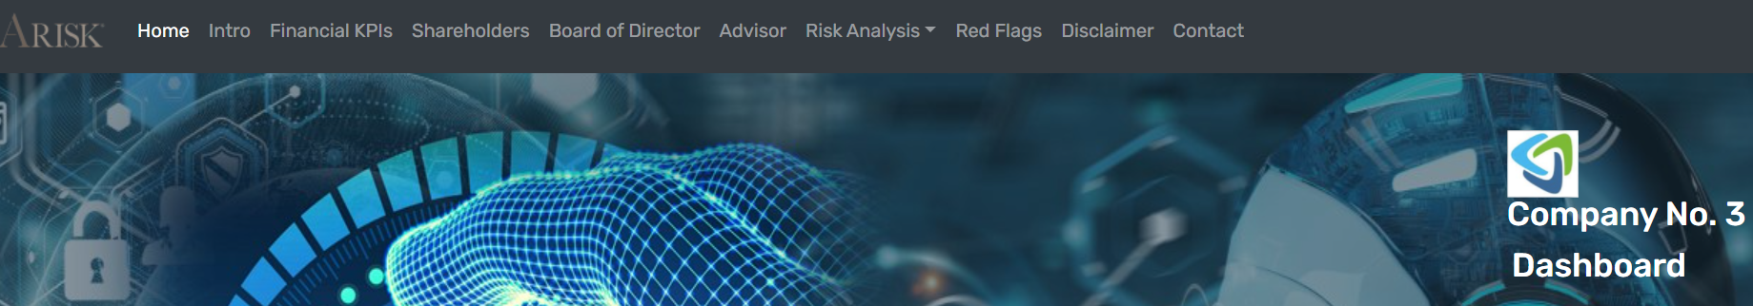
Demo- Dashboard Menu
The report includes various information, the most important are:
Financial KPIs, in this section the main financial KPIs of the company are collected and presented in tabular form.
Risk Analysis, information section in which it is possible to see the risk analysis compiled in the survey section in graphic format.
Red Flags, this section presents the instantly computed scores that satisfy a condition.

Slide 30
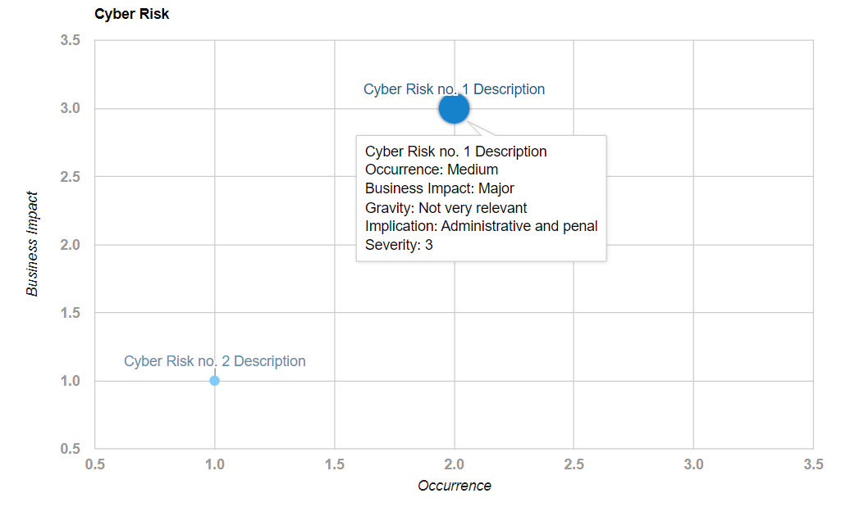
Demo- Risk Analysis - Example

Slide 31
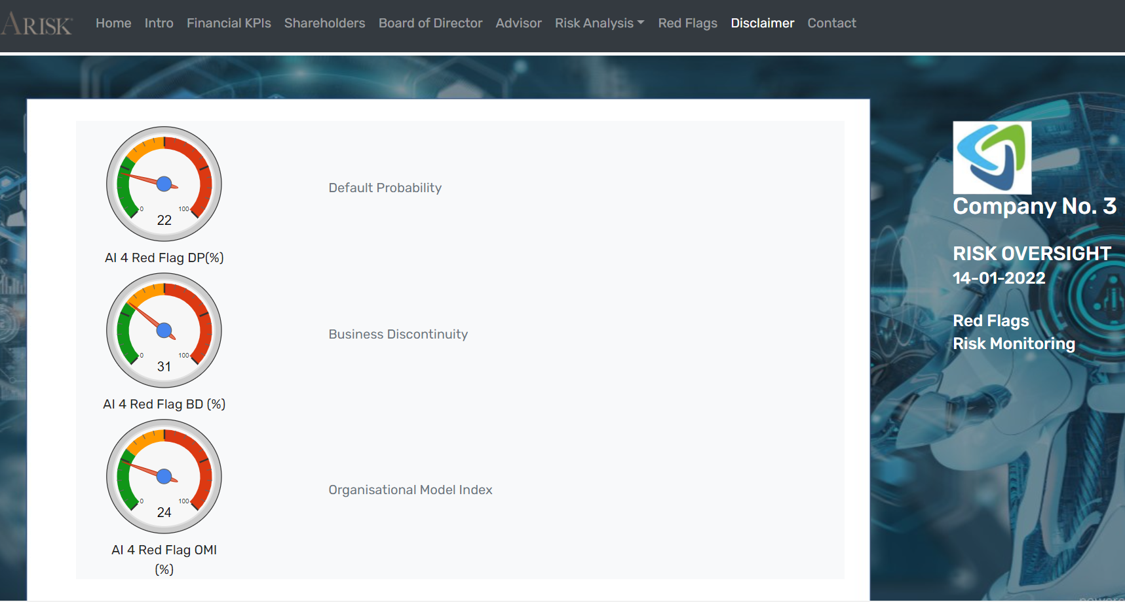
Demo – Instant Score - Example
Red Flags: Last section but one of the most important of the report.
Primary Default
(%)
Organisational Model (%)
Primary Discontinuity
(%)
22% chance of default in the next 36 months
LOW RISK
24% the risk of inadequacy of the organizational model
GOOD STRUCTURE
31% the risk of business discontinuity
GOOD RISK MANAGEMENT
INSTANT SCORE
The ML/AI used in this DEMO Software is indicative of the MPAI-CUI potential.
This demo is a work by Arisk Srl

Slide 32


We look forward to working
with you
on this exciting MPAI project!
Join MPAI
Share the fun
Build the future
https://mpai.community/standards/mpai-cui/cpp/v2-2
32
32
32
32

