Slide 1
Presentation of Call for Technologies: MPAI as a Service (MPAI-MAS) V1.0
Online, 2026/03/30T08 and 15 UTC
.

Slide 2
The evolution of computing
Raw computing services - CPU cycles, memory allocation, network primitives, file systems - represent the foundational substrate of computation.
Tight coupling between applications and infrastructure, limited portability, modularity, and scalability.
Hardware complexity - abstracted by operating systems, middleware, and cloud services.
But AI introduced new demands:
Heterogeneous compute (CPU/GPU/TPU mixes)
Distributed execution
Dynamic module composition
Real‑time communication and event pipelines
Cross‑platform interoperability
Trust and security for ML components

Slide 3

MPAI – standards for AI
MPAI – Moving Picture, Audio and Data Coding by Artificial Intelligence, an international, unaffiliated, non-profit association based in Geneva.
MPAI mission: the promotion of the efficient use of Data by
Developing Technical Specifications for
Coding of any type of Data, especially using Artificial Intelligence.
Technologies that facilitate integration of Data Coding components in ICT systems, & by
Bridging the gap between Technical Specifications and their practical use through the development of Intellectual Property Rights Guidelines (“IPR Guidelines”).
MPAI operation: based on open international collaboration of interested parties supporting the MPAI mission and the means to accomplish it.

Slide 4
The need for an AI Application execution environment
The AI Framework standard (MPAI-AIF) - a layer above raw computing services, providing standard structure, interfaces, and behaviour.
User Agent
AI Workflow (AIW)
AI Module (AIM)
AI Module (AIM)
Outputs
Inputs
AIM
Storage
AI Module (AIM)
AI Module (AIM)
Controller
Communication
Global Storage
Access
MPAI Store

Slide 5
Controller for managed orchestration
The Controller handles scheduling, resource management, communications, and interactions with the MPAI Store.
The Controller abstracts raw execution by:
Managing communication between AIF components.
Activating, suspending, and managing AIWs.
Running AIWs across multiple computing platforms.
Allowing hot‑plugging of AIMs.
No manual composition of computational services.
Orchestration is systematic and programmable.

Slide 6
Modular compute units
AI Modules (AIM) - encapsulate algorithms, models, or processing functions behind standardised ports and event interfaces.
No raw compute primitives.
Key AIM characteristics include:
Standardised input/output ports.
Independent execution (local or heterogeneous hardware).
Hot‑plug capability.
AIMs can include other AIMs (Composite AIMs).
Computation involves interoperable modular building blocks, allowing reuse and composition without rewriting infrastructure.

Slide 7

Standard API
MPAI-AIF specifies a rich set of API enabling
The Controller to download AIMs and AIWs from the MPAI Store.
The User Agent to call the Controller.
The AIMs to call the Controller.

Slide 8
MPAI-AIF API
1 Store API called by Controller
1.1 Get and parse archive
2 Controller API called by User Agent
2.1 General
2.3 Inquire about state of AIWs and AIMs
2.2 Start/Pause/Resume/Stop Messages to other AIWs
2.4 Management of Shared and AIM Storage for AIWs
2.5 Communication management
2.6 Resource allocation management
3 Controller API called by AIMs
3.1 General
3.2 Resource allocation management
3.3 Register/deregister AIMs with the Controller
3.4 Send Start/Pause/Resume/Stop Messages to other AIMs
3.5 Register Connections between AIMs
3.6 Using Ports
3.7 Operations on messages
3.8 Functions specific to machine learning
3.9 Controller API called by Controller

Slide 9
AIF - A New Layer Above Raw Compute
The move from raw computing services to the MPAI‑AIF architecture parallels the evolution
Machine code → high‑level languages
Physical networking → software‑defined networking
ML pipelines → platform‑managed AI ecosystems
AIF provides the missing abstraction layer enabling:
Interoperability-Modularity-Distributed execution
AIF transforms computation into standardised, orchestrated AI workflows, making raw compute services an implementation detail.

Slide 10
The current requirement – local not remote
MPAI envisages the MaaS Service where:
A Remote Client Application (RCA) can select an AI Workflow amongst those available in the MPAI Store.
A Service Controller Instance (SCI) downloads and executes the AI Workflow.
RCA retrieves outputs resulting from execution of the AI Workflow.
To leverage the availability of AIMs and AIWs from various sources, MaaS requires:
Ubiquitous access to the MPAI Store to support envisaged application scenarios.
Guaranteed highest level of authorisation when accessing AI Workflows and their constituent components.
Exercise of the highest level of authenticity control on AI Workflows and their constituent packaged components.

Slide 11
Call for Technologies - MPAI as a Service (MaaS)
MPAI-AIF design: driven by the need to locally execute AI Workflows.
MaaS moves the current user-centric view of MPAI to the centralised view of the MaaS service provider.
In MaaS, users can instantiate Controllers, download and execute AIWs, provide their own data, and obtain the result of the processing.
The MaaS Call intends to extend current standards to enable remote access to remote AIF facilities.

Slide 12
Reference Architecture of MPAI as a Service
Remote Client
SLA
MPAI as a Service
MPAI Store
API Client
API Server
Store API
AIF Remote API
AIF Enhanced API
AIW Descriptions
AIW Metadata
Distributed Repository
Functional Requests
AIF Basic API
AIW Metadata
Client Application
Controller
MPAI Store
AIF Basic API
AIW Metadata

Slide 13
The MPAI as a Service workflow
# | Who | Does | What | Via | Through | To/From
1 | RCA | Issues | SCI Creation Request | API Client |  | API Server
2 | API Server | Returns | SCI ID |  |  | RCA
3 | RCA | Issues | AIW Instantiation Request | API Client | API Server | SCI
4 | SCI | Issues | AIW Request |  |  | MPAI Store
5 | MPAI Store | Returns | Requested elements |  |  | SCI
5’ | MPAI Store | Issues | Requested elements Request |  |  | Rem. Repos.
5” | Rem. Repos. | Returns | Requested elements |  | MPAI Store | SCI
6 | SCI | Returns | AIW ID |  |  | API Server
7 | API Server | Returns | AIW ID |  |  | RCA
8 | RCA | Issues | InMsg to AIM Port Request | API Client | API Server | SCI
9 | RCA | Issues | OutMsg fm AIM Port Request | API Client | API Server | SCI
10 | SCI | Returns |  |  |  | API Server
11 | API Server | Returns | OutMsg fm AIM Port Request |  |  | RCA
12 | RCA | Issues | AIW termination Request | API Client | API Server | SCI
13 | RCA | Issues | SCI termination Request | API Client | API Server | SCI

Slide 14
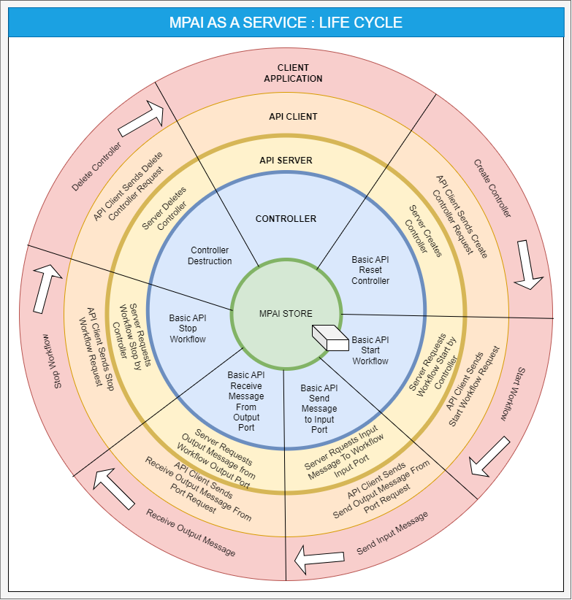

Slide 15
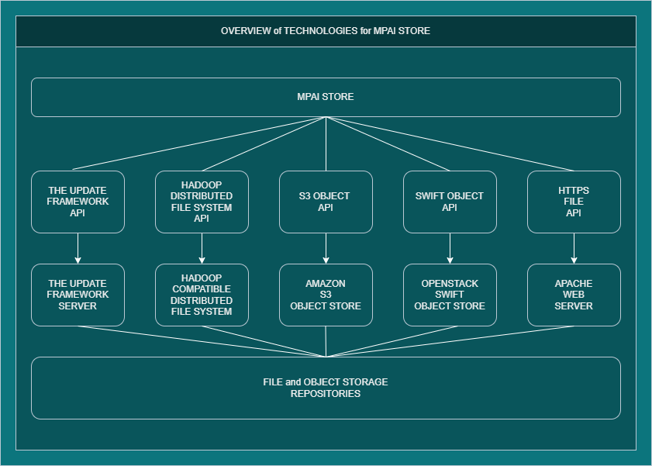

Slide 16
The Maas Call requests
An architecture for the management of the MPAI Store and the subordinate distributed repositories.
Protocol(s) that are considered suitable for supporting the specific requirements.
Alternatively, a single interface enabling Service Controller Instances to access a plurality of repositories each supporting different protocols.
Solutions proposed may be original, or rely on existing technologies, or any integration thereof.
If needed, proposals for revision of the MPAI-AIF Basic API, to accommodate requirements of the proposed technologies.

Slide 17
To submit a proposal
Read Call for Technologies
Accept Framework Licence
May send inquiries to secretariat@mpai.community
Respond using Template for Responses
Submit response by 2026/04/13T15:00 UTC
Join MPAI to participate in MPAI-MAS development

Slide 18
Proposal evaluation
Submission features | Evaluation Elements
Completeness of description | A detailed description is recommended.
Understandability of description | A detailed description is recommended.
Complexity of proposal | The implementation complexity and technologies that are potentially usable to implement the proposal.
Reliance on established technologies | When assessments are similar, preference will be given to proven technologies.
Availability of reference software | When assessments are similar, preference will be given to technologies for which a running reference software is available.
Existence of Essential Patents | A proposal that is not encumbered by IP may be selected against a functionally equivalent encumbered proposal.

Slide 19
AI Framework
AI for Health
MPAI Standards
Finance
Audio Enhancement
Automotive
Gaming
Governance
Human-Machine Communication
Metaverse
Multimodal Conversation
Neural Network Watermarking
NNW Traceability
NNW Technologies
Objects and Scenes
Portable Avatar
Profiles
Qualifiers
Up-sampling Video Filter

Slide 20


MAS docs: https://mpai.community/standards/mpai-mas/
Submit Innovation - Inspire Transformation
Join MPAI: https://mpai.community/how-to-join/
Join MPAI
Share the fun
Build the future
20
20
20
20

