Slide 1
Neural Network Traceability
Technologies – NNW-TEC
2025/03/10 T15:00UTC
http://nnw.mpai.community

Slide 2
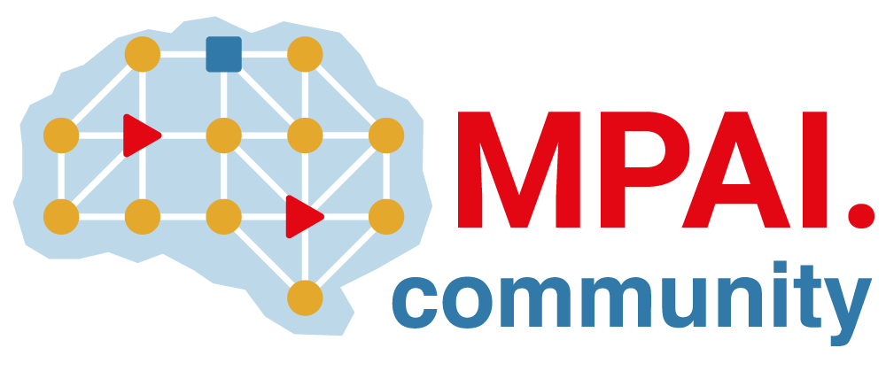
Who is MPAI
MPAI – Moving Picture, Audio and Data Coding by Artificial Intelligence is an international, unaffiliates, non-profit association based in Geneva.
MPAI mission is the promotion of the efficient use of Data by
  Developing Technical Specifications for
    Coding of any type of Data, especially using new technologies such as Artificial Intelligence, and
    Technologies that facilitate integration of Data Coding and Decoding components in Information and Communication Technology systems, and by
  Bridging the gap between Technical Specifications and their practical use through the development of Intellectual Property Rights Guidelines (“IPR Guidelines”),.
MPAI operates based on open international collaboration of interested parties supporting the MPAI mission and the means to accomplish it.

Slide 3
AI Framework
AI for Health
MPAI Standards
Finance
Audio Enhancement
Automotive
Gaming
Governance
Human-Machine Communication
Metaverse
Multimodal Conversation
Neural Network Watermarking
NNW Traceability
NNW Technologies
Objects and Scenes
Portable Avatar
Profiles
Qualifiers
Up-sampling Video Filter

Slide 4
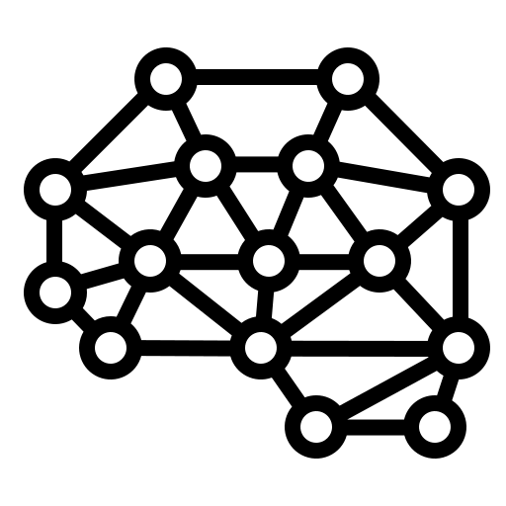
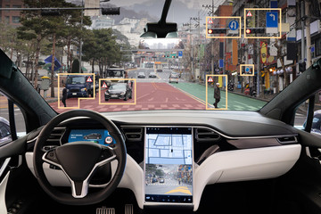
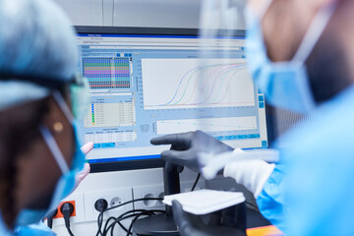
Neural Networks today
Deployed in an increasing variety of domains
Continuously renewed (industry & academia)
At the heart of various autonomous systems:
  Autonomous robots
  Unmanned vehicles
Deployed in more and more critical domains:
  Medical decisions
  Autonomous vehicles with passengers

Slide 5
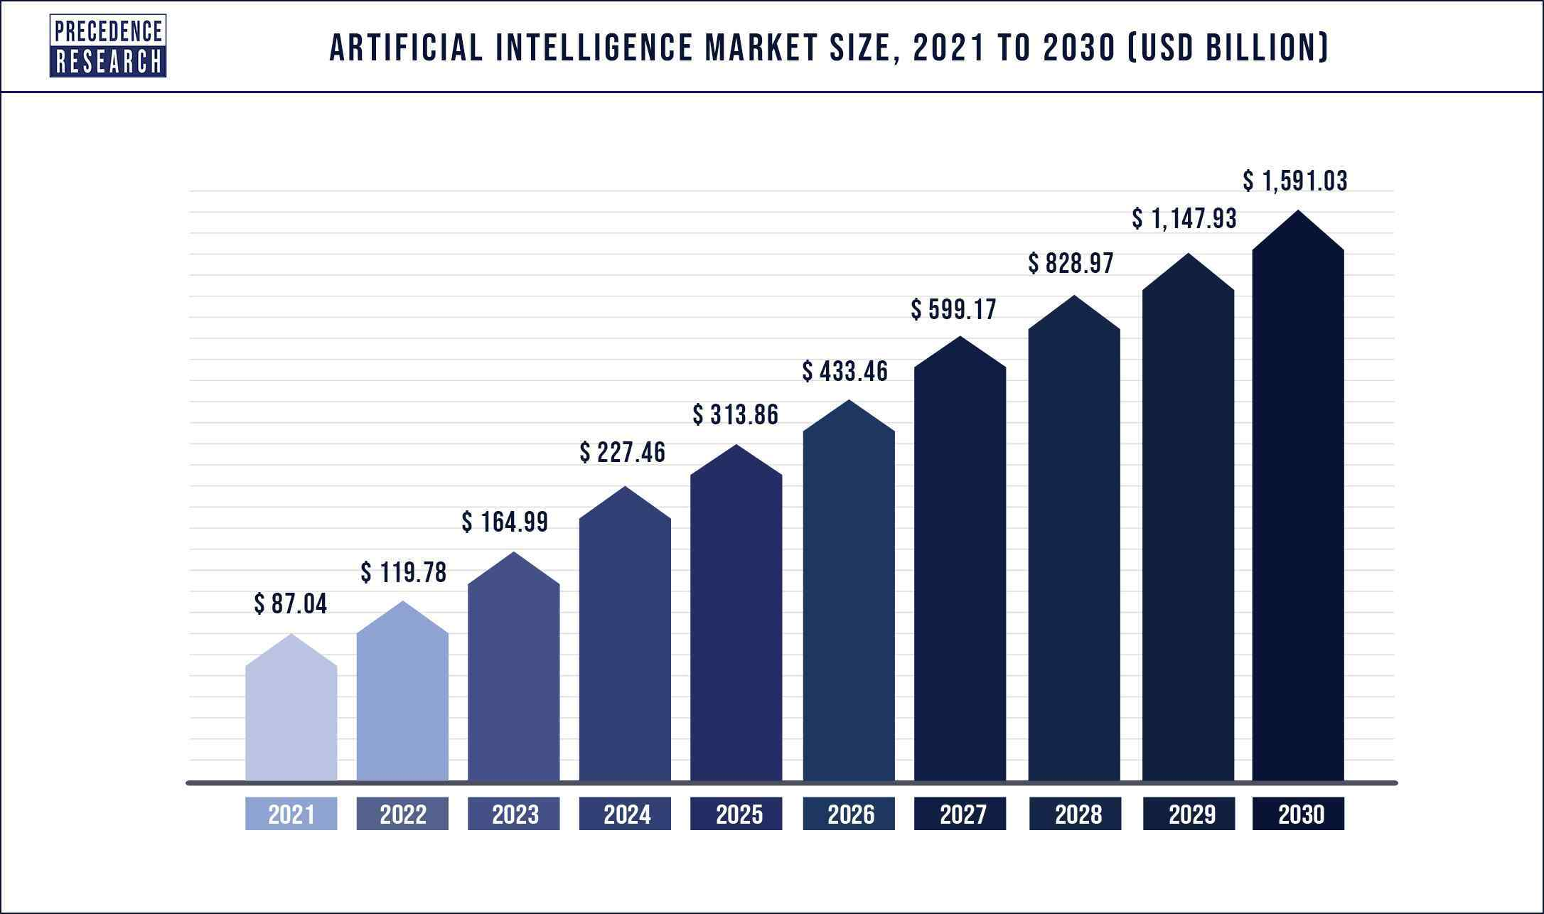

Why traceability is useful for Neural Networks
Machine learning is a costly field, e.g.:
  Buying AI solution ranges from thousands to billions
  Renting a pre-built module is costly
An AI solution could:
  use multiple alternative Neural Networks to provide an inference -> identifying the one that actually produced the inference is important
  be shared among multiple users -> keeping track of this process is useful
  be altered or maliciously attacked -> identifying such modifications avoid faulty functioning
Ensuring traceability and integrity of Neural Networks becomes mandatory

Slide 6
Neural Network Traceability synopsis
Traceability enables identification of the origin or verification of the integrity of data.
For NN, Traceability enables understanding and tracking the distribution, storage, exchange, use, and evolution of NN models.
NN Traceability can be divided into 2 categories:
  Watermarking (active) which modifies the model
  Fingerprinting (passive) which does not modify the model
Watermarking
Fingerprinting

Slide 7
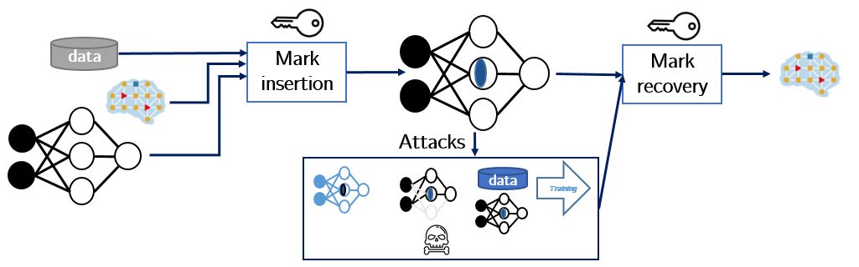

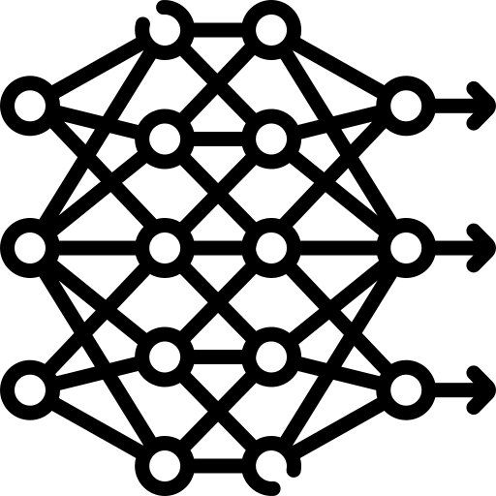
Neural Network Watermarking synopsis
Watermarking allows to imperceptibly and persistently insert some data into original content
Watermarking Neural Network is a challenge:
  Watermark insertion is not static (as it was for media) but dynamic, as the watermark can also be:
    inserted during training
    detected from inference
  Evaluation of watermark impact on inference is much more complex
  than on multimedia quality
Imperceptibility
Watermarking
Robustness
Data payload

Slide 8
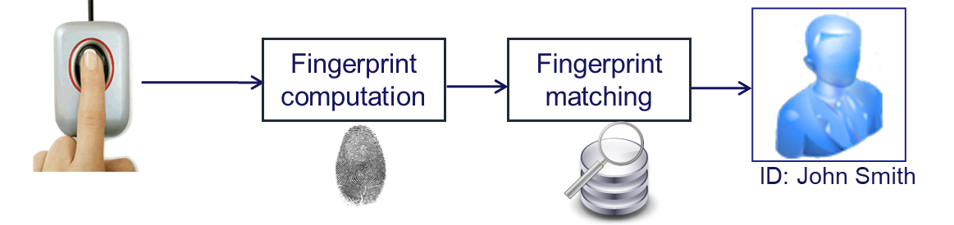


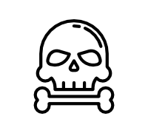
Neural Network Fingerprinting synopsis
Fingerprinting allows to extract NN identification data from the NN parameters or their inference and to match it with a known repository.
Fingerprint extractor
Fingerprint
detector
Uniqueness
Fingerprinting
Attacks
Robustness
Search
efficiency
data
Training

Slide 9
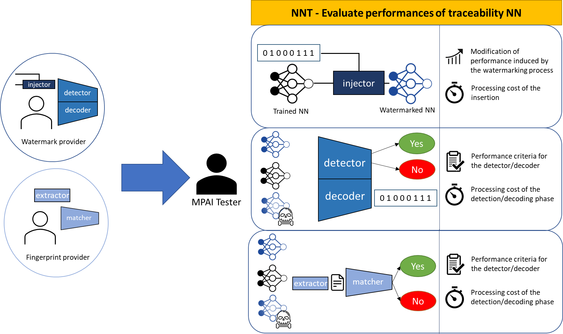

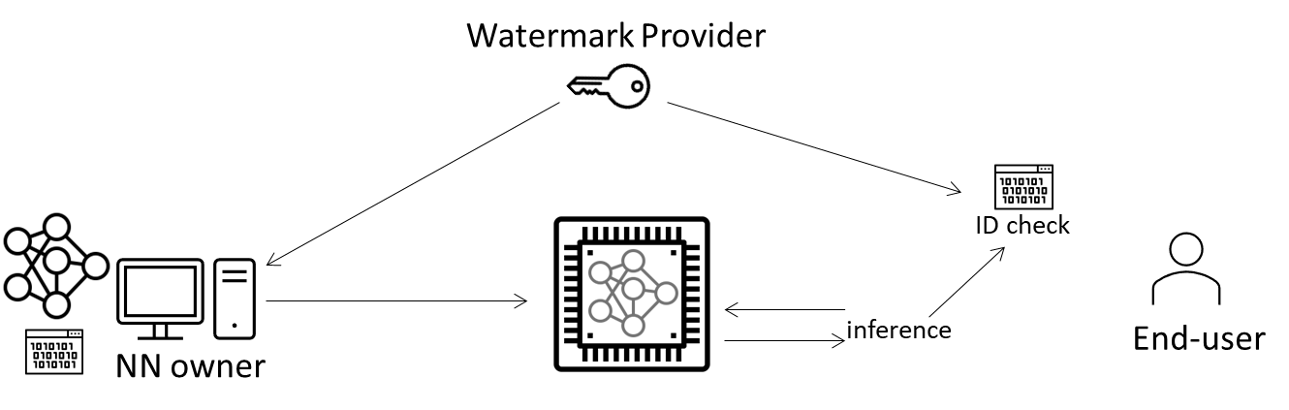

NNW-DC track record
Timeline of the group
November 2024
Technical Specification NNT
IEEE P3309
GA50
January 2022
Interest collection
GA16
April 2023
Reference Software
GA30
January 2024
AMQ watermarking
GA39
June 2025
CfT NNW-TEC
GA57
January 2023
Technical specification
NNW
GA28
November 2023
IEEE P3304
April 2024
MCUs watermarking
GA43
January 2025
Reference Software for NNT
March 2026
NNW-TEC V1.0
GA65

Slide 10
Scope of a new Standard: NNW-TEC
Neural Network Watermarking Technologies (NNW-TEC) uses the MPAI-NNT Technical Specification to evaluate the properties of Neural Network Traceability technologies that are applicable to specific classes of Neural Networks and used in specific application domains. Evaluations are done for:
Verification that the data provided by an Actor and received by another Actor is not compromised.
Identification of the Actors providing and receiving the data.
Evaluation of the performances of solutions supporting points 1 and 2.
Actor is a process that produces, provides, processes or consumes information

Slide 11
Actors and their roles
Five typologies of actors:
Architect – Designs model architecture; involved in watermark insertion; knowledge may influence later modifications.
Trainer – Trains the model; collaborates during watermark embedding; performs updates (e.g., fine-tuning).
Tracker – Provides and verifies tracking technology on original and modified models.
Distributor – Deploys the trained, watermarked model with tracking capability.
Attacker – Applies modifications (malicious or not) in order to:
  Remove IDs
  Mislead authentication
  Create watermark ambiguity
Generic User – Authorized user operating under distributor’s service agreement.

Slide 12
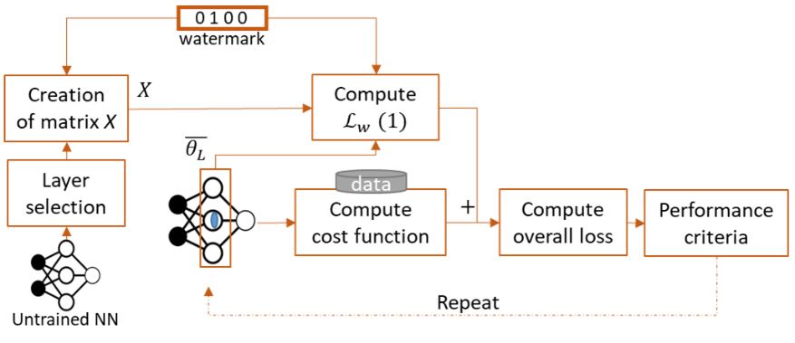
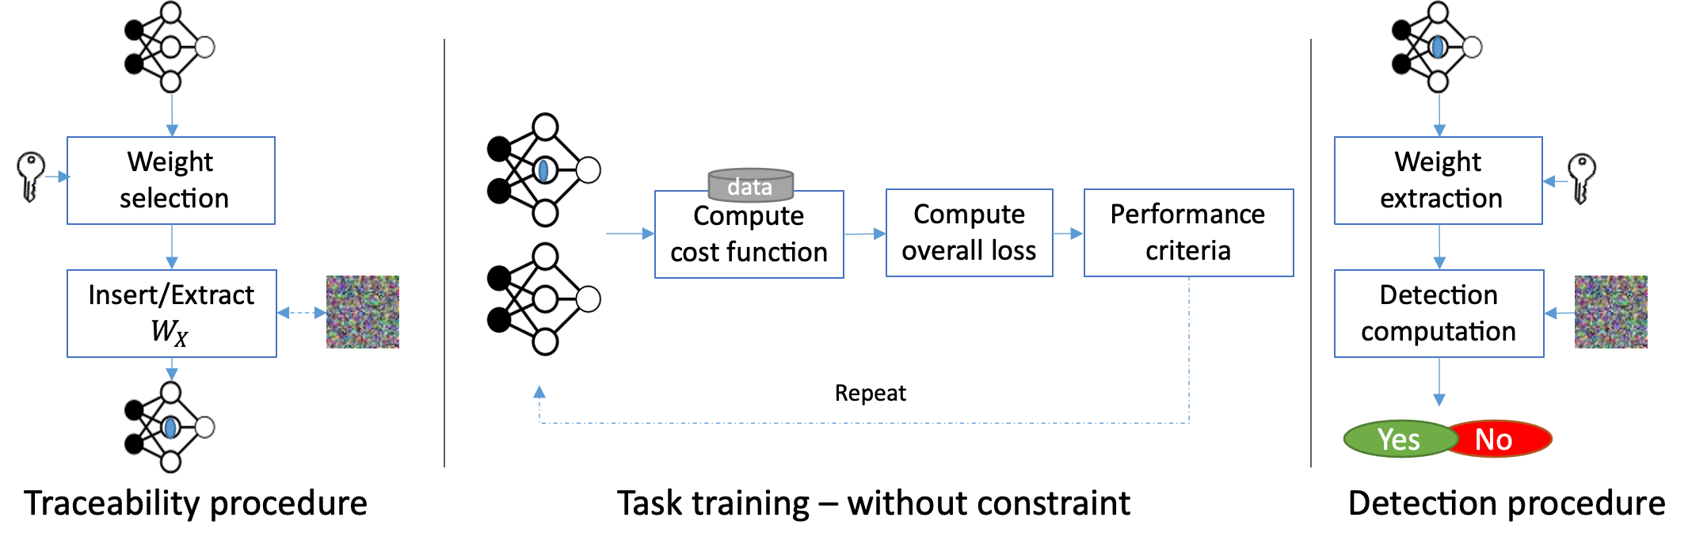
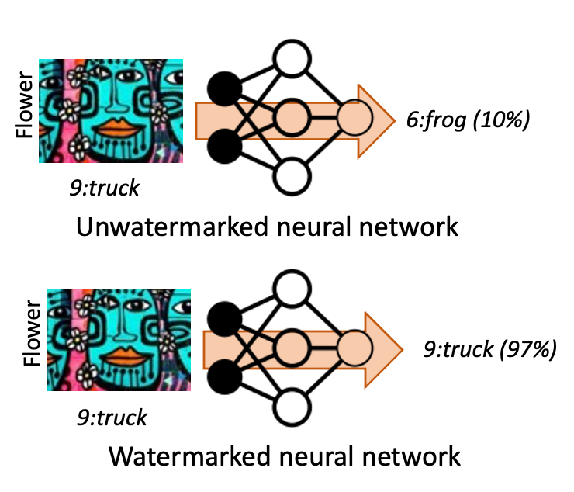
NNW-TEC evaluates 3 NNT technologies
Regularization Term Watermarking (RTW) ^{[1]}
No-Constraint Traceability (NCT) ^{[3]}
Trigger-Based Watermarking (TBW) ^{[2]}
[1] Y. Uchida, Y. Nagai, S. Sakazawa, and S. Satoh, “Embedding Watermarks into Deep Neural Networks,” Proceedings of the 2017 ACM on ICMR, pp. 269–277, Jun. 2017
[2] Y. Adi, C. Baum, M. Cisse, B. Pinkas, and J. Keshet, “Turning Your Weakness Into a Strength: Watermarking Deep Neural Networks by Backdooring,” presented at the 27th USENIX Security Symposium Aug. 2018
[3] C. De Sousa Trias, “Robust watermarking for neural networks in multimedia tasks,” These de doctorat, Institut polytechnique de Paris, 2025. Available: https://theses.fr/2025IPPAS007

Slide 13

Quality solution evaluation setup
Benchmark composed of 5 NN architectures, 4 tasks and 3 datasets:
VGG16 & ResNet8 image classification on CIFAR10
Pix2Pix generative image task on Cityscapes
RDN up-sampling on DIV2K
DeepLabV3 image segmentation on Cityscapes
Impact on the model’s performance is defined as:
$$Impact=\frac{\left|{Performance}_{uwm}−{Performance}_{wm}\right|}{{Performance}_{uwm}}$$
 |  | Datasets
 |  | CIFAR10 | Cityscapes | Div2K
NN model | VGG16 | Top-1 accuracy | - | -
 | ResNet8 | Top-1 accuracy | - | -
 | Pix2pix | - | PSNR and SSIM | -
 | RDN | - | - | PSNR and SSIM
 | DeepLab | - | mIoU | -

Slide 14
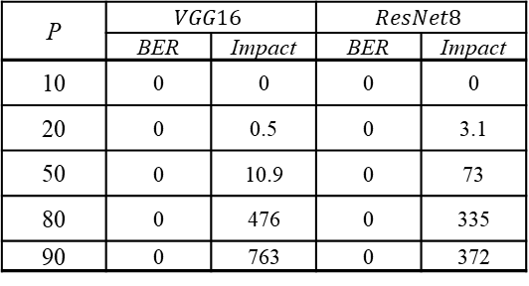
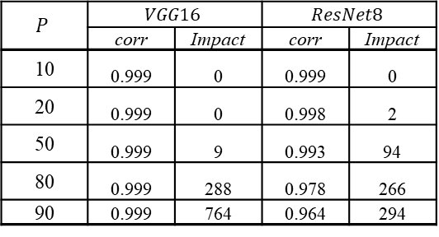
Examples of results
Task | Model | Impact
Semantic segmentation | DeepLabV3 | mIoU = 8.7
Up-Sampling | RDN | PSNR = 0 | SSIM = 0
City scene generation | pix2pix | PSNR = 3.2 | SSIM = 3.4
Imperceptibility evaluation of 1 technology
Robustness against magnitude pruning for 2 technologies
Computational Cost of NCT and RTW
  NCT does not impact the training of the model and the memory footprint
  RTW increases the training time by 16.67% but has no impact on memory footprint
P | $$VGG16$$ |  | $$ResNet8$$
 | BER | Impact | BER | Impact
10 | 0 | 0 | 0 | 0
20 | 0 | 0.5 | 0 | 3.1
50 | 0 | 10.9 | 0 | 73
80 | 0 | 476 | 0 | 335
90 | 0 | 763 | 0 | 372
$$P$$ | $$VGG16$$ |  | $$ResNet8$$
 | corr | Impact | corr | Impact
10 | 0.999 | 0 | 0.999 | 0
20 | 0.999 | 0 | 0.998 | 2
50 | 0.999 | 9 | 0.993 | 94
80 | 0.999 | 288 | 0.978 | 266
90 | 0.999 | 764 | 0.964 | 294

Slide 15


https://mpai.community/standards/mpai-nnw/tec/v1-0/
Submit Innovation - Inspire Transformation
https://www.mpai.community/
https://mpai.community/how-to-join/
Join MPAI
Share the fun
Build the future
15
15
15
15

