Slide 1
MPAI-AIP Version 1.0
AI Passport and Framework Standards
Guido Perboli – Politecnico di Torino

Slide 2
The MPAI way to AI-based data coding
MPAI Application Standards break up monolithic AI applications into a set of interacting components.
The semantics of the data exchanged between components is known (as far as possible).
Developers compete by offering “standard” components with “improved” performance.
The MPAI AI Framework standard makes possible a “Lego-type” approach:
  “Applications”, called AI Workflows – AIWs
  Composed of AI Modules called AIMs
  Executed in AI Frameworks called AIFs.

Slide 3

Technical Specification: MPAI AI Framework (MPAI-AIF)
Enables dynamic configuration, initialisation, and control of AI Workflows in a standard AI Framework.
  Architecture
  Metadata
  Common API Features
  Basic API
  Security API
  Profiles

Slide 4
The MPAI-AIF Reference Model
User Agent
AI Module (AIM)
AI Module (AIM)
Outputs
Inputs
AIM/AIW Storage
(non-secure)
AI Module (AIM)
AIM/AIW Storage
(secure)
AI Module (AIM)
Controller (Non-secure/Secure)
SAL
MPAI Store
Communi-cation
Global Storage
Access
Communication Service
Encryption Service
Attestation Service

Slide 5
Why an AI Passport Standard?
Difficulty in finding the right AI for right job
Compliance with regulations
Governance of agentic AI systems
Current regs give loose definitions of how to comply. There is a need for automatic check that an AI can be technically and legally used. Standard way to describe the risk, but no standard way what is provided to cope with the risk.
Finding the right AI for the right job remains a significant challenge across industries, with no standardized way to compare or evaluate AI systems.
Society of interacting agents, an agent does not know whether it can or may interact with a particular agent.

Slide 6
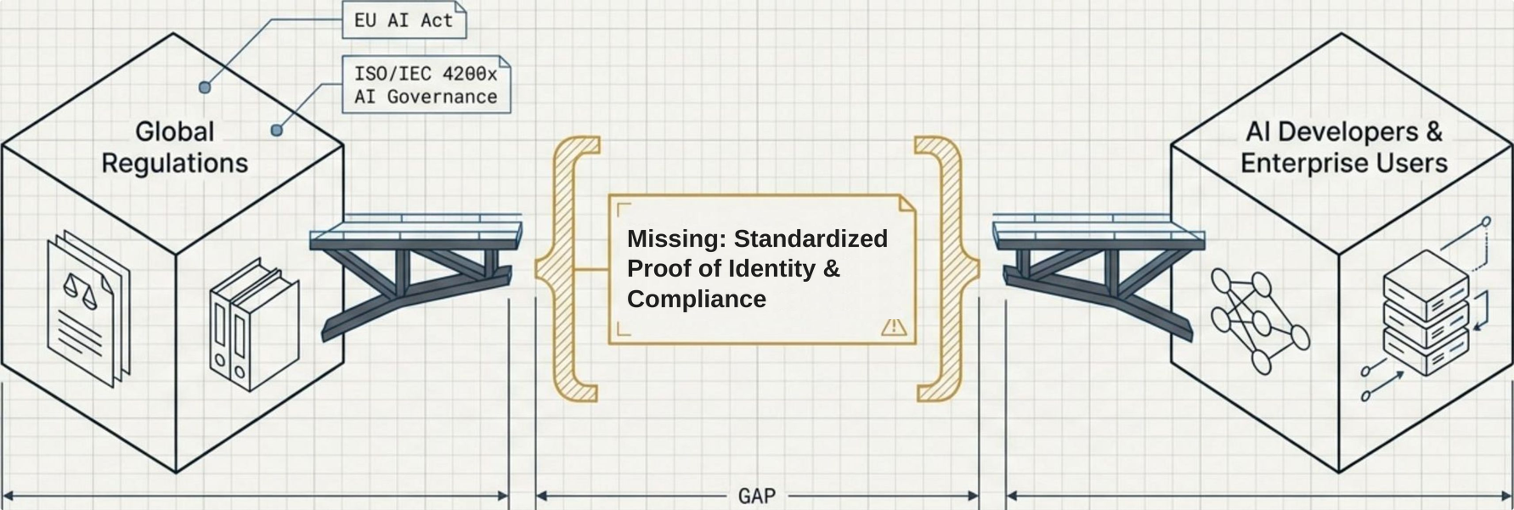
Regulators mandate compliance, but the industry lacks a standardized format for technical execution.
While emerging regulations establish legally and administratively binding rules for AI, they lack specifications for practical, technical operation. This leaves the burden of proving identity, provenance, and ethics entirely on isolated enterprise initiatives.

Slide 7

What is currently available?
Mostly for healthcare: specific, hard to generalise.
A generic AI Passport standard is needed.

Slide 8



The AI Passport standardizes verifiable AI information for humans and machines.
A single standard powering both human
and machine discovery and interaction
Human User (Checking compliance)
Human-to-AI Interaction
Verify functionality and application-specific KPIs.
Guarantee legal, ethical, and safety compliance.
Audit provenance (ground models and training datasets).
Provide a definitive technical reference for legal contracts.
Machine/Server (Automated API matching)
Machine-to-AI Interaction
Automate discovery in global marketplaces or local repositories.
Execute real-time matching based on I/O protocols.
Validate computational and hardware requirements before interaction.
Regulator (Auditing ethics)

Slide 9

Use Cases: Human-AI Interaction
1
A user is searching for an AI System with appropriate functionalities.
By looking at the AI Passport, the user can easily find the main features of a particular AI System.
2
A user knows the functionalities and the requirements of a given AI
E.g., technical, legal, ethical, safety.
3
A user wants to know the ground model and the datasets used for training a given AI System.
4
A user is assured that a given AI System is the one that he intends to use.

Slide 10
Use Cases: Human-AI Interaction (continued)
5
A user may know the functionalities but is unsure that the AI used with specific data respect the regulation of their country.
6
A user wants to know the KPIs (generic and application-specific) of an AI System.
7
A user wants to know the properties of the input and output data and protocols used by the AI System.
8
An AI Provider wants to state the main characteristics of an AI System in a syntactic and semantically bounded context.
9
Companies developing a contract related to an AI System want to make reference to an undisputed source of technical and legal information.
10
Regulatory bodies want to enforce a common way of expressing information about AI Systems.

Slide 11
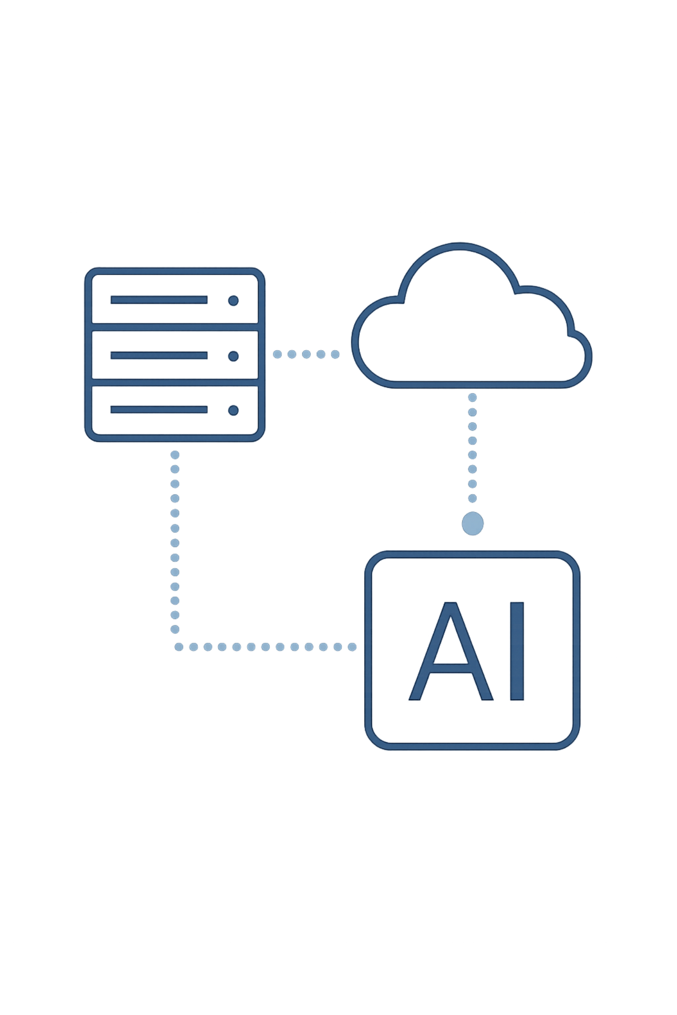
Use Cases: Machine-to-AI Interaction
A machine wants to know the features of an AI System before dealing with it
Search/identification for an AI System with specific characteristics
E.g., search/identification of a suitable AI System in a marketplace/platform/local repository. This may be performed in non-real or real-time.
Direct AI-to-AI interaction
An AI System can decide whether to interact with another AI-System on the basis of the latter's characteristics, e.g., available input and output protocols, computational requirements, compliance with specific regulations.

Slide 12
What should an AI Passport convey
Field | Description
AI Passport ID | ID of an AI Passport associated to a specific AI Instance. ID shall be provided by an authorised agency or the AI developer if an agency. An ID identifies an AI model with bit-wise precision to the entries of the AI Passport. An AI may have more than one ID.
Agency ID | ID of the Passport-issuing entity (an agency or a developer if it is an agency). (Taxonomy)
AI System ID | A string that uniquely identifies an AI System.
Function | Natural Language Text describing what the AI is intended to do.
Fingerprint | Hash used to validate that the AI instance is what it says it is. It includes a specification (e.g., an ID) of the fingerprint method. Note that if the AI changes, the hash is different.
Interfaces | The interfaces of the AI System. Input/Output: May be Input, Output, or Input/Output (Taxonomy). Protocol(s): The Protocols used to input and output data. (Taxonomy)
Data | Data types used by the AI System. Semantics: A standard way to represent a relevant set of characteristics of a data instance (syntax and semantics) (Taxonomy or identification system or annotation). Governance: The legislation and regulations under which the data is input and data was produced.
Certification | The legislation, regulations, or standards under which the operation of the AI was certified (Taxonomy)
Origin | Ground Model: Shall be identified according to a standard identification system for AI Models. Training: The name and version of the data set, a reference (e.g., DOI, URL, hash), DAO (Decentralized Autonomous Organisation), reference to developer documentation.
KPIs | General: List of application-independent KPIs for the AI System, e.g., Precision, Area Under the Curve. Application: Lists of application-independent KPIs for the AI. Guidelines for app-dependent KPIs may be developed.
Ethical Evaluation | Evaluations of the Ethical aspects of the AI System. Accountability: All data reference the mean.

Slide 13

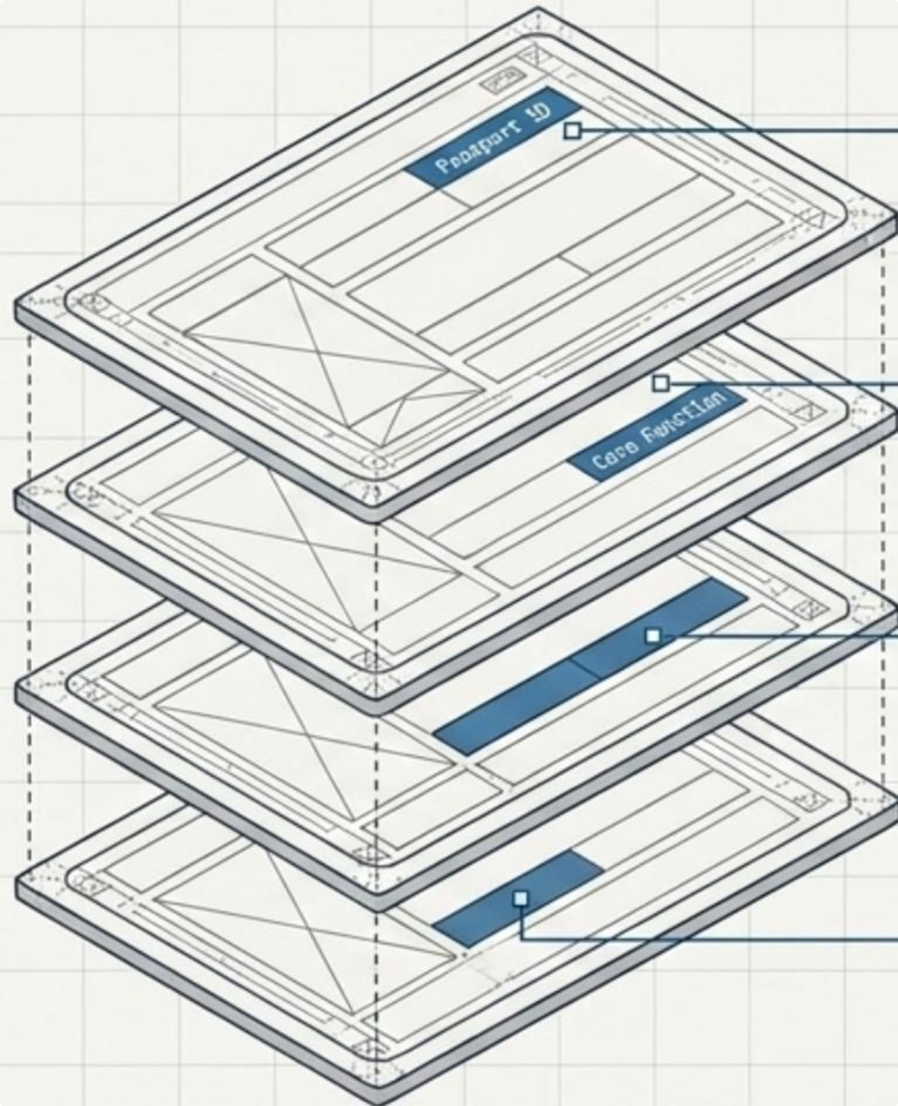
The Anatomy of an AI Passport Four Abstract Layers of Data
Layer 1 - Core Identity
Passport ID, Agency ID, System ID, Cryptographic Fingerprint.
Layer 2 - Capabilities
Core Function, Input/Output Interfaces, Protocols, Standardized KPIs.
Layer 3 - Provenance
Ground (Parent) Model ID, Training Data semantics, DAO references.
Layer 4 - Governance
Certification standards, Ethical Evaluations (Accountability, Social/Dual-use, Environmental), Technology Environment (Hardware/OS).

Slide 14
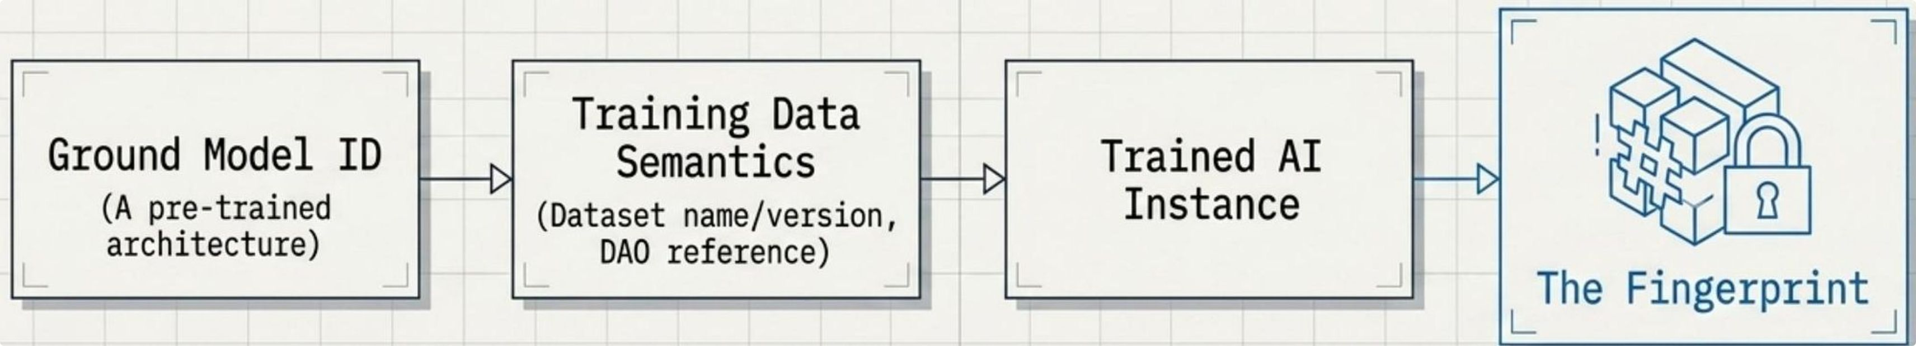
Identity and Provenance rely on authoritative agencies and bit-wise cryptography.
The Agency
The Fingerprint
Identifiers must be issued by a recognized authority (or authorized developer) managing a database of registered AI systems.
A hash function characterized by bit sensitivity and anti-collusion uniqueness. It validates that the AI instance is exactly what the Passport claims. Any bit-wise change to the AI alters the hash, breaking the verification.

Slide 15
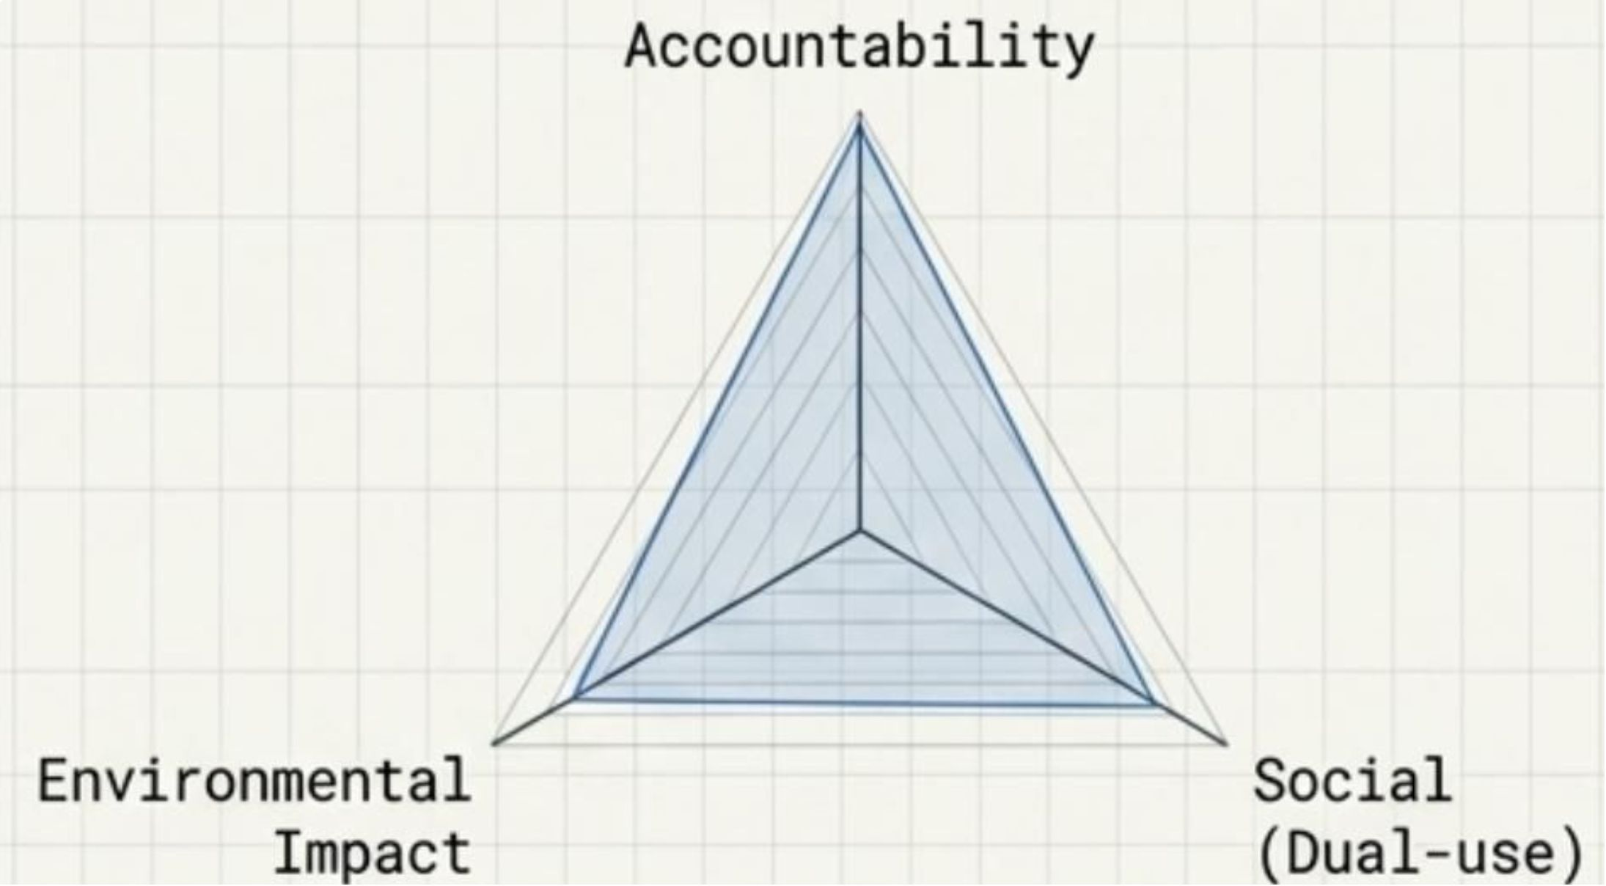
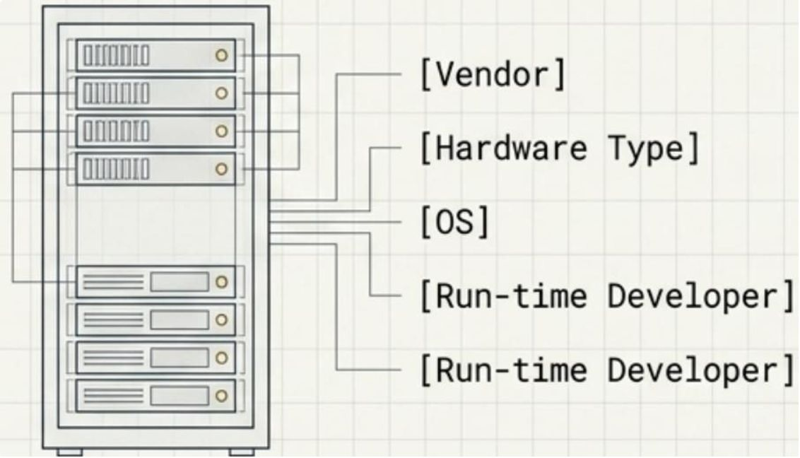
Defining operational dependencies and ethical impact through strict taxonomies.
Governance
Tech Environment
[Vendor]
[Hardware Type]
[OS]
[Run-time Environment]
The passport must standardize the declaration of input/output protocols and hardware architectures to ensure safe deployment environments.
Requires formal reference methods indicating how ethical, social, and environmental issues are adopted by the AI (e.g., "by design," "bias mitigation," or "ex-post KPIs").

Slide 16
How do we securely attach a passport to an AI?
MPAI is soliciting technologies to solve the complex binding problem.
Method 1: Macro-object / Watermarking
Method 2: DAO Storage
Method 3: Distributed Blockchain
Utilizing a Decentralized Autonomous Organization system to securely store and link the AI Passport.
Creating a combined macro-object and watermarking the AI with a payload containing the Passport ID.
Leveraging a blockchain-based system to ensure truly distributed governance and immutable binding.

Slide 17




The Call for Technologies
What is needed to Develop V1.0
Taxonomies
Binding Methods
Standardized classifications for Agencies, Legislations, I/O Data/Protocols, KPIs, Ethics, and Hardware.
Secure, verifiable mechanisms to bind an AI Passport directly to an AI System.
Identification Systems
Formats
A standardized, global identification syntax specifically for AI Models (both Ground Models and resulting instances).
Optimal syntactic representation structures to encode and transport the AI Passport data securely.

Slide 18
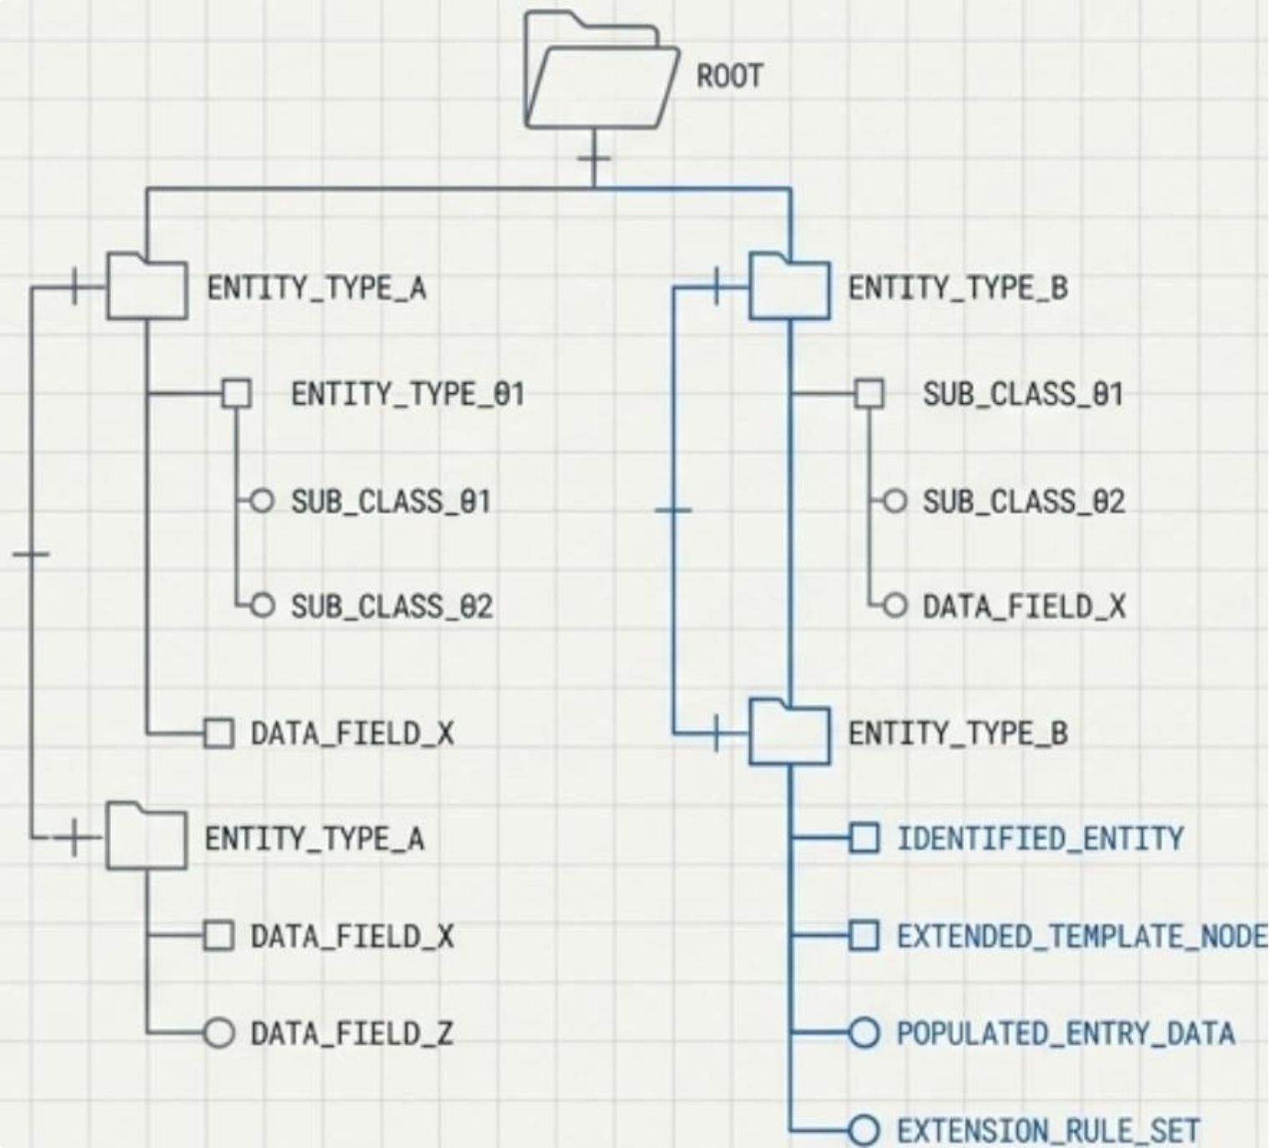
Structural Requirements for Taxonomy Proposals
Any technology submitted to fulfill the Taxonomy requirements must include four mandatory structural elements:
Identification Procedure: The exact procedure used to identify entities within the Taxonomy.
Extensible Template: A structural template that allows the taxonomy to scale.
Actual Entries: Proposed taxonomy models must include actual, populated data entries (if possible at the time of response).
Extension Procedures: Documented rules for how the taxonomy can be legally and technically expanded in the future.

Slide 19
MPAI-AIP V1.0 Deadlines
August 19, 2026 (17:00 UTC)
September 27, 2026 (23:59 UTC)
Call Issued: The official launch of the Call for Technologies.
Notice of Intent: Deadline to submit the Annex 1 form to the Secretariat indicating intent to respond.
1
2
3
4
September 10, 2026 (08:00 & 15:00 UTC)
October 27, 2026 (15:00 UTC)
Online Presentations: Two live events detailing the Call. Recorded materials will be published online.
IMPERATIVE DEADLINE: Final cutoff for submission of full Responses.

Slide 20


We look forward to working
with you
on this exciting MPAI project!
Join MPAI
Share the fun
Build the future
https://aip.mpai.community/
20
20
20
20

